Slide 1
Magnetic property of dilute magnetic semiconductors
Yoshida lab.
Ikemoto Satoshi
2014.05.07
K.Sato et al, Phys, Rev.B 70 201202 2004

Slide 2
Contents
Introduction
-First-principles calculation
-Dilute magnetic semiconductor (DMS)
Calculation method for Curie temperature
Ferromagnetic mechanisms in DMS
Summery
Future work

Slide 3
Contents
Introduction
-First-principles calculation
-Dilute magnetic semiconductor (DMS)
Calculation method for Curie temperature
Ferromagnetic mechanisms in DMS
Summery
Future work

Slide 4
First-principles calculation
First-principle= quantum mechanics
No experimental parameter
Notes:
原子番号と結晶構造だけ

Slide 5
Contents
Introduction
-First-principles calculation
-Dilute magnetic semiconductor (DMS)
Calculation method for Curie temperature
Ferromagnetic mechanisms in DMS
Summery
Future work

Slide 6
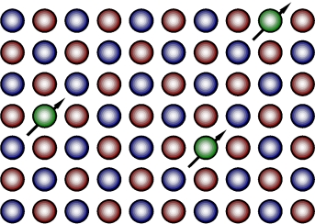
Dilute magnetic semiconductor(DMS)
We can obtain DMS by replacing cations
in semiconductor by magnetic ions.
Transition metals
(Fe,Co,Ni,Mn,Cr )
In 1996, We found (In,Mn)As was
Ferromagnetic
But Why…?
F.Matsukura , H.Ohno, and T. Dietl, Handbook of Magnetic Materials,14 2002
Dilute magnetic semiconductor:希薄磁性半導体

Slide 7
Contents
Introduction
-First-principles calculation
-Dilute magnetic semiconductor (DMS)
Calculation method for Curie temperature
Ferromagnetic mechanisms in DMS
Summery
Future work

Slide 8
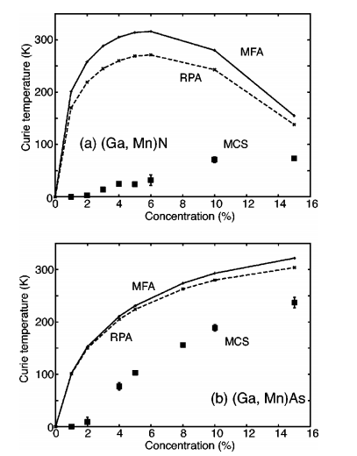
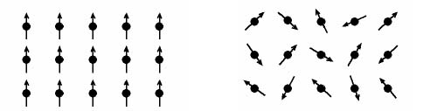
Curie temperature in DMS
ferromagnetic
paramagnetic
Which method is correct approximation?
MFA or MCS
MFA:平均場近似
MCS:モンテカルロ法

Slide 9
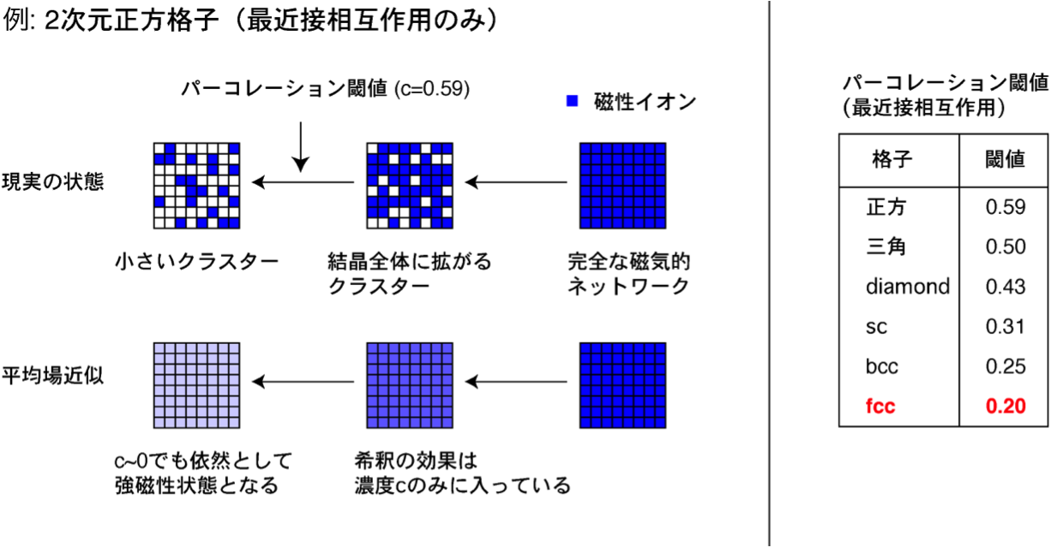
Mean-Field Approximation(MFA)
Mean-field approximation:平均場近似
In Heisenberg model , Hamiltonian is given as
We assume a uniform magnetic force
As magnetic atoms increase, it gets more dense.

Slide 10
Monte-Carlo Simulation
Average A is given as
The more magnetic atoms , the more substituted atoms.
K.Binder and D.W.Heermann,Monte Calro Simulation
in Statistical Physics 2002
Notes:
重みを加えることによってその状態を平均化していく感じ。平均化したものが成立するかしないかを考えるため

Slide 11
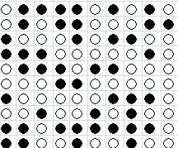
Percolation in dilute system
Curie temperature(K)
concentration
●: magnetic atom
Percolation threshold (nearest-neighbor)
Notes:
希薄系に関しての重要な性質としてパーコレーションがあります。

Slide 12
Result(1)
More correct calculation method
is MCS which can take
the magnetic percolation effect
into consideration.
So we often use MCS
In order to understand
magnetic property of DMS

Slide 13
Contents
Introduction
-First-principles calculation
-Dilute magnetic semiconductor (DMS)
Calculation method for Curie temperature
Ferromagnetic mechanisms in DMS
Summery
Future work

Slide 14
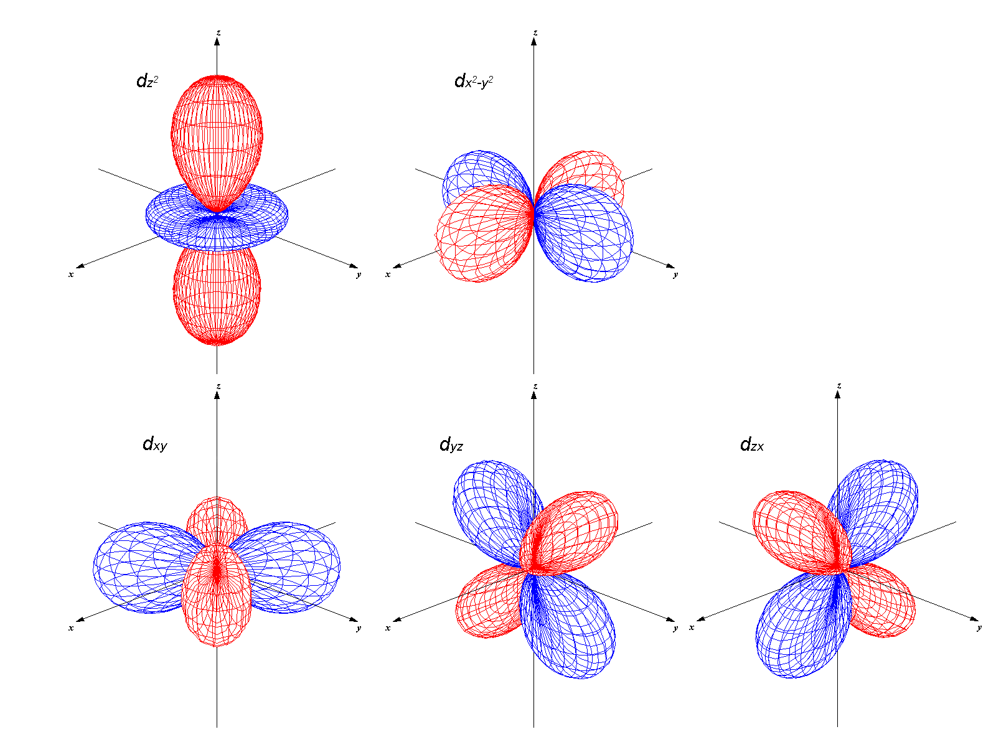
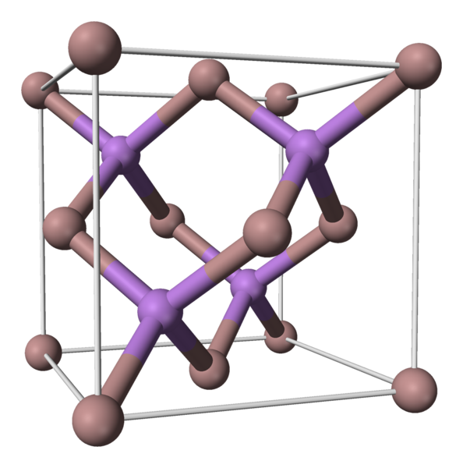
Electronic structure by crystal field theory
A series of 3d orbital
Zinc-blend structure
３d
Fund’s rule
Crystal field theory:結晶場理論
Notes:
陰イオンのp軌道とのクーロン反発によってエネルギー的に高くなる。

Slide 15
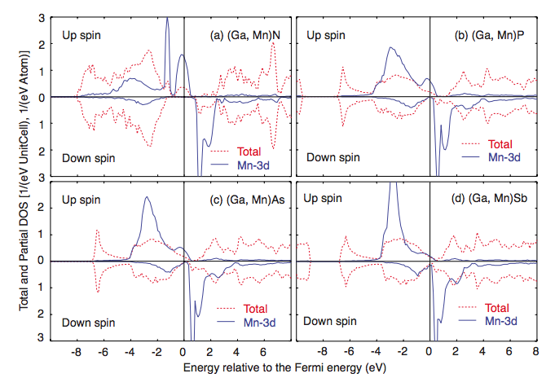
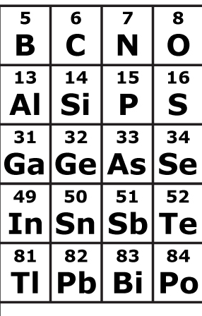
Density of state by KKR-CPA method
Rev. Mod. Phys. 82,1650 2010
Notes:
D軌道が部分的に占有されていることとフェルミ凖位より深い位置にd軌道があることは矛盾しない？

Slide 16
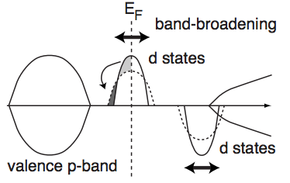
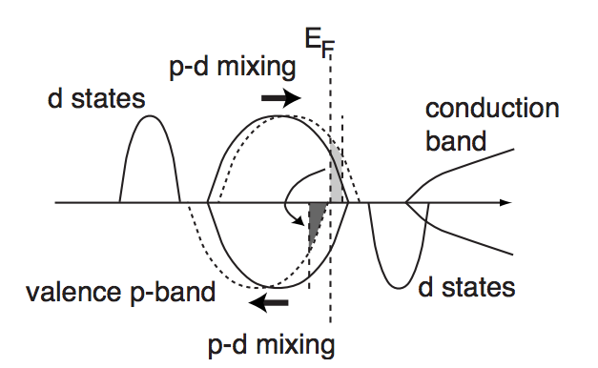
Ferromagnetic mechanism
When the Fermi level is
Within the partially occupied band of
the impurity state ,the energy gain
caused by the double-exchange mechanism
p-d exchange mechanism is dominant
when d majority level lies below or
At the lower edge of the As p band.
Zener, C., 1951a,Phys.Rev.82,403.
Zener, C., 1951b,Phys.Rev.82,430.

Slide 17
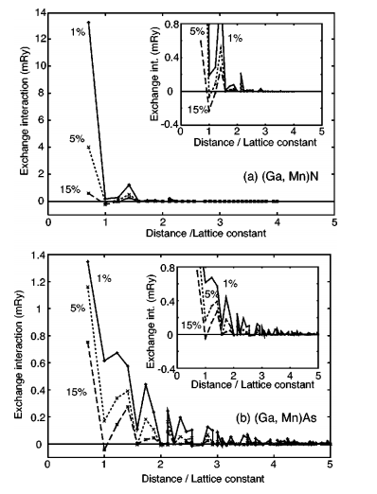
Exchange interaction in (Ga,Mn)N and (Ga,Mn)As
The range of the exchange interaction
in (Ga,Mn)N,
being dominated
by the double exchange mechanism, is
Very short ranged.
In the case of (Ga,Mn)As, where
the p-d exchange mechanism dominates,
the interaction range is
weaker but long ranged.
[1] PHYSICAL REVIEW B 70, 201202(R) (2004)

Slide 18
Result(2)
In (Ga,Mn)N ,double exchange mechanism
is dominant ,so Curie temperature is
not high in low concentration.
In (Ga,Mn)As ,Curie temperature is higher
than the former because of domination of
p-d exchange mechanism.

Slide 19
Summary
Monte-Carlo simulation is better than mean-field approximation for estimating Curie temperature.
Curie temperature depends on length of magnetic interaction, not strength.
It is necessary that long ranged interaction or high concentration in order to obtain high Curie temperature.
Magnetic interaction is defined by relative position between impurities states and valence band .

Slide 20
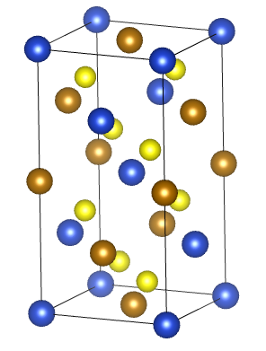
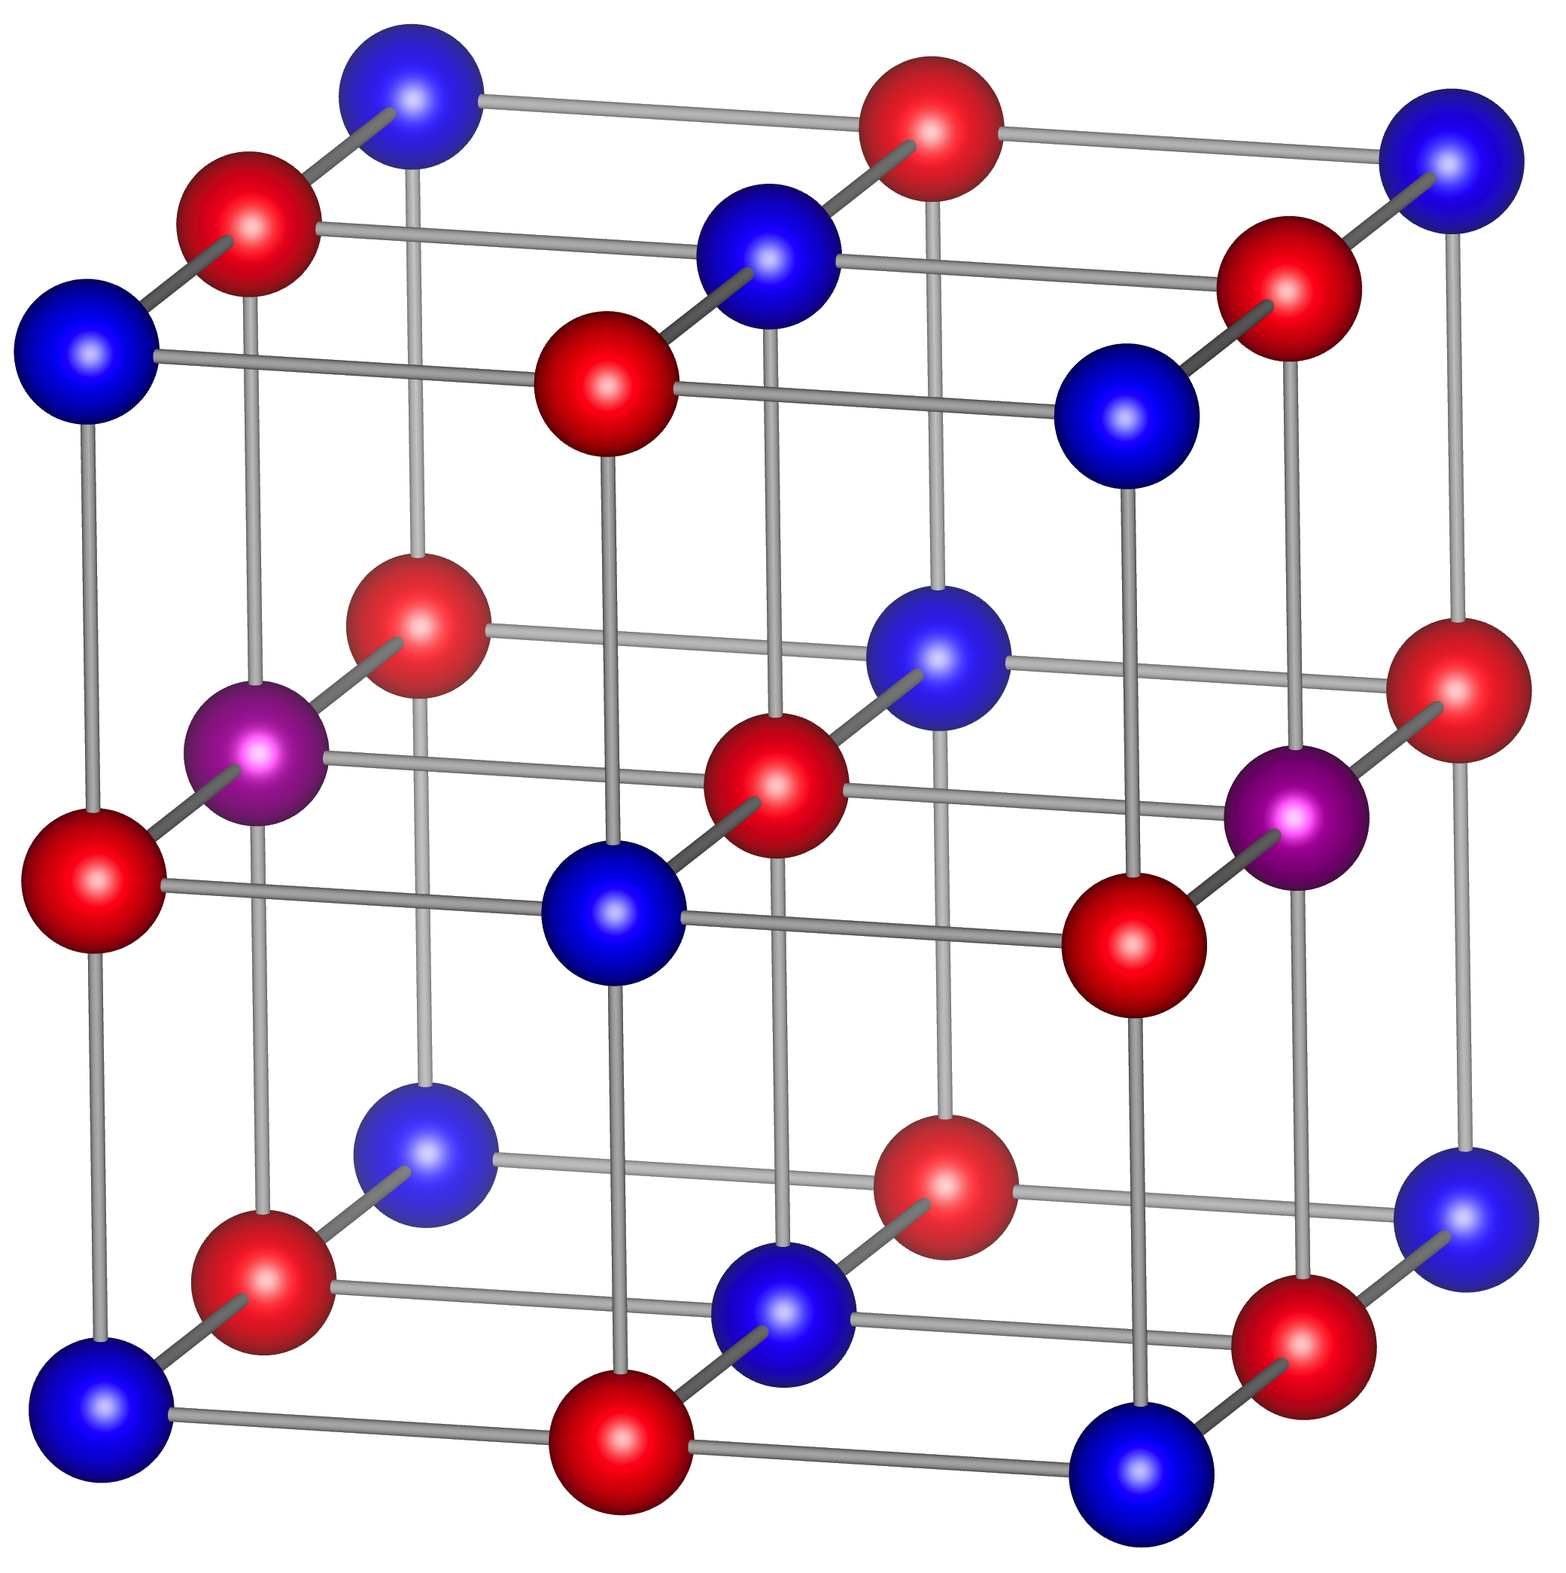
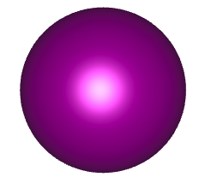
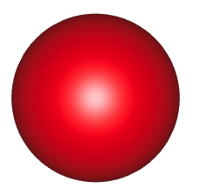
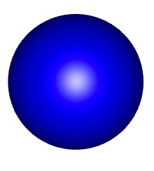
Future works
Materials design of high T_{C} DMSs
IV-VI type DMS (Transition metal doped GeTe)
Hold doped CuFeS₂
TM
Ge
Te

