Slide 1


Pressure Dependence of Superconductivity of Iron Chalcogenides
Shimizu group
M1 Hidenori Fujita

Slide 2

Contents
Introduction
High pressure
Superconductor
K_{x}Fe_{2-y}Se₂
My experiment
High pressure experiment
Sample & Data
Conclusion & Future work

Slide 3
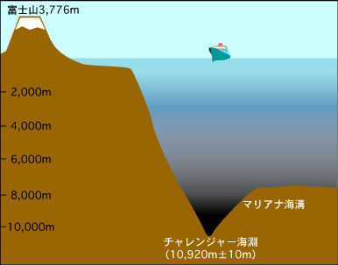
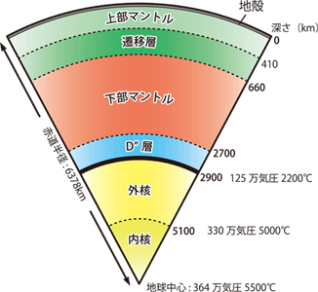
introduction
High Pressure
1 GPa = 10,000 atm
≅ 100,000 m (water depth)
360 GPa ≅ center of the earth
http://www.jsanet.or.jp/qanda/text/q1_03.html
100,000m
http://www.spring8.or.jp/ja/news_publications/research_highlights/no_57/

Slide 4
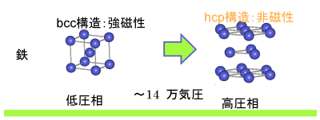
introduction
High Pressure
Pressure can change crystal structure
atomic distance, structure type ….. etc.
pressurization
pressurization
monatomic metal
Molecule
Insulator
(金属単原子)

Slide 5
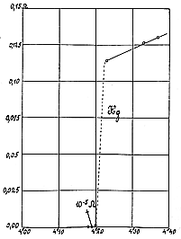
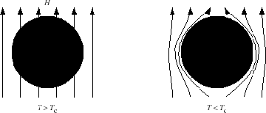
Introduction
Superconductivity (SC)超伝導
Zero resistance
Meissner effect
Emerge at low temperature
Application
Superconducting magnet
SQUID
Transmission line
…. etc.
http://www.kek.jp/ja/NewsRoom/Highlights/20110512133324/
http://www.st-h.ed.jp/oldpage/club-page/kaken/physics/katudou/tyoudenndou.html

Slide 6
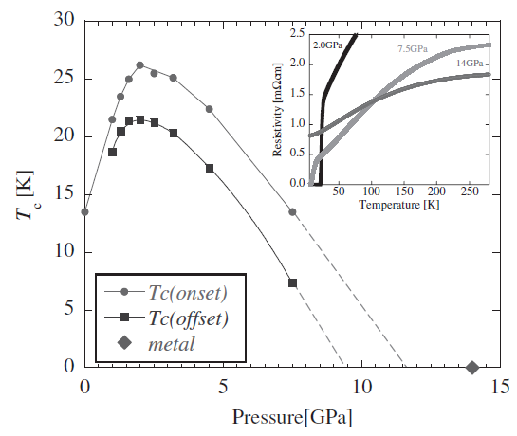
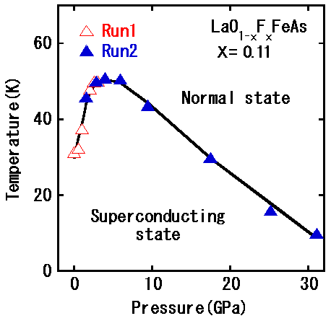
Introduction
Pressure dependence of SC
Transition temperature can change with pressure
Journal of the Physical Society of Japan
Vol. 78, No. 6, June, 2009, 063705
http://www.jst.go.jp/pr/announce/20080424/

Slide 7
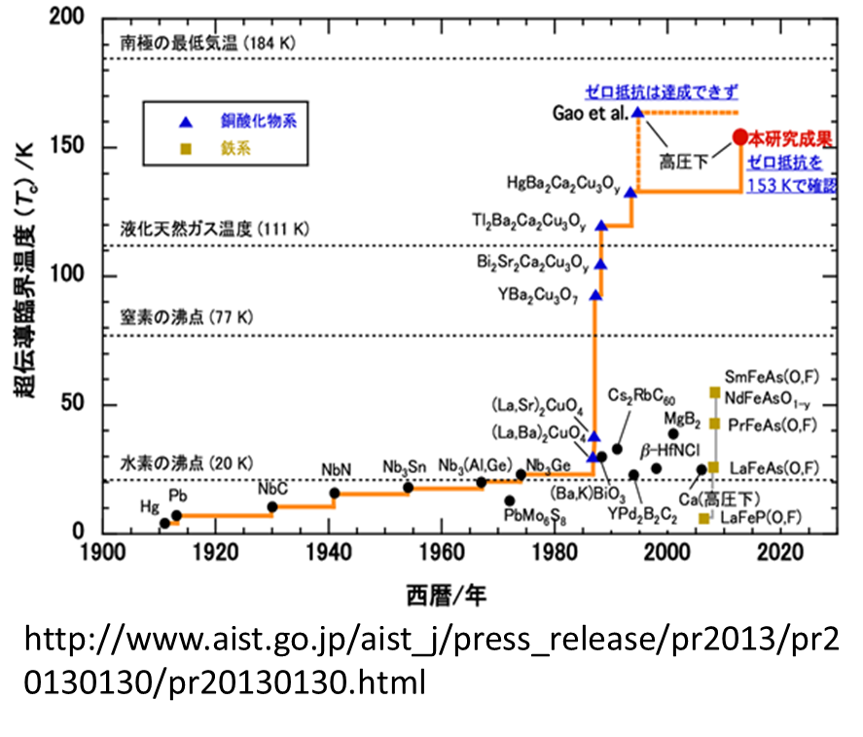
Introduction
History of T_{c}
Highest ≅ 170 K (under high pressure in HgBa₂Ca₂Cu₃O_{8+δ}(Hg-1223) )
Iron based superconductor
T_{c} < 60 K
Chalcogenide & pnictide

Slide 8
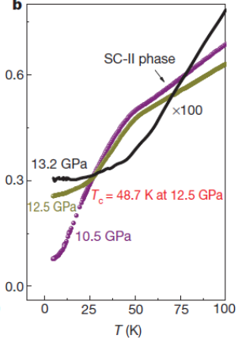
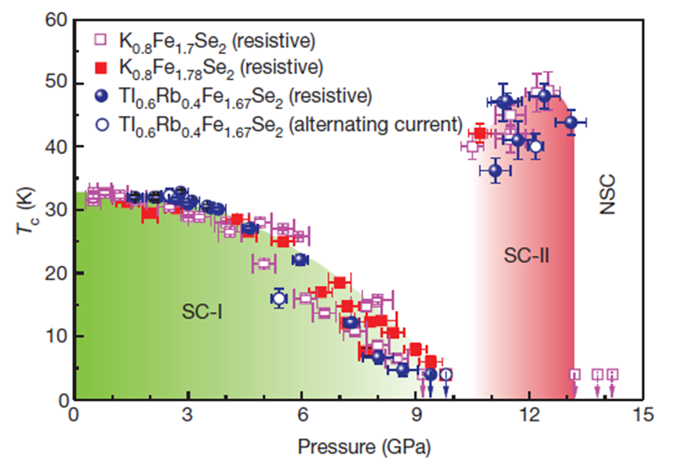
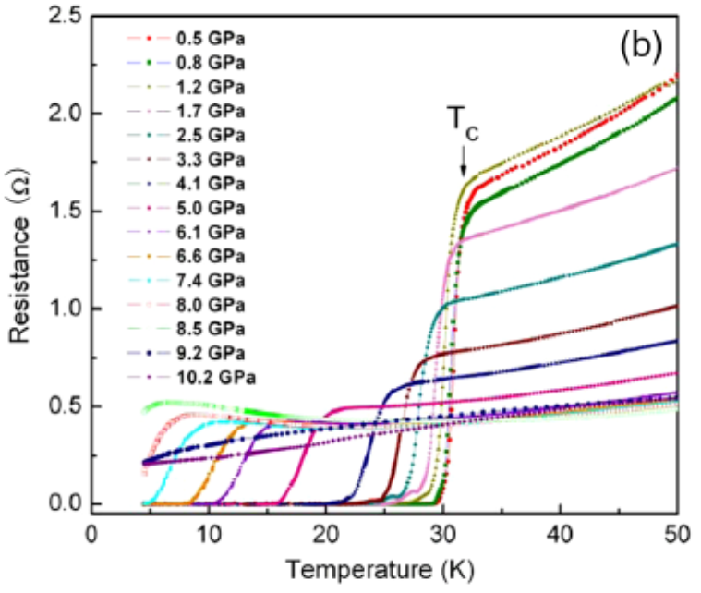
Introduction
K_{x}Fe_{2-y}Se₂
T_{c} of K_{x}Fe_{2-y}Se₂ decrease by applying pressure
SC phase re-emerge at higher pressure (at 11GPa)
doi:10.1038/nature10813

Slide 9
Motivation
Research….
difference of sample (amount of K)
Previous research : K_{0.8}Fe_{1.7}Se₂
behavior at high pressure

Slide 10
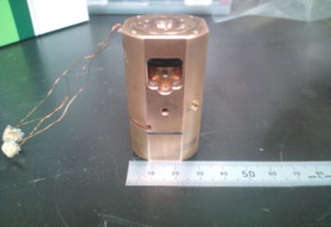
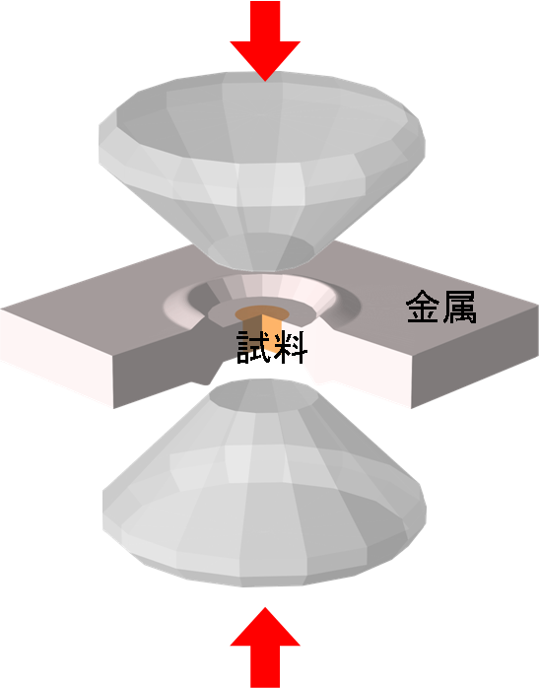
My experiment
High pressure experiment
Apply pressure with Diamond Anvil Cell

Slide 11
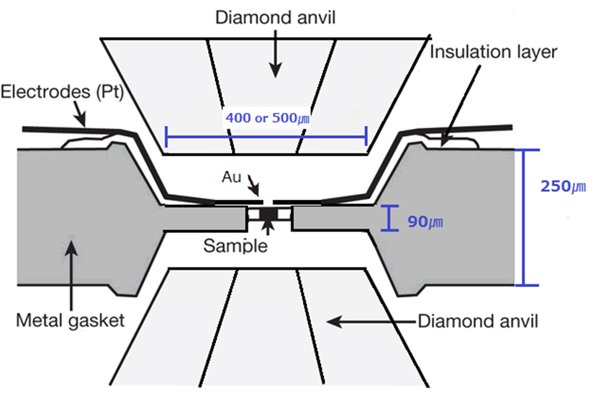
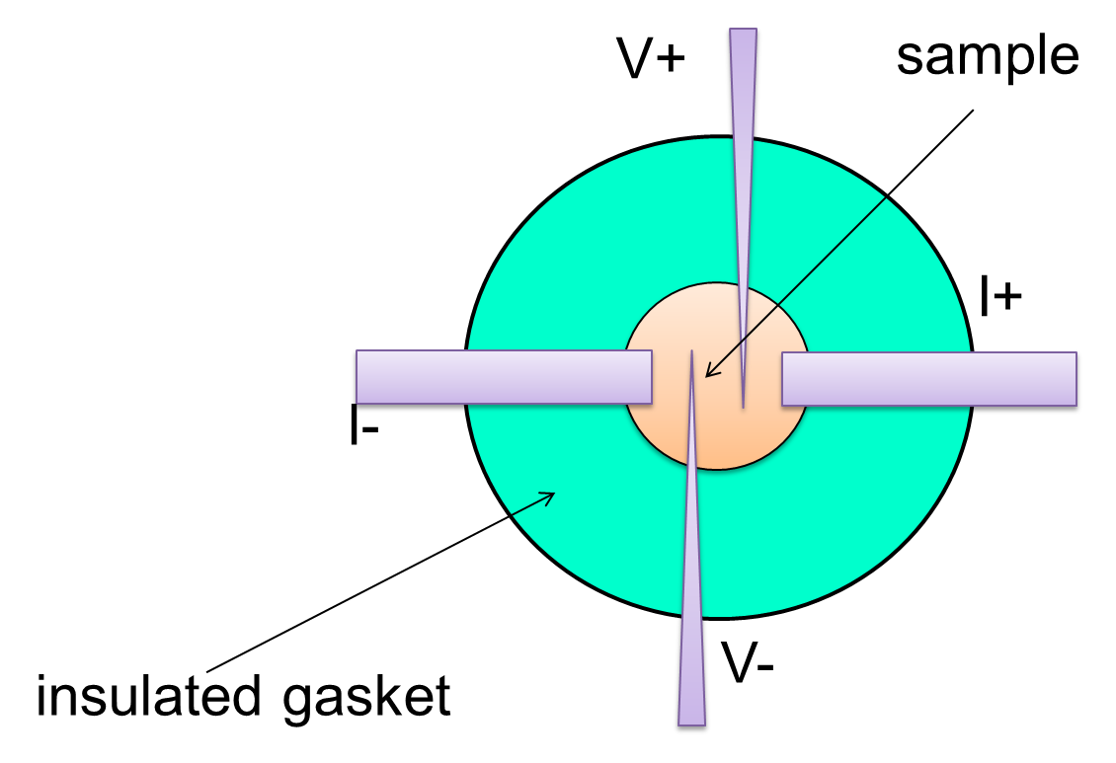
My experiment
High pressure experiment
How to measure the electrical resistance

Slide 12
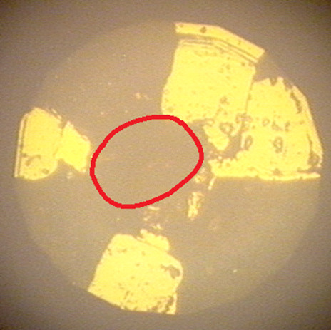
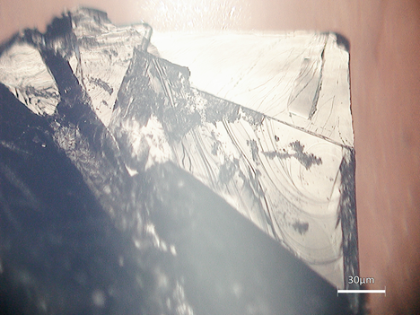
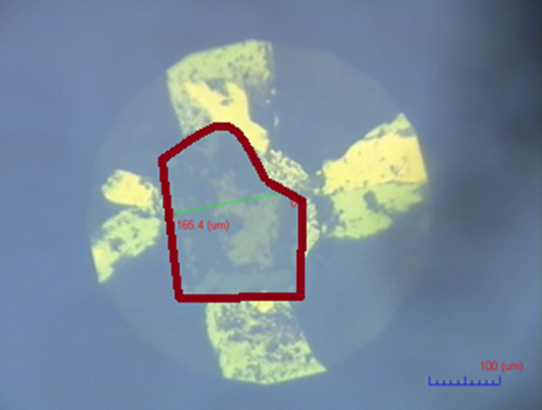
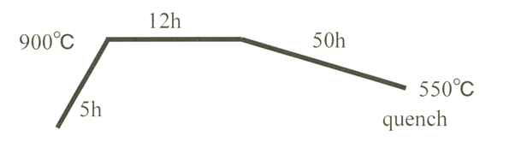
My experiment
Run 1
Sample 1
Property and condition
K_{0.66}Fe_{1.78}Se₂
(amount of K is few)
Run 2

Slide 13
My experiment
Sample 1
Results
Run 1
Run 2

Slide 14
My experiment
Sample 1
Results
Notes:
10GPa~の拡大
今回の測定では転移温度の減少は確認できましたがSC2-phaseの確認はできませんでした。こちらは10GPa以降の電気抵抗の様子ですが、先行研究のようなドロップは見られていません。

Slide 15
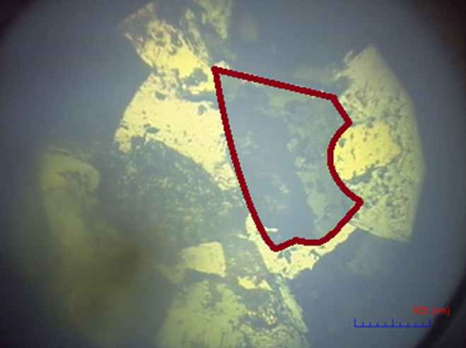
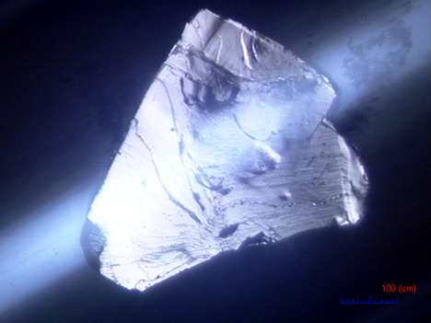
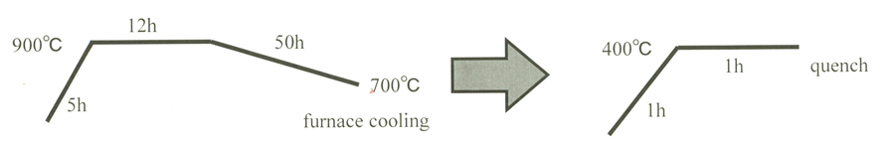
My experiment
Sample 2
Property and condition
K_{0.8}Fe₂Se₂
(original composition)

Slide 16
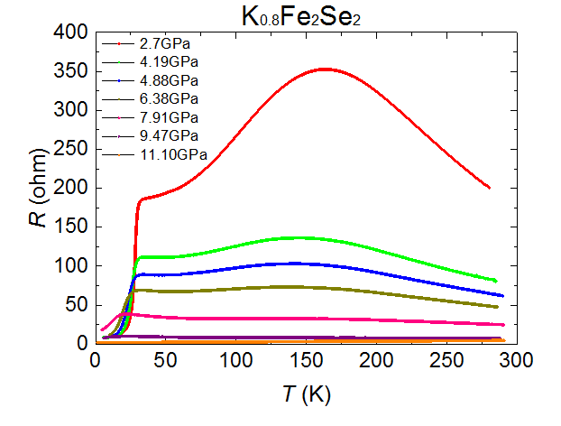
My experiment
Sample 2
Results

Slide 17
My experiment
Sample 1
Results

Slide 18
Sample 1
Sample 2

Slide 19
Conclusion & Future work
SC1-phase remains
SC2-phase didn’t appear
Future work
Change the amount of Fe
Continue to research at high pressure

