Slide 1
Superconductivity and magnetism in iron-based superconductor
M1 colloquium
Kitaoka Lab.
Takayoshi SHIOTA
M. Hiraishi et al., Nature Phys. 10, 300-303 (2014)
S_IIMURA et al., Nature Commun. 3, 943 (2012)
S_IIMURA et al., Phys. Rev. B. 88, 060501(R) (2013)

Slide 2
Contents
Introduction
Superconductivity(properties, history)
Iron-based superconductor
(structure, phase diagram)
LaFeAs(O_{1-x}F_{x})
Results
LaFeAs(O_{1-x}H_{x})
Experiment
Theoretical calculation
Summary

Slide 3
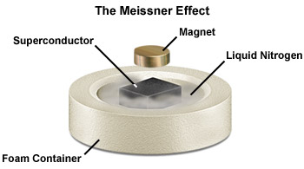
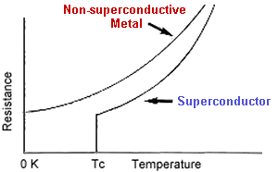
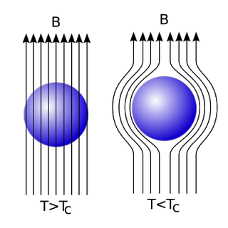
Superconductivity
introduction
Zero resistivity
Perfect diamagnetism
http://allnewscience.blogspot.jp/2010/07/anti-gravity.html
http://teachers.web.cern.ch/teachers/archiv/HST2001/accelerators/superconductivity/superconductivity.htm

Slide 4
History of Superconductivity
introduction
1911
200
Discovery of superconducting phenomenon
metal
heavy fermion system
163
high-T_{c} cuprate
Hg-Ba-Ca-Cu-O
150
iron-based system
（
under high pressure
）
Hg-Ba-Ca-Cu-O
1979
Tl-Ba-Ca-Cu-O
Heavy fermion superconductor
Bi-Sr-Ca-Cu-O
100
Transition temperature (K)
Y-Ba-Cu-O
77
1986
High-T_{c} cuprate superconductor
50
MgB₂
SmFeAsO_{0.9}F_{0.1}
La-Ba-Cu-O
LaFeAsO_{0.89}F_{0.11}
Nb
Nb
Ge
PuCoGa₅
2006
Pb
NbN
CeCu₂Si₂
Hg
NbC
LaFePO
0
Iron-based high-T_{c} superconductor
1900
1920
1940
1960
1980
2000
2020
Year

Slide 5

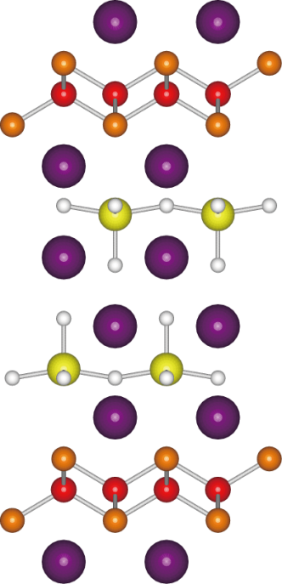
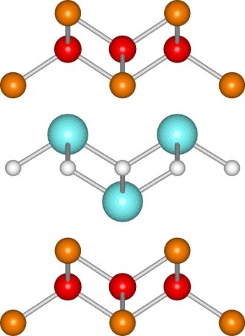
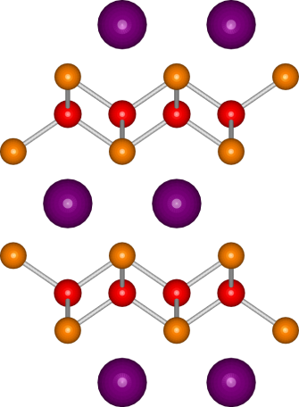
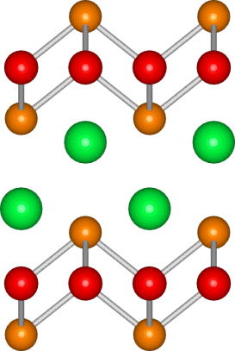
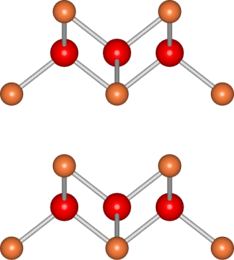
Iron-based superconductors
introduction
Pn
Fe
Iron Pnictides
Ae₄M₂O₆Fe₂Pn₂
LnFePnO
AeFe₂Pn₂
AFePn
Ln =La, Ce, Pr, Nd, Gd, Tb, Dy, Er, Y
Ae =Ba, Sr,
Ca, Eu
A =Li, Na
O
M
Ln
Ae
Ae
A
Ae₂Fe₄Ch₅
FeCh
Iron Chalcogenides

Slide 6
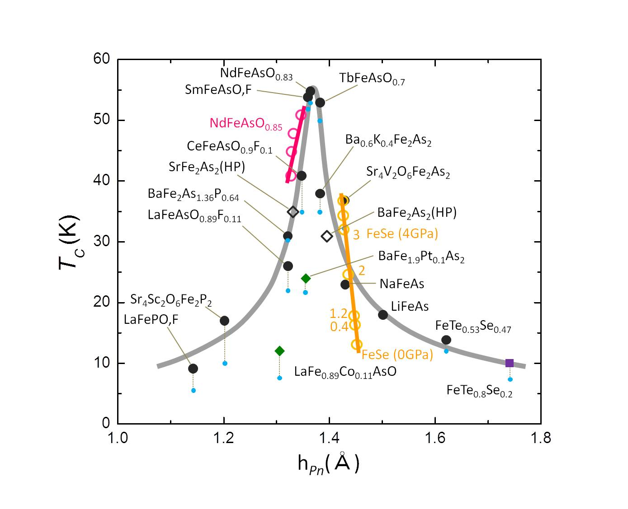
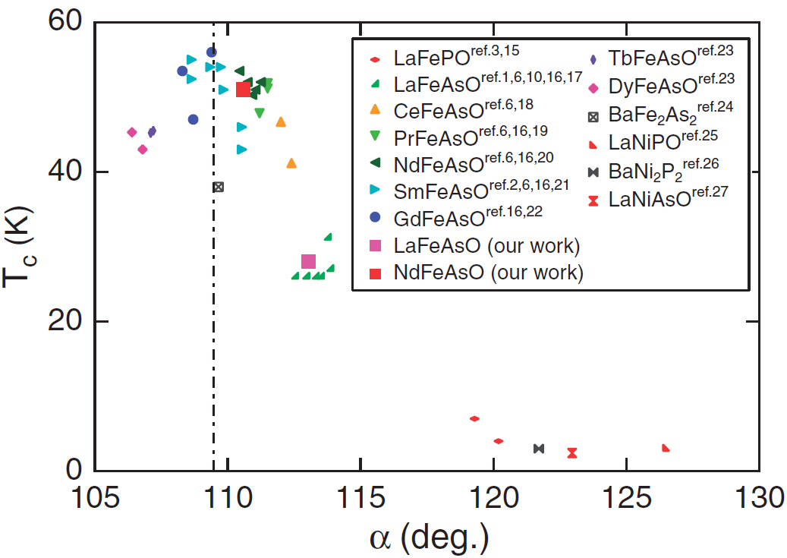
FePn tetrahedral structure and T_{c}
introduction
Pn
h_{Pn}
Fe
h_{Pn} ~ 1.38Å
α
Regular tetrahedron
α = 109.5ﾟ
Mizuguchi et al. Supercond. Sci. Technol. 23 (2010) 054013.
C. H. LEE et al. J. Phys. Soc. Jpn., Vol. 77, No. 8

Slide 7
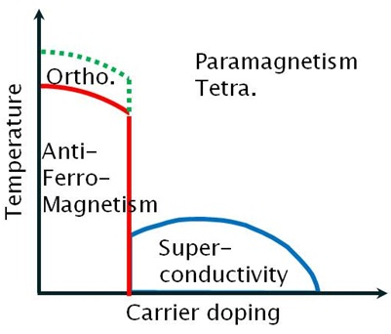
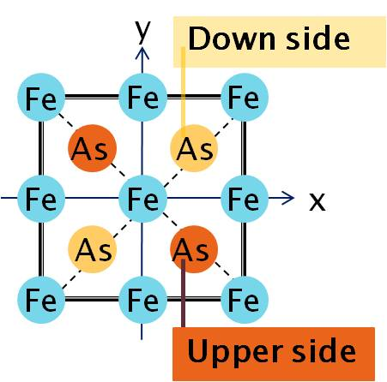
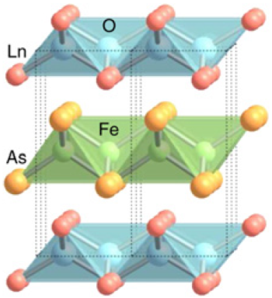
Phase diagram
introduction
LnFeAsO

Slide 8
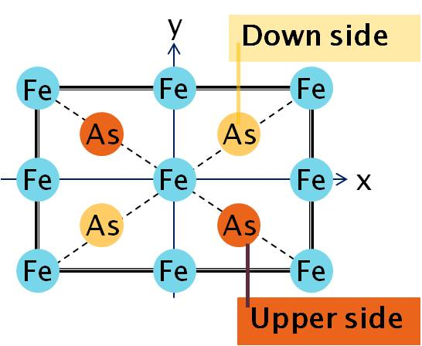
Phase diagram
introduction
T_{S}：Structural transition temperature
T<T_{S}
LnFeAsO

Slide 9
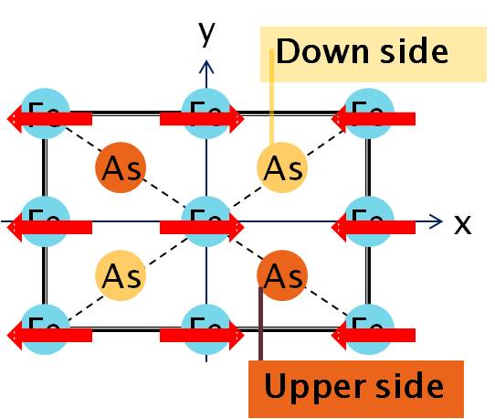
Phase diagram
introduction
T_{N}：Magnetic transition temperature
T<T_{S}
T<T_{N}
Stripe antiferromagnetic state
LnFeAsO

Slide 10
Phase diagram
introduction
T_{N}：Magnetic transition temperature
T<T_{N}
LnFeAs(O_{1-x}F_{x})
O²⁻ = F⁻ + e⁻
Electron doping

Slide 11
Phase diagram
introduction
T_{c}：Superconducting transition temperature
T<T_{c}
Superconducting state
(cooper-pair)
LnFeAs(O_{1-x}F_{x})
O²⁻ = F⁻ + e⁻
The correlation between
magnetic/structural fluctuation
and superconductivity?
Electron doping

Slide 12
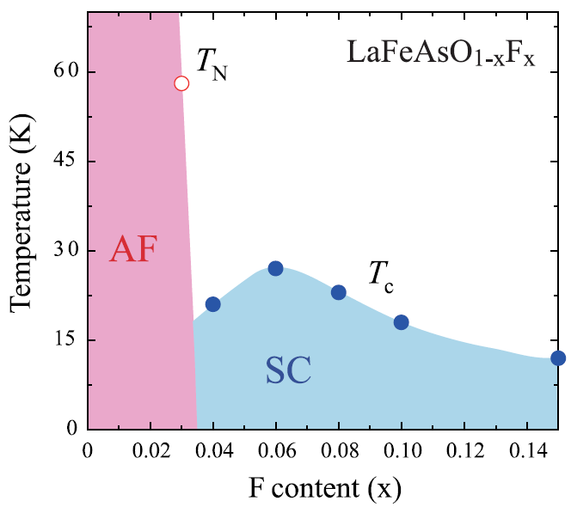
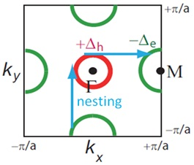
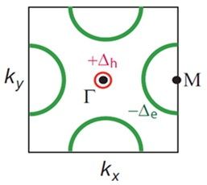
Electron doping
introduction
Phase diagram
Band structure
E
electron
Electron doping
Nesting weak
hole
ε_{F}
k
(π,0)
Fermi-
surface
Electron
doping

Slide 13
LaFeAs(O_{1-x}F_{x})
introduction
AF：Antiferromagnetism
SC：Superconductivity
Problem
O²⁻ → F⁻
Low solubility limit of F⁻ in O²⁻
Nesting weak
O² ⁻ → H⁻
Hydrogen behaves H⁻ in oxide
Electron dopant as flourine
The disappearance of SC had not been confirmed
High solubility limit!

Slide 14
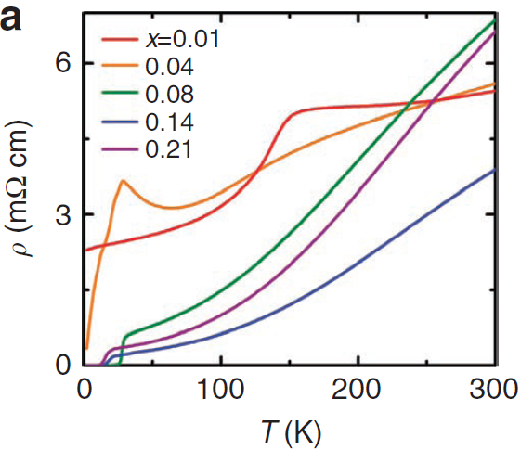
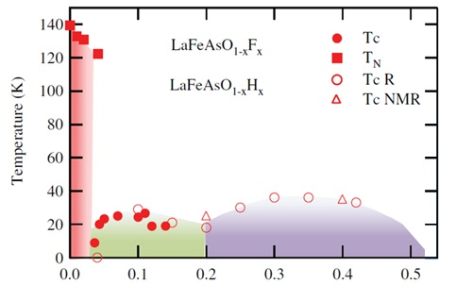
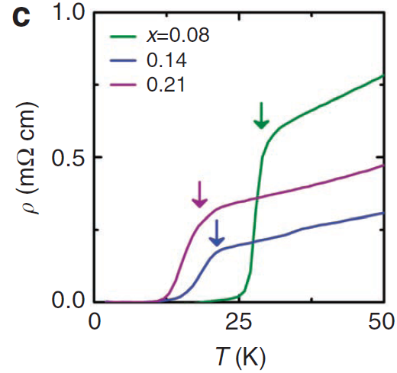
LaFeAs(O_{1-x}H_{x})
Results
x=0.08
T_{c}=29K
x
x=0.01
kink in resistivity due to
structural or magnetic transition
was seen around 150K
T_{c} =29K
T_{c} =18K
x≧0.08
zero resistivity due to
superconductivity

Slide 15
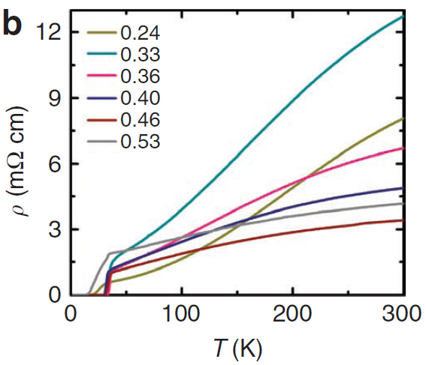
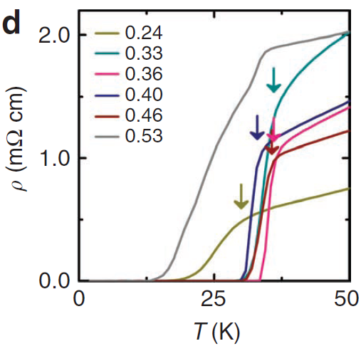
LaFeAs(O_{1-x}H_{x})
Results
x=0.36
T_{c} =36K
x
x=0.08~0.53
zero resistivity due to
superconductivity

Slide 16
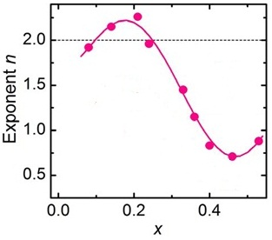
LaFeAs(O_{1-x}H_{x})
Results
n=2
Fermi liquid
state
x=0.08
T_{c}=29K
x=0.36
T_{c} =36K
n=1
Non-Fermi
liquid state
x
0.04<x<0.21：
first dome(SC1)
0.21<x<0.53：
second dome(SC2)
Electronic state around x=0.40 is different from x=0.10
Why??

Slide 17
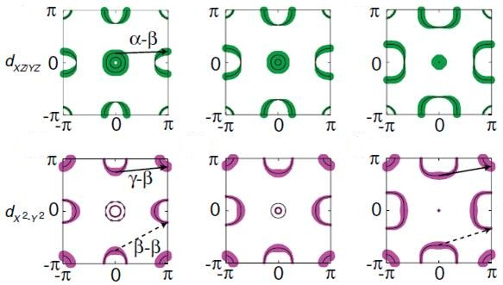
Fermi surfaces of LaFeAs(O_{1-x}H_{x})
Results
Weaker α-β nesting
γ
α
β
x = 0.08
x=0.21
x=0.40
Stronger γ-β/β-β nesting

Slide 18
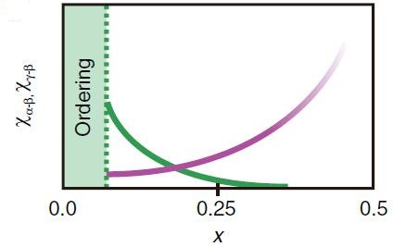
Spin susceptibility of LaFeAs(O_{1-x}H_{x})
Results
Χα-β
Χγ-β
0≦x≦0.05
Large χ_{α-β} (π,0) induces
stripe-type AFM ordering
0.05<x<0.20
Spin fluctuations at Q ∼ (π,0) develop
x~0.20
Switching from χ_{α-β} to χ_{γ -β}
0.20<x
χ_{γ –β} becomes stronger
with increasing x
Nesting weak
x

Slide 19
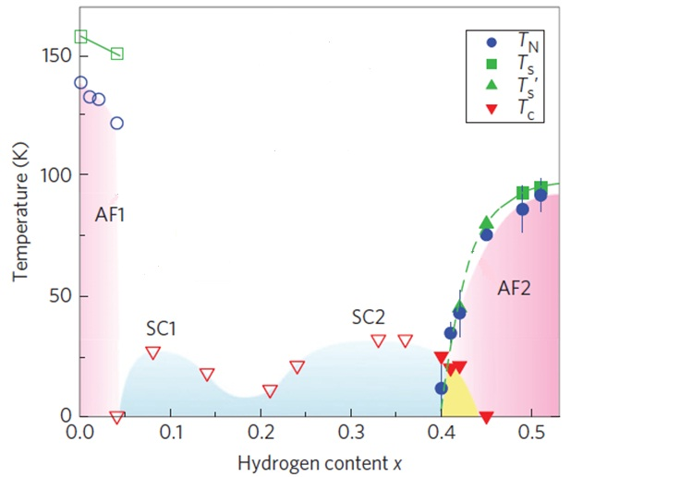
LaFeAs(O_{1-x}H_{x})
Results
Electron
doping

Slide 20
LaFeAs(O_{1-x}H_{x})
Results
Hole doping

Slide 21
Summary
These experiment and theoretical calculation were performed in LaFeAs(O_{1-x}H_{x}).
Two-dome superconducting phases (SC1,SC2) were found.
The ground state is an antiferromagnetic ordering
in 0≦x<0.05 (AFM1) and 0.40≦x≦0.51 (AFM2) .
These results suggest that superconductivity relates to magnetism.

Slide 22
END

