Slide 1
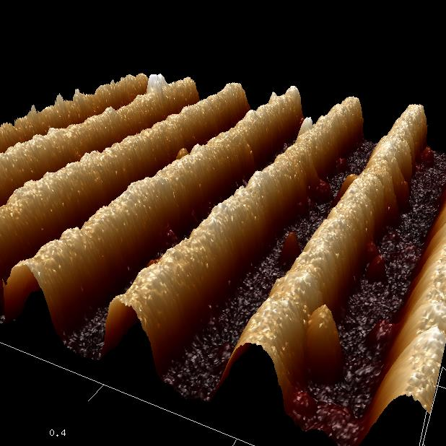
Measurement of nano-scale physical characteristics in VO₂
nano-wires by using Scanning Probe Microscope (SPM)
a VO₂ nano-wire
Tanaka lab.
Kotaro Sakai

Slide 2
Contents
・Background
Strongly correlated electron system
The characteristics of VO₂
VO₂ nano-wire
・My work
Purpose of my research
Fabrication of VO₂ nano-wires
SEM & AFM images of VO₂ nano-wires
・Summary
・Future work

Slide 3
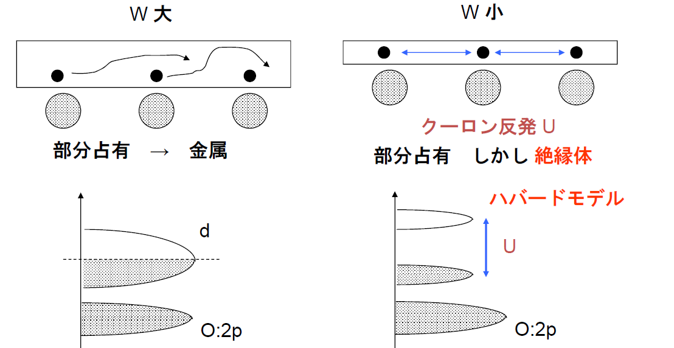
Strongly correlated electron system
Band Width：
S band > P band > d band > f band
3d > 4d > 5d
Band Width : wide
Band Width : narrow
Coulomb's repulsion U
Partial occupation ⇒
Metal
Partial occupation ⇒ but Insulator
Hubbard model

Slide 4
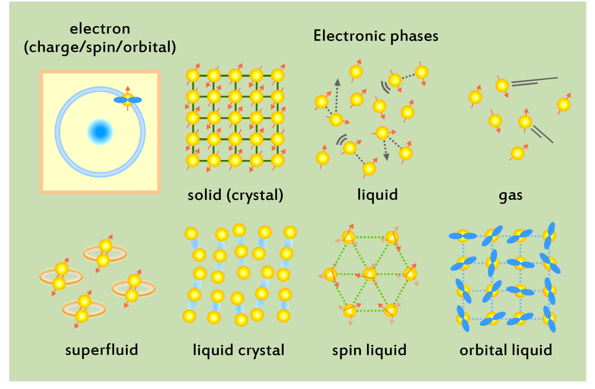
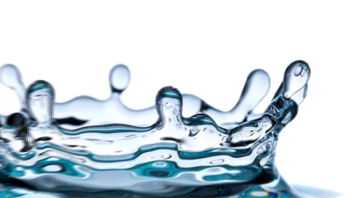
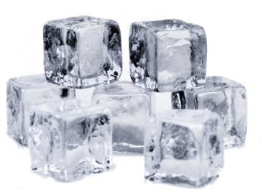
Strongly correlated electron system
Insulator
Metal
Stimulation
Temperature
Electric field
Strain

Slide 5
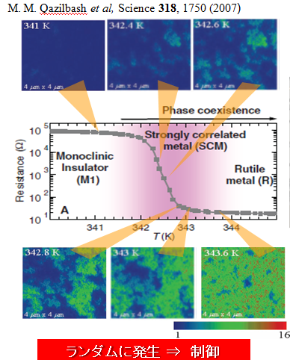
The characteristics of VO₂
High-T: metal
Low-T: insulator
Vanadium dioxide (VO₂) has attractive properties as follows:
1. Orders of magnitude resistive changes due to a metal-insulator transition (MIT)
2. Coexistence of metallic and insulating domains with several tens nanometer in size during MIT.

Slide 6
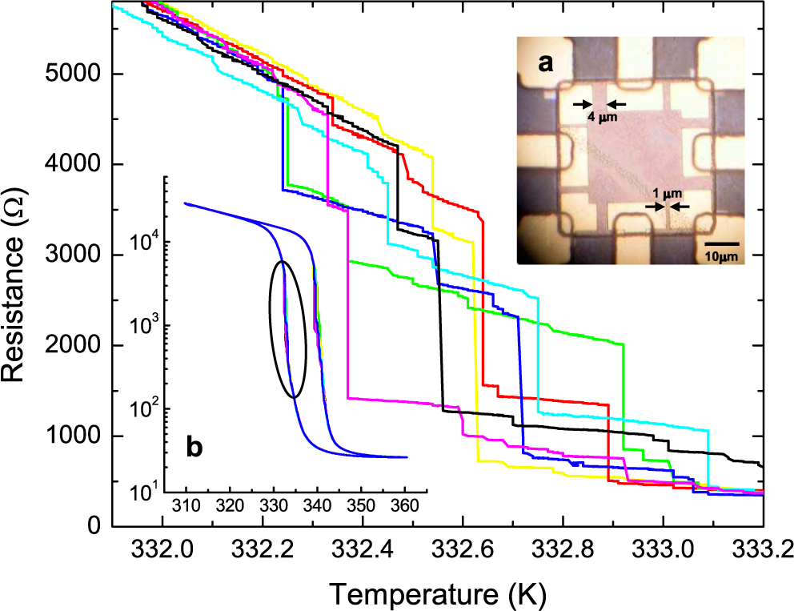
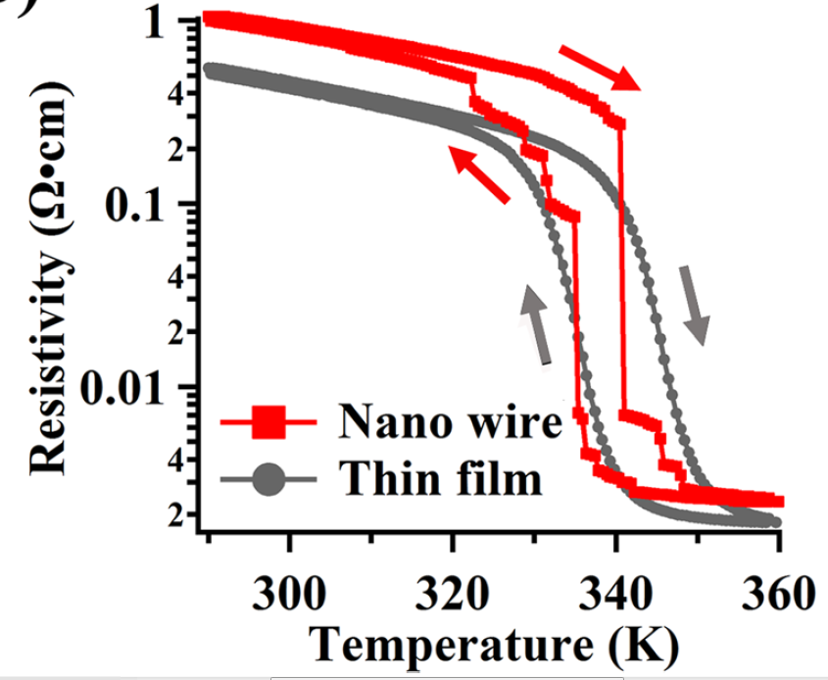
VO₂ nano-wire
・Step resistivity changes in VO₂ micro-wires and nano-wires(200nm)
Phys. Rev. Lett 101, 1750 (2008)
Appl. Phys. Lett. 104, 023104 (2014)
These data show MIT in VO₂ domains is first order phase transition.
The advantage of VO₂ nano-wire
・VO₂ nano-wire (<50nm) makes large and sharp resistivity change.
・Each nano-scale domain conductive behavior is clearly appeared.
・The electron conducting path is simplified.

Slide 7
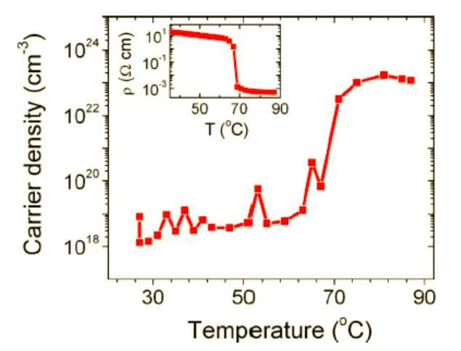
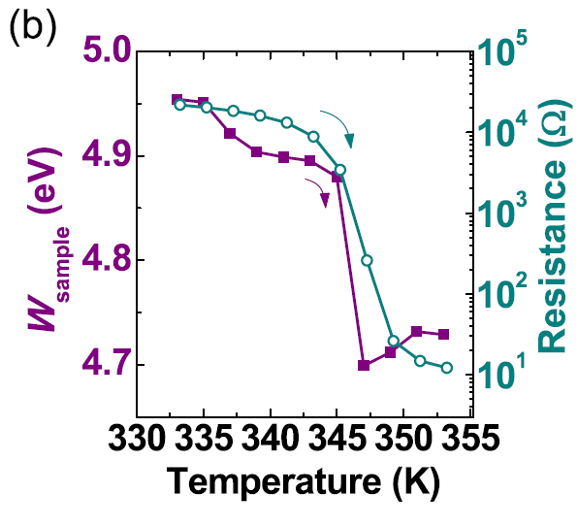

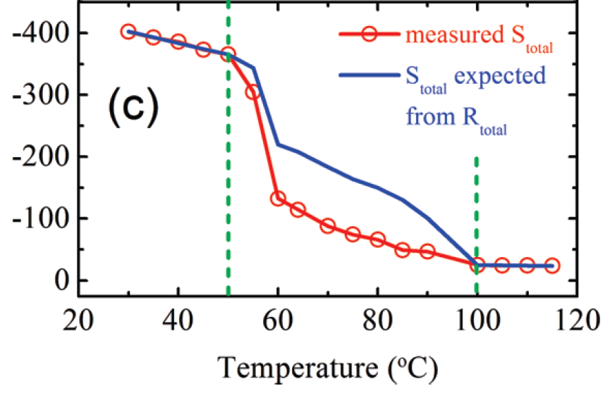
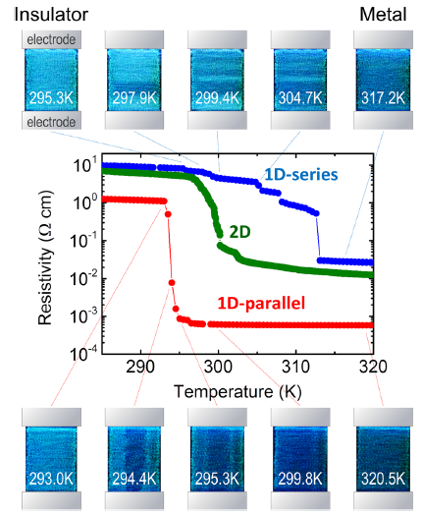
The characteristics of VO₂
・Carrier density(キャリア密度)
・Work function(仕事関数)
Phys. Rev. B 79, 153107 (2009)
・Seebeck coefficient(ゼーベック係数)
Appl. Phys. Lett. 101, 191605 (2012)
Insulator
Metal + Insulator
Metal
・Transmittance(透過率)
Nano Lett. 9, 4001(2009)
Appl. Phys. Lett. 102, 153106(2013)

Slide 8
My purpose
Fabrication of VO₂ nano-wire which width is
smaller than domain size (approximately 50nm)
and Measurement of these physical properties

Slide 9
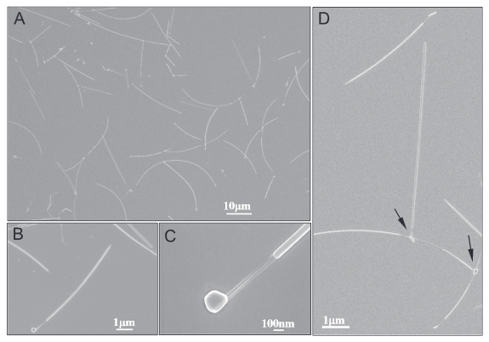
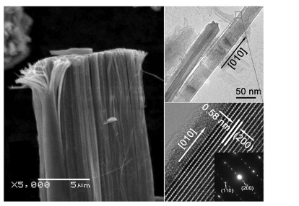
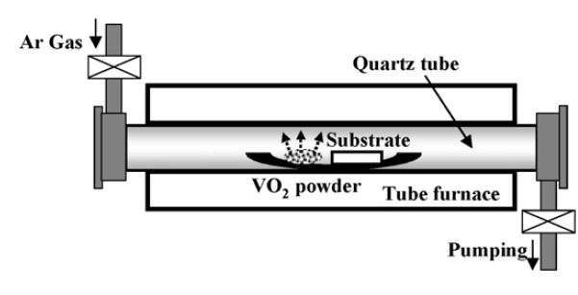
Fabrication of VO₂ nano-wires
・Conventional method
Chemical Vapor Deposition(CVD,化学気相合成法)
50μm
w=50～100nm
w=～30nm(the upper inset)
They successfully fabricated VO₂ nano-wires which width
is under 50nm,but didn‘t report these electrical properties.

Slide 10
Fabrication of VO₂ nano-wires
・Our fabrication method
Combination of Pulsed Laser Deposition (PLD) and
Nano-Imprint Lithograph (NIL) techniques
Target
UV
mold
pulsed laser
Resist
VO₂
substrate
1, Deposition
2, Nano-imprinting
O₂,SF₆plasma
a VO₂ nano-wire
3, Etching(RIE)
4, Resist removal

Slide 11
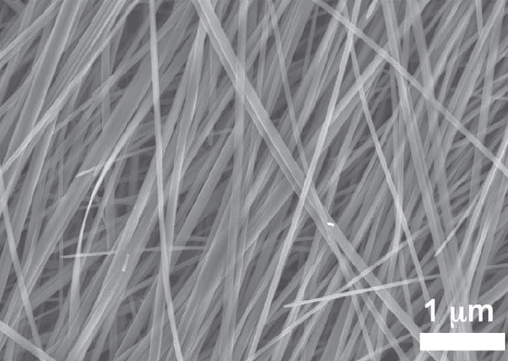
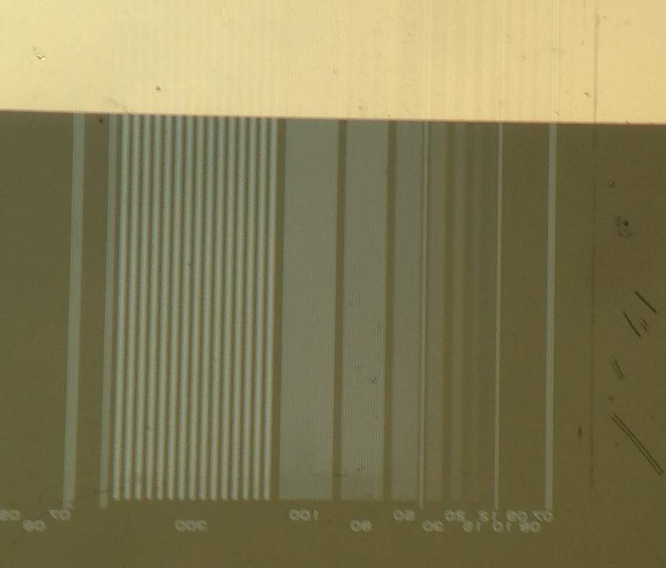
Fabrication of VO₂ nano-wires
Conventional method
Our method
Chemical Vapor Deposition
Pulsed Laser Deposition (PLD)
& Nano Imprint Lithography (NIL)
electrode
50μm
Sung-Hwan Bae et al, Adv. Mater, 25, 5098 (2013)
Position : uncontrollable
Making devices : difficult
Position : precisely controllable
Making devices : easy

Slide 12
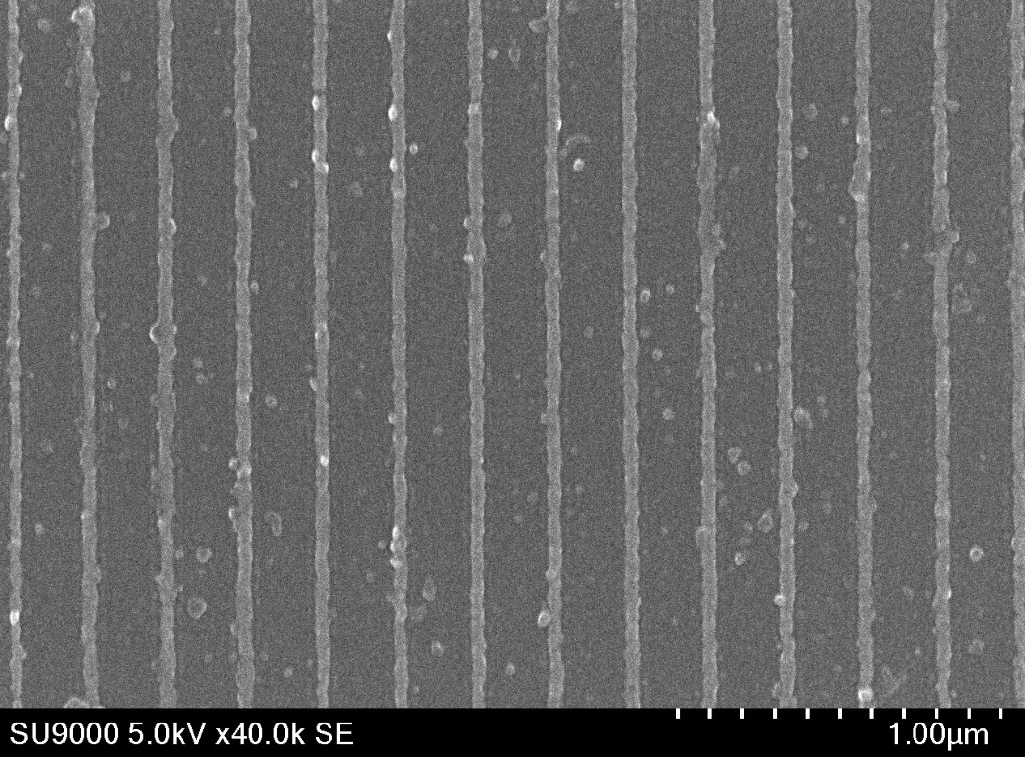
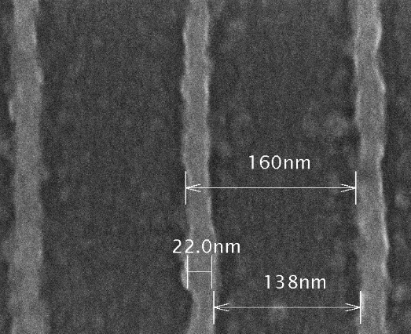
SEM images of VO₂ nano-wires
・SEM images
120nm_nano-wires pattern
80nm_nano-wires pattern
a VO₂ nano-wire
a VO₂ nano-wire
Space between wires : 195nm
Wire thickness : 20nm
Wire width : 45nm
Space between wires : 138nm
Wire thickness : 20nm
Wire width : 22nm
We successfully fabricated VO₂ nano-wires which
width is smaller than domain size.

Slide 13
Measurement system
・Conductive-AFM
A cantilever coated with Pt
Pt electrode
VO₂-NW
Al₂O₃
Pt electrode
The advantage of this method is we can freely select distance between electrodes.

Slide 14
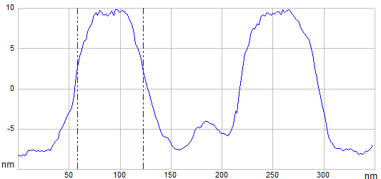
a difference between SEM and AFM images
80nm nano-wires pattern(line and space : 1:1)
SEM image
VO2 nano-wire
AFM image
65nm

Slide 15
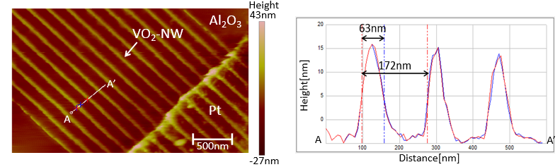
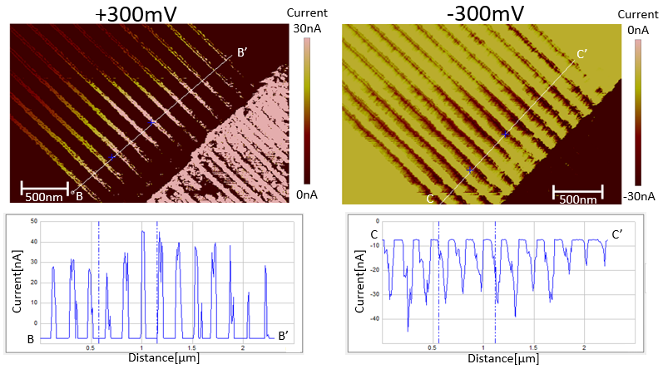
C-AFM images of VO₂ nano-wires (at Room Temperature)

Slide 16
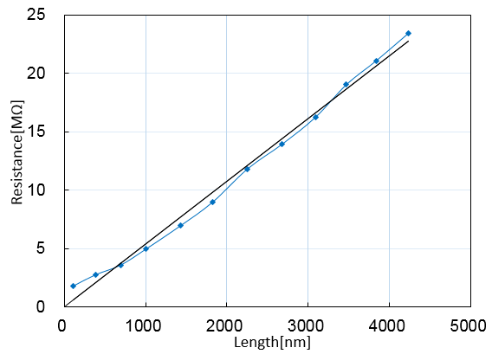
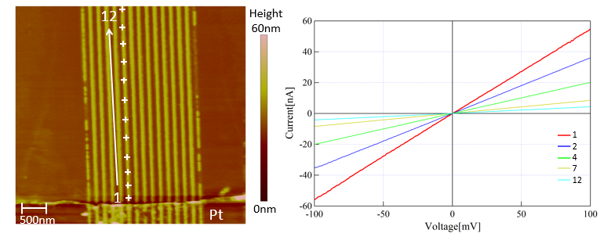
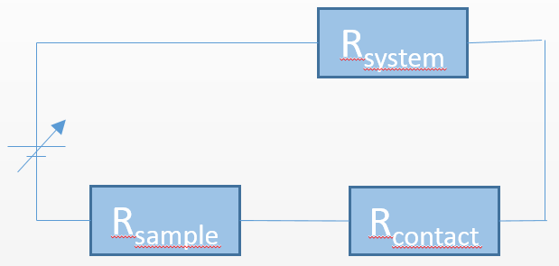
Resistivity of VO₂ nano-wires (at Room Temperature)
A cantilever coated with Pt
Pt electrode
VO₂-NW
Al₂O₃
R_{system}
This VO₂ nano-wire | Typical VO₂ thin film
0.54[Ωcm] | 0.1～1.0[Ωcm]
R_{sample}
R_{contact}

Slide 17
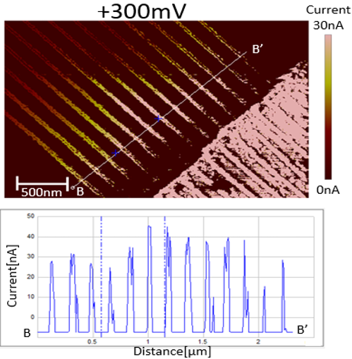
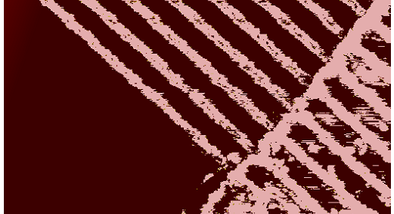
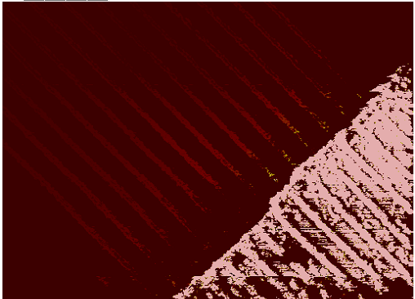
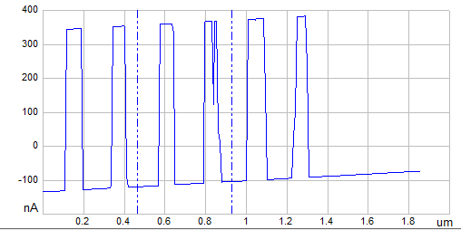
Insulator-Metal Transition
RT(+300mV)
360K(+20mV)
150nA
500nm
500nm
Current[nA]
Distance[μm]
 | RT | 360K
Resistivity | 0.54[Ωcm] | ＜0.005[Ωcm]

Slide 18
Summary
We successfully fabricated VO₂ nano-wires with
approximately 20 nm in width , which is smaller than
domain size.
We observed the electric current in VO₂ nano-wires with
by using C-AFM and could estimate the resistivity of the
VO₂ nano-wire, which is consistent value with typical VO₂.
RT(+300mV)
360K(+20mV)
500nm
500nm

Slide 19
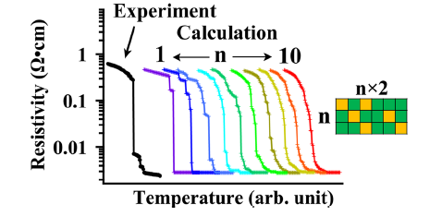
Future work
・We will observe huge resistive
change during MIT which is
characteristics of VO nano-wires .
・We will observe one domain behavior
and investigate the relationship
between nano-domain spatial address
and a conductive property.
Appl. Phys. Lett. 104, 023104 (2014)

