Slide 1


Search for superconductivity from measuring electrical resistivity at high pressure on SrFeO₂
Shimizu lab.
Masayoshi Kikuchi

Slide 2

Contents
Introduction
    Extreme condition
    Superconductor
    High pressure
    SrFeO₂
My work
Summary

Slide 3
What is extreme condition?
We especially measure this extreme condition in Shimizu lab.
High Pressure
Strong Magnetic Field
Temperature

Slide 4
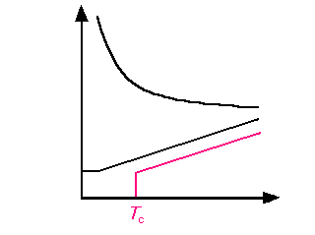
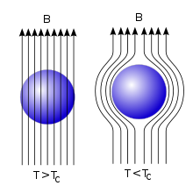
Superconductivity
Resistance
Resistance suddenly
turns to 0 at critical temperature!
Semiconductor
Metal
Residual
resistance
Superconductor
Temperature
Meissner Effect

Slide 5
Pressure effect
Pressurized
Applying pressure means…
・Structural transition
・Magnetic transition
・Insulator-Metal transition
・Superconducting transition
The atomic distance becomes closer.
Electronic states change.

Slide 6
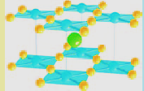
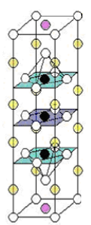
SrFeO₂
O
Fe
Cu
Sr
(La)
Hg
At ambient condition,
P4/mmm
a=3.991 Å, c=3.474 Å
Antiferromagnetic
T_{N}=473K
Insulator
Ba
Cu
O
HgBa₂Ca₂Cu₃O_{8+δ}
Sr_{0.9}La_{0.1}CuO₂
Ca
T_{c} = 135K
T_{c} = 42K
T. Kawakami et al., Nature Chemistry 1, 371 (2009)

Slide 7
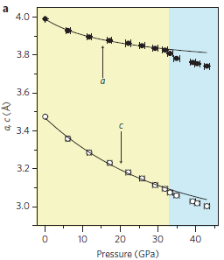
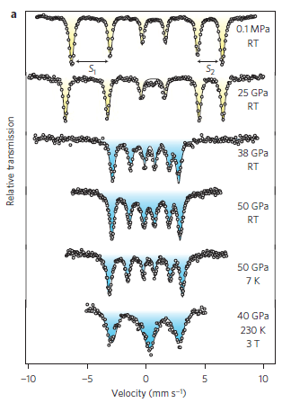
Prior reseach
T. Kawakami et al., Nature Chemistry 1, 371 (2009)

Slide 8
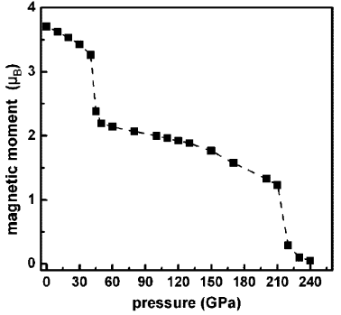
Calculation result of magnetic moment
At 45 GPa,
a spin transition from S = 2 to S = 1, accompanied by an AFM-FM transition, is observed.
At ∼220 GPa,
another spin transition from S = 1 to S = 0 occurs.
M. Rahman et.al., Inorg. Chem., 52, 12529 (2013).

Slide 9
My Motivation
Antiferromagnetic
Insulator
S=2
Ferromagnetic
Metal
S=1
Nonmagnetic
Metal(superconductor?)
S=0
32
130
Pressure (GPa)
・According to collaborator, spin transition from S = 1 to S = 0 is observed by ⁵⁷Fe Mӧssbauer spectra and X-lay diffraction.
・SrFeO₂ is expected to be a superconductor because of its crystal structure.

Slide 10
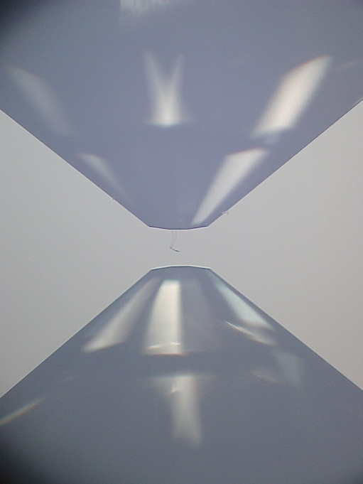
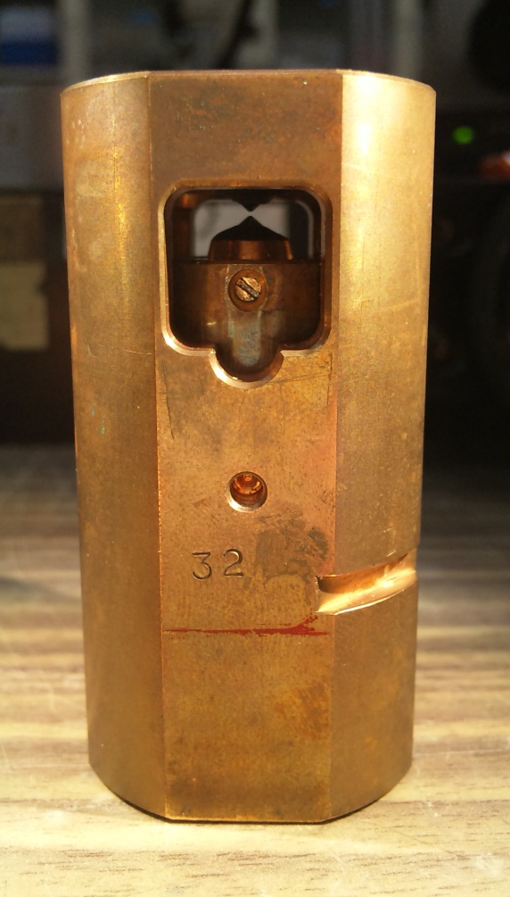
High pressure
3 cm
6 cm
～ 350 GPa
(≒ the center of the earth)
Diamond Anvil Cell
(DAC)

Slide 11
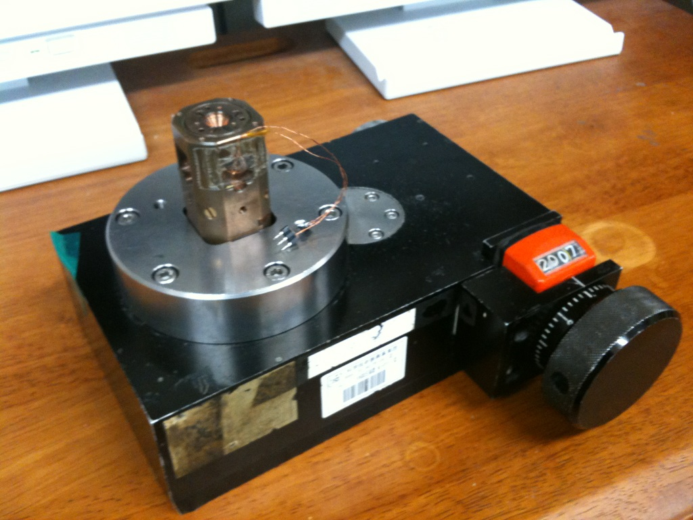
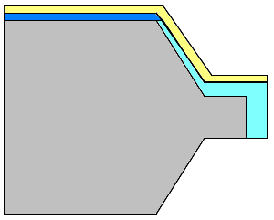
About DAC
Pressure
Gear Box(加圧台)
Handle
advantages
disadvantages
・ Making very high pressure.
・ The size of DAC is very small.
・ It can use for optical measuring.
・ Making hydrostatic
pressure is difficult.
・ The volume of sample
must be small.

Slide 12
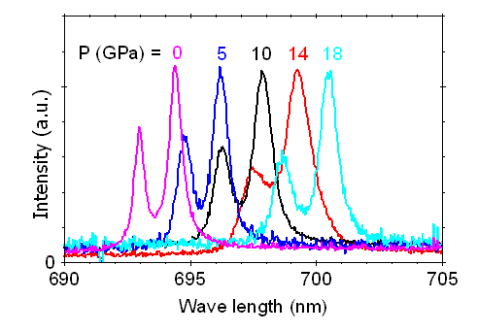
How to estimate pressure
Ruby Fluorescence（ルビー蛍光法）
Ruby produces fluorescence when irradiated by laser. The wavelength of the peak changes with pressure.
Raman Spectroscopy (ラマン分光法）
Irradiate diamond with laser. On applying pressure, the vibration of C-C bond in diamond changes, the wavelength of scattered light becomes small.
Y.Akahara et. al, J. Appl. Phys. 96, 3748 (2004)

Slide 13
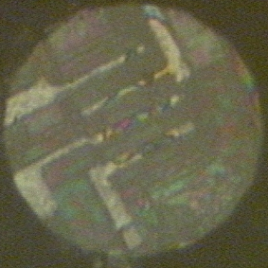
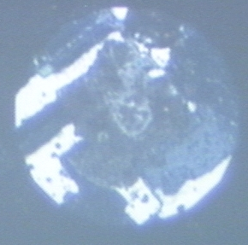
Setting
Experimental setup
Sample;SrFeO₂ powder
Anvil culet ; 100 μm^{ϕ}
Pressure medium; Not-used
Measurement method; four-probe scheme
Gasket; Rhenium
Insulation material; c-BN + epoxy
Electrodes ; Platinum
diamond
ruby
Insulating layer
sample
100 µm
Electrodes
gasket
ruby
sample
Electrodes

Slide 14
My result

Slide 15
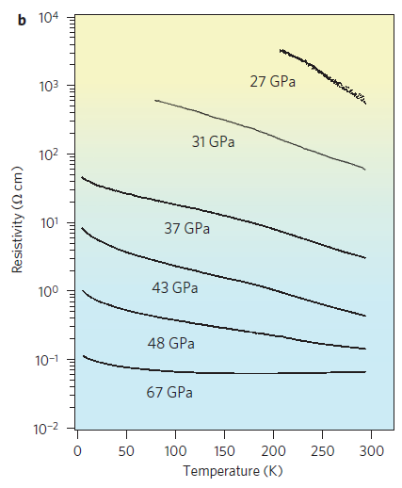
34-70GPa
T. Kawakami et al.,
Nat. Chem. 1, 371 (2009)

Slide 16
70-90GPa
Insulating behavior can be measured again.

Slide 17
Summary & Future work
Summary
With applying pressure, insulater-metal and metal-insulater transition can be measured.
Future work
Measure T dependence of R at more high pressure to find superconductivity

Slide 18
My result
Various changes have occurred with applying pressure.

Slide 19
90-125GPa

Slide 20
headline

Slide 21
headline

