Slide 1
Magnetism and Superconductivity of Copper-Oxide Superconductor
Kitaoka Lab.
Nozomu Shiki
T.ADACHI et al., J. Phys. Soc. Jpn. 82 (2013) 063713
Y.Krockenberger et al., Scientific Reports Volume: 3, Article number: 2235

Slide 2
Contents
Introduction
History of Superconductivity
Main subject
Copper-Oxide Superconductor
(Hole and electron doping type)
Pr_{2-x}Ce_{x}CuO₄(thin film)
Summary

Slide 3
History of Superconductivity
Introduction
High-T_{c} copper oxides
T_{c} (K)
HgCaBaCuO
（under high pressure）
160
160
HgCaBaCuO
（under high pressure）
TlCaBaCuO
HgCaBaCuO
TlCaBaCuO
BiCaSrCuO
100
100
YBaCuO
80
liquid nitrogen
60
V₃Si
Nb₃Ge
LaSrCuO
NbN
LaBaCuO
Pb
NbC
Nb-Al-Ge
Hg
Nb
Nb₃Sn
O
0
1910
1930
1950
1970
1990
年
1911
1986

Slide 4
kind of carriers (Electrons, Holes）
Hole type (T-structure)
Nd_{2-x}Ce_{x}CuO₄
T
La_{2-x}Sr_{x}CuO₄
Nd
3+
4+
→
Ce
La
3+
→
Sr
2+
La (Sr)
Electron doping
Hole doping
Cu
AFM
SC
SC
La_{2-ｘ}Sr_{x}CuO₄
0
0.15
x
x
0.15
Mother material is Mott insulator.
La³⁺ Sr²⁺
Notes:
キャリアが増えるにつれて

Slide 5
kind of carriers (Electrons, Holes）
Hole type (T-structure)
Nd_{2-x}Ce_{x}CuO₄
T
La_{2-x}Sr_{x}CuO₄
Nd
3+
4+
→
Ce
La
3+
→
Sr
2+
La (Sr)
Electron doping
Hole doping
Cu
AFM
SC
SC
La_{2-ｘ}Sr_{x}CuO₄
0
0.15
x
x
0.15
Mother material is Mott insulator.
La³⁺ Sr²⁺
Notes:
キャリアが増えるにつれて

Slide 6
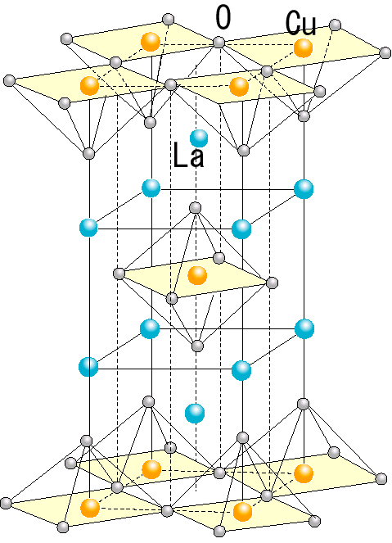
High-T_{c} Superconductor
Charge Reservoir
La₂CuO₄
ＣｕＯ_{２}plane
Mott Insulator
Charge Reservoir
Cu²⁺ (3d⁹)
Notes:
La2CuO4

Slide 7
High-T_{c} Superconductor
Charge Reservoir
La₂CuO₄
ＣｕＯ_{２}plane
Mott Insulator
Charge Reservoir
Crystal field
O²⁻
x²-y²
Cu²⁺ (3d⁹)
3z²-r²
O²⁻
Cu²⁺
O²⁻
O²⁻
xy
O²⁻
yz
zx
O²⁻
cubic symmetry
Notes:
La2CuO4

Slide 8
High-T_{c} Superconductor
Charge Reservoir
La₂CuO₄
ＣｕＯ_{２}plane
Mott Insulator
Charge Reservoir
Crystal field
Jahn-Teller effect
O²⁻
x²-y²
x²-y²
Cu²⁺ (3d⁹)
3z²-r²
3z²-r²
Cu²⁺
O²⁻
O²⁻
O²⁻
xy
xy
O²⁻
yz
yz
zx
zx
O²⁻
Notes:
La2CuO4

Slide 9
High-T_{c} Superconductor
Charge Reservoir
La₂CuO₄
ＣｕＯ_{２}plane
Mott Insulator
Charge Reservoir
U: coulomb energy
t : hopping energy
Antiferromagnetic interaction Ｊ
$$J∝\frac{t^{2}}{U}$$
Crystal field
Jahn-Teller effect
x²-y²
x²-y²
Cu²⁺ (3d⁹)
3z²-r²
3z²-r²
xy
xy
t
yz
yz
zx
zx
Notes:
反強磁性ならパウリ排他より飛び移って戻るというのが許されエネルギー的に得

Slide 10
High-T_{c} Superconductor
Charge Reservoir
La₂CuO₄
ＣｕＯ_{２}plane
Mott Insulator
Charge Reservoir
U: coulomb energy
t : hopping energy
Antiferromagnetic interaction Ｊ
$$J∝\frac{t^{2}}{U}$$
Crystal field
Jahn-Teller effect
x²-y²
x²-y²
U
Cu²⁺ (3d⁹)
3z²-r²
3z²-r²
xy
xy
t
yz
yz
zx
zx
Notes:
反強磁性ならパウリ排他より飛び移って戻るというのが許されエネルギー的に得

Slide 11
High-T_{c} Superconductor
Charge Reservoir
La₂CuO₄
ＣｕＯ_{２}plane
Mott Insulator
Charge Reservoir
U: coulomb energy
t : hopping energy
Antiferromagnetic interaction Ｊ
$$J∝\frac{t^{2}}{U}$$
Crystal field
Jahn-Teller effect
x²-y²
x²-y²
U
Cu²⁺ (3d⁹)
3z²-r²
3z²-r²
xy
xy
t
yz
yz
zx
zx
Notes:
反強磁性ならパウリ排他より飛び移って戻るというのが許されエネルギー的に得

Slide 12
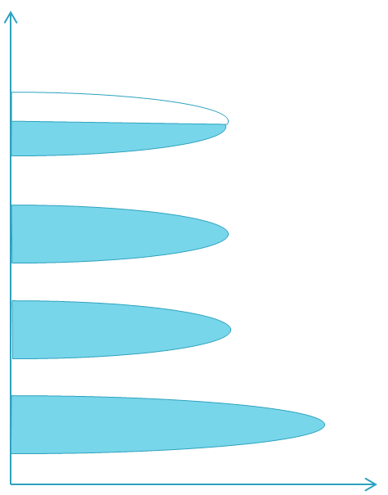
High-T_{c} Superconductor
Charge Reservoir
La₂CuO₄
ＣｕＯ_{２}plane
Mott Insulator
Charge Reservoir
E
Jahn-Teller effect
U.H.B.
x²-y²
3z²-r²
xy
yz
L.H.B.
zx
DOS
Notes:
反強磁性ならパウリ排他より飛び移って戻るというのが許されエネルギー的に得

Slide 13
High-T_{c} Superconductor
Charge Reservoir
La₂CuO₄
ＣｕＯ_{２}plane
Mott Insulator
!!
Charge Reservoir
Δ:charge transfer gap
E
U:Mott Hubbard gap
$$Cu{3d}_{x^{2}−y^{2}} (U.H.B.)$$
Δ
E_{F}
U
$$O2p$$
$$Cu{3d}_{x^{2}−y^{2}} (L.H.B.)$$
Notes:
反強磁性ならパウリ排他より飛び移って戻るというのが許されエネルギー的に得

Slide 14
High-T_{c} Superconductor
Nd_{2-x}Ce_{x}CuO₄
T
La_{2-x}Sr_{x}CuO₄
Nd
3+
4+
→
Ce
Charge Reservoir
La
3+
→
Sr
2+
La_{2-x}Sr_{x}CuO₄
Electron doping
Hole doping
ＣｕＯ_{２}plane
substitution
AFM
Sr²⁺
Charge Reservoir
SC
SC
La³⁺
Sr²⁺
x
E
x²-y²
x²-y²
E_{F}
$$Cu{3d}_{x^{2}−y^{2}} (U.H.B.)$$
Cu²⁺ (3d⁹)
3z²-r²
3z²-r²
$$O2p$$
xy
xy
yz
yz
zx
zx
$$Cu{3d}_{x^{2}−y^{2}} (L.H.B.)$$
Notes:
La2CuO4

Slide 15
High-T_{c} Superconductor
Charge Reservoir
La_{2-x}Sr_{x}CuO₄
ＣｕＯ_{２}plane
substitution
Charge Reservoir
Sr²⁺
La³⁺
Sr²⁺
E
x²-y²
x²-y²
E_{F}
$$Cu{3d}_{x^{2}−y^{2}} (U.H.B.)$$
Cu²⁺ (3d⁹)
3z²-r²
3z²-r²
$$O2p$$
xy
xy
yz
yz
zx
zx
$$Cu{3d}_{x^{2}−y^{2}} (L.H.B.)$$
Notes:
La2CuO4

Slide 16
High-T_{c} Superconductor
Charge Reservoir
La_{2-x}Sr_{x}CuO₄
ＣｕＯ_{２}plane
substitution
Charge Reservoir
Sr²⁺
La³⁺
Sr²⁺
E
x²-y²
x²-y²
$$Cu{3d}_{x^{2}−y^{2}} (U.H.B.)$$
Cu²⁺ (3d⁹)
3z²-r²
3z²-r²
E_{F}
Hole
$$O2p$$
xy
xy
yz
yz
zx
zx
$$Cu{3d}_{x^{2}−y^{2}} (L.H.B.)$$

Slide 17
High-T_{c} Superconductor
Charge Reservoir
La_{2-x}Sr_{x}CuO₄
ＣｕＯ_{２}plane
substitution
Charge Reservoir
Sr²⁺
La³⁺
Sr²⁺
E
x²-y²
x²-y²
$$Cu{3d}_{x^{2}−y^{2}} (U.H.B.)$$
Cu²⁺ (3d⁹)
3z²-r²
3z²-r²
E_{F}
Hole
$$O2p$$
xy
xy
yz
yz
S=0
zx
zx
$$Cu{3d}_{x^{2}−y^{2}} (L.H.B.)$$

Slide 18
High-T_{c} Superconductor
Charge Reservoir
La_{2-x}Sr_{x}CuO₄
ＣｕＯ_{２}plane
substitution
Charge Reservoir
Sr²⁺
La³⁺
Sr²⁺
E
x²-y²
x²-y²
$$Cu{3d}_{x^{2}−y^{2}} (U.H.B.)$$
Cu²⁺ (3d⁸)
3z²-r²
3z²-r²
E_{F}
Hole
$$O2p$$
xy
xy
yz
yz
S=0
zx
zx
$$Cu{3d}_{x^{2}−y^{2}} (L.H.B.)$$

Slide 19
High-T_{c} Superconductor
Charge Reservoir
La_{2-x}Sr_{x}CuO₄
ＣｕＯ_{２}plane
substitution
Charge Reservoir
Sr²⁺
La³⁺
Sr²⁺
x²-y²
x²-y²
Cu²⁺ (3d⁸)
3z²-r²
3z²-r²
xy
xy
yz
yz
zx
zx

Slide 20
Hole doping
Hole doping type
(T-structure)
Nd_{2-x}Ce_{x}CuO₄
T
La_{2-x}Sr_{x}CuO₄
Nd³⁺
→
Ce⁴⁺
La³⁺
→
Sr²⁺
Electron doping
Hole doping
Cu
La (Sr)
O
Cu
AFM
La,
Sr
SC
SC
0.15
0
0.15
x
Mother material is Mott insulator.
La_{2-ｘ}Sr_{x}CuO₄
As carriers increase, the groundstate changes from AFM to SC.
La³⁺ Sr²⁺
Notes:
キャリアが増えるにつれて

Slide 21
Electron doping
Electron doping type
(T’-structure)
Nd_{2-x}Ce_{x}CuO₄
T
La_{2-x}Sr_{x}CuO₄
Nd³⁺
→
Ce⁴⁺
La³⁺
→
Sr²⁺
Electron doping
Hole doping
Cu
Nd (Ce)
O
Cu
AFM
Nd,
Ce
SC
SC
0.15
0
0.15
x
Mother material is Mott insulator.
Nd_{2-ｘ}Ce_{ｘ}CuO₄
As carriers increase, the groundstate changes from AFM to SC.
Nd³⁺ Ce⁴⁺
Notes:
キャリアが増えるにつれて

Slide 22
Electron doping
$$Cu{3d}_{x^{2}−y^{2}} (U.H.B.)$$
Electron doping type
(T’-structure)
E_{F}
doping
E_{F}
$$O2p$$
Nd (Ce)
Cu
$$Cu{3d}_{x^{2}−y^{2}} (L.H.B.)$$
x²-y²
3z²-r²
Cu²⁺ (3d⁹)
Nd_{2-ｘ}Ce_{ｘ}CuO₄
xy
Nd³⁺ Ce⁴⁺
yz
zx
Notes:
キャリアが増えるにつれて

Slide 23
Electron doping
$$Cu{3d}_{x^{2}−y^{2}} (U.H.B.)$$
Electron doping type
(T’-structure)
E_{F}
doping
E_{F}
$$O2p$$
Nd (Ce)
Cu
$$Cu{3d}_{x^{2}−y^{2}} (L.H.B.)$$
x²-y²
3z²-r²
Cu²⁺ (3d¹⁰)
Nd_{2-ｘ}Ce_{ｘ}CuO₄
xy
Nd³⁺ Ce⁴⁺
yz
zx
Notes:
キャリアが増えるにつれて

Slide 24
Electron doping
$$Cu{3d}_{x^{2}−y^{2}} (U.H.B.)$$
Electron doping type
(T’-structure)
E_{F}
doping
E_{F}
$$O2p$$
Nd (Ce)
Cu
$$Cu{3d}_{x^{2}−y^{2}} (L.H.B.)$$
x²-y²
3z²-r²
Cu²⁺ (3d¹⁰)
Nd_{2-ｘ}Ce_{ｘ}CuO₄
xy
Nd³⁺ Ce⁴⁺
yz
zx
Notes:
キャリアが増えるにつれて

Slide 25
Electron doping
$$Cu{3d}_{x^{2}−y^{2}} (U.H.B.)$$
Electron doping type
(T’-structure)
E_{F}
doping
E_{F}
$$O2p$$
Nd (Ce)
Cu
$$Cu{3d}_{x^{2}−y^{2}} (L.H.B.)$$
x²-y²
3z²-r²
Cu²⁺ (3d¹⁰)
Nd_{2-ｘ}Ce_{ｘ}CuO₄
xy
Nd³⁺ Ce⁴⁺
yz
zx
Notes:
キャリアが増えるにつれて

Slide 26
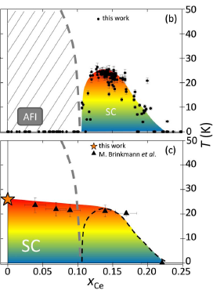
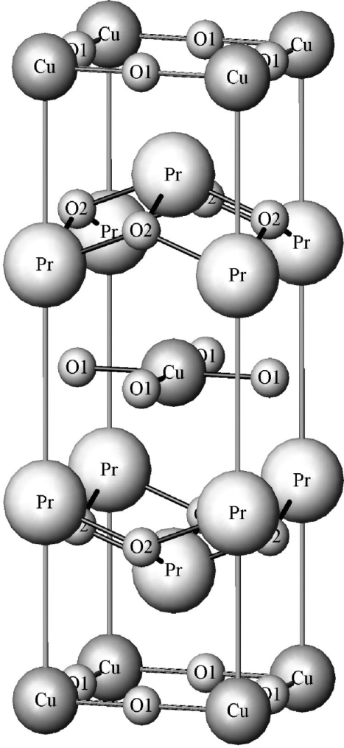
Pr_{2-x}Ce_{x}CuO₄ (thin film)
Pr₂CuO₄
annealing
(10⁻⁶ Torr , 550K)
AFM
SC
annealing(1st)
(10⁻¹ Torr , 800K)
annealing(2nd)
(10⁻⁶ Torr , 550K)
http://infrared.phy.bnl.gov/pdf/homes/homes_02.pdf

Slide 27
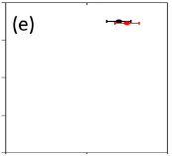
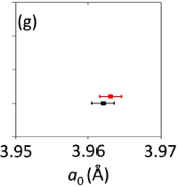
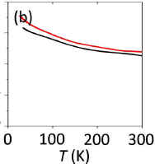
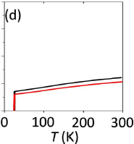
Pr₂CuO₄
as grown
2 step annealing

Slide 28
Pr₂CuO_{4+δ}
Pr₂CuO_{4+δ}
O
as grown
2 step annealing
http://infrared.phy.bnl.gov/pdf/homes/homes_02.pdf
Notes:
では、なぜ酸素を除去することによって超伝導が発現するのか、ということを理解するために、新しい電子・磁気状態が提案されています。

Slide 29
influence of excess oxygen
O
Cu-O bond becomes longer
Cu
O
Cu
E
E
$$Cu{3d}_{x^{2}−y^{2}} (U.H.B.)$$
E_{F}
E_{F}
U
$$O2p$$
$$Cu{3d}_{x^{2}−y^{2}} (L.H.B.)$$

Slide 30
influence of excess oxygen
O
Cu-O bond becomes longer
Cu
O
Cu
E
E
$$Cu{3d}_{x^{2}−y^{2}} (U.H.B.)$$
E_{F}
E_{F}
U
$$O2p$$
$$Cu{3d}_{x^{2}−y^{2}} (L.H.B.)$$

Slide 31
influence of excess oxygen
O
Cu-O bond becomes longer
Cu
O
Cu
E
E
$$Cu{3d}_{x^{2}−y^{2}} (U.H.B.)$$
E_{F}
U
$$O2p$$
E_{F}
$$Cu{3d}_{x^{2}−y^{2}} (L.H.B.)$$

Slide 32
Summary
O
Cu
O
Cu
Lattice constant of c-axis decreases by appropriate annealing, and SC appears in Pr₂CuO₄(thin film),
Length of Cu-O bonds in a square plane is larger than in a pyramidal plane,
because of removing apical oxygen
energy of ${3d}_{x^{2}−y^{2}}$goes down, and metal states realize in Fermi surface

Slide 33
END

