Slide 1


Search for liquid-metallic hydrogen under high temperature and high pressure
Shimizu group
M1 SHO Kawaguchi
V. Dzyabura et al. PNAS, 110, 20, 8040-8044 (2013)
M. I. Eremets et al. Nat. Mater., 10, 927-931 (2011)

Slide 2

Contents
Introduction
About high pressure
About Hydrogen
previous work
LASER heating
Future work
Electric resistance measurement
Conclusion

Slide 3
About high pressure
High Pressure
1 GPa ≈ 10,000 atm ≈ 10,000 kgf/cm²
(Center of the Earth = 360 GPa)
Pressure can change crystal structure
atomic distance, structure type … etc.
pressure
pressure
monatomic metal
Molecule
Insulator

Slide 4
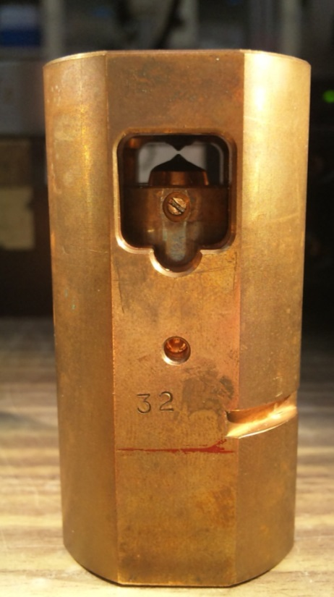
About Diamond Anvil Cell
3cm
Diamond anvil
gasket
sample
6cm
Apply pressure
Why use Diamond? .....
Very hard → high pressure
(～ 350 GPa)
Transparent → optical measuring
Diamond Anvil Cell
(DAC)

Slide 5
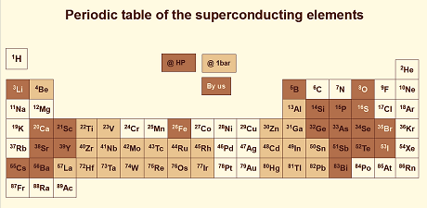
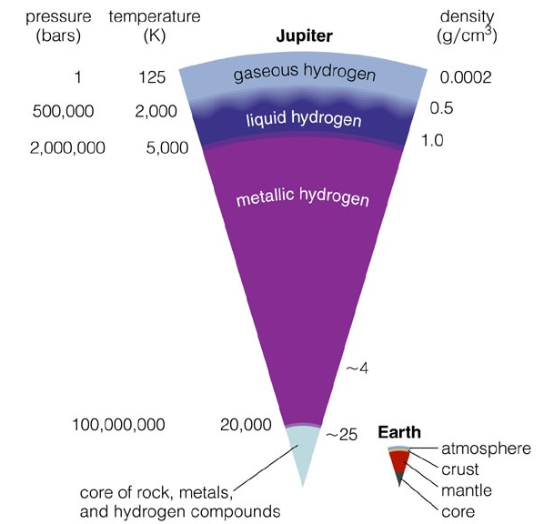
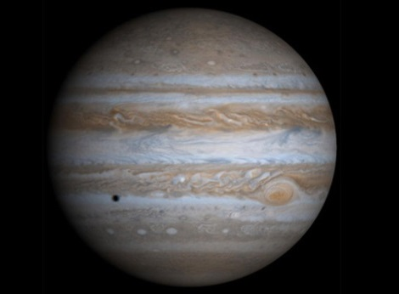
About Hydrogen
Jupiter

Slide 6
About Hydrogen
Experiment has NOT been under high temperature and high pressure
Liquid H₂
Liquid- metallic H
Observe liquid-metallic hydrogen and
determine phase transition boundary

Slide 7
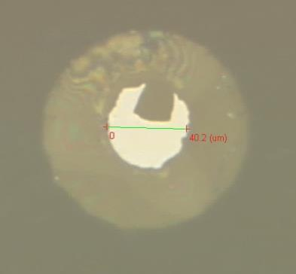
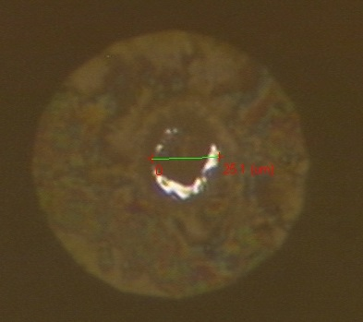
About Hydrogen
Technical difficulties of experiments
Small atomic radius and high diffusibility (拡散性)
→ Hydrogen embrittlement (水素脆化) of diamond anvil
and reduction of hydrogen
High compressibility(圧縮率)
→ Contraction of the sample room
Apply pressure
@ 1 atm
@ 50 GPa

Slide 8
Previous Work
LASER heating ( T vs LASER power )
transition temperature
Metallized
Specific heat capacity(比熱)
and reflectance changes
Temperature
metalized
Heating efficiency changes
LASER power

Slide 9
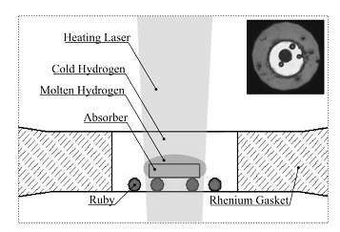
LASER heating
Setting
Heating LASER
Anvil Culet : φ100 μm
Gasket : Re
LASER absorber : Pt
Heating LASER : 1065 nm
Al₂O₃ coating on the diamond surface
(to prevent hydrogen embrittlement of diamond )
prevent gold from touching with diamond
V. Dzyabura et al. PNAS, 110, 20, 8040-8044 (2013)

Slide 10
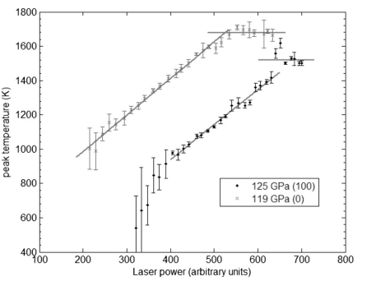
LASER heating
Results
Heating efficiency changes
Catch the metallization of Hydrogen
inflection point
V. Dzyabura et al. PNAS, 110, 20, 8040-8044 (2013)

Slide 11


LASER heating
LASER heating
Anvil Culet : φ100 or 150 μm
Gasket : Re+NaCl
LASER absorber : Gold
Heating LASER : 1053 nm
(To prevent hydrogenation of Rhenium)
heating
Au foil
Ichimaru. K. et al. (2014)

Slide 12
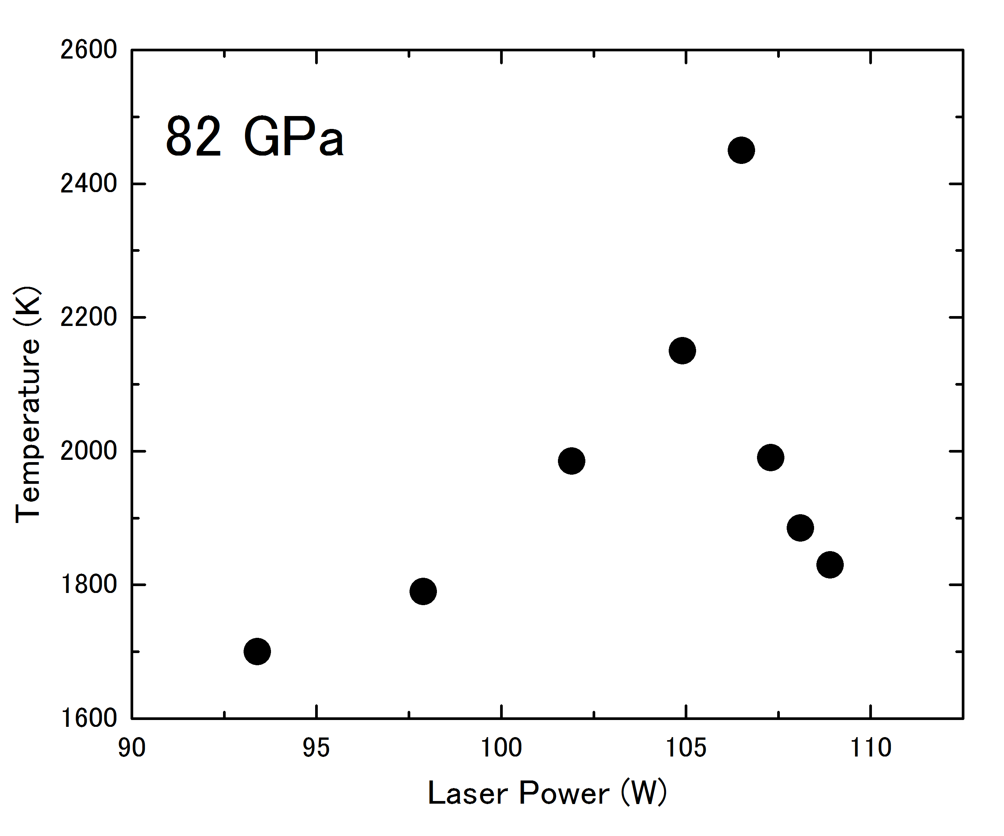
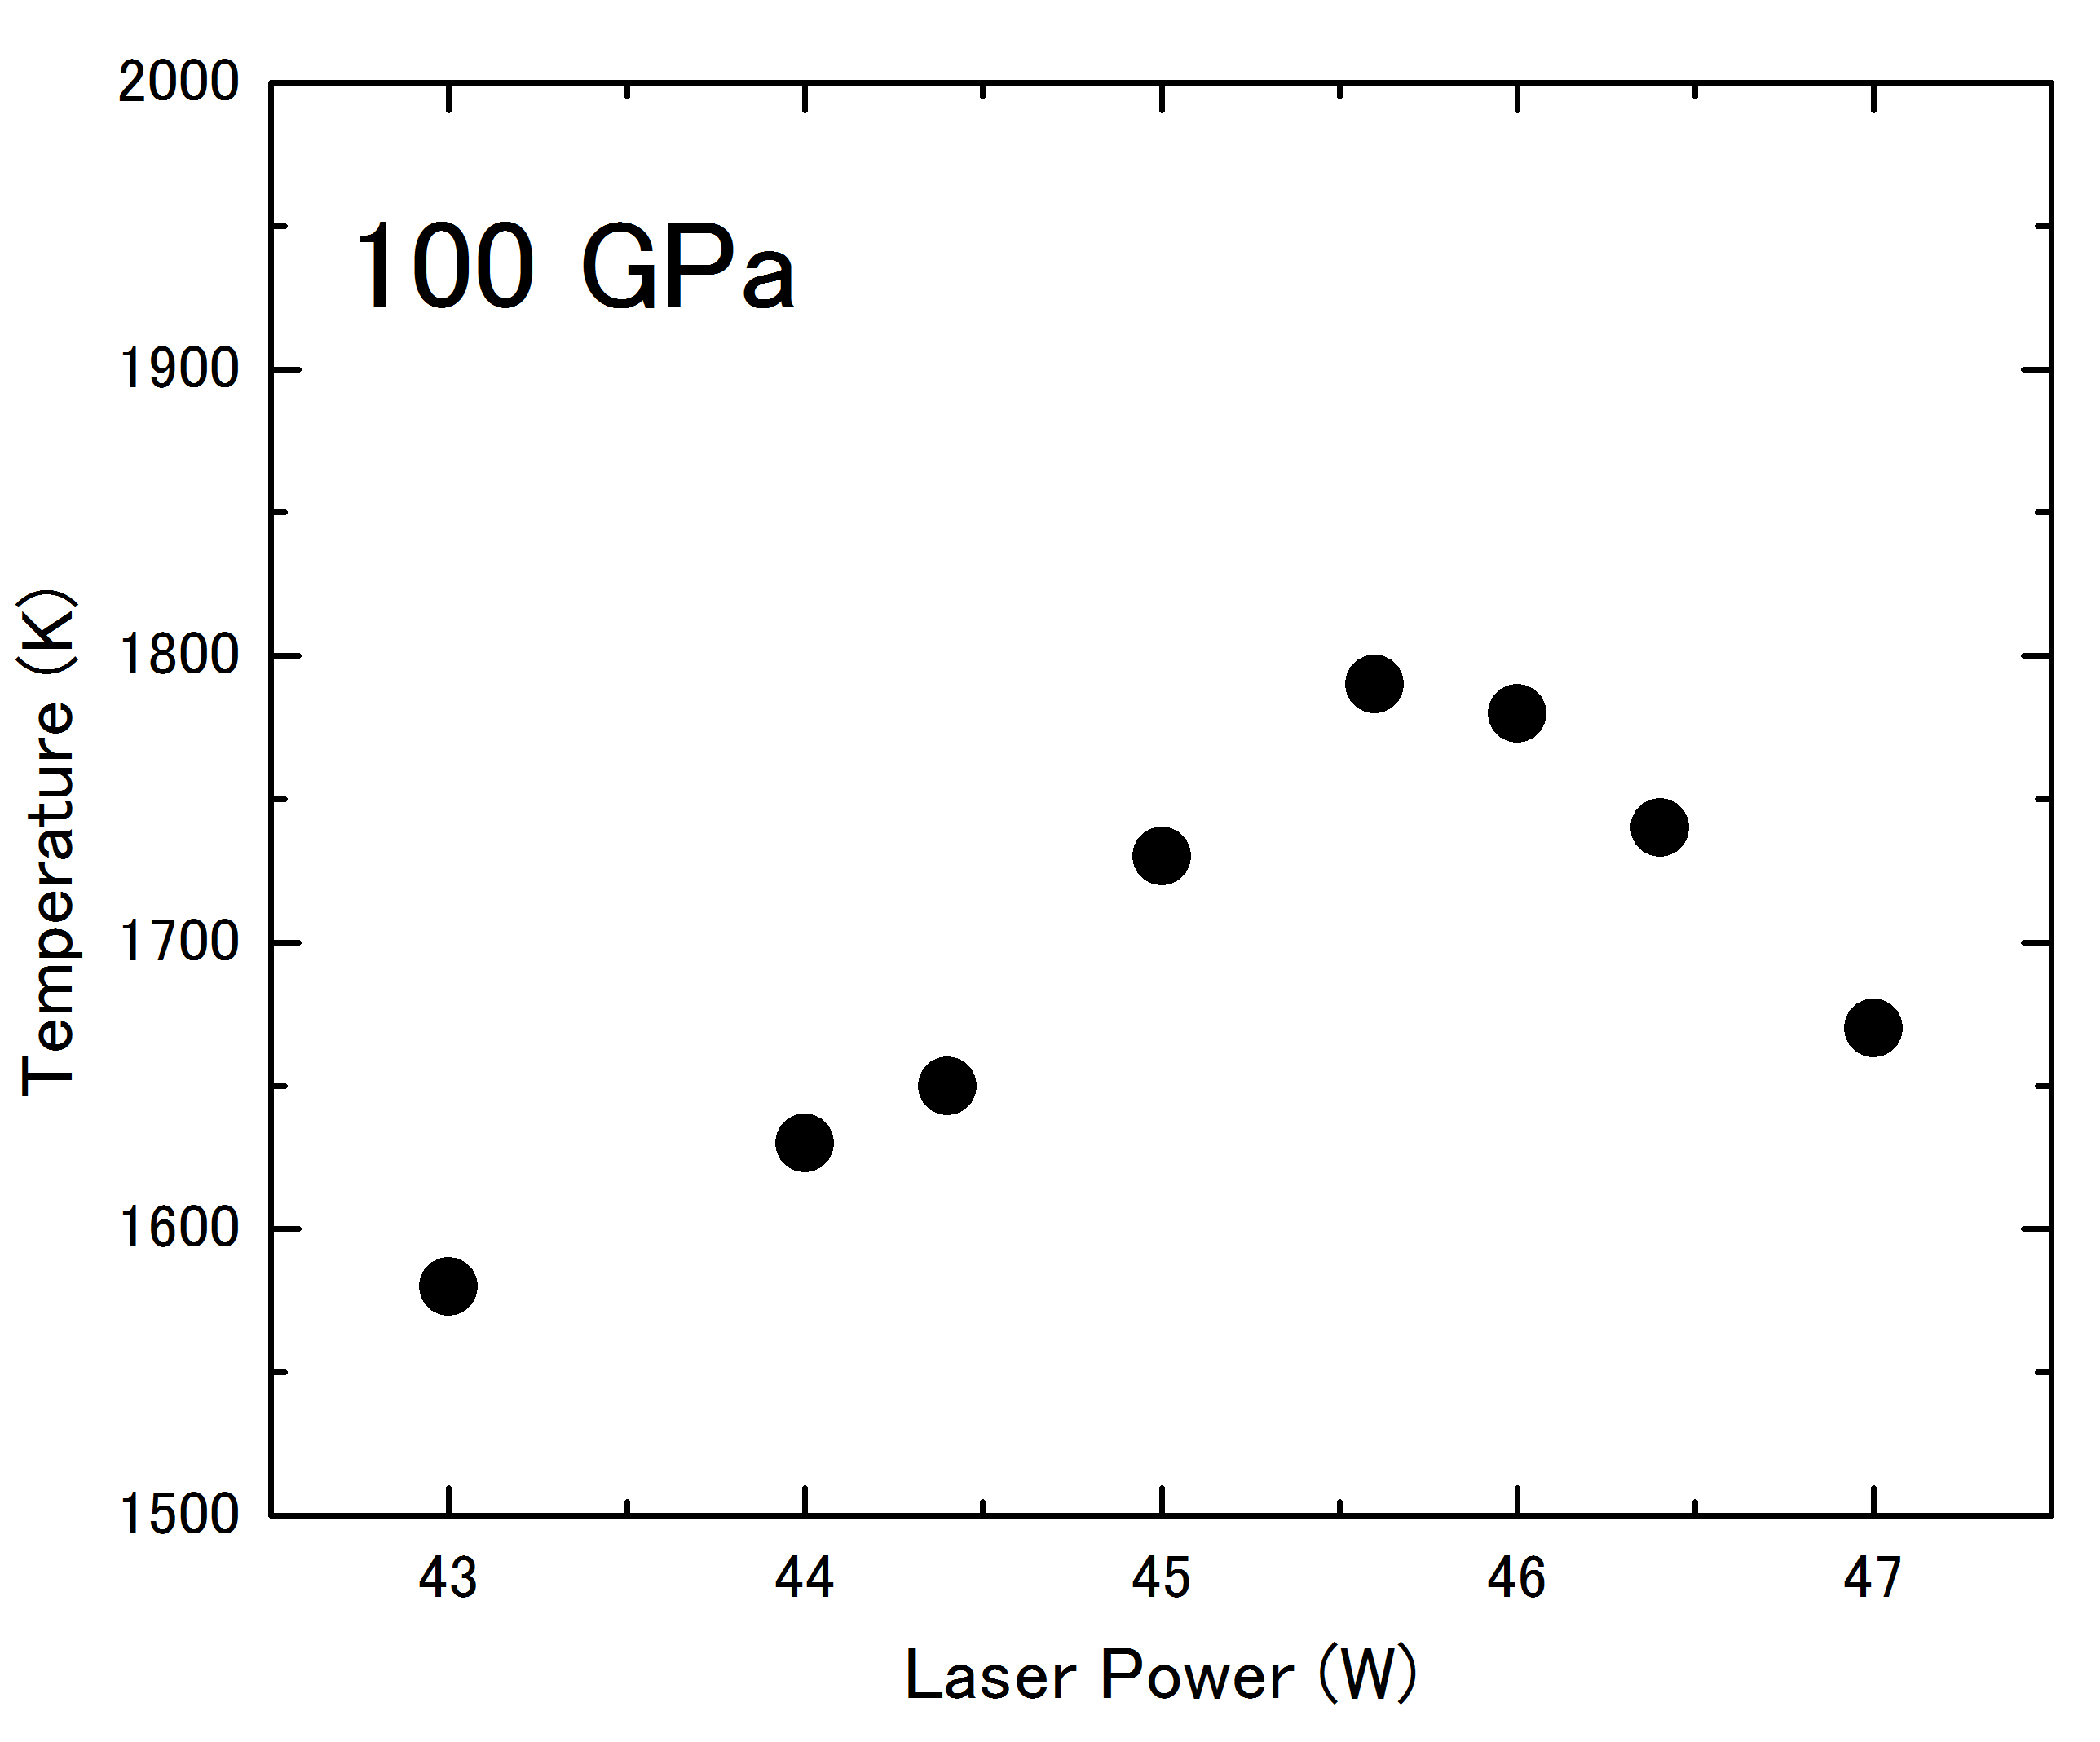
LASER heating
Results
Heating efficiency changes
Catch the metallization of Hydrogen
Ichimaru. K. et al. (2014)

Slide 13
LASER heating
Liquid-metallic hydrogen was observed by LASER heating.
Liquid H₂
Metallic liquid H

Slide 14
Future work
In order to confirm the metallization directly….
Electric resistance measurement
Drop of electric resistance with the metallization
Raman spectroscopy
Loss of vibron of hydrogen with the metallization

Slide 15
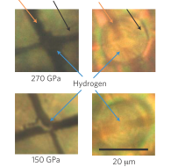
Resistance measurement
Setting
Anvil Culet : φ20 μm
Gasket : Re
Electrodes : Pt
Insulating layer : Alumina+epoxy
M. I. Eremets et al. Nat. Mater., 10, 927-931 (2011)

Slide 16
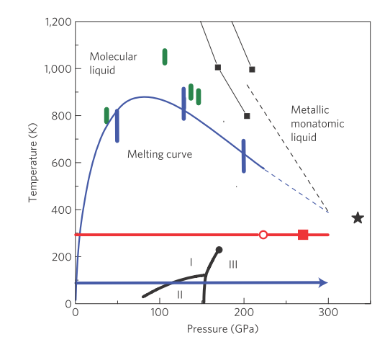
Resistance measurement
Results
Drop of resistance
@R.T.
Metallized?
Observe drop of electrical resistance @ 270 GPa
→ Metallized?
M. I. Eremets et al. Nat. Mater., 10, 927-931 (2011)

Slide 17
Conclusion
Liquid-metallic hydrogen was observed by LASER heating.
Electric resistance measurement is needed to confirm the metallization of hydrogen.
Liquid H₂
Metallic liquid H

