Slide 1
High pressure phase diagram of Beryllium Phys.Rev.B 86,174118(2012)
2014.06.11
Shimizu Lab.
Takuya Yamauchi

Slide 2
Contents
Introduction
Motivation
Supplements
Experiment
Summary
Future work

Slide 3
Superconductivity of beryllium Introduction
Tc: superconducting transition temperature.
※Tc: 超伝導転移温度
Beryllium
Tc=24mK
The value is considerably lower than other light elements.
So Tc may enhance in high pressure?
Fig. Superconducting transition temperature of elements.(under pressure)
What causes?
Ref. HP@SPring8(2011)

Slide 4
Enhancement of Tc Introduction
From BCS theory
Tc ∝
Tc: superconducting transition temperature.
θD: Debye temperature
N: Density of state at the Fermi surface
According to previous presentation...
Applying pressure causes
Structural transition
Electronic states change.
Let’s inspect how the structure of beryllium would change under high pressure!!

Slide 5
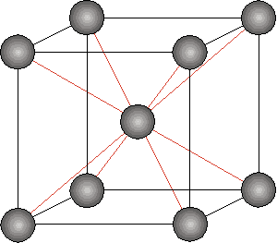
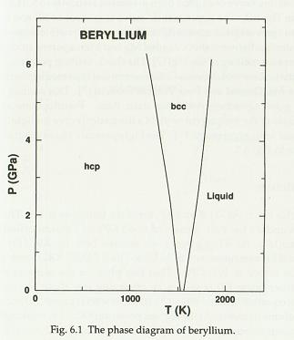
Structure of beryllium Introduction
Beryllium has small c/a ratio.→ 1.568
(Its ideal value of hcp is 1.633 )
heat
pressure
hcp(～1530K)
bcc(1530～1560K)
α-Be(hcp structure) is
stable at ambient temperature and pressure.
β-Be(bcc structure) would be appeared at high temperature and prssure.
Ref. D. A. Young, Phase Diagrams of the Elements (University of California, 1991), P. 79.c

Slide 6
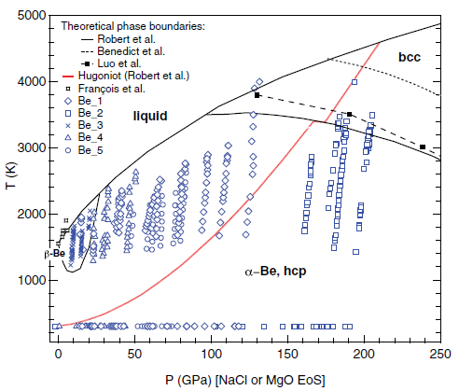
Motivation
Measuring P-V and c/a of Be to high precision.
Confirming the stability field of β-Be predicted at high pressure.

Slide 7
Loading of beryllium supplements
Diamond
300μm
Rhenium
Ruby
Beryllium

Slide 8
Pressure medium supplements
There is a pressure medium.
There is no pressure medium.
Similar to a theoretical situation.
For XRD(X-ray diffraction)
Gas: Helium
Liquid: Mixture of the alcohol.
For electric resistance measurement.
Solid: NaCl
Similar to a real situation.
Pressure intensity
Having medium
No medium
Diamond cullet

Slide 9
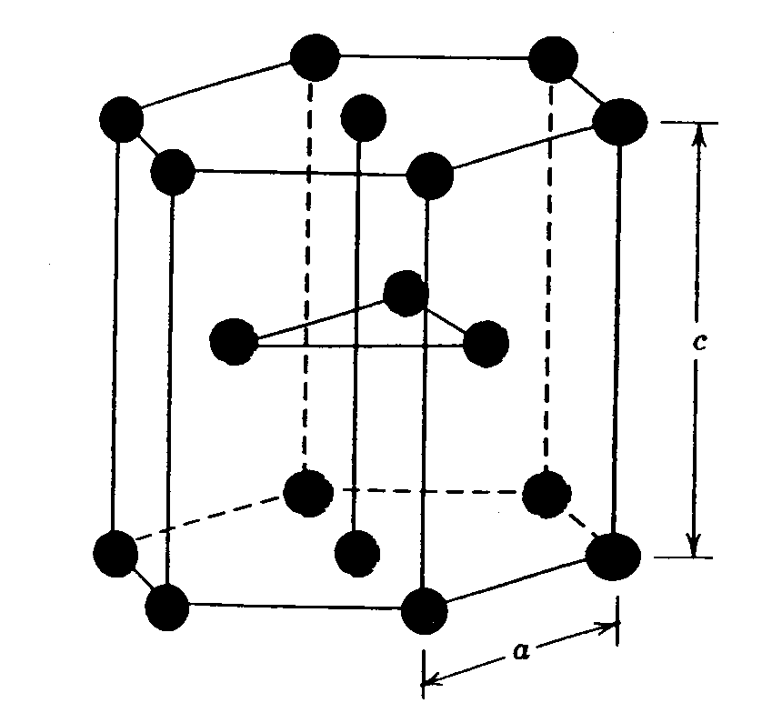
Experimental method supplements
For the accurate measurement of c/a ratio.
Three runs
Sample: Be (purity 99.5%)
Pressure medium: He
Method: single crystal XRD
X-ray diffraction(XRD)
干渉
Waves intensified by interference satisfies the Bragg’s condition is observed
X-ray is diffracted by electron.
Bragg’s condition
2dsinθ=nλ
X-ray
c
Diamond anvil cell
Imaging plate
(検出器)
a

Slide 10
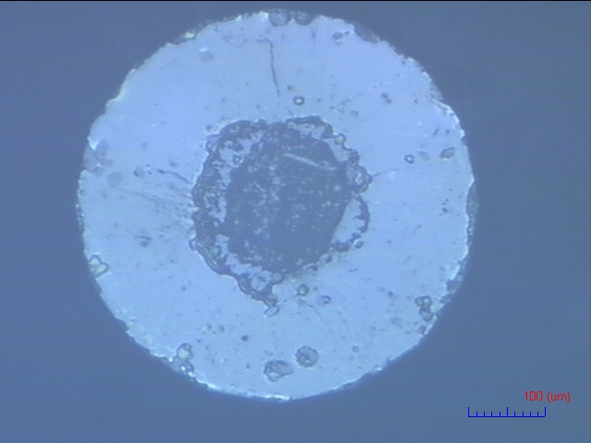
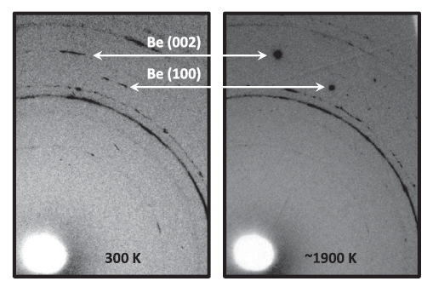
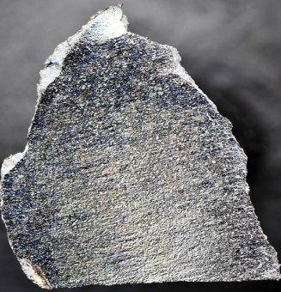
Difficulty of the experiment of Be
300μm
Integrated X-ray diffraction patterns
Hole diameter is 100μm
The peak intensity of Be is weak.
There is low atomic number of Be.
It’s difficult to load Be in diamond- anvil cell.
Be is so hard and toxic.
Sample size is too small.
X-ray diffraction patterns@~40GPa

Slide 11
P-V and c/a of Be Experiment
Beryllium remained hcp up to the maximum pressure.(205GPa)
The scatter of the c/a ratio is smallest for the current data.
Beryllium contained in He or NaCl medium(pressure medium).

Slide 12
Summary
The c/a ratio has been took with the highest precision.
No sign of β-Be has been observed at moderate pressure. The stability field of β-Be would be much narrower than previously thought.

Slide 13
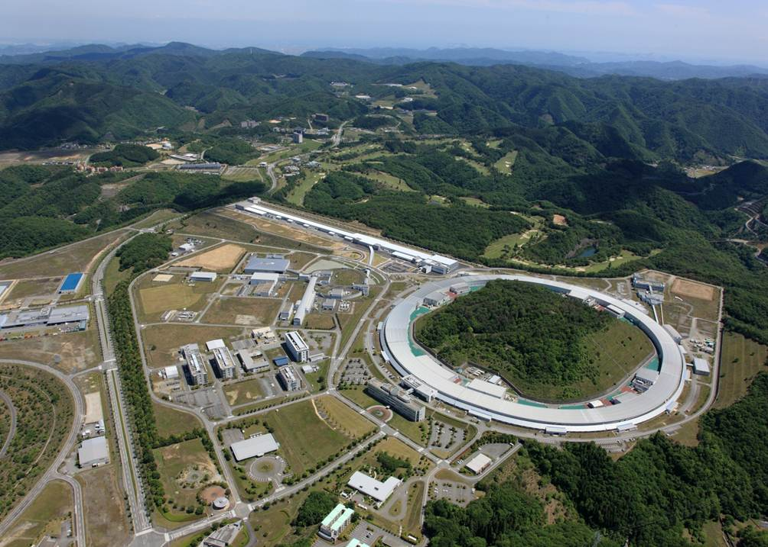
Future work
The enhancement of Tc under high pressure is reported in recent research. According to that the Tc has relation to the drop of c/a ratio.
I will experiment to inspect the c/a ratio of beryllium under high pressure at SPring-8.
Sorry, the data is under analyzing.
I’ll show it you next presentation.
THE END.

