Slide 1
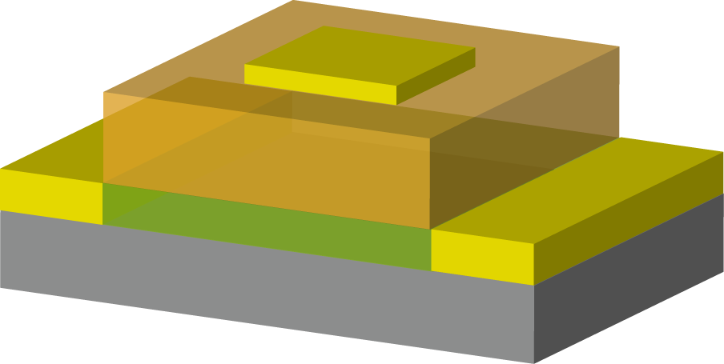
Master Colloquium
Field-effect Control of Insulator-metal Transition Property in Strongly Correlated (La,Pr,Ca)MnO₃ Film
Working as p-type
Electric Double Layer Transistor
Gate
Source
Ion Liquid (IL)
Drain
LPCMO channel
TANAKA LAB.
Takuro Nakamura
1

Slide 2
Metal Insulator Transition (MIT) in 3d Transition Metal Oxide Materials
Strongly correlated electron materials
have strong Coulomb interaction between narrow 3d-orbitals
Electron Crystal
Electron Liquid
External field
Gigantic physical properties changes emerge from electronic phases transition
2

Slide 3
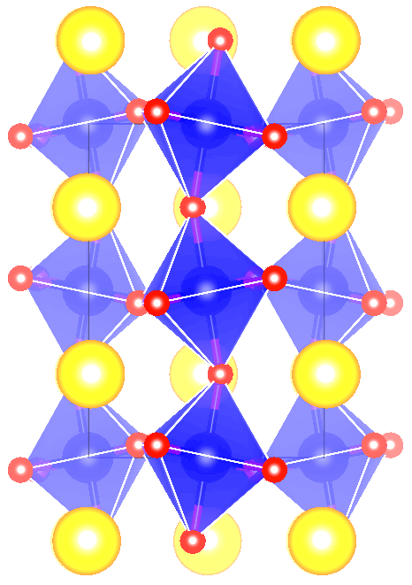
(La_{1-x-y}Pr_{y}Ca_{x})MnO₃
3+
3+
LaMnO₃
Mn³⁺
(d⁴)
Mn³⁺
(d⁴)
Mn³⁺
(d⁴)
Mn³⁺
(d⁴)
La,Pr,Ca
e_{g}
t_{2g}
3+
3+
2+
3+/4+
Mn
(La, Pr, Ca) MnO₃
Mn³⁺
(d⁴)
Mn⁴⁺
(d⁴)
Mn³⁺
(d⁴)
Mn³⁺
(d⁴)
e_{g}
O
Insulator
t_{2g}
Mn³⁺
(d⁴)
Mn⁴⁺
(d⁴)
Mn³⁺
(d⁴)
Mn³⁺
(d⁴)
e_{g}
Metal
t_{2g}
3

Slide 4
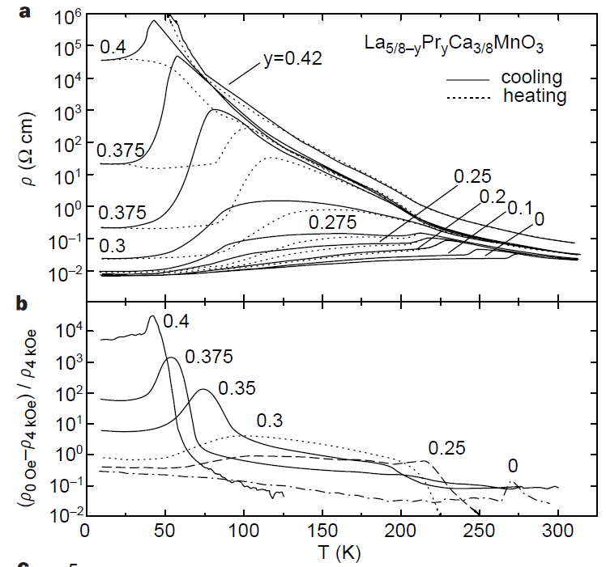
(La_{1-x-y}Pr_{y}Ca_{x})MnO₃
Low T
High T
La,Pr,Ca
0.35
Mn
Nature 399 560 (1999)
O
La_{1-x}Sr_{x}MnO₃
PRB 51, 14103 (1995)
4

Slide 5
Conventional Field-effect-transistor
MISFET
V_{G} = 0
V_{G}
V_{G} > 0
Source
Drain
Gate
Insulator
n⁺
n⁺
I_{D}
Inversion Layer
p-type semiconductor
V_{D}
Strongly correlated materials are different from semiconductor materials
5

Slide 6
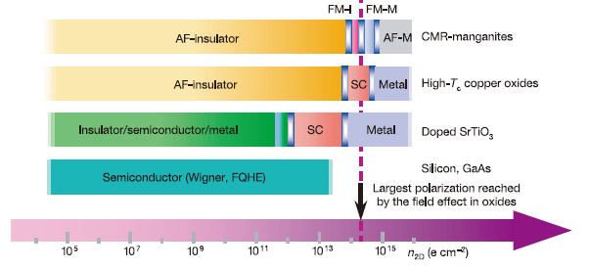
Required Carrier for Electric-field-effect
Nature 4241015 (2003)
Carrier 10¹⁴ – 10¹⁵ cm⁻² is required
6

Slide 7
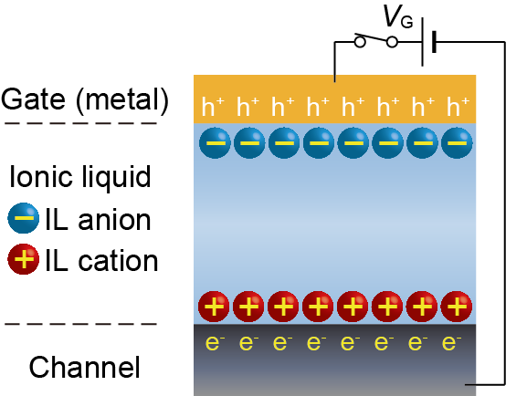
Electric Double Layer Transistor (EDLT)
Carrier doping with ionic liquid gating
Gate
EDL
Ion Liquid (IL)
LPCMO channel
Electric field > 1 MV/cm
Capacitance ~10 μF/cm²
MOTIVATION
Base experiments for realization of electric-field-effect nano-device
*Fabrication of EDLT structure on LPCMO thin film
*Verification of gate control of electronic properties
7

Slide 8
Epitaxial LPCMO thin film
Deposited (La_{0.525}Pr_{0.1}Ca_{0.375})MnO₃ on MgO(001) sub. by pulsed laser deposition method.
ArF excimer laser
(l =193 nm)
Target
Substrate
T_{Sub.} = 700 (ºC), P_{O2} = 30 (Pa)
in-situ annealing T_{Sub.} = 700 (ºC), P_{O2} = 1000 (Pa)
Plume
Thin film
Heater
Out-of-plane XRD
Pluse Laser Deposition
002 MgO
t = 20 nm
040 LPCMO
// [001]_{MgO}
001 MgO
8

Slide 9

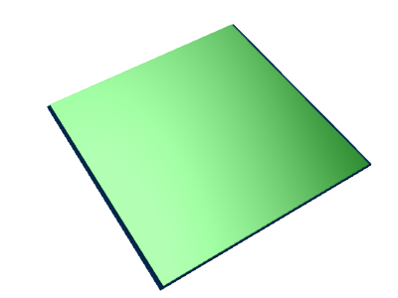
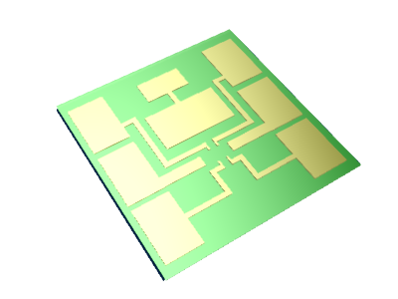
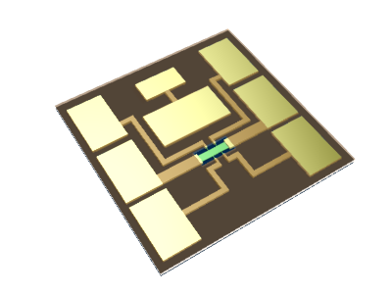
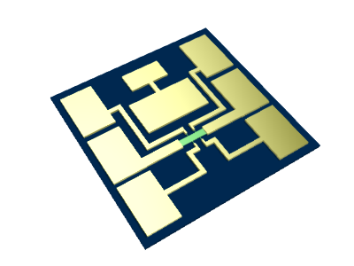
Fabrication Process of LPCMO-channel EDLT
Depositing LPCMO film
Depositing Au/Ni electrode
MgO (001) substrate
Putting ionic liquid
(DEME-TFSI)
Sputtering
SiO₂ seperator
hall-bar structure
9

Slide 10
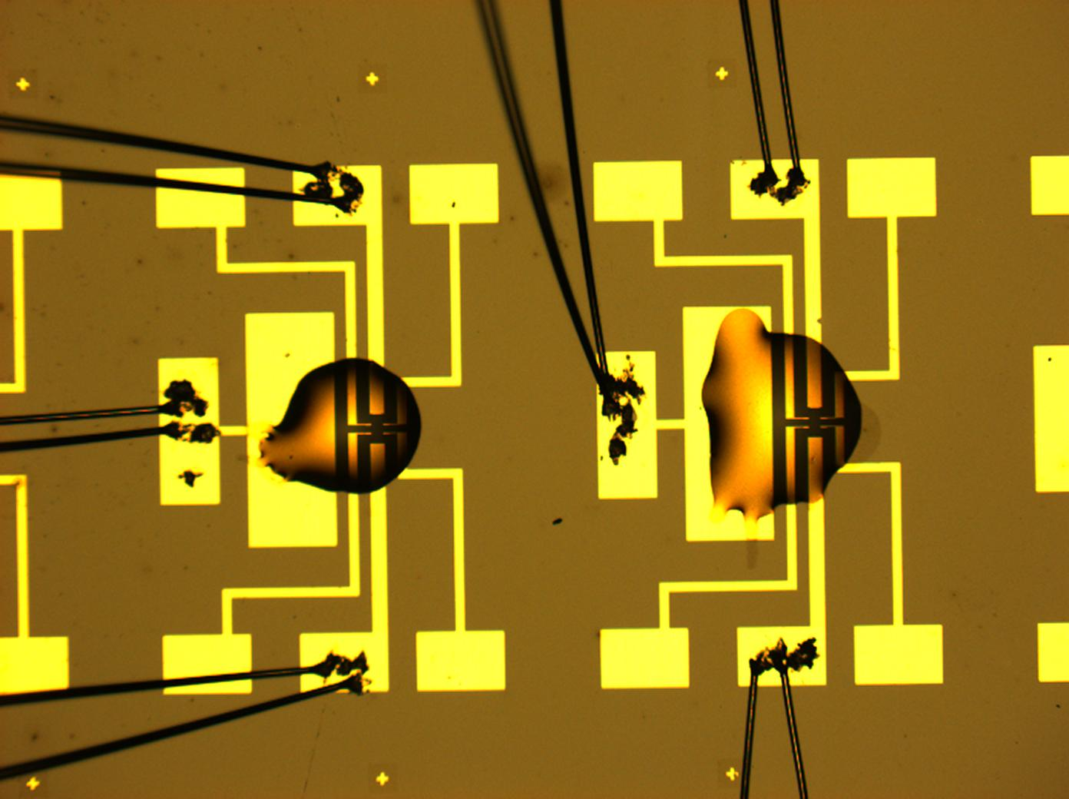
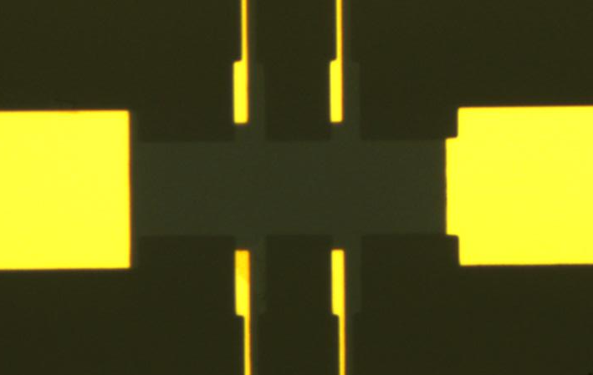
LPCMO-channel EDLT structure
Picture of EDLT
Ionic liquid
DEME-TFSI
Source
Drain
20 μm
LPCMO thin film thickness : ~ 8 nm
200 μm
Gate
V_{ds} = 0.1 V , V_{G} = -3~+3 V applied at 220K
Sweep 220~10 K and measure Resistivity
11

Slide 11

Gate voltage dependence of the transport properties
in LPCMO Thin Film
Mn³⁺
(d⁴)
Mn⁴⁺
(d³)
Mn³⁺
(d⁴)
3+
3+
2+
3+/4+
e_{g}
(La, Pr, Ca) MnO₃
t_{2g}
t = 8 nm
S
D
20 μm
Verified LPCMO thin film work as p-type with Electric-field-effect
11

Slide 12
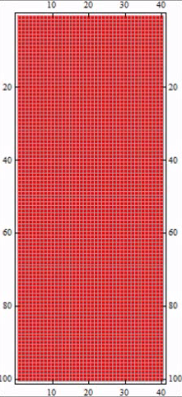
Nano-scale Phase Separation
(La,Pr,Ca)MnO₃ thin film
FMM
COI
T_{MI}
Insulator
Metal
12

Slide 13
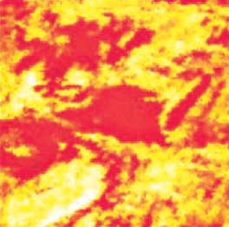
Nano-scale Phase Separation
(La,Pr,Ca)MnO₃ thin film
FMM
COI
Phase separation picture
FMM
T_{MI}
COI
200nm
Science 285, 1540 (1999)
Coexisting FerroMagnetic Metal (FMM)
and Charge Ordered Insulator (COI)
with nano-meters scale
13

Slide 14
Origin of Resistivity Changes with EDL Gating
T ~ T_{MI}
V_{G} ＞ 0 [V] (electron doping)
COI rich
V_{G} = 0 [V]
V_{G} ＜ 0 [V] (hole doping) FMM rich
Metal
Insulator
Tuning volume fraction of metal domain and insulator domain
by electrostatic carrier doping
14

Slide 15
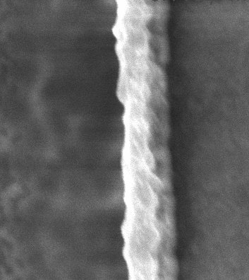
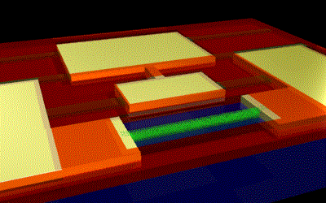
Summary & Future Work
Gate
Ion Liquid (IL)
*I succeed to fabricate EDLT structure
*I verified field-effect resistivity change in LPCMO
Work as p-type
Oxide channel
LPCMO nano-wire
*fabricating EDLT structure
on the LPCMO nano-wire
300nm
MgO
LPCMO
15

