Slide 1
Superconductivity in Bismuth Oxide Compounds
Kitaoka Lab.
Takashi MATSUMURA
Mirza H. K. Rubel Angewandte Chemie International Edition Volume 53, Issue 14
B. A. Baumert Journal of Superconductivity, Vol. 8, No. 1, 1995
H. Matsuura and K. Miyake, J. Phys. Soc. Jpn. 81 (2012) 113705
R. A. Schweinfurth et al., Appl. Phys. Lett. 61 (1992)

Slide 2
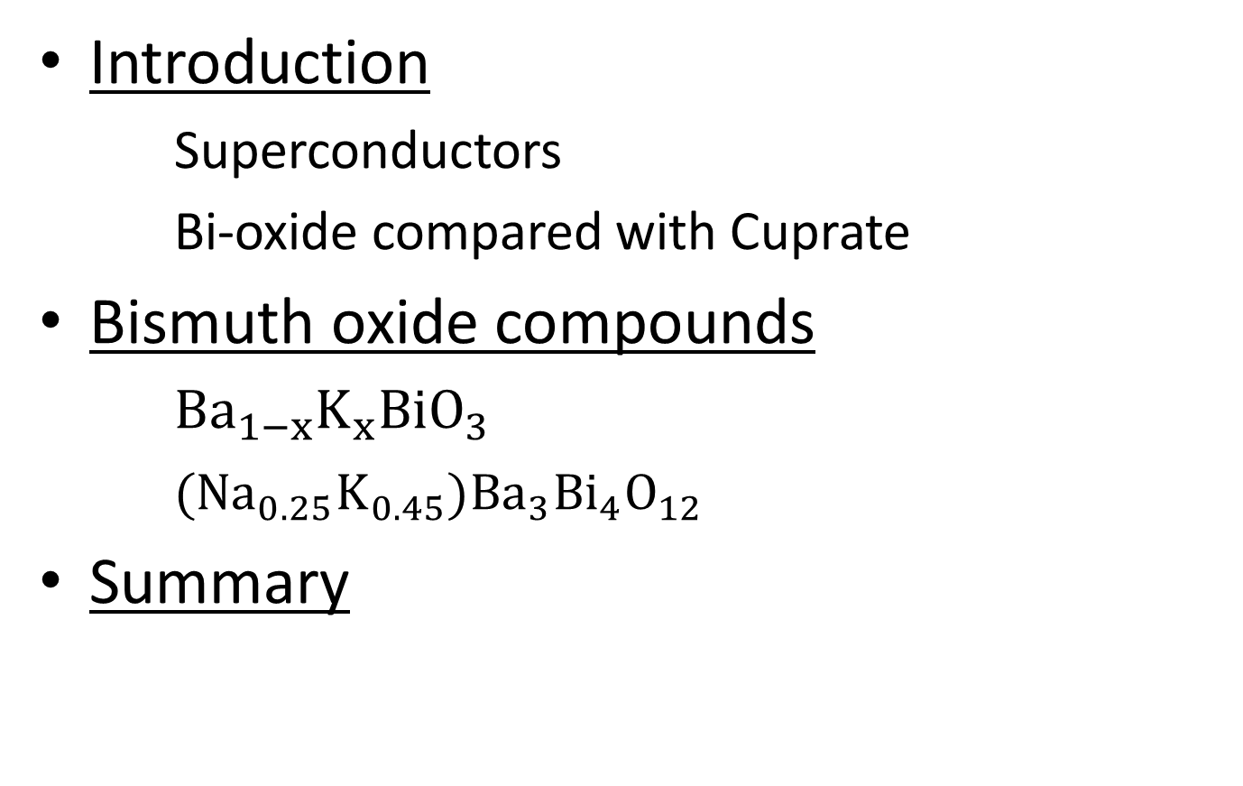
Contents
Introduction
Superconductors
Bi-oxide compared with Cuprate
Bismuth oxide compounds
${Ba}_{1−x}K_{x}BiO_{3}$
$({Na}_{0.25}K_{0.45}){Ba}_{3}{Bi}_{4}O_{12}$
Summary

Slide 3
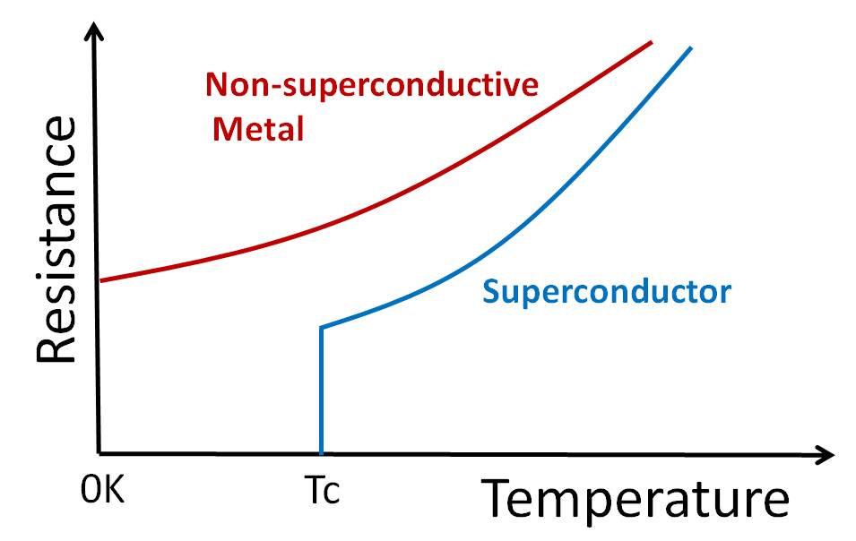
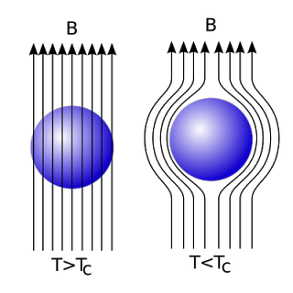
What is Superconductors
Zero resistivity
Perfect diamagnetism
Superconductivity is caused
by formation of an electron pair.
http://allnewscience.blogspot.jp/2010/07/anti-gravity.html
Introduction

Slide 4
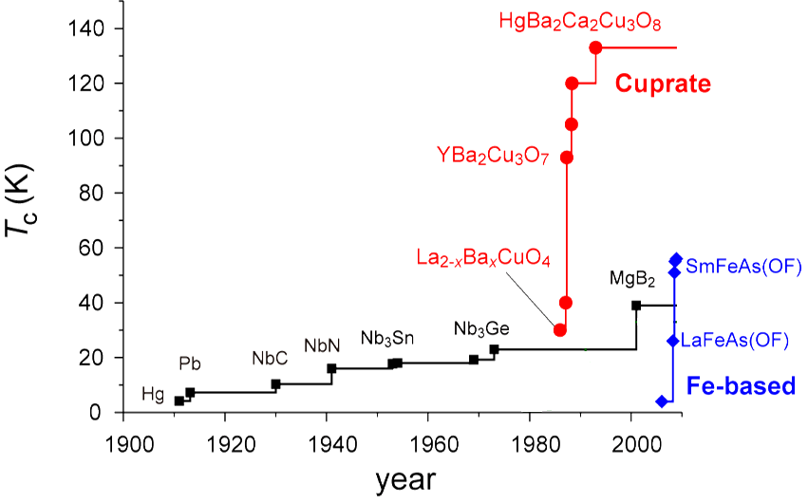
History of Superconductors
1975
T_{c}max~12K
spin
BaPb_{X}Bi_{1-X}O₃
1988
T_{C}max~30K
Spin
+
orbital
Ba_{1-X}K_{X}BiO₃
phonon
Introduction

Slide 5
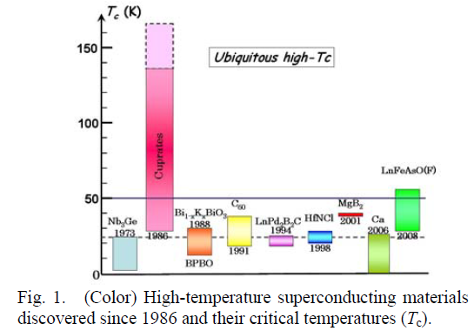
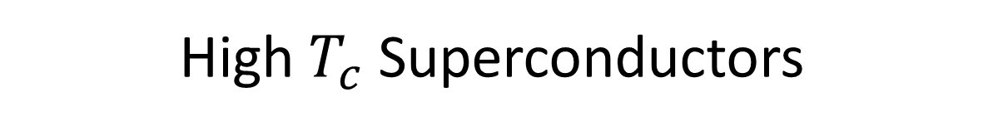
High $T_{c}$ Superconductors
Introduction

Slide 6
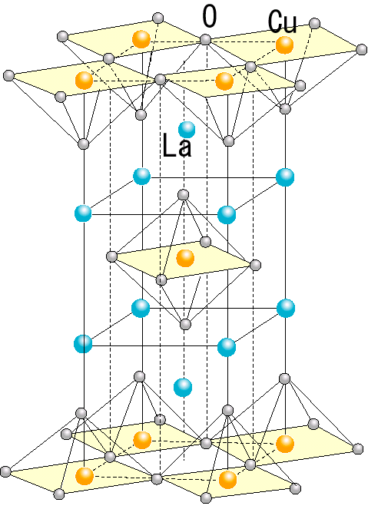

Bi-oxide compared with Cuprate
Bi-oxide
Cuprate
${Ba}_{1−x}K_{x}BiO_{3}$
LaSrCuO
3D
2D
Introduction

Slide 7
Bi-oxide compared with Cuprate
Ｅｎｅｒｇｙ
Ｅｎｅｒｇｙ
?
(6s)?
(3d)⁹
(5d)¹⁰
Bi
Cu
Introduction

Slide 8
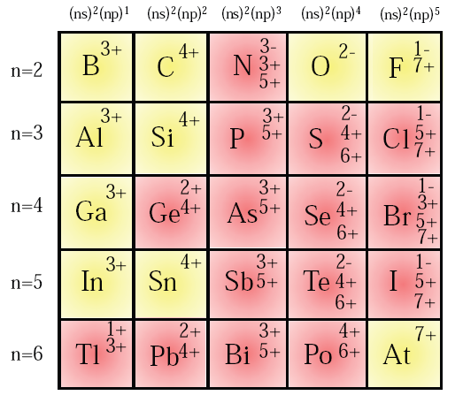



Valence skipping element Bi
Bi³⁺
[Xe](4f)¹⁴(5d)¹⁰
Bi⁴⁺
[Xe](4f)¹⁴(5d)¹⁰
Bi⁵⁺
[Xe](4f)¹⁴(5d)¹⁰
Ｅｎｅｒｇｙ
Bi⁴⁺
(6s)
$$(6{S)}^{1}$$
Bi³⁺
Bi⁵⁺
$$(6{S)}^{2}$$
$$(6{S)}^{0}$$
Introduction

Slide 9






BaBiO₃
$${Ba}^{2+}$$
$${Bi}^{4+}$$
$${Bi}^{3+}$$
/
$${Bi}^{5+}$$
$$O^{2−}×3$$
${Ba}_{1−x}K_{x}BiO_{3}$

Slide 10
BaBiO₃
In one dimension
q
Bi⁵⁺
Bi⁵⁺
Bi⁵⁺
Bi⁵⁺
-2e
Bi³⁺
Bi³⁺
Bi³⁺
Bi³⁺
0e
R
charge density wave(CDW) state
${Ba}_{1−x}K_{x}BiO_{3}$

Slide 11

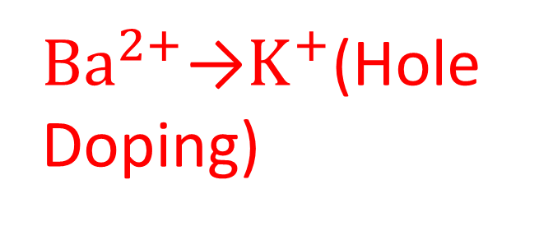
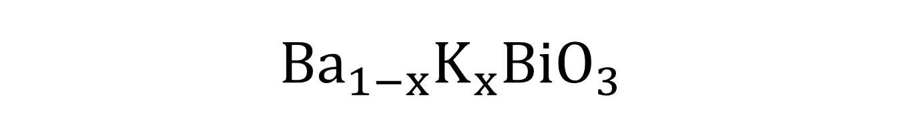
${Ba}_{1−x}K_{x}BiO_{3}$
${Ba}^{2+}$→$K^{+}$(Hole Doping)
Electron number
is reduced
$${Ba}^{2+}→K^{+}×2$$
Bi⁵⁺
Bi³⁺
${Ba}_{1−x}K_{x}BiO_{3}$

Slide 12
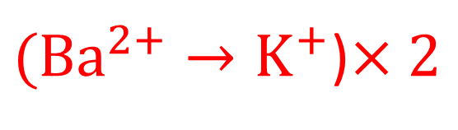
In one dimension
Bi³⁺
Bi⁵⁺
Bi³⁺
Bi⁵⁺
Bi³⁺
Bi⁵⁺
Hole Doping
$({Ba}^{2+}→K^{+}$)$×2$
Bi³⁺
Bi⁵⁺
${Ba}_{1−x}K_{x}BiO_{3}$

Slide 13
In one dimension
Bi⁵⁺
Bi⁵⁺
Bi³⁺
Bi⁵⁺
Bi³⁺
Bi⁵⁺
Hole Doping
$({Ba}^{2+}→K^{+}$)$×2$
Bi³⁺
Bi⁵⁺
${Ba}_{1−x}K_{x}BiO_{3}$

Slide 14
In one dimension
Bi⁵⁺
Bi⁵⁺
Bi³⁺
Bi⁵⁺
Bi⁵⁺
Bi⁵⁺
Hole Doping
$({Ba}^{2+}→K^{+}$)$×2$
Bi³⁺
Bi⁵⁺
${Ba}_{1−x}K_{x}BiO_{3}$

Slide 15
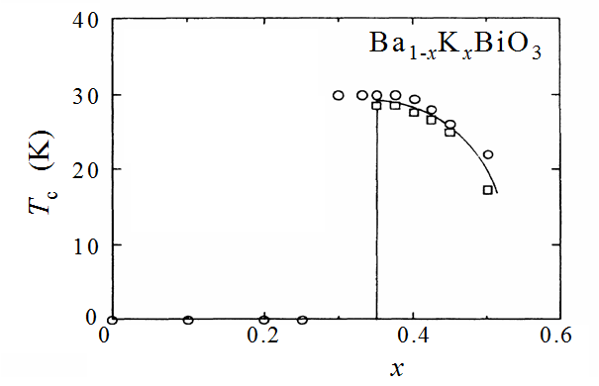
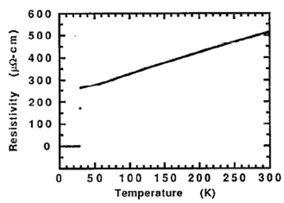
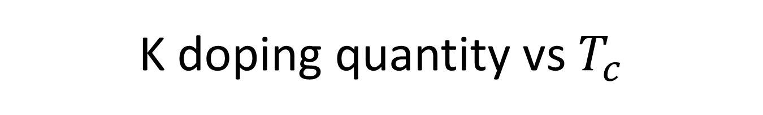
K doping quantity vs $T_{c}$
Superconductivity
${Ba}_{1−x}K_{x}BiO_{3}$

Slide 16
K doping quantity vs $T_{c}$
C
D
W
?
S
C
${Ba}_{1−x}K_{x}BiO_{3}$

Slide 17

Crystal structure
$$({Ba}^{2+}→K^{+})×2$$
Bi⁵⁺
Bi³⁺
${Ba}_{1−x}K_{x}BiO_{3}$

Slide 18
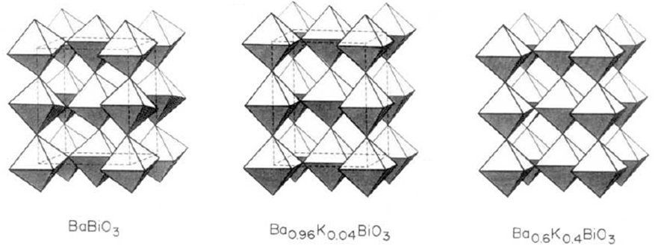
Crystal structure
K concentration X
x=0
x=0.04
x=0.4
${Ba}_{1−x}K_{x}BiO_{3}$

Slide 19
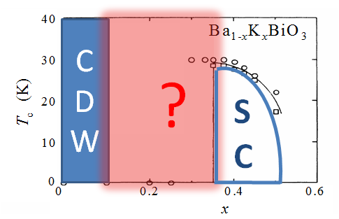
Crystal structure
x=0
x=0.04
x=0.4
${Ba}_{1−x}K_{x}BiO_{3}$

Slide 20
After doping
Bi⁵⁺
Bi⁵⁺
Bi³⁺
Bi⁵⁺
Bi⁵⁺
Bi⁵⁺
${Ba}_{1−x}K_{x}BiO_{3}$

Slide 21
After doping
Bi⁵⁺
Bi⁵⁺
Bi³⁺
Bi⁵⁺
Bi⁵⁺
Bi⁵⁺
${Ba}_{1−x}K_{x}BiO_{3}$

Slide 22
After doping
Bi⁵⁺
Bi³⁺
Bi⁵⁺
Bi⁵⁺
Bi⁵⁺
Bi⁵⁺
${Ba}_{1−x}K_{x}BiO_{3}$

Slide 23
After doping
Bi³⁺
Bi⁵⁺
Bi⁵⁺
Bi⁵⁺
Bi⁵⁺
Bi⁵⁺
${Ba}_{1−x}K_{x}BiO_{3}$

Slide 24
Over doping
Bi⁵⁺
Bi⁵⁺
Bi⁵⁺
Bi⁵⁺
Bi⁵⁺
Bi⁵⁺
No electron
Cannot be superconductor
${Ba}_{1−x}K_{x}BiO_{3}$

Slide 25
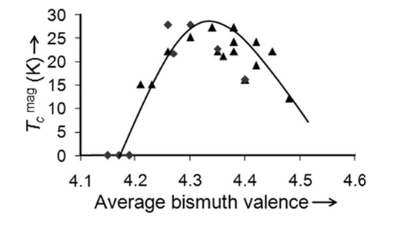
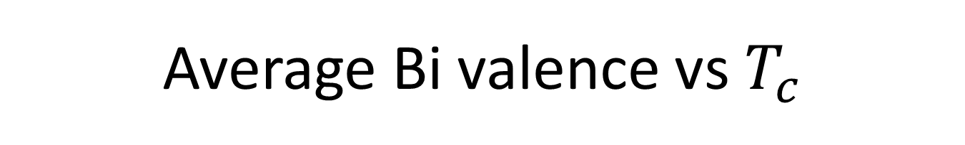
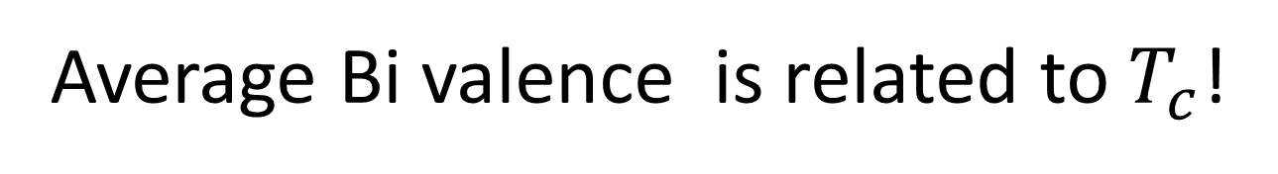
Average Bi valence vs $T_{c}$
Average Bi valence is related to $T_{c}$!
${Ba}_{1−x}K_{x}BiO_{3}$

Slide 26
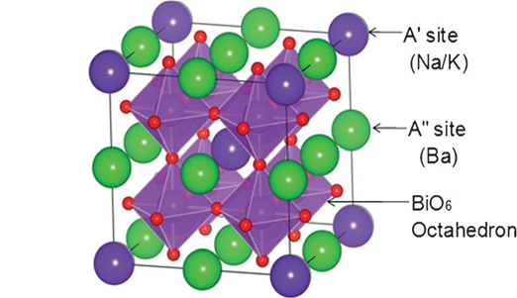

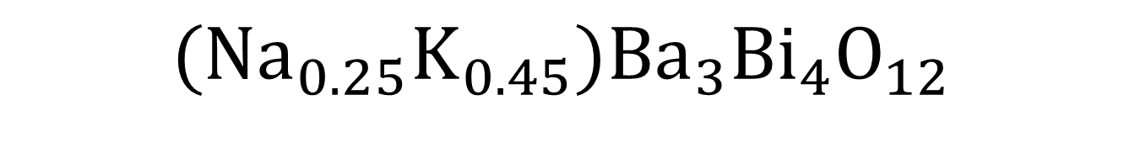



$$({Na}_{0.25}K_{0.45}){Ba}_{3}{Bi}_{4}O_{12}$$
$$BaBiO_{3}$$
$${Ba}_{4}{Bi}_{4}O_{12}$$
$$({Na}_{0.25}K_{0.45}){Ba}_{3}{Bi}_{4}O_{12}$$
Double Perovskite structure
$$({Na}_{0.25}K_{0.45}){Ba}_{3}{Bi}_{4}O_{12}$$

Slide 27
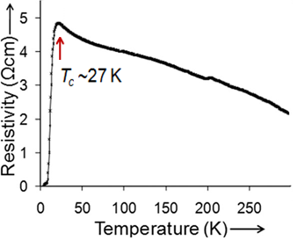
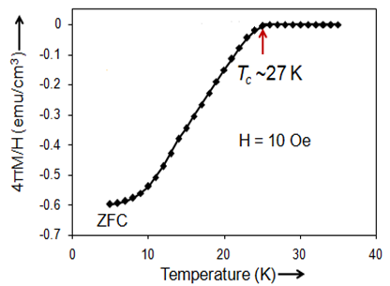
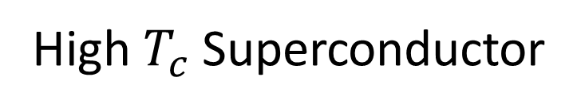
$$({Na}_{0.25}K_{0.45}){Ba}_{3}{Bi}_{4}O_{12}$$
High $T_{c}$ Superconductor
$$({Na}_{0.25}K_{0.45}){Ba}_{3}{Bi}_{4}O_{12}$$

Slide 28
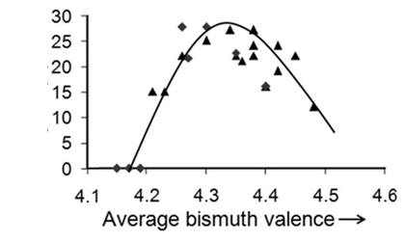
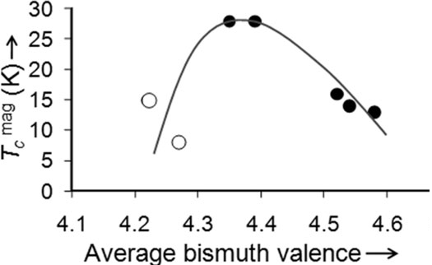

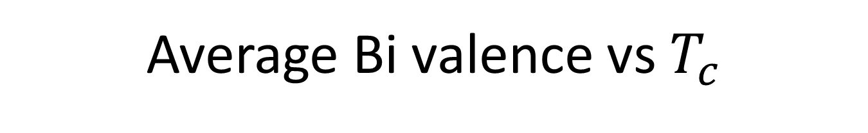
Average Bi valence vs $T_{c}$
(BKBO)
Similar Behavior!!
$$({Na}_{0.25}K_{0.45}){Ba}_{3}{Bi}_{4}O_{12}$$

Slide 29
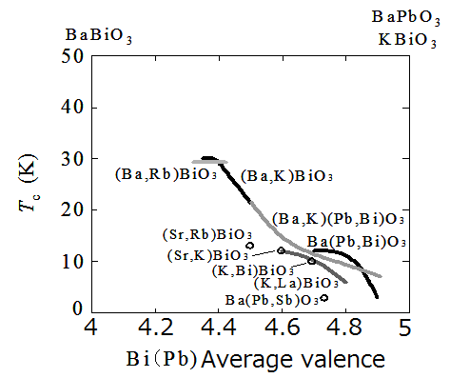
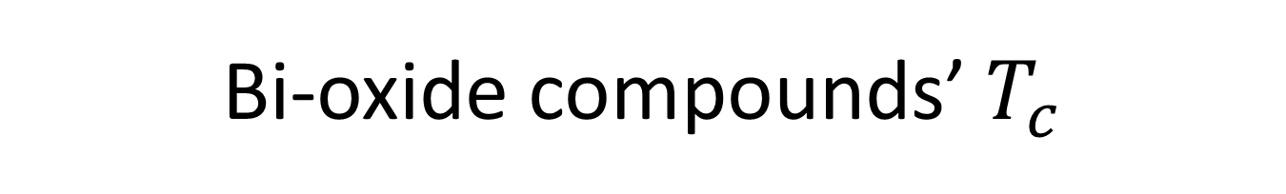
Bi-oxide compounds’ $T_{c}$

Slide 30
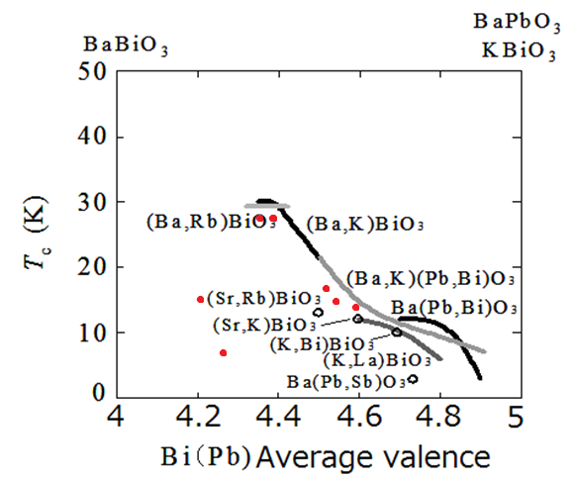

Bi-oxide compounds’ $T_{c}$
$$({Na}_{0.25}K_{0.45}){Ba}_{3}{Bi}_{4}O_{12}$$
CDW

Slide 31
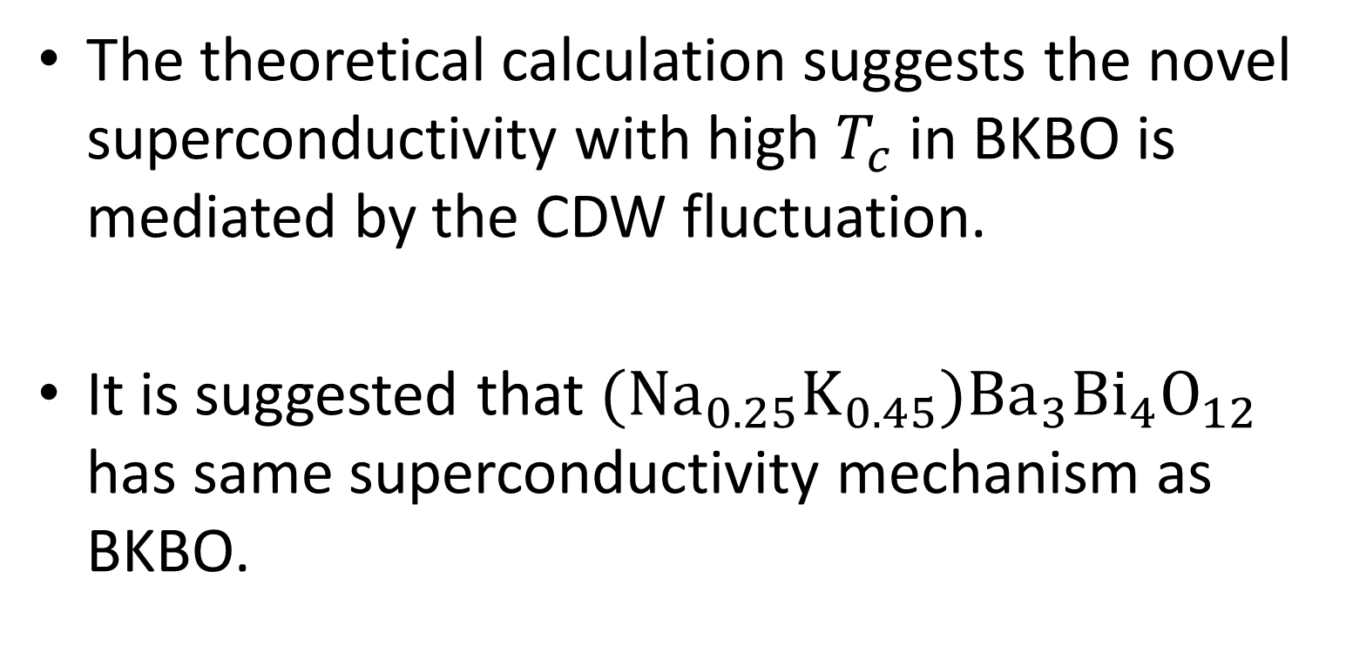
Summary
The theoretical calculation suggests the novel superconductivity with high $T_{c}$ in BKBO is mediated by the CDW fluctuation.
It is suggested that $({Na}_{0.25}K_{0.45}){Ba}_{3}{Bi}_{4}O_{12}$ has same superconductivity mechanism as BKBO.

