Slide 1
Fiber-coupled microsphere laser
Ashida lab M1 toyota
M. Cai, O.Painter, K. J. Vahala, Opt. Lett. 25, 1430 (2000).

Slide 2
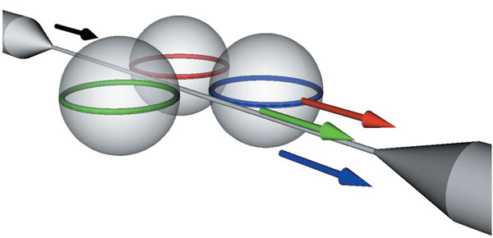
Image

Slide 3
Contents
Introduction
・Laser
・Microsphere resonator
・Mode number
・WGM spectra
・Coupling (fiber-taper , microsphere)
Sample
Results
・Photoluminescence spectra
・Laser power
・Bisphere system
Summary

Slide 4
Laser
Laser medium
Cavity (resonator)
E
E
hν
Population inversion
Stimulated emission

Slide 5
Resonator
Mode volume
Q-factor
large (high)
reflection loss
small (low)

Slide 6
Microsphere resonator
Whispering gallery modes !!
Geometric optics
Wave optics
High Q-factor despite small mode volume

Slide 7
Whispering gallery modes
Mode number n,m,l
Fundamental WGM → n = 1
half wavelength
l = 4
l = 3

Slide 8
Whispering gallery modes
m = 0
m = l － 2
m = l
m = l
m = l － 2
m = 0

Slide 9
Spectra
l = 2
intensity
sphere
$${FSR}_{l}$$
l = 3
l = 2
l = 3
l = 4
Wavelength
intensity
$${FSR}_{m}$$
Oblate sphere
l = 4
Wavelength

Slide 10
Coupling (fiber-taper , microsphere)
Resonance of Evanescent light
Total reflection

Slide 11
Sample
E
coupling
Phosphate glass
・Yb 20 %
・Er 0.5 %
Transformation temperature
・450 ℃
Refractive index
・1.521 (at 1.5 μm)
$$I_{11/2}$$
$$F_{5/2}$$
Non-radiative
decay
Absorption
976±5 nm
α = 4~5${ cm}^{−1}$
$$I_{13/2}$$
1.5 μm
$$I_{15/2}$$
$$F_{7/2}$$
$${Er}^{3+}$$
$${Yb}^{3+}$$

Slide 12
Set up
pump wave
spectrometer
microsphere resonator

Slide 13
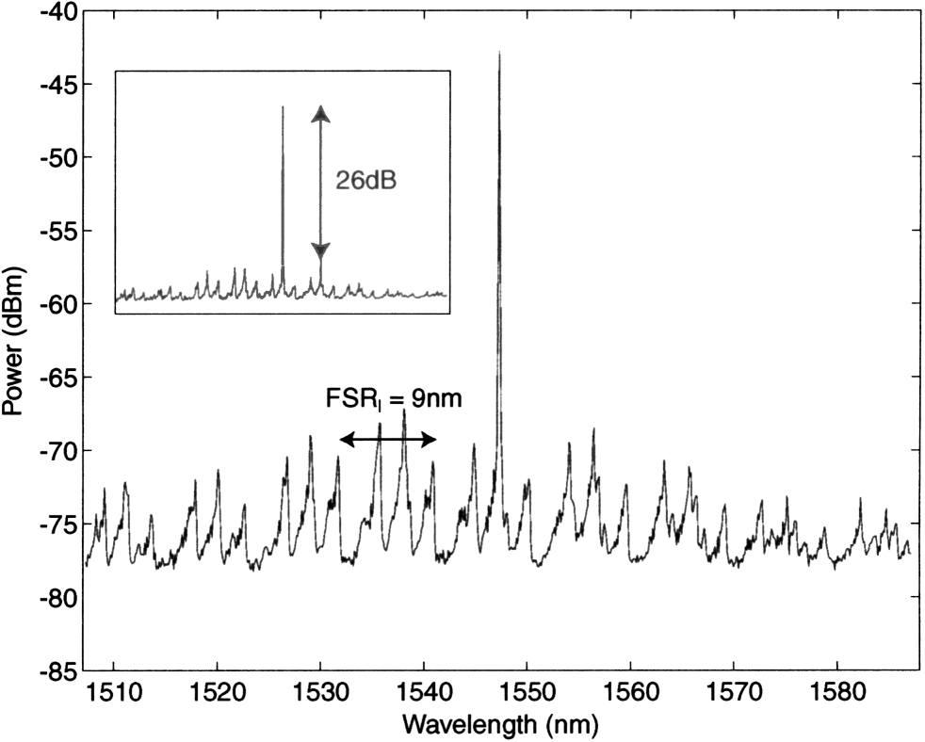
Photoluminescence spectra
Main
Absorbed pump power
≈120 μW
Output laser power
≈1 μW
Inset
Absorbed pump power
≈200 μW
Output laser power
≈2.6 μW
Pump wave
…980 nm
Sphere
…57 μm
Taper
…1.75 μm

Slide 14
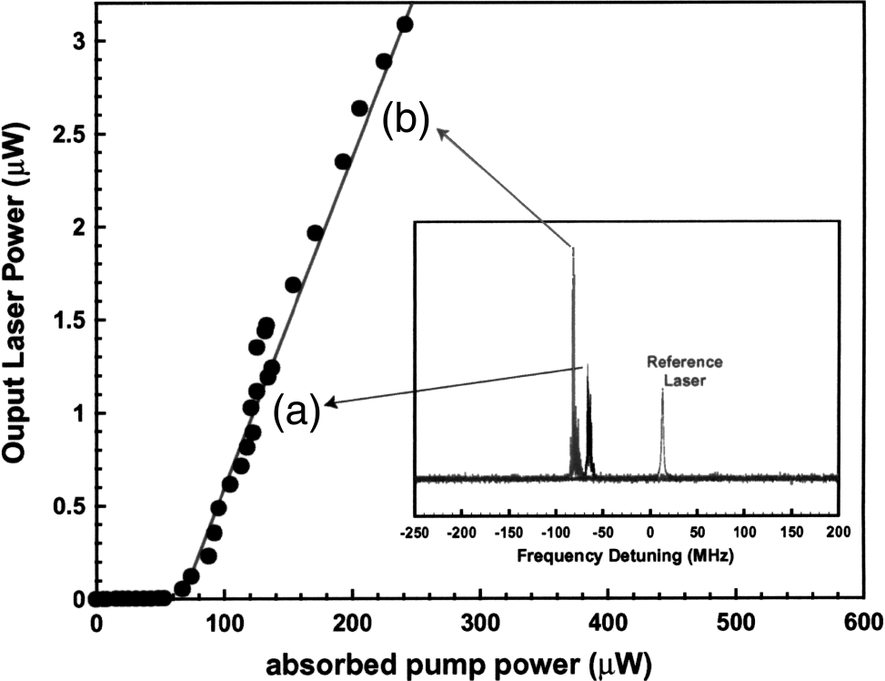
Laser power
Lasing threshold = 60 μW

Slide 15
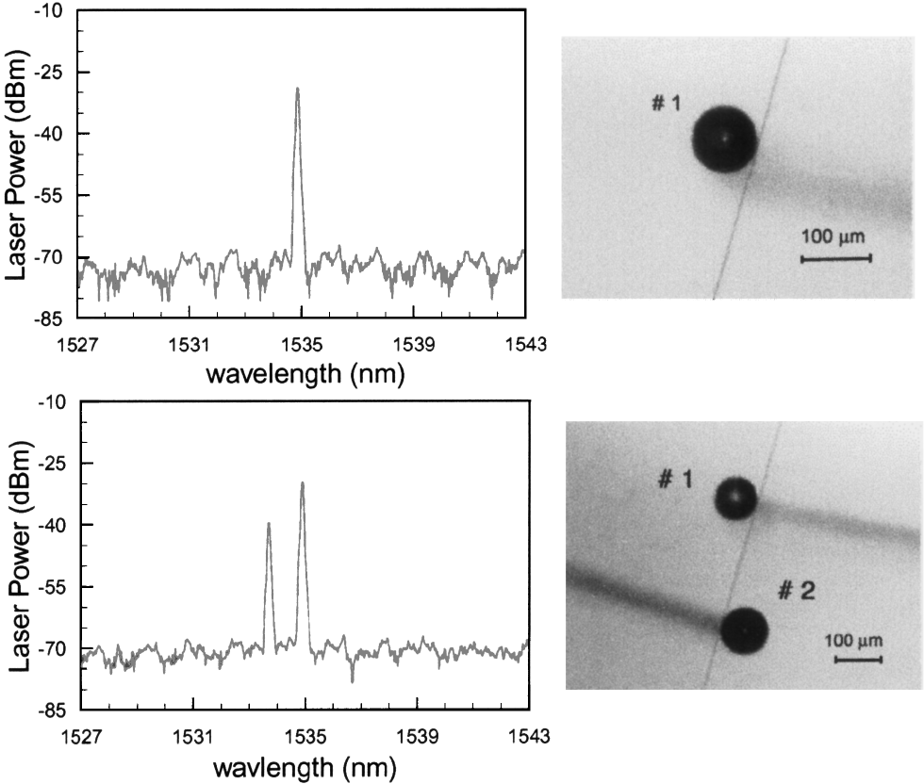
Bisphere system

Slide 16
Summary
Fiber-coupled microsphere laser
Single sphere
・lasing threshold is estimated at 60 μW
・single mode …. Max 3 μW
Bisphere
・first laser …. 1535 nm
・second laser …. 1533 nm

Slide 17
Future plan

Slide 18
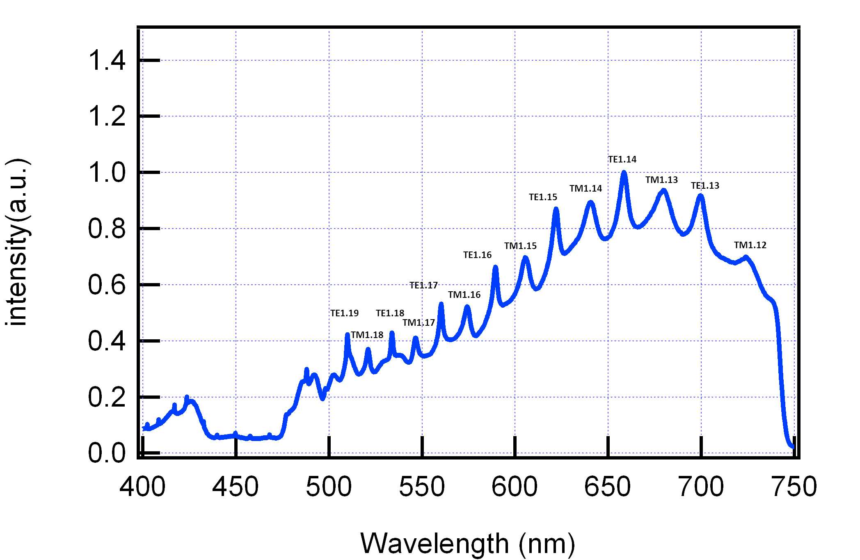
WGM spectra
Leinonen, J., Python code for calculating Mie scattering from single- and dual-layered spheres. Available at http://code.google.com/p/pymiecoated/.

Slide 19
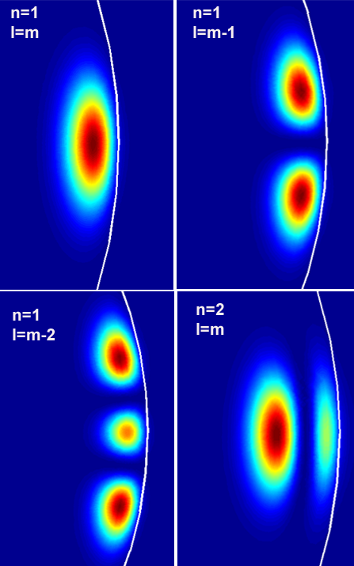
Mode number
About mode number l,m,n
z
Zoom in
l
n
y
m
x
Tobias Jan August Kippenberg, Nonlinear Optics in Ultra-high-Q
Whispering-Gallery Optical Microcavities, Ph.D. thesis, California Institute of Technology,(2004).

Slide 20
l = 4
n = 1
n = 2

Slide 21
Fabry-Perot filter
θ
t_{op}
mλ＝2 t_{op} cosθ

