Slide 1
Ultrabroadband spectroscopy in photo-excited semiconductors
[1]Masaya Nagai, Makoto Kuwata-Gonokami.
Journal of Luminescence 100 (2002) 233-242
Tomohide Morimoto ,ashida lab.

Slide 2
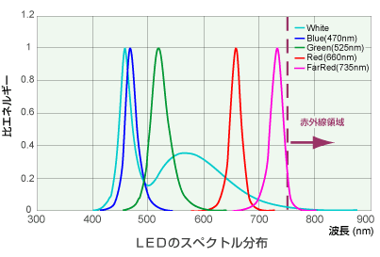
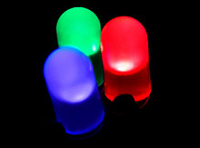
Luminescence in photo-excited semiconductors
Semiconductor emission devise is important for present photonics
Wikipedia LED
http://www.ccsinc.co.jp
Even now, the spectral analysis of the emission is not established
Many-body effects for e-h pairs
Strong Coulomb interaction in wide-gap semiconductors

Slide 3
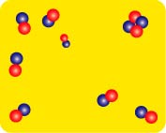
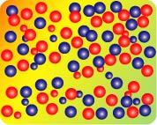
exciton, biexciton, and e-h plasma in semiconductors
insulator
metallic
exciton, biexciton
electron-hole plasma
e-h density
e-h pair is analogous to hydrogen atom
Ex. hydrogen atom, hydrogen molecule, plasma
(solid) , gas, liquid

Slide 4
Many-body effects for e-h plasma(1)
Screening of Coulomb potential causes Bandgap shrinkage
∝
e
−
κ
r
/
r
V
(
r
)
r
0
∝
1
/
r

Slide 5
Many-body effects for e-h plasma(2)
μ_{e}
μ_{h}
+
μ_{e}
E’_{g}
μ_{h}
hν
E’_{g}
hν
k
In the emission processes of e-h pairs, it is not clear whether k-conservation rules can be applied.

Slide 6
Interband transition and intraband motion
Interband transition
M
e
t
a
l
l
i
c
I
n
s
u
l
a
t
o
r
E
m
i
s
s
i
o
n
Strong Coulomb interaction
Spectral overlap
Photon mediated effects
y
t
1
i
v
i
t
c
e
x
c
i
t
e
o
n
l
p
h
o
n
o
n
f
e
R
b
a
n
d
g
0
a
p
f
ω
a
r
-
I
R
m
i
d
-
I
R
n
e
a
r
-
I
R
V
i
s
.
U
V
Changes of ε at low energy side is
caused by intra-band free carrier motion.

Slide 7
Plasma reflection
Energy(eV)
R
ω<ω_{p}
ε<0 → R~1
ω
wavelength(µm)
Simple assumption of uniform plasma
distribution can explain this.

Slide 8
Example: CuCl e-h system
CuCl I-VII compound semiconductor
Eg=3.395 eV
Large exciton binding energy, Eex=213 meV
Stable biexciton

Slide 9
Time-integrated emission spectrum
+
-
+
-
+
-
emission
ω
What’s this?
+
+
-
emission
-
+
-
+
+
-
-
+
-
-
-
+
+
ω

Slide 10
Time-resolved emission spectrum
Continuous change of EHP emission
to Stable EHP or biexciton ?
10ps
3ps
15ps
390
395
400
405
Notes:
先に左下の説明

Slide 11
Transient reflectivity in mid-IR region
Increase of reflectivity shows ionization of e-h pairs
Simple assumption of uniform plasma distribution cannot explain this

Slide 12
Spatially condensed plasma
p
l
a
s
m
a
m
e
t
a
l
l
i
c
c
o
l
l
o
i
d
Energy (eV)
0.1
1
6
2
3
4
5
6
7
8
9
1.0
5
CuCl 8K
1 ps
383nm ex.
0.8
4
3
5 ps
0.6
1
R
0
2
R
/
0.4
y
R
0
t
Δ
10 ps
+
i
1
4.1 mJ/cm
2
Δ
v
i
t
0.2
R
c
0
e
l
20 ps
f
e
R
-1
0.0
1
0.9 mJ/cm
2
0
ω
0.2
P
0
Metallic colloid is formed
-1
0.0
10
9
8
7
6
5
4
3
2
1
Wavelength (µm)

Slide 13
Summary
In addition to the emission spectra, this paper measure transient reflection in mid-infrared after the intense ultrashort pulse excitation in CuCl to get the complementary information for the interpretation of the luminescence
In results, this paper conclude that unknown emission called X-band is attributed to metallic colloid.

Slide 14
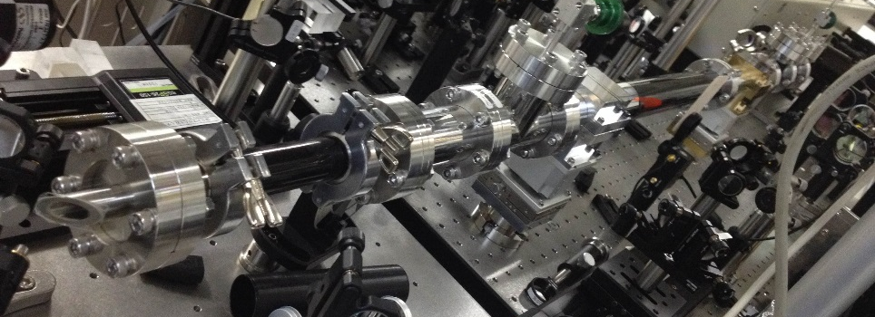
My work
THz-time-domain-spectroscopy
＋
Broadband coherent detection
Ultrashort pulse by hollow fiber
y
t
1
i
v
i
t
c
e
x
c
i
t
e
o
n
l
p
h
o
n
o
n
f
e
R
b
a
n
d
g
0
a
p
f
ω
a
r
-
I
R
m
i
d
-
I
R
n
e
a
r
-
I
R
V
i
s
.
U
V

Slide 15
ε
−
ε
(
)
ε
−
ε
0
f
M
e
f
f
+
1
−
f
b
e
f
f
=
M
2
ε
+
ε
M
2
ε
+
ε
M
e
f
f
b
e
f
f
f
<
<
1
metallic colloid
M

