Slide 1
Defect physics of CuFeS₂ chalcopyrite semiconductor
Yoshida Lab.
Satoshi Ikemoto
2014.10.1

Slide 2
Contents
Introduction
-Semiconductor spintronics
-Dilute magnetic semiconductors
-First principles calculation
Previous work
Results
-DOS (AFM and FM states)
-Formation energy
Summary & Future works
Notes:
----- 会議メモ (2014/09/29 14:45) -----
principles

Slide 3
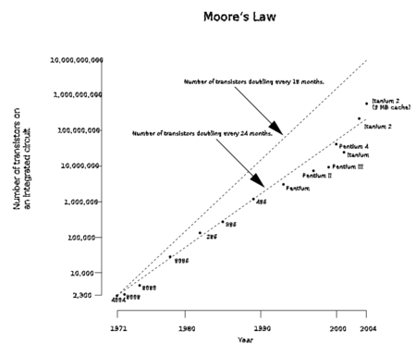
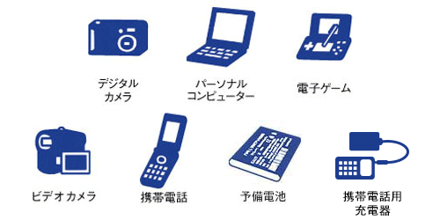
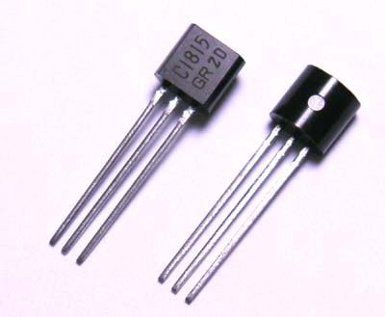
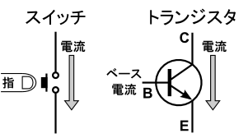
Semiconductor spintronics
Electronic devices
Moore’s law
Number of transistors
on an integrated circuit
Number of transistors doubling every 18 months
Number of transistors doubling every 24 months
1971
1980
1990
2000
2004
transistor
Year
switch
A
According to Moore’s law, we will face
the limitation of the miniaturization in
about 2020, because the scale of
the transistor reaches an atomic level.
So, we need transistors with new mechanisms.
Base
current
=
B
transistors
C
Notes:
現状のシリコンデバイスでは，集積化に伴う素子の消費電力増大，微細化の物理的限界，特性ばらつきの増大等が喫緊の課題となっている。
----- 会議メモ (2014/09/29 14:45) -----
グラフの説明、微細化が弁士レベルになっていて
will go baankrupt
is predicted to be bankrupt
グラフをおおきくしたほうがいい
題名をmoore's law will 破綻
transistor with new mechanism.
new desghin of transistor

Slide 4

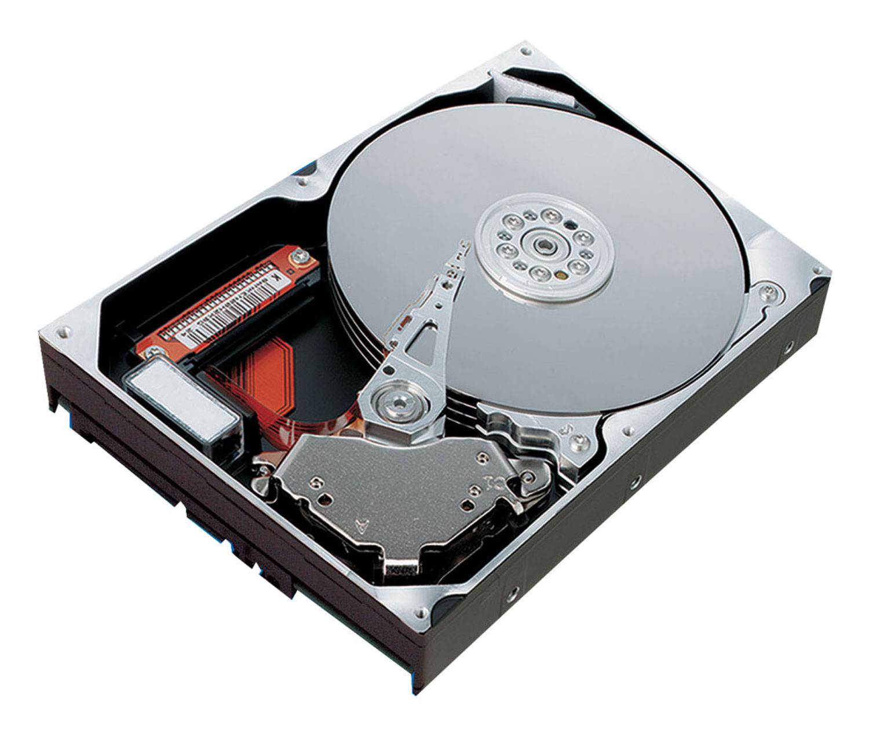
Semiconductor spintronics
Semiconductor
Magnetism
Used in transistor
Used in magnetic card, HDD
Semiconductor
spintronics
If the semiconductor spintronics is realized, one can expect
non-volatile memories
reduction of electricity consumption
much more miniaturization of electronic devices
e-
spin
Notes:
半導体のよさと磁性体のよさをあわせたもの。半導体スピントロニクスへの応用が期待されている。ハードディスクによって情報を記録し書き換えするのは揮発性の半導体メモリというように共存してきたのであった。だが、これが応用されたあかつきには、そもそもの半導体が記録媒体を担うのではるかに省エネになりかつスピンのスケールで情報を記録できるので近い将来破綻するとされているムーアの法則という経験則に新たな息吹を吹き込むことができる。なぜ今までこれが行われていなかったかというと磁性金属では容量が少なく、またスピンを反転する際に右ねじの法則のように磁化を用いなければならなかったため、かえって効率が悪くなるという事態がおこっていた
----- 会議メモ (2014/09/29 14:45) -----
文字をsemiconductorとかの文字を大きくする。
N,Sを消した方が良い。

Slide 5
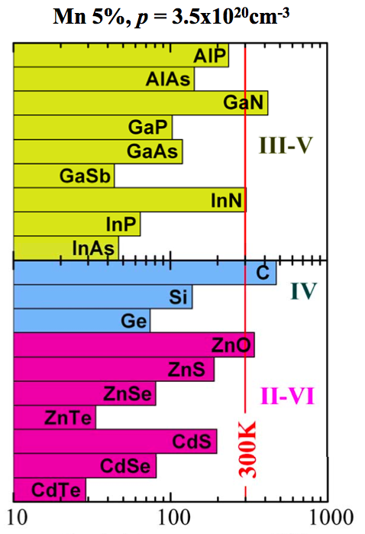
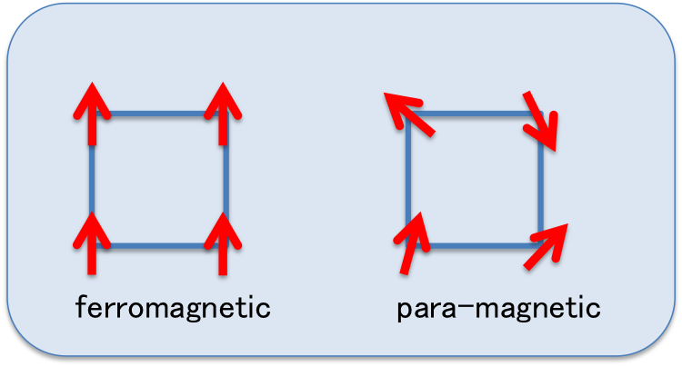
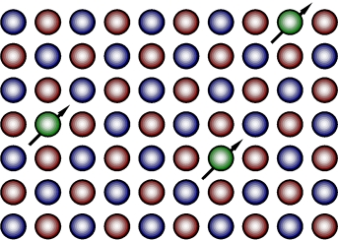
Dilute magnetic semiconductor (DMS)
We can obtain DMS by replacing cations
in semiconductor by magnetic ions.
Transition metals
(Fe,Co,Ni,Mn,Cr )
Model calculation
In 1996, Munekata et al. found carrier-induced ferromagnetism
in (In,Mn)As.
In order to realize the practical use of DMS,
one needs the high-Curie temperature (T_{C}) DMS
Curie temperature(K)
Dietl et al. Science (2000)
Appl. Phys. Lett. 69 (3), 15 July 1996
Notes:
----- 会議メモ (2014/09/29 14:45) -----
モデル計算simulation predictをmodel calculation。
we found ()As is
ferromagnetic was found in (In,Mn)As
1996レファレンス
in order to realize the practical use of DMS.

Slide 6
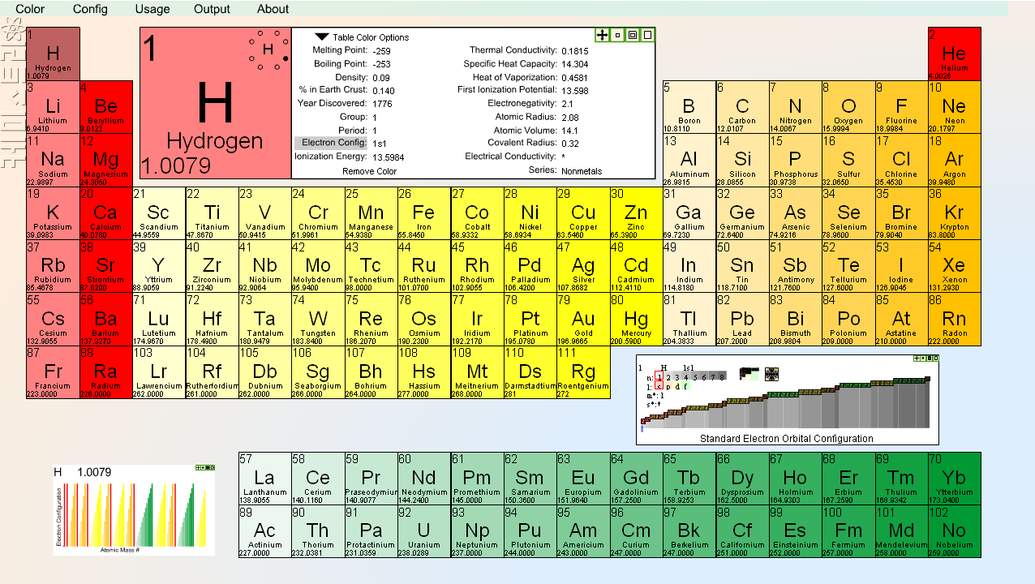
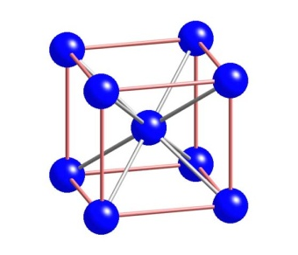
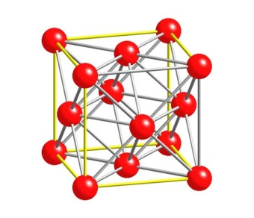
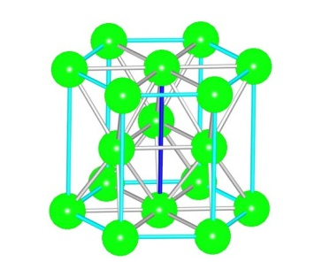
First-principles calculation
Predict physical properties of materials ← Input parameters: Atomic number and Atomic position !
Advantages
  Un-known materials
  Low costs
  Extreme conditions
  Ideal environment
  …
・・・
Notes:
----- 会議メモ (2014/09/29 14:45) -----
advantage
Un-known
Atomic number

Slide 7
Density functional theory
In density functional theory, we replace many body problem with one electron problem.
Description in equation
Description in figure
Computational cost is very low compared to many body problem.
Notes:
原子番号と結晶構造だけ
----- 会議メモ (2014/09/29 14:45) -----
密度汎関数
we treat
reduce costs
ko-nnsyamu
密度のこと触れてないから触れる。

Slide 8
Contents
Introduction
-Semiconductor spintronics
-Dilute magnetic semiconductors
-First principles calculation
Previous work
Results
-DOS (AFM and FM states)
-Formation energy
Summary
Future works

Slide 9
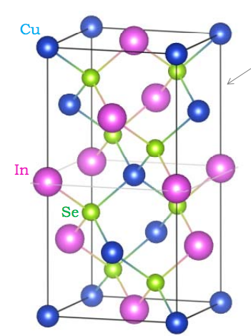
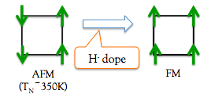
Purpose
CuFeS₂
Crystal structure : chalcopyrite
Ground state : anti-ferromagnetic
Neel temperature : 853K
Magnetic moment of Fe : 3.85μ_{B}^{[1]}
Cu
Fe
To make it ferromagnetic
S
anti-ferromagnetic
ferromagnetic
CuFeS2
[1]journal of the physical society of japan, Vol.36, No.6, JUNE.1974
Notes:
----- 会議メモ (2014/09/29 14:45) -----
investgated
DOS
total energy defference
formation energy
legend いらない
一回どっかで目的をいっとく
これを二回もってくる

Slide 10
Density of states for anti-ferromagnetic CuFeS₂
occupied state
un-occupied state
Density Of State(1/eV/unit cell)
Fe-3d
Cu-3d,S-3p
Fermi level
Notes:
----- 会議メモ (2014/09/29 14:45) -----
これを目的
横軸eV

Slide 11
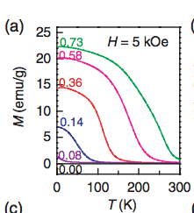
Previous work
Transition from antiferromagnetic insulator to ferromagnetic metal in LaMnAsO by hydrogen substitution
T_{C}=273K
The AFM state is induced by
super exchange interaction between Mn spins through Mn-As-Mn bonding.
O²⁻→H⁻+e⁻
Conduction electrons mediate a direct
FM interaction between neighboring Mn.
This interaction is called
double exchange interaction.
PHYSICAL REVIEW B 87, 020401(R) (2013)
Notes:
磁化率の温度依存性のグラフよりわかる、H＝５kOeてことは磁場中で実験をおこなった？
----- 会議メモ (2014/09/29 14:45) -----
LaO MnAsとする？
----- 会議メモ (2014/09/29 14:51) -----
ここの前に自分の材料について

Slide 12
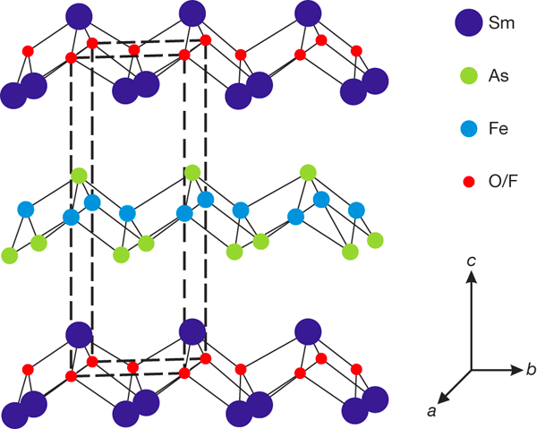
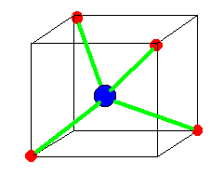
Origin of anti-ferromagnetism
Super exchange interaction
Super exchange interaction is a strong antiferromagnetic coupling
between two magnetic cations though a non-magnetic anion.
La
Mn
As
O
ZrCuSiAs structure
tetrahedral
Mn²⁺(3d)
Mn²⁺(3d)
As³⁻(4p)
Super exchange interaction is virtual hopping
process of electrons from occupied As states to
unoccupied Mn states.
E_{F}
DOS
Notes:
----- 会議メモ (2014/09/29 14:45) -----
fund' rule pauliはいた立
ホッピング
Mnにある→を点線にする

Slide 13
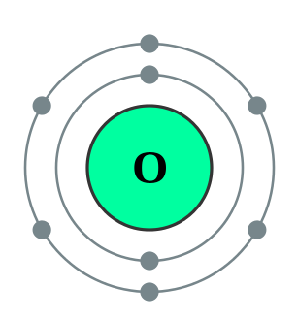
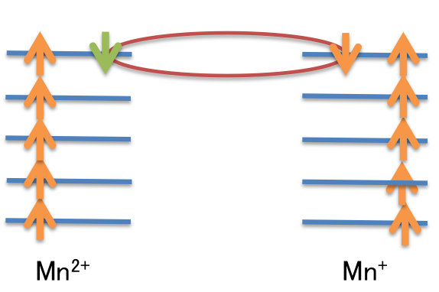
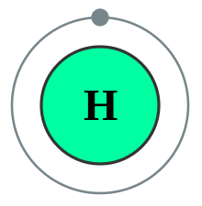
Origin of ferromagnetism
Double exchange interaction
Ferromagnetic state is stabilize by the direct hopping between partially occupied Mn-3d states.
＋・・
＋・・
O²⁻
H⁻ +e-
By broadening the band width, the system can gain the kinetic energy.
DOS
Notes:
----- 会議メモ (2014/09/29 14:45) -----
下向きの価電子帯も書く

Slide 14
Origin of ferromagnetism
Double exchange interaction
Ferromagnetic state is stabilize by the direct hopping between partially occupied Mn-3d states.
＋・・
＋・・
O²⁻
H⁻ +e-
By broadening the band width, the system can gain the kinetic energy.
DOS

Slide 15
Origin of ferromagnetism
Double exchange interaction
Ferromagnetic state is stabilize by the direct hopping between partially occupied Mn-3d states.
＋・・
＋・・
O²⁻
H⁻ +e-
By broadening the band width, the system can gain the kinetic energy.
DOS
Notes:
----- 会議メモ (2014/09/29 14:45) -----
the result of this interaction is
by lowering
ferromagneitsm is realized by loering thier kinetic energy.
Condution
remember ~conserve
alignをarrenge

Slide 16
Contents
Introduction
-Semiconductor spintronics
-Dilute magnetic semiconductors
-First principle calculation
Previous work
Results
-DOS (AFM and FM states)
-Formation energy
Summary
Future works

Slide 17
Crystal structure of CuFeS₂
Crystal structure : chalcopyrite
Ground state : anti-ferromagnetic
Neel temperature : 853K
Magnetic moment of Fe : 3.85μ_{B}^{[1]}
Cu
vacancy-doping
Fe
S
We may have higher T_{C} than previous work
In this talk, I will show
Density of states (AFM and FM states)
Total energy difference between AFM and FM states
Formation energies of Cu and S vacancies
[1]journal of the physical society of japan, Vol.36, No.6, JUNE.1974

Slide 18
Crystal structure of CuFeS₂
Crystal structure : chalcopyrite
Ground state : anti-ferromagnetic
Neel temperature : 853K
Magnetic moment of Fe : 3.85μ_{B}^{[1]}
Cu
vacancy-doping
Fe
vacancy
S
We may have higher T_{C} than previous work
In this talk, I will show
Density of states (AFM and FM states)
Total energy difference between AFM and FM states
Formation energies of Cu and S vacancies
[1]journal of the physical society of japan, Vol.36, No.6, JUNE.1974
Notes:
----- 会議メモ (2014/09/29 14:45) -----
investgated
DOS
total energy defference
formation energy
legend いらない
一回どっかで目的をいっとく
これを二回もってくる

Slide 19
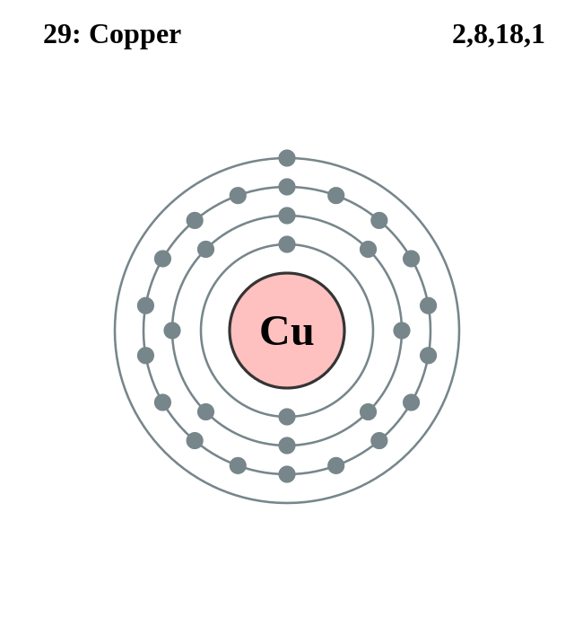
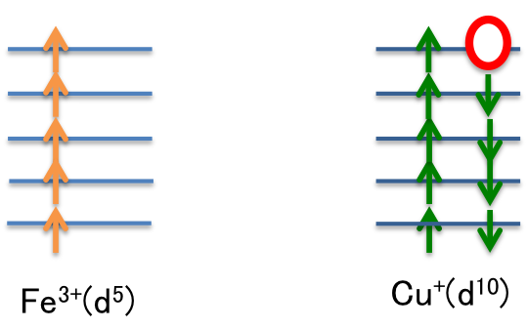
Origin of ferromagnetism
p-d exchange interaction
Ferromagnetism is stabilized by coupling between the negatively polarized spin of induced carriers and the localized spin.
・
Cu⁺
Fe³⁺(d⁵)
Cu²⁺(d⁹)
Since the Fe-d wave functions hybridize with the Cu-d wave functions, the majority-spin Cu-d band is shifted to higher energies, while the minority-spin Cu-d band is shifted to lower energies due to hybridization with the higher-lying minority- spin Fe-d band.
DOS
E_{F}
Notes:
クーロン反発ってホールドープすればするほど増加する？なぜ上向きのホールが形成されるかというとクーロン反発？エネルギーの利得は運動エネルギー？上向きから下向きにかわるから？

Slide 20
Origin of ferromagnetism
p-d exchange interaction
Ferromagnetism is stabilized by coupling between the negatively polarized spin of induced carriers and the localized spin.
・
Cu⁺
Fe³⁺(d⁵)
Cu²⁺(d⁹)
Since the Fe-d wave functions hybridize with the Cu-d wave functions, the majority-spin Cu-d band is shifted to higher energies, while the minority-spin Cu-d band is shifted to lower energies due to hybridization with the higher-lying minority- spin Fe-d band.
DOS
E_{F}

Slide 21
Origin of ferromagnetism
p-d exchange interaction
Ferromagnetism is stabilized by coupling between the negatively polarized spin of induced carriers and the localized spin.
・
Cu⁺
Fe³⁺(d⁵)
Cu²⁺(d⁹)
Since the Fe-d wave functions hybridize with the Cu-d wave functions, the majority-spin Cu-d band is shifted to higher energies, while the minority-spin Cu-d band is shifted to lower energies due to hybridization with the higher-lying minority- spin Fe-d band.
DOS
E_{F}

Slide 22
Electronic structure for super-exchange and p-d exchange interactions
Fe 3d
S 2p
Cu 3d
Hole-dope
Vacancy-doping
Fe 3d
Anti-ferromagnetism is stabilized by
super-exchange interaction
Hole doping leads to
ferromagnetic Zener’s p-d hybridization
Notes:
----- 会議メモ (2014/09/29 14:45) -----
vacancy dope

Slide 23
Density of states for ferromagnetic CuFeS₂
Fe 3d
Fe-3d
(no hole)
(2 holes)
Density Of State(1/eV/unit cell)
Cu 3d,S 3p
Cu 3d,S 3p
Fe 3d
Fermi level is located at Cu-d bands.
In the 2 and 3 hole doping cases, the half metallic states are realized by the energy shift due to the p-d exchange interaction.
(3 holes)
Cu 3d,S 3p
Notes:
no hole 3.607~3.612 2holes3.825-3.827 3holes3.795-3.796
----- 会議メモ (2014/09/29 14:45) -----
vacancy
S-3p

Slide 24
Stability of ferromagnetic state
By calculating the energy difference between AFM and FM states, we can investigate the stable
magnetic state as a function of the hole concentration.
ΔE(eV)
number of hole per unit cell(/unit cell)
With increasing the hole concentration, the ferromagnetic state becomes more stable.
Notes:
このとき構造の最適化はしなくてよかったん・？

Slide 25
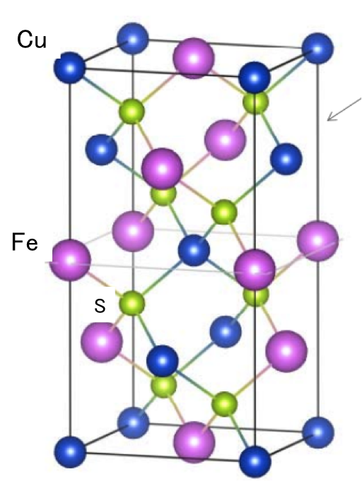
Formation energy
The formation energy is the difference in the total crystal before and after the defect arises.
it represents the penalty in broken atomic bonds and in lattice stress.
μ_{α}
 | Cu vacancy | S vacancy
E_{α}(eV) | -303.957 | -303.363
E_{host}(eV) | -308.814 | -308.814
μ(eV) | -3.730 | -4.084
ΔE : formation energy
E_{α} : defect αtotal energy
E_{host} : total energy
μ_{α} :chemical potential
Cu vacancy 1.13eV
S vacancy 1.37eV
we produce formation energy
of Cu-vacancy and S-vacancy. therefore,
we realize which site is easy to dope.
E_{host}
Notes:
一般的な第一原理バンド計算では、絶対零度、無加圧下の材料の様子しか計算できないため、材料機能と深く関連する有限温度・圧力下での相転移現象などを予測することが難しかった。われわれは、配置のエントロピー、振動のエンタルピーとエントロピーの計算、また機械的特性での材料の電子エネルギーを第一原理計算から導き統計力学理論などと結びつけることで、有限温度や有限圧力下での材料の相安定性について定量的視点から解析することを実践している。
----- 会議メモ (2014/09/29 14:45) -----
Sの結晶構造を記入
粒度をそろえる
μのまえはプラス
RyをeV
表、をもう少し丁寧に

Slide 26
summary & future works
Summary
As a prediction, valence band is on the Fermi level when we dope holes into CuFeS_{2.} In other words, it generalizes p-d exchange interaction.
We could see the transition from anti-ferromagnetic state to ferromagnetic state when we dope 2.3 holes per unit cell.
Cu-vacancy is easier to be doped than S-vacancy.
Future work
I will calculate Tc of CuFeS₂ in ferromagnetic state.

Slide 27
Thank you for your attention
Satoshi Ikemoto

Slide 28
磁性半導体Tc
高いTcを実現するためには高い遷移金属のドープ量を必要とする。しかし、半導体にたくさんの磁性原子を入れてしまうと、結晶構造が崩れてしまうことが難点
Tcのグラフとかほしい
結晶成長条件を変えることで230Kを実現(Ba0.7K0.3)(Zn0.85Mn0.15)2As2
. Chen, L, Yang, X and Yang, FH et al. Nano Lett2011; 11: 2584–9.
(Ga,Mn)As to 200K
Chen L, Yang X, Yang FH, et al. Nano Lett 2011;11:2584-9.
We need High curie temperature

Slide 29
Origin of antiferromagnetic
Super exchange
S(3p⁶)
Fe³⁺(d⁵)
Fe³⁺(d⁵)
Fe
Cu,S
Fe

Slide 30
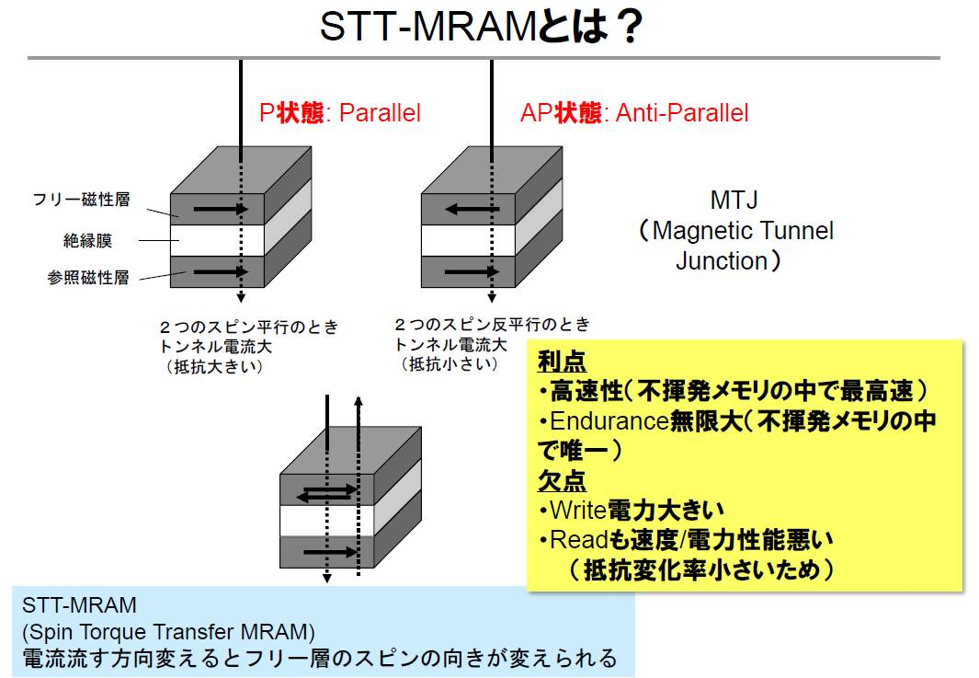
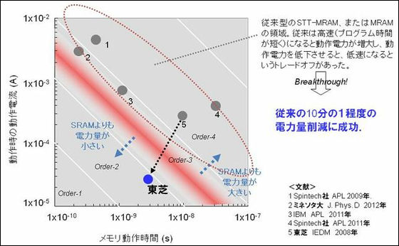
垂直磁化stt-mram
高速動作とは何に依存するのか、
半導体である意味がそこに隠されているのか
不揮発で維持ができるのと
スイッチングの消費電力が微細化すればするほど得する
Mramの場合、待機電力の消費は押さえることができるが
動作電力（書き込み）の消費が大きいのが課題
Stt-mram
面内磁化より垂直磁化がいい。
垂直磁化反転で読み込みのときは
反転しないの？

Slide 31
強磁性金属を使わない理由
キュリー温度の問題を解決するためには、キュリー温度が高い強磁性金属を半導体基板の上に成長しようという研究も行われている。たとえば、GaAs と Si 基板上に MnAs という化合物金属の単結晶が成長できる2-4。しかし、一般に強磁性金属の結晶構造（例えば MnAsは六方晶）は半導体の結晶構造（例えば GaAs は閃亜鉛鉱型）と異なるため、強磁性金属/半導体/強磁性金属という多層構造の作製は極めて難しい。従って、強磁性金属を利用して、1)スピン注入と 3)のスピン検出を同時に実現することが難しい。

Slide 32
LDA+U
Energy from Korn-Sham equation
＋U
LDA+U
t>>U
Wave nature of electron is more effective than particulate of it
U>>t
Particulate of electron is more effective than wave nature of it
Notes:
LDAでは一様な密度の電子ガス状態であるという近似であり、強相関物質の場合、一様とはほど遠く電子は強く局在するので電子間相互作用を半経験的に用いて計算する手法がよく用いられる。これをLDA+Uという。

Slide 33
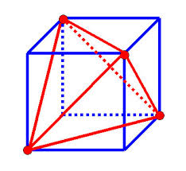
Crystal splitting
Cu-S
Fe-S
Cu is more unstable than Fe, because anti-bonding state is compensated.

Slide 34
Hole-dope property
磁性の変化の前例
LaMnAsO→LaMnAsO_{1-x}H_{x} from antiferromagnetic to ferromagnetic(264K,x=0.73)
GaN→GaN with gallium vacancy(V_{Ga}) nonmagnitec to ferromagnetic (150K)
(simulation) applied physics letters 102,062411(2013)
Phys. rev. B 87,020401(R)(2013)
Magnetism of systems is changed by doping H, vacancy and transitional metal.

Slide 35
Origin of ferromagnetic
P-d exchange
強磁性が発現するときには、同じ順位にいたときの電子相関エネルギー（クーロン、量子的交換作用）が大きい場合である。なぜなら、電子が遍歴したときに同じ順位に入る確率が高い、なので大きな電子相関エネルギーだと損する。よって局在化する、つまり孤立して存在することとなる、だが、一方で孤立して局在化すると運動エネルギーが増大する、よってこの運動エネルギーと電子相関エネルギーとの競合によって強磁性

Slide 36
Density of state of anti-ferromagnetic CuFeS₂
Density Of Spin(1/eV/unit cell)
Energy relative to Fermi level (eV)

Slide 37
Desity of state of ferromagnetic CuFeS2
Density Of Spin(1/eV/unit cell)
Energy relative to Fermi level (eV)

Slide 38
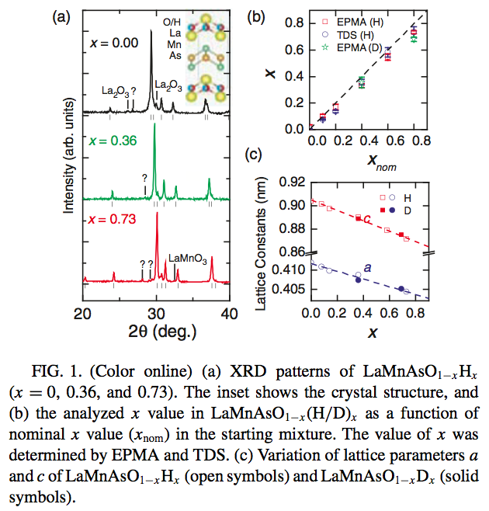
Previous work
From antiferromagnetic insulator to ferromagnetic metal:Effects of hydrogen substitution in LaMnAsO
H⁻ dope
AFM
(T_{N}~350K)
FM
La
As
Mn
O
PHYSICAL REVIEW B 87, 020401(R) (2013)
Notes:
MnーμB＝21

Slide 39
Density Of State for anti-ferromagnetic CuFeS₂
Fe 3d
(no hole)
Fe 3d
(2 holes)
Density Of State(1/eV/unit cell)
Cu 3d,S 2p
Cu 3d,S 2p
E_{F}
Fe 3d
(3 holes)
Fermi level come to valence band
the Fe 3d band is more narrow than that of ferromagnetic state.
the Fe 3d band have higher energy than that of ferromagnetic state.
Cu 3d, S 2p
Notes:
nohole 3.671muB 2holes 3.717 3holes 3.773
なぜ強磁性やと鉄の
バンド幅は小さいのか
なぜ混成がおおくなるのか

