Slide 1


High pressure study on superconductor K_{x}Fe_{2-y}Se₂
M1 Hidenori Fujita
Shimizu group

Slide 2

Contents
Introduction
Iron based superconductor
K_{x}Fe_{2-y}Se₂
Experiment
Methods
Result & Discussion
Conclusion

Slide 3
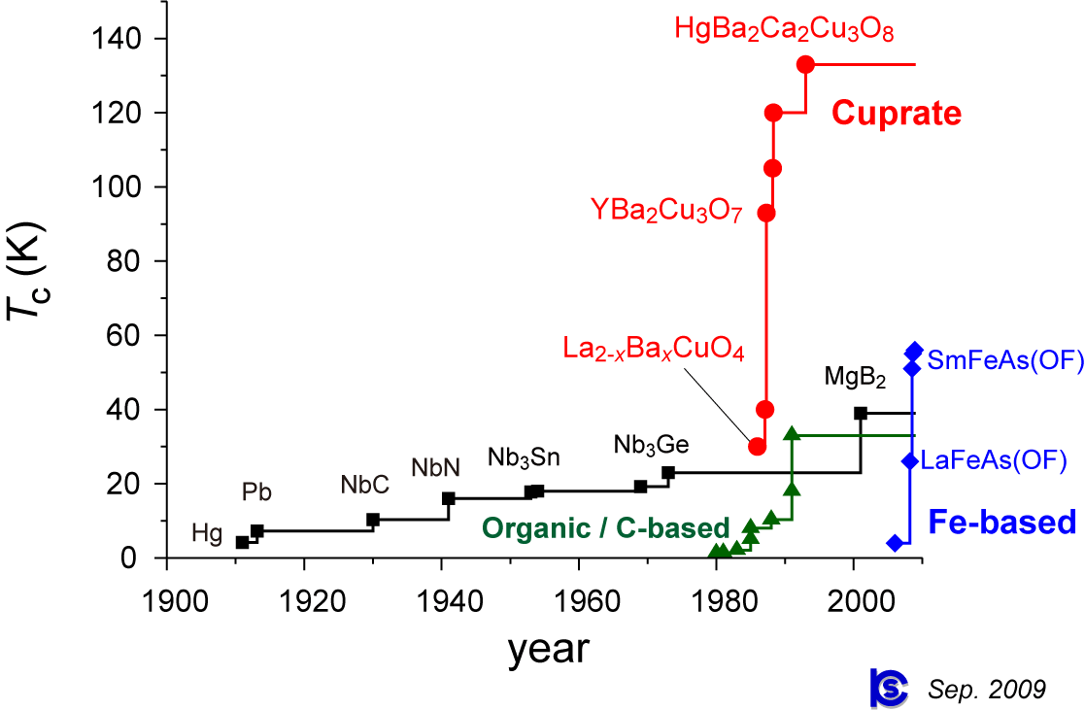
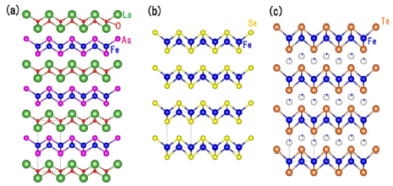
Introduction
Iron based superconductor
K Deguchi et al.
Sci. Technol. Adv. Mater. 13 054303 (2012)
http://sakaki.issp.u-tokyo.ac.jp/user/kittaka/contents/others/tc-history.html
Simple structure ⇒ easy to analyze

Slide 4
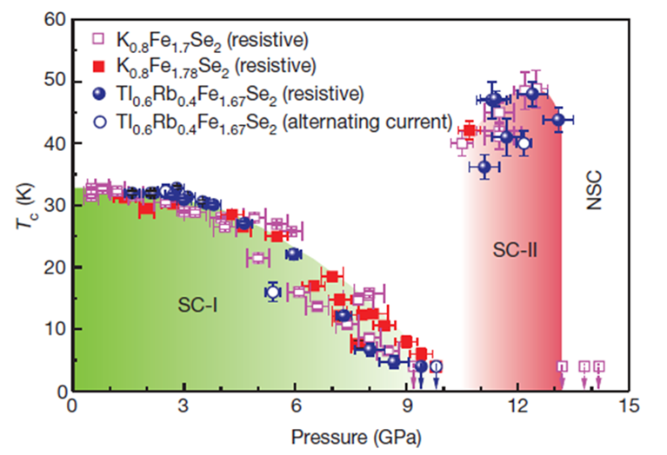
Introduction
K_{x}Fe_{2-y}Se₂: two dome of SC-phase
Pressure enhances two SC-phase
T_{c} of second phase is 48 K higher than first phase.
L. Sun et al. Nature 483, 67 (2012).

Slide 5
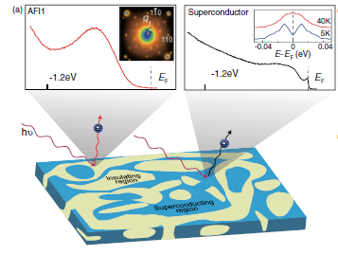
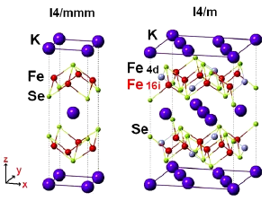
Introduction
K_{x}Fe_{2-y}Se₂: Phase separation
There are two coexisting phase mesoscopically: superconducting phase and insulating phase
122-type
245-type
Fe-vacancy
Fe
Chen et al. PRB 86, 184511 (2012)
A. Ricci et al., Supercond. Sci. Technol., 24, 082002 (2011).

Slide 6
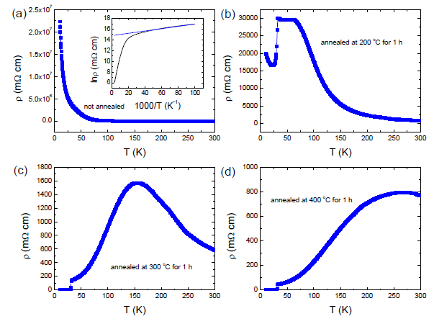
Introduction
K_{x}Fe_{2-y}Se₂: Effect of quenching
Making method = flux method
Quenching has effects on physics property: electric resistance, magnetic moment, …
Electric resistance:
Quenching temperature when the sample grows is high
⇒ hump shape appears
⇒ metallic behavior
Fei Han et al. Philosophical Magazine 92 2553-2562 (2012)
Zhou et al. arXiv:1401.6906 (2014)

Slide 7
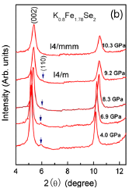
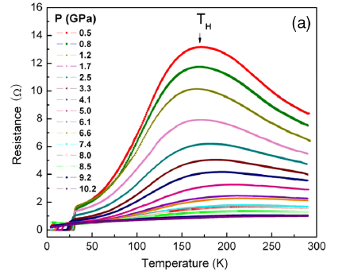
Introduction
Pressure effect on K_{x}Fe_{2-y}Se₂
The hump is suppressed and shifted by pressure
The hump disappear at 10 GPa
Around 10 GPa, the peak of Fe-vacancy-ordered phase also disappear
122-type
245-type
J. Guo et al. PRL 108, 197001 (2012)

Slide 8


Introduction
Motivation
To research the SC-2 phase in some materials
Quenching effects
Degree of Fe vacancy and K (their composition)

Slide 9
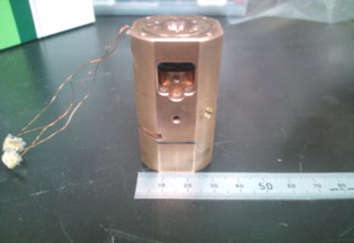
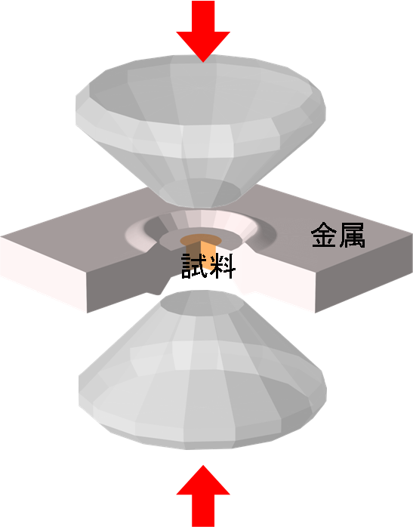
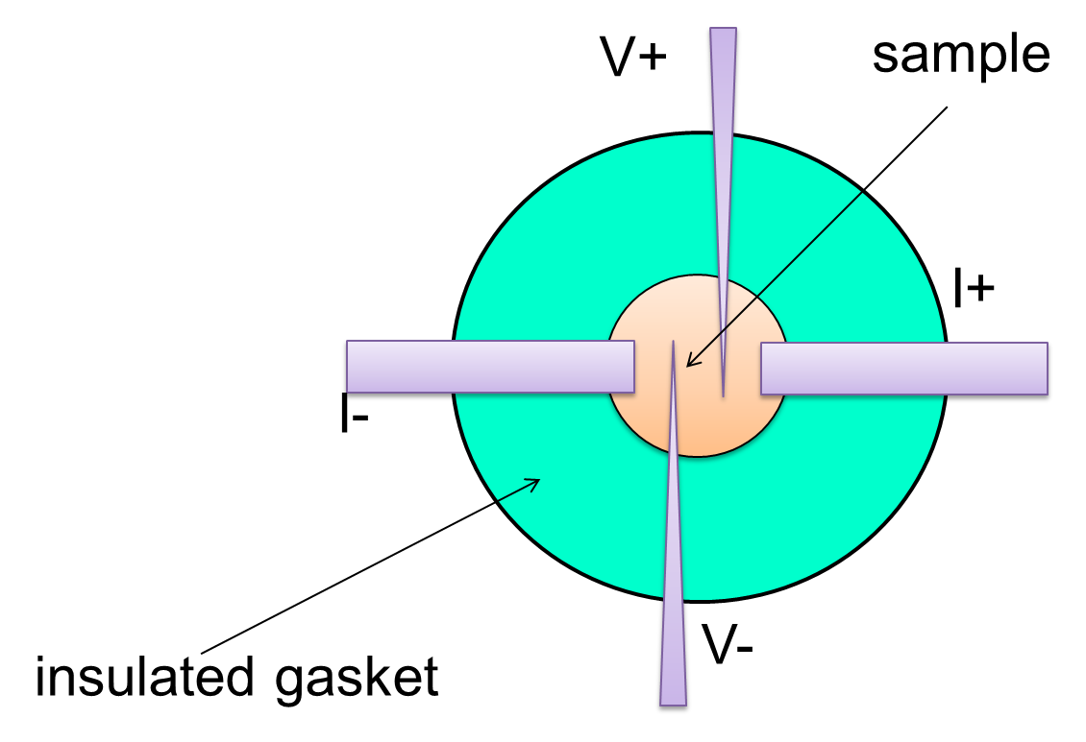
Experiment
Pressure device: Diamond anvil Cell
Measurement: temperature dependence of electric resistance

Slide 10

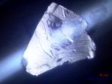
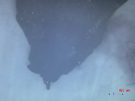
Experiment
Samples
Restore in Ar gas
Sample 1
Sample 2
Sample 3
K_{0.77}Fe_{1.68}Se₂
Quench at 550 ℃
Meissner effect was observed at 31 K.
K_{0.62}Fe_{1.65}Se₂
Slow cooling
Meissner effect was not observed
Quench at 400℃
Meissner effect was observed at 32 K

Slide 11
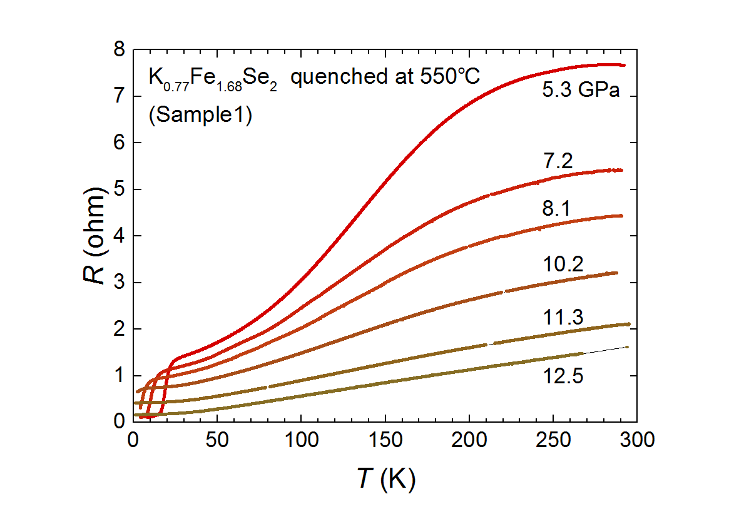
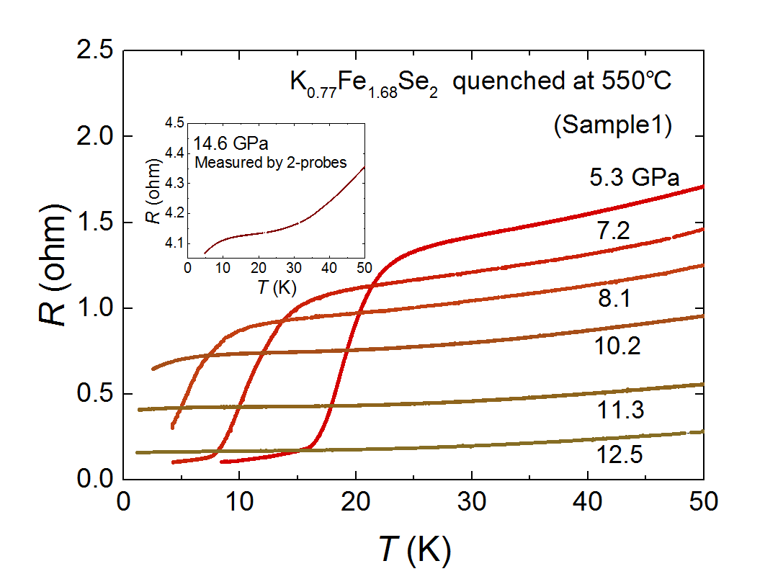
Result
Previous result: quenched at 550℃

Slide 12
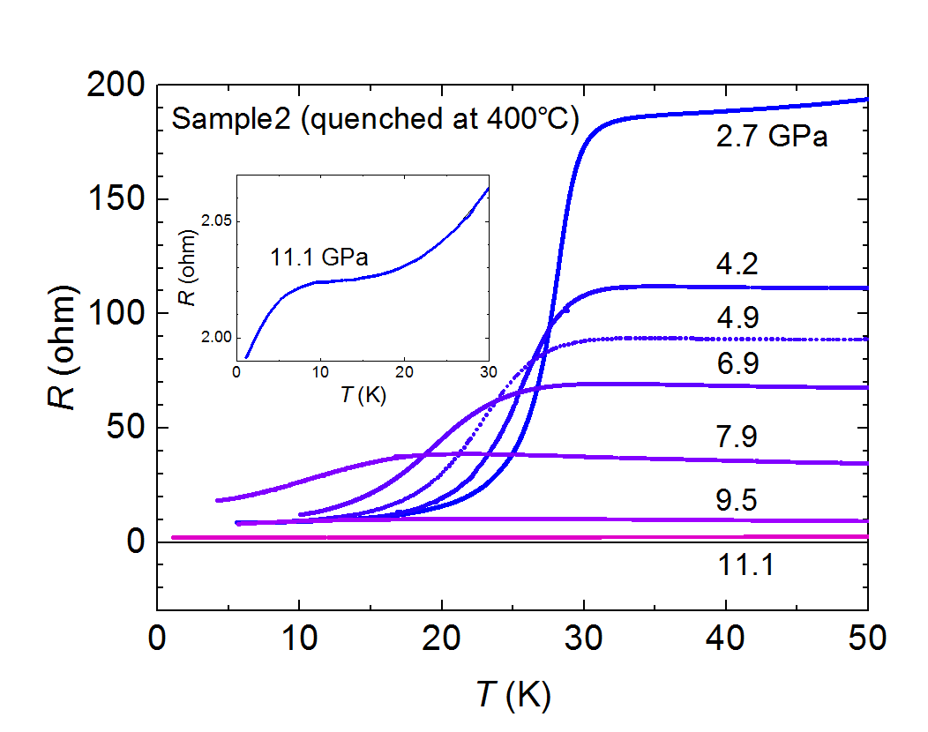
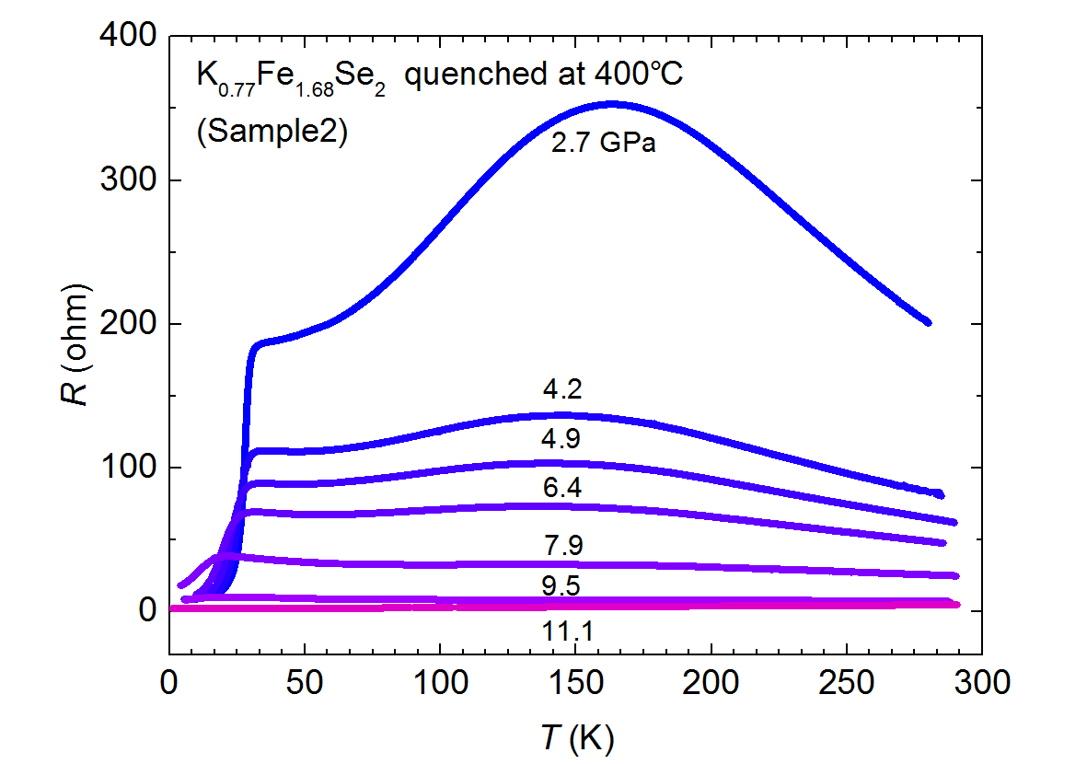
Result
Previous result: quenched at 400℃

Slide 13
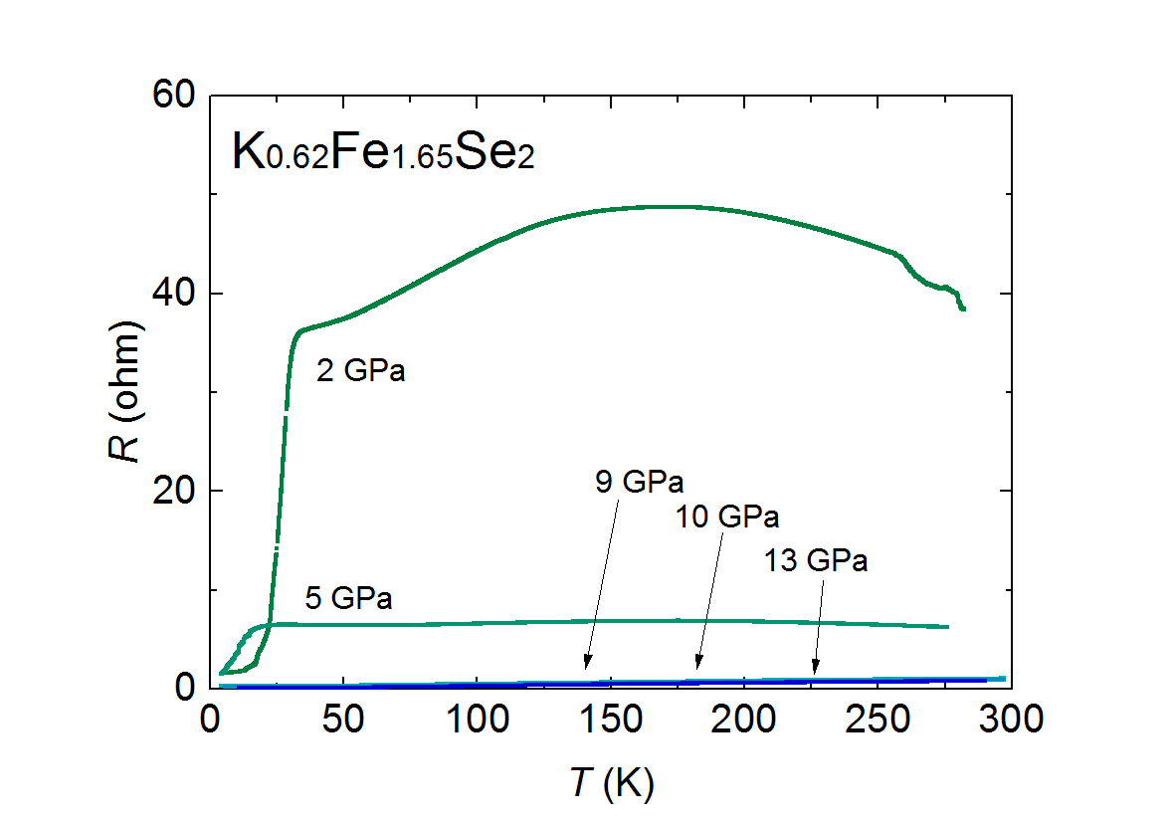
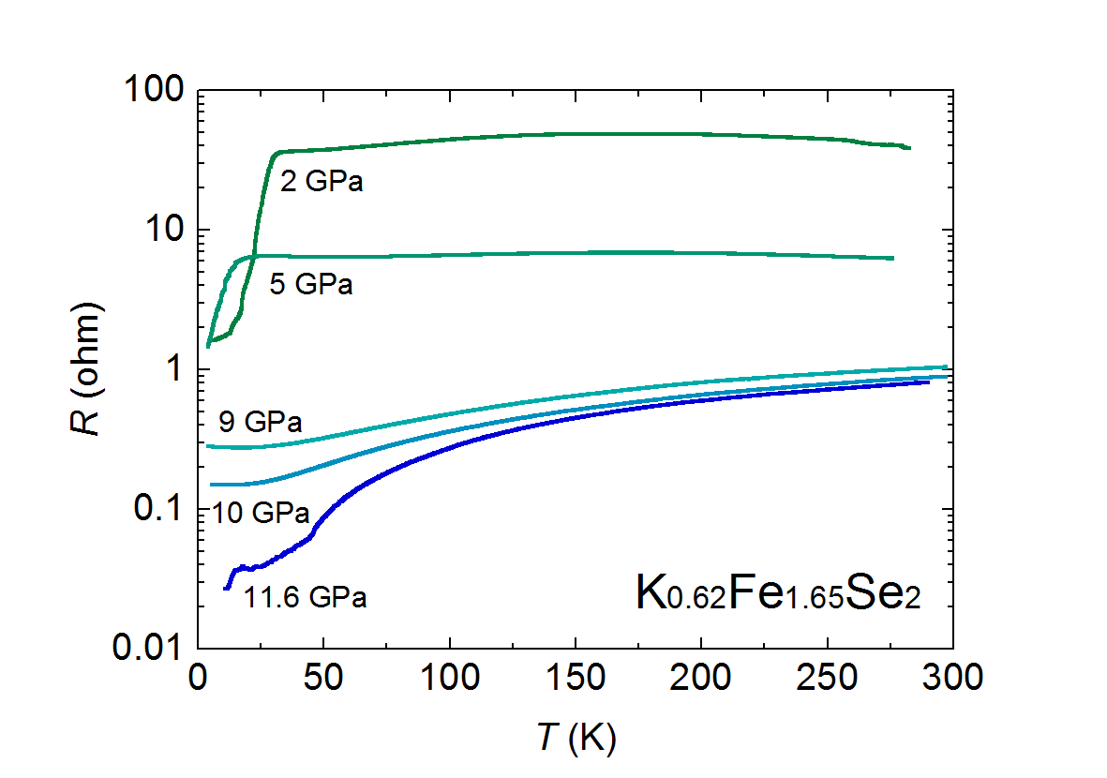
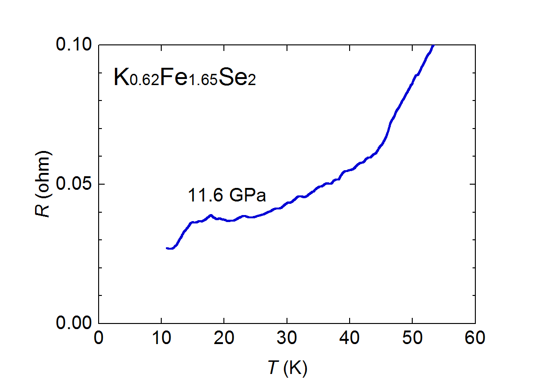
Result
Recent result: slow cooling
At 12 GPa, we observed two transition

Slide 14
Result
Diagram of T_{c} vs P
metal

Slide 15
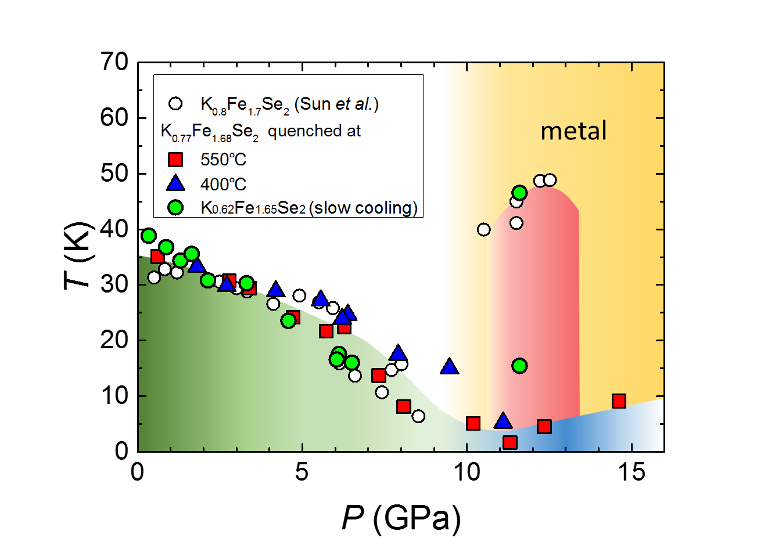
Conclusion
Three type samples show same pressure dependence of T_{c} under the 10 GPa.
Quenching temperature doesn’t have effect on SC1-Phase
Over 10 GPa, there are some differences among these samples
Quenching may compress the SC2-phase. Slow cooling seems better to emerge SC2-phase.

Slide 16
Conclusion
Future work
Research the repeatability.
Plan to measure the sample cleaved from previous crystals.
Measure the resistance at higher pressure
Plan to apply pressure up to 20 GPa.
Measure the new sample
The sample quenched at 700℃

Slide 17
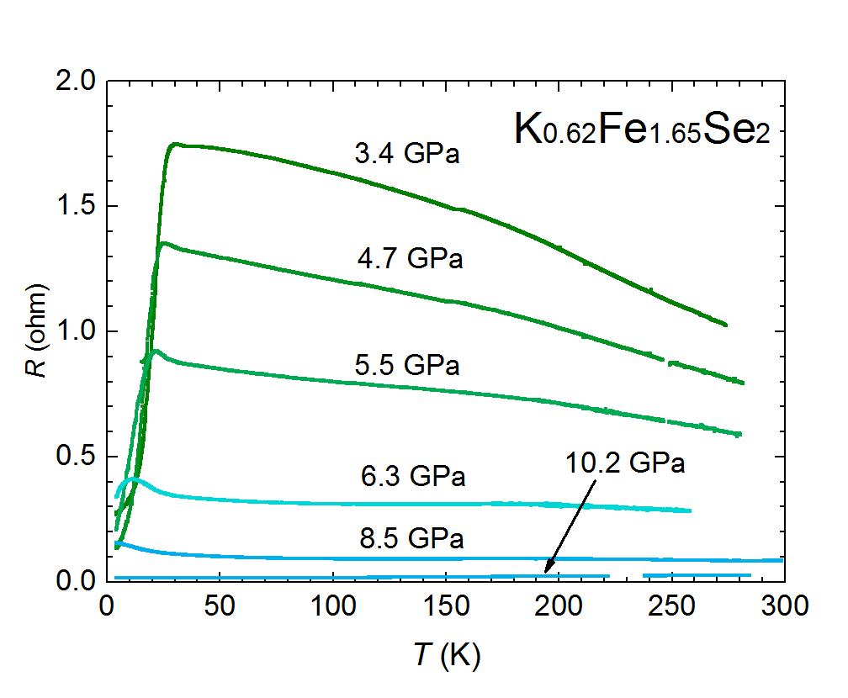
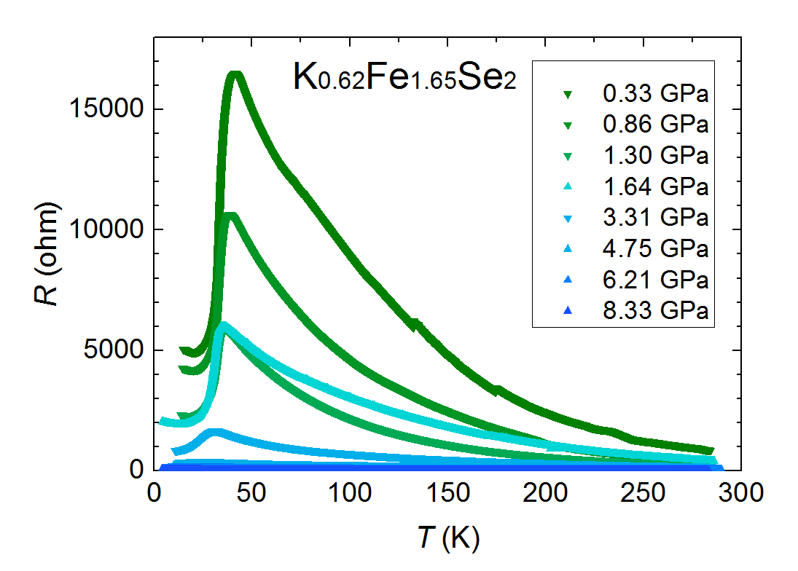
Problems
Possibility of time dependence
First run
second run
Third run

Slide 19
研究背景

Slide 20
研究背景

Slide 21
研究背景

Slide 22
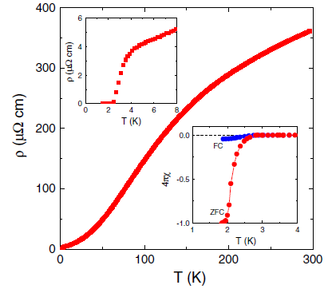
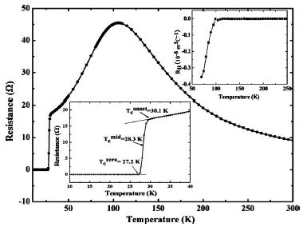
Introduction
Iron based superconductor: pnictide and chalcogenide
Chalcogenide = compound with 16th periodic family (O, S, Se, Te)
Pnictide = compound with 16th periodic family (N, P, As, Sb)
Many iron based superconductors are pnictide
In 122-type structure, chalcogenides seems to be better in T_{c}
Temperature dependence of electric resistance of KFe₂As₂
Temperature dependence of electric resistance of KFe₂Se₂
Dong et al. PRL 104, 087005 (2010)
Guo et al. PRB 82, 180520 (2010)
Notes:
IBSC have two type, those are chalcogenides and pnictide.
Chalcogenide = compound with 16th periodic family like this
Pnictide = compound with 16th periodic family like this
Mainly, IBSCs are pnictide. A IBSC which show highest Tc in IBSC is also pnictide. However recently chalcogenides also show high Tc, so these materials get attention in term of the origin of SC

Slide 23
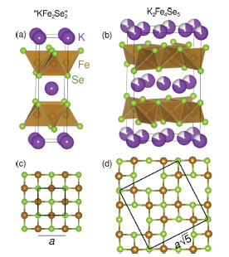
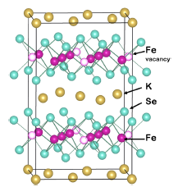
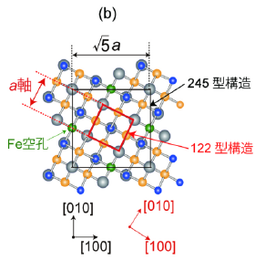
Introduction
K_{x}Fe_{2-y}Se₂: structure
Basic structure is 122-type structure.
Fe-vacancy have two state: ordered and disordered state.
Fe-vacancy-ordered makes 245-type structure
122-type = superconductor
245-type = insulator
a-axis
245-type
vacancy
122-type
Bao et al. Chin. Phys. Lett. 30, 027402.(2013)
Shoemaker et al. PRB 86, 184511 (2012)
Notes:
The difference between the phases is a state of Fe-vacancy-order. Basically KxFe2-ySe2 is 122-type structure, which is tetragonal layer structure. When potassium is doped, iron atoms are removed. Then the positions of Fe-vacancies can be ordered or disordered. Ordered state makes 245-type structurein which iron vacancies make superstructure square root of 5, and disordered state is 122-type structure. In a previous slide, the insulator phase show this vacancy-order with TEM. So these phases coexist like this.
As I show, SC is emerged by disorder phase, but on the other hand, it is wondered whether the 245-type structure has any relation or not.
熱処理を加えた試料との測定がこちらになりますが、この測定から鉄の 価のスペクトルが大きくなっていることが確認されています。ここから、熱処理により超伝導相が大きくなっていることがわかります。
これらのことから現在では完全に金属相のみの試料を作成し、超伝導の発現と相分離が関連するかが調べられている。

Slide 24
Result
Metal transition
Around 10 GPa, there is certain transition.
The pressure region corresponds to metal transition.
Notes:
これらの試料において共通してみられるのは10GPaでの電気抵抗の振る舞いの大きな変化です。このように金属化がみられています。そのほかの研究でも欠陥のオーダーがなくなり金属化が観測されています。

Slide 25
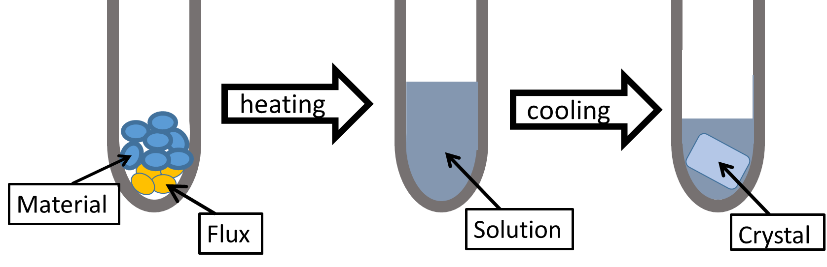
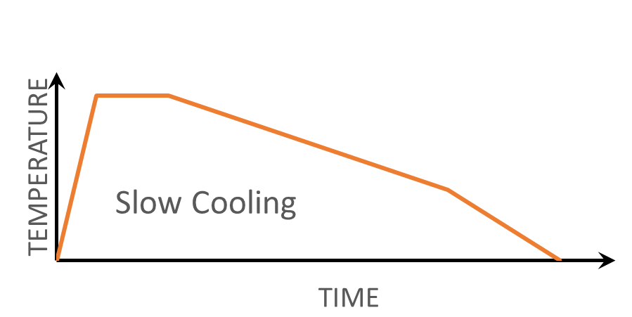
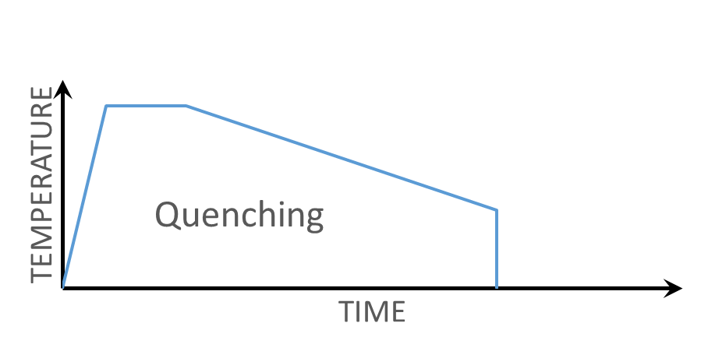
Introduction
K_{x}Fe_{2-y}Se₂:
how to make the sample
Self flux method: making the crystal by using flux.
Mixing substance and flux
Heating and fluxing
Recrystallize
Notes:
This phase separation seems to be affected by quenching. many papers report effects on physics properties like electric resistance. This figure show the effect. Each measurement have different heat treatment. Not annealing, ……. As you see, when quenching temperature raises, temperature dependence of resistance changes. At 300 degrees Celsius, the hump shape appear like this.
この物質にはアニールと急冷により超伝導などの物理特性が変化することが知られています。電気抵抗の変化についてもさまざまな研究が行われており、急冷の温度が低いと絶縁体的、高くなるにつれ超伝導が現れ、hungがみられる。急冷時の温度が高温になるにつれ、高温側にシフトしていくことが知られています。
このhungがなくなると超伝導が確認できなくなることが知られています。このことから超伝導とこのhungの関連に興味が持たれています。

