Slide 1
The ultimate nonlinear optical process in the semiconductor by phase controlled several cycle AC electromagnetic pulse
M1 Hiroki Okada
Ashida lab

Slide 2
Contents
Nonlinear optics in perturbative regime
SFG DFG optical Kerr effect
Internal electric field in the matter
Extreme nonlinear optics in non-perturbative regime
higher-harmonic generation in atomic gas
Returning model
Carrier envelope phase
higher-harmonic generation in the semiconductor
My works

Slide 3
Nonlinear optics in perturbative regime
In the case of the laser electric field << the coulomb force of nucleus, polarization can be dealt with in perturbation theory.
$$P=x^{(1)}E+x^{(2)}E^{2}+x^{(3)}E^{3}+x^{(4)}E^{4}+…$$
These $x^{(2)}, x^{(3)}$ are important in order to know physical properties, and various nonlinear effects are acquired by these.

Slide 4
Nonlinear optics in perturbative regime
2nd : SFG, DFG
harmonic generation, optical rectification by them
3rd : Optical kerr effect
Absorption saturation
Input ${ℏω}_{1}$
Output ${ℏω}_{2}$
Output ${ℏω}_{1+2}$
Input ${ℏω}_{1}$
Input ${ℏω}_{2}$
Output ${ℏω}_{1−2}$
Sum frequency generation
Difference frequency generation
Used for laser technique, communication technique, and optical switching technology

Slide 5
Nonlinear optics
The nonlinear optical response depends on the intensity of the laser electric field to give.
internal field in H atom $F=\frac{q^{2}}{4πε_{0}r^{2}}=qE$
$E_{1s}=5.13$ MV/cm
$${ℏω}_{1}$$
(1) laser electric field << coulomb force of nucleus
$${ℏω}_{1+2}$$
Light is treated as a photon.
High order harmonic in perturbation theory
(2) laser electric field ～ coulomb force of nucleus
レーザー電場
再結合→発光
An electron begins classic movement by potential,
and it emits light by re-combination with an atom.
High order harmonic in non-perturbation theory

Slide 6
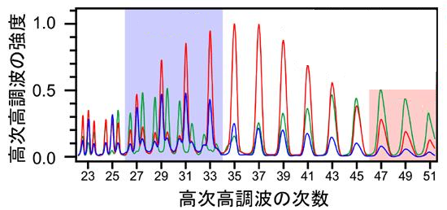
Higher-harmonic generation in atomic gas
An electron is accelerated by the electric field pulse exceeding an internal electric field. When re-combining with an atom again, the harmonics are emitted.
The energy is equal 3.17 times of the mean kinetic energy by the laser electric field called ponderomotive potential ($U_{p}$).
$$U_{p}=\frac{e^{2}E_{0}^{2}}{4mω^{2}}$$
ponderomotive potential
HHG from He gas
HHG from Ne gas
HHG from He/Ne mixed gas
The spectrum of the high order harmonics in a rare gas atom

Slide 7
Higher-harmonic generation in atomic gas
Corkum Returning model
Laser electric field
Recombination→luminescence
The movement is dependent on the form of the electric field pulse to impress.
electron
tunnel ionization
Classic movement in electric field
In order to observe the harmonics generations, it is necessary
to make the career envelope phase (CEP) locked pulse.

Slide 8
CEP(career envelope phase)
CEP : a phase of electric field vibration in a ultra-short pulse.
If the light pulse becomes high intensity, argument about an interaction with a substance and the light as a classic electric field is needed. In that case, the real time waveform of an electric field is important.
$$φ=\frac{π}{2}$$
$$φ=0$$
イオン化
イオン化
イオン化
sin型
cos型
Sin-like, cos-like the interaction of an electric field pulse and the electron in potential

Slide 9
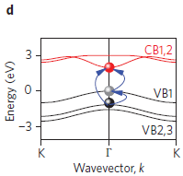
Higher-harmonic generation in the semiconductor
In a semiconductor, it is decided by the band gap instead of an internal electric field whether a perturbation theory nonlinear response will be shown.
Few processes of tunnel ionization and classic movement but many response of electrons.
Model electronic band structure of GaSe

Slide 10
Higher-harmonic generation in the semiconductor
Here, we introduce the incidence intensity dependence of the optical response at the time of entering a several-cycle pulse with the frequency of 10 THz or less into a bulk semiconductor.
The several-cycle pulse are generated by the difference frequency generation.

Slide 11
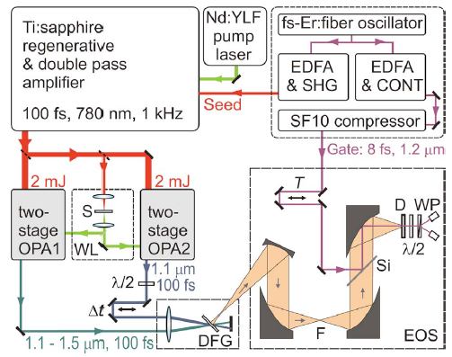
Higher-harmonic generation in the semiconductor
Experimental setup
The THz pulse is generated by taking a difference cycle for the pulse amplified by OPA.

Slide 12
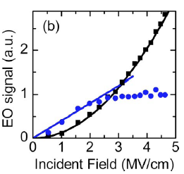
Higher-harmonic generation in bulk GaSe by CEP-locked pulse
In 2 MV/cm or less electric field, the first electron optics response becomes large linearly in proportion to incident Thz amplitude.
This is based on nonlinear susceptibility $x^{(2)}$.
However, a higher order nonlinear clause begins to rule over in more or 2 MV/cm.
Electric field intensity dependence of the electron optics response in 90μm thick GaSe

Slide 13
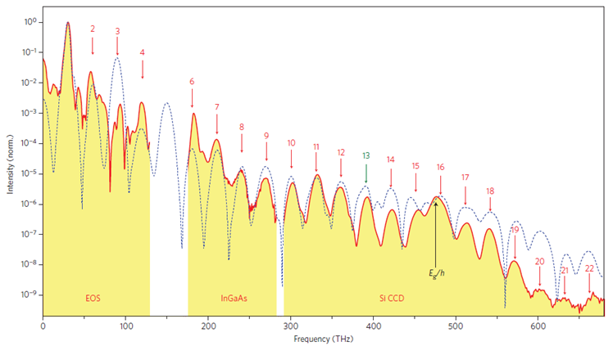
Higher-harmonic generation in bulk GaSe by CEP-locked pulse
Calculated
measured
Classic example of a non-perturbation nonlinear response.
The domain of a non-perturbation nonlinear response 0.1THz～675THz, and has no less than 12.7 octaves.

Slide 14
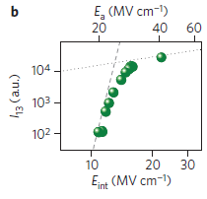
Higher-harmonic generation in bulk GaSe by CEP-locked pulse
Incidence THz electric field dependence of the luminescence intensity of a 13th harmonic generation
$E_{a}$ : Incidence THz electric field intensity
$E_{int}$ : The internal electric field by reflection in the sample surface
If it exceeds a steady value with incidence intensity,
luminescence intensity will not adopt-like proportionally how to go up.
Non-perturbation response

Slide 15
My works
It is possible to generate the dozens of high order harmonics by the THz electric field which controlled CEP.
I would like to observe the nonlinear optical response of a semiconductor with a two-level system using the THz pulse which controlled this CEP.

