Slide 1
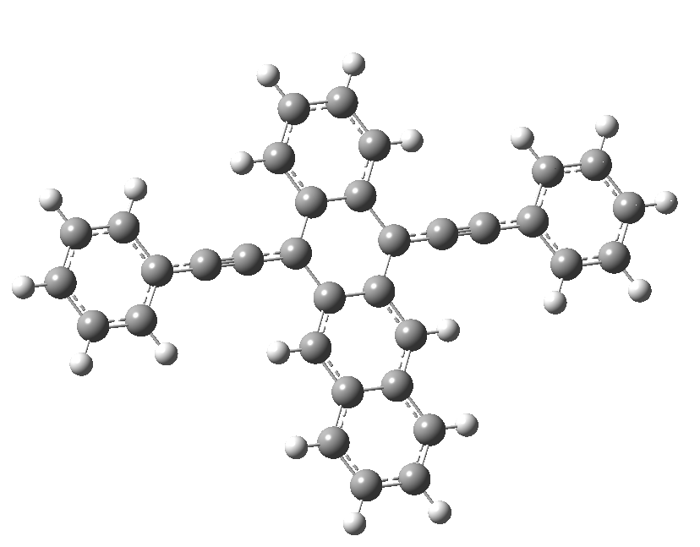
The effect of intramolecular nuclear wavepacket motion in an ultrafast electron transfer reaction
Miyasaka Lab.
Yoneda Yusuke

Slide 2
Contents
Background
Electron Transfer Reaction
Experiment
Ultrafast Electron Transfer System
Transient Absorption Spectroscopy Measurement
Result and Discussion
BPN / 1-CN or DMA
Conclusion

Slide 3
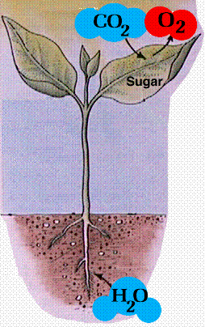
Light Energy Conversion
http://www.space-device.com/solar-top.html
http://www2.estrellamountain.edu/faculty/farabee/BIOBK/BioBookPS.html
Photoinduced electron transfer (PET) reaction is a primary reaction in solar cell and photosynthesis.
photoinduced electron transfer reaction 光誘起電子移動反応

Slide 4
Photoinduced Electron Transfer (PET) Reaction
(a)
(b)
D*
A
D⁺
A⁻
D
A*
D⁺
A⁻
Electronic excited state ・Decrease ionization potential
・Increase electron affinity
→ Easy to exchange electron compared to ground state.
D : electron donating molecule
A : electron accepting molecule
Common organic molecules have a finite excited state life time (~ 10⁻⁹ s.).
→ Ultrafast electron tramsfer is important!
electron donating / accepting molecule 電子供与性 / 受容性分子

Slide 5
Solvation
^{δ+}
^{δ-}
Neutral State
D
A
D
A
Entropy
Stable
Charge Separated State
D
⁺
A
⁻
D
⁺
A
⁻
Solvation
Stable
solvation 溶媒和

Slide 6
The Classical Marcus Theory
R
P
R
P
D
A
D
A
⁺
⁻
λ
Energy
ΔG‡
-ΔG
D
A
D
A
⁺
⁻
Reactant
Product
Reaction coordinate
Reaction coordinate represents solvation coordinate.
The curvature of the reactant and product surface is assumed to be same.
reaction coordinate 反応座標 reactant 反応物 product 生成物

Slide 7
The Classical Marcus Theory
R
P
R
P
D
A
D
A
⁺
⁻
λ
Energy
ΔG‡
-ΔG
D
A
D
A
⁺
⁻
Reactant
Product
Reaction coordinate
$$k_{ET}=κ_{el}ν_{n}exp(−\frac{{ΔG}^{‡}}{k_{B}T})$$
k_{ET} : rate of electron transfer reaction
κ_{el} : electronic transmission coefficient
ν_{n} : frequency of passage (nuclear motion) ~ 10¹³ s⁻¹
ΔG‡ : activation energy
k_{B} : Boltzmann constant
T : tempareture
activation energy 活性化エネルギー

Slide 8
The Classical Marcus Theory
R
P
R
P
D
A
D
A
⁺
⁻
λ
Energy
ΔG‡
-ΔG
D
A
D
A
⁺
⁻
Reactant
Product
Reaction coordinate
$$k_{ET}=κ_{el}ν_{n}exp(−\frac{{ΔG}^{‡}}{k_{B}T})$$
$${ΔG}^{‡}=\frac{{\left(λ+ΔG\right)}^{2}}{4λ}$$
ΔG‡ : activation energy
λ : reorganization energy
-ΔG : difference of free energy in reactant and product
reorganization energy 再配向エネルギー

Slide 9
The Classical Marcus Theory
(a)
R
P
(c)
R
P
λ
ΔG‡
λ
-ΔG
(b)
R
P
ΔG‡
Energy
λ
-ΔG
ΔG‡ = 0
-ΔG
Reaction coordinate
$$k_{ET}=κ_{el}ν_{n}exp(−\frac{{ΔG}^{‡}}{k_{B}T})$$
$${ΔG}^{‡}=\frac{{\left(λ+ΔG\right)}^{2}}{4λ}$$
(a) -ΔG < λ ΔG‡ will decrease if -ΔG increase, and reaction rate will increase (normal region)
(b) -ΔG = λ activation energy zero, and reaction rate maximum
(c) -ΔG > λ ΔG‡ will increase if -ΔG increase, and reaction rate will decrease (inverted region)

Slide 10
The Classical Marcus Theory
Log(k_{ET})
normal
region
inverted
region
-ΔG
k_{ET} shows bell shape dependence to –ΔG.

Slide 11
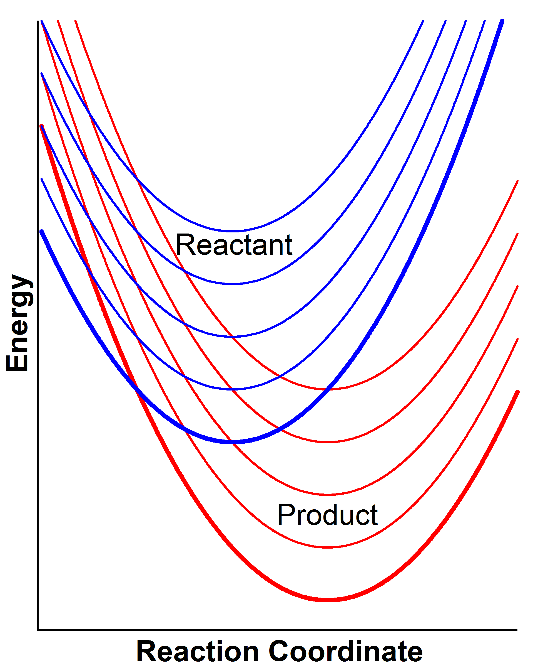
The Contribution of Intramolecular Vibration
v_{r} = 4
v_{r} = 3
v_{r} = 2
v_{r} = 1
v_{p} = 4
v_{r} = 0
v_{p} = 3
v_{p} = 2
v_{p} = 1
v_{p} = 0
J. Jortner, M. Bixon
J. Chem. Phys., 1988, 88, 167
In addition to solvation, the effect of quantum-mechanical discrete vibrational level of the solute must be also considered.

Slide 12
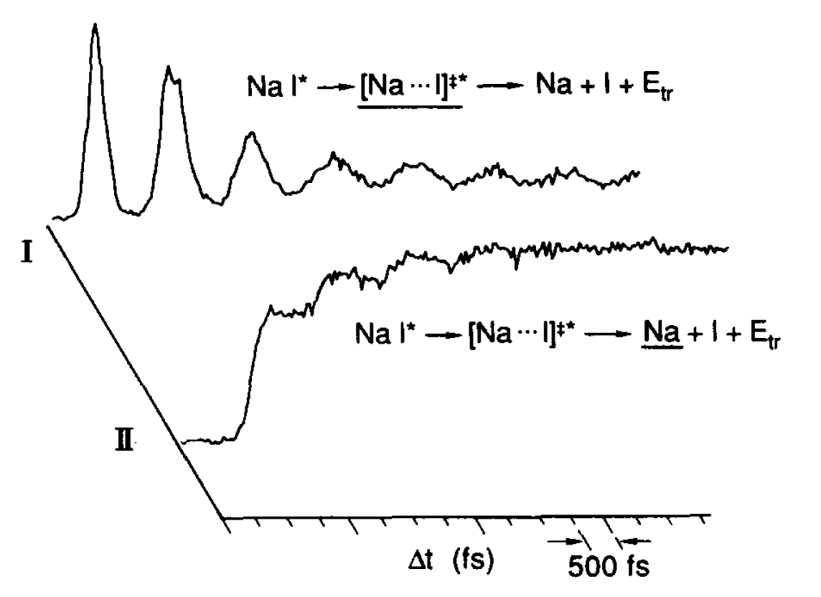
Molecular Vibration and Chemical Reaction
Photodissociation Reaction of NaI.
If the pulse duration is sufficiently short, it can induce and monitor the molecular vibration.
The product, Na atom (II), is produced stepwise each time when the molecule is stretched (I).
Todd S. Rose1, Mark J. Rosker1 and Ahmed H. Zewail1
J. Chem. Phys., 1998, 88, 6672

Slide 13
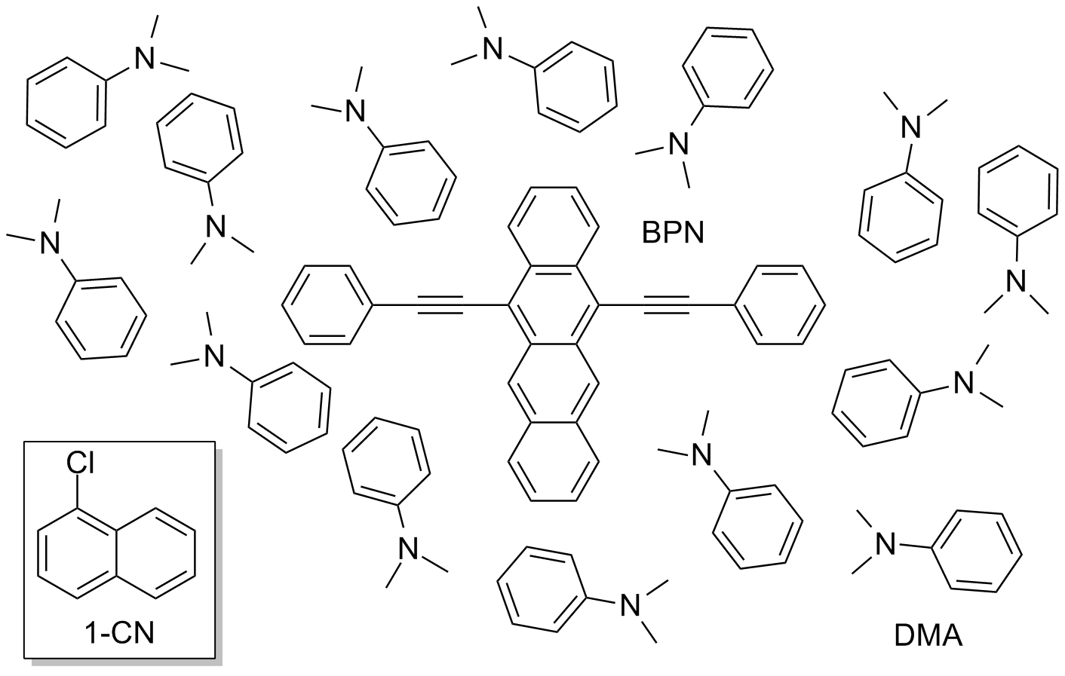
Ultrafast Electron Transfer System
A Dye Dissolved in an Electron Donating Solvent
BPN: 5,12-Bis(phenylethynyl)-naphthacene
DMA: N,N-Dimethylaniline
Electron donating solvent
1-CN: 1-Chloronaphthalene
An ineart solvent
The electron acceptor is always surrounded by donors, the electron transfer occurs for the most favorable pair without any molecular diffusion (a few 100 fs ~ a few ps).

Slide 14
Transient Absorption Spectroscopy Measurement
(Time Resolved Electronic Spectra)
t
S_{n}
Probe
Probe
S₁
Sample
Detector
Pump
Pump
S₀
ΔA: Transient absorbance
I: Intensity of transmitted light without pump pulse
I’: Intensity of transmitted light with pump pulse
$$ΔA= log\frac{I}{I′}$$
A few tens of femtoseconds (10 × 10⁻¹⁵ s) time resolution!
transient absorption 過渡吸収

Slide 15
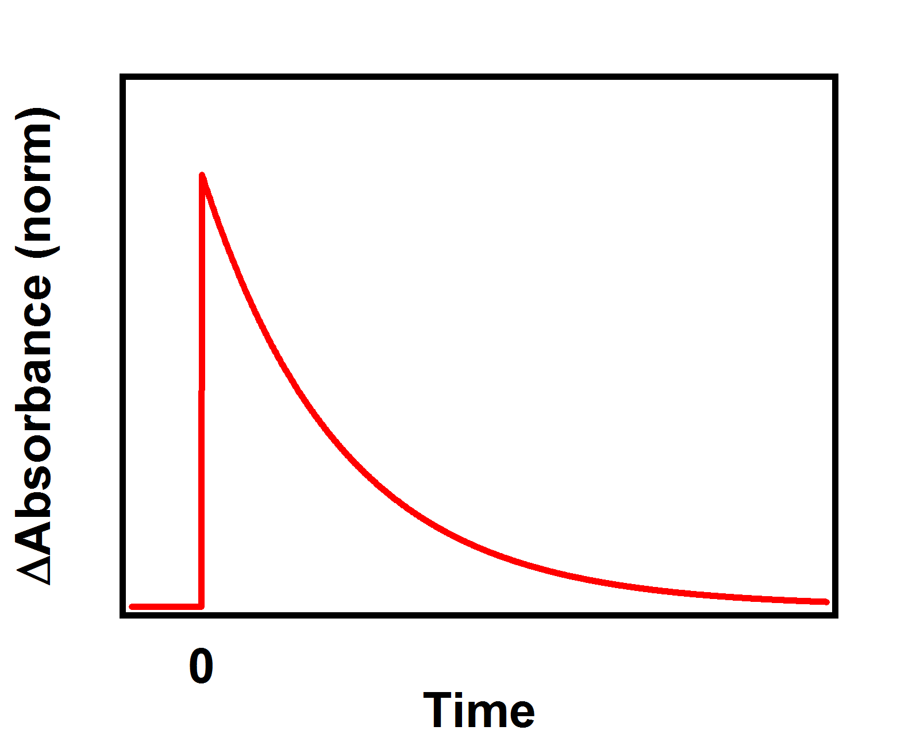
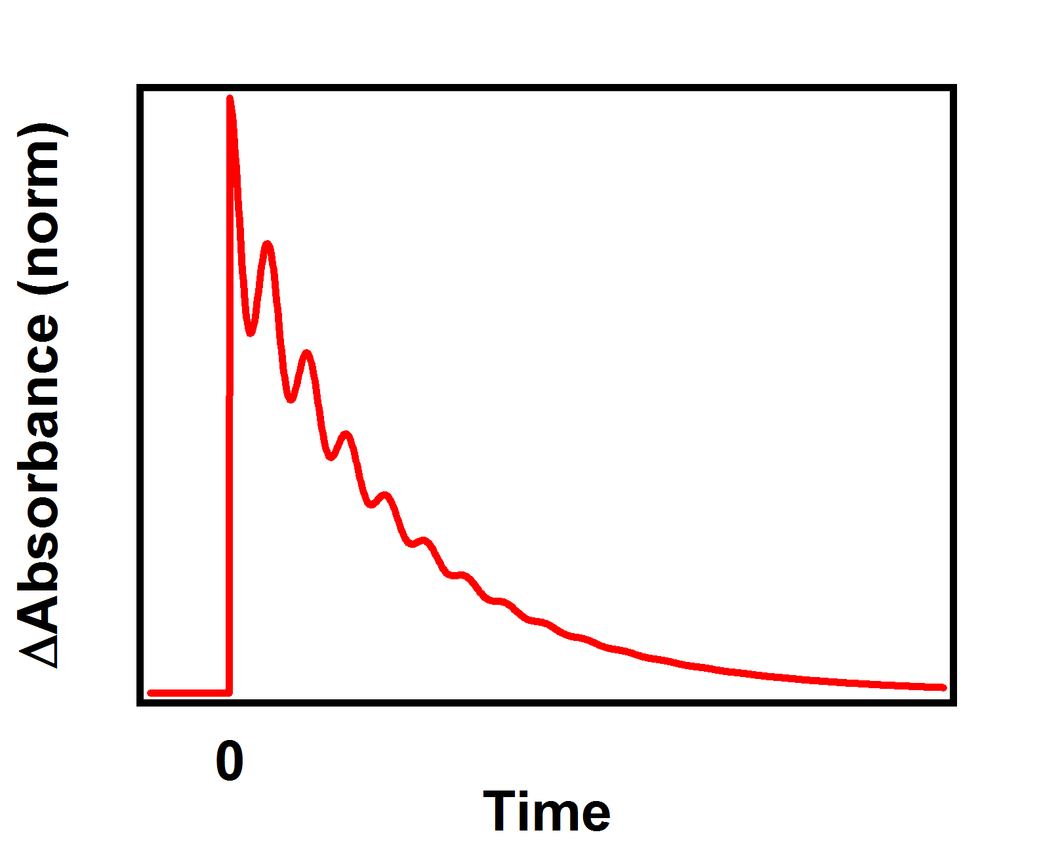
Wavepacket Motion
(a) Wavepacket in excited state
(b) Wavepacket in ground state
S_{n}
S_{n}
Probe
S₁
S₁
Pump
Pump
S₀
S₀
Wavepacket is produced when the pulse duration is shorter than the half period of molecular vibration.
Time evolution of wavepacket corresponds to the nuclear motion.
wavepacket motion 核波束運動

Slide 16
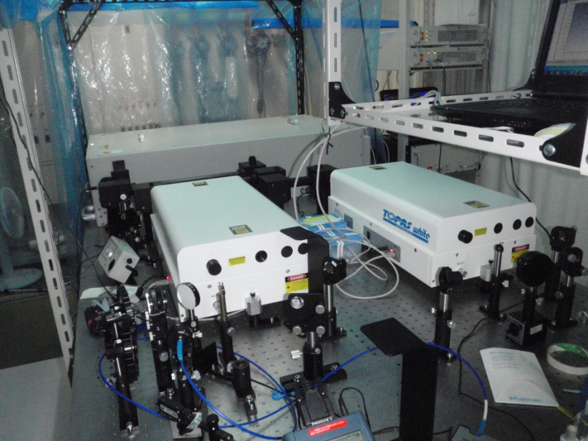
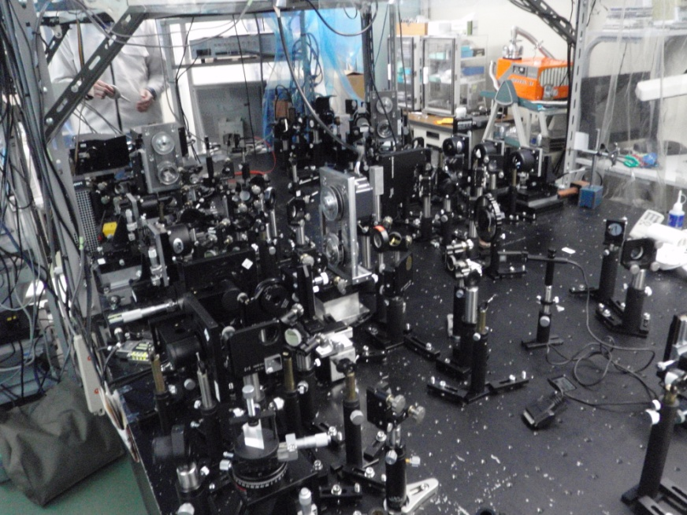
Experimental Setup
Solstice
TOPAS White
・Regenerative Amplifid Ti : Sapphire laser（Spectra Physics, Solstice, 1 KHz, 802 nm, 4.2 W）
pulse laser light source
・NOPA（Non-collinear optical parametric amplifier）（Light Conversion, TOPAS White）
wavelength converter

Slide 17
Optics System
Regulation of delay time
Change optical distance （3 μm = 10 fs）
ND
f=100mm
SM
f=35mm
f=300mm
DL
PM
CM
CaF₂
Probe
sample
f=100mm
CM
OP1
MCPD1
Pump
f=35mm
BP
OP2
SM
Continuum generation
DL : Delay line
(中央精機, ALS-150)
OP : Optical chopper
(New Focus, Model 3501)
PM : Parabolic mirror
ND : Neutral density plate
BP : Bereck plate
SM : Spectometer
MCPD2

Slide 18
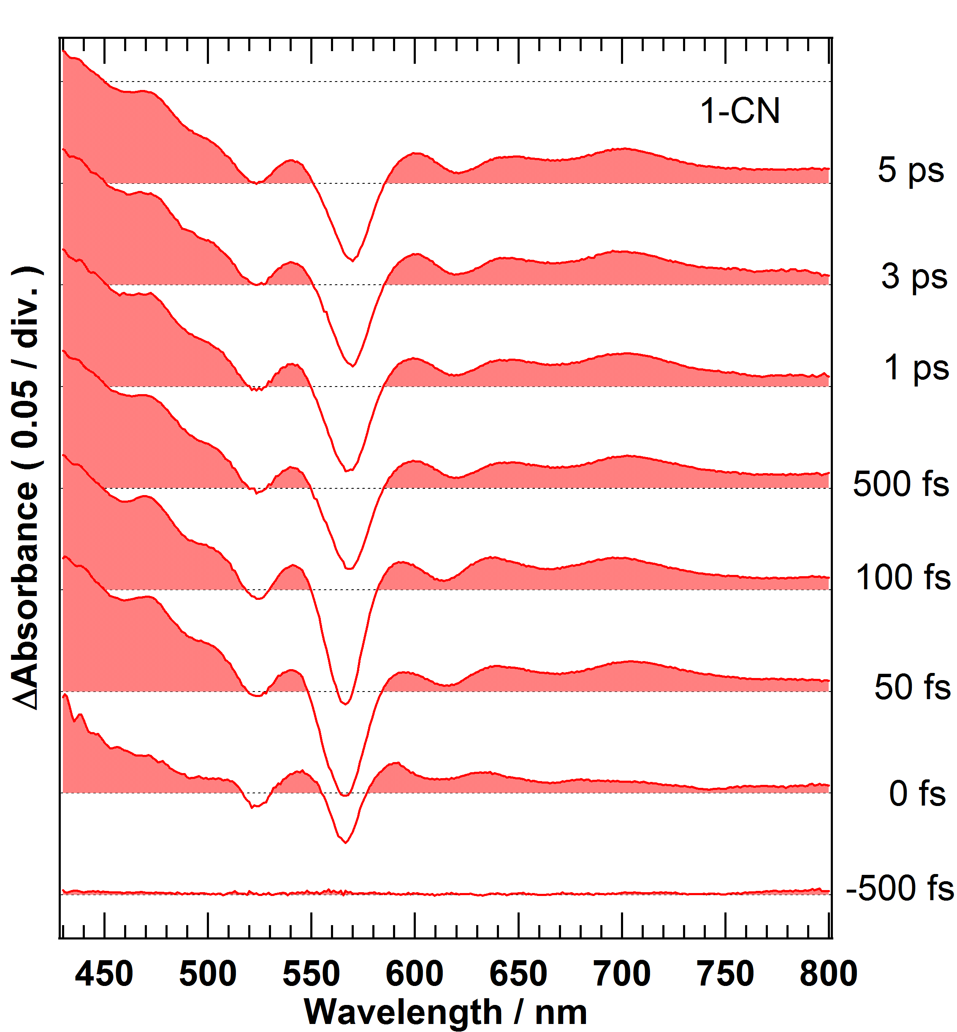
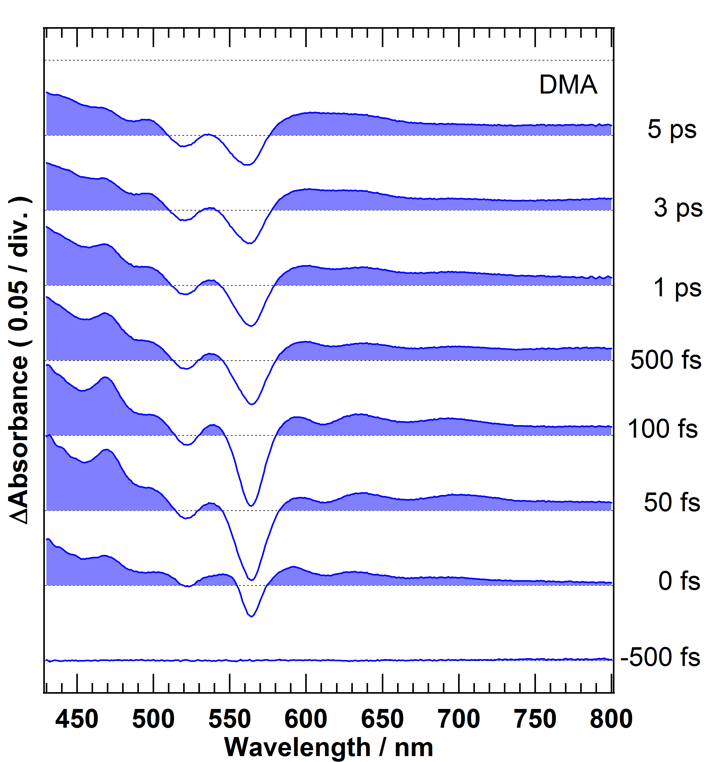
Transient Absorption Spectra
Excited State Absorption
Ground State
Bleach
Stimulated Emission
Excited at. 560 nm Pulse duration 18 fs Excitation power 35 nJ
Excites State Absorption 励起状態の吸収
Ground State Bleach 基底状態のブリーチ
Stimulated Emission 誘導放出
1-CN: Nearly no change was observed in this time range.
DMA: Stimulated emission disappeared in a few ps due to the ET.

Slide 19
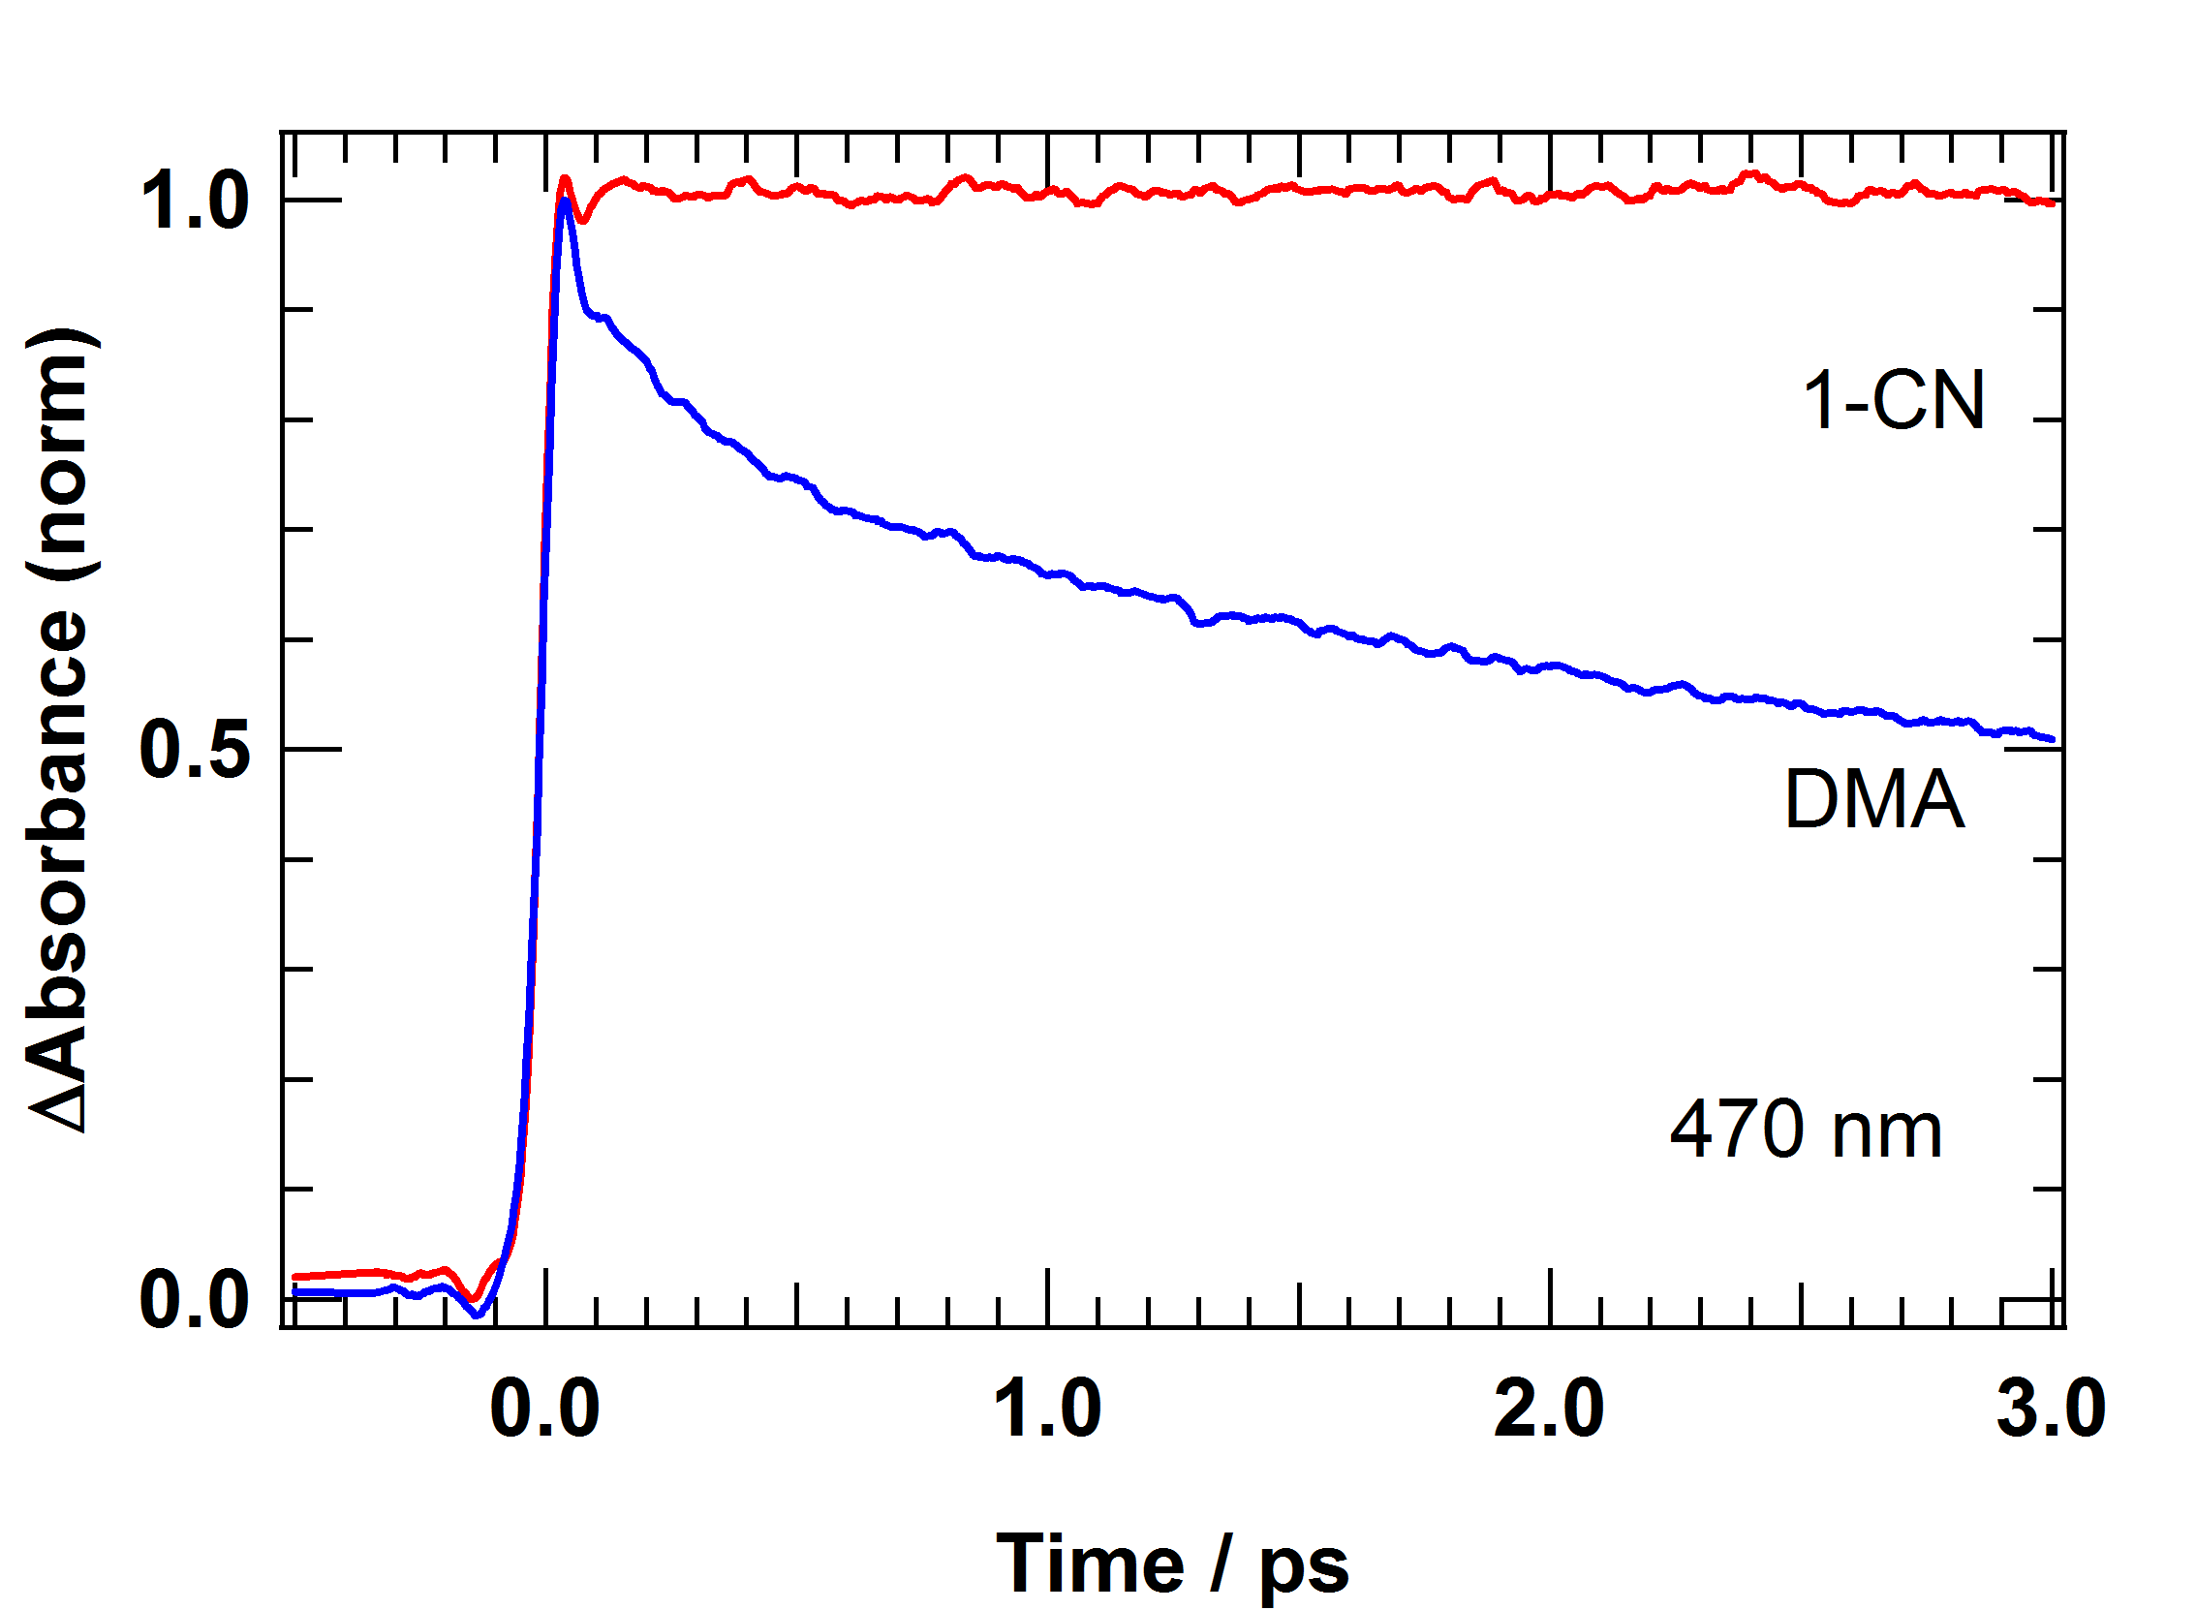
Electron Transfer Rate
1-CN: No decay was observed in this time range.
DMA: Ultrafast decay due to the electron transfer.
τ₁ = 230 fs τ₂ = 3.2 ps

Slide 20
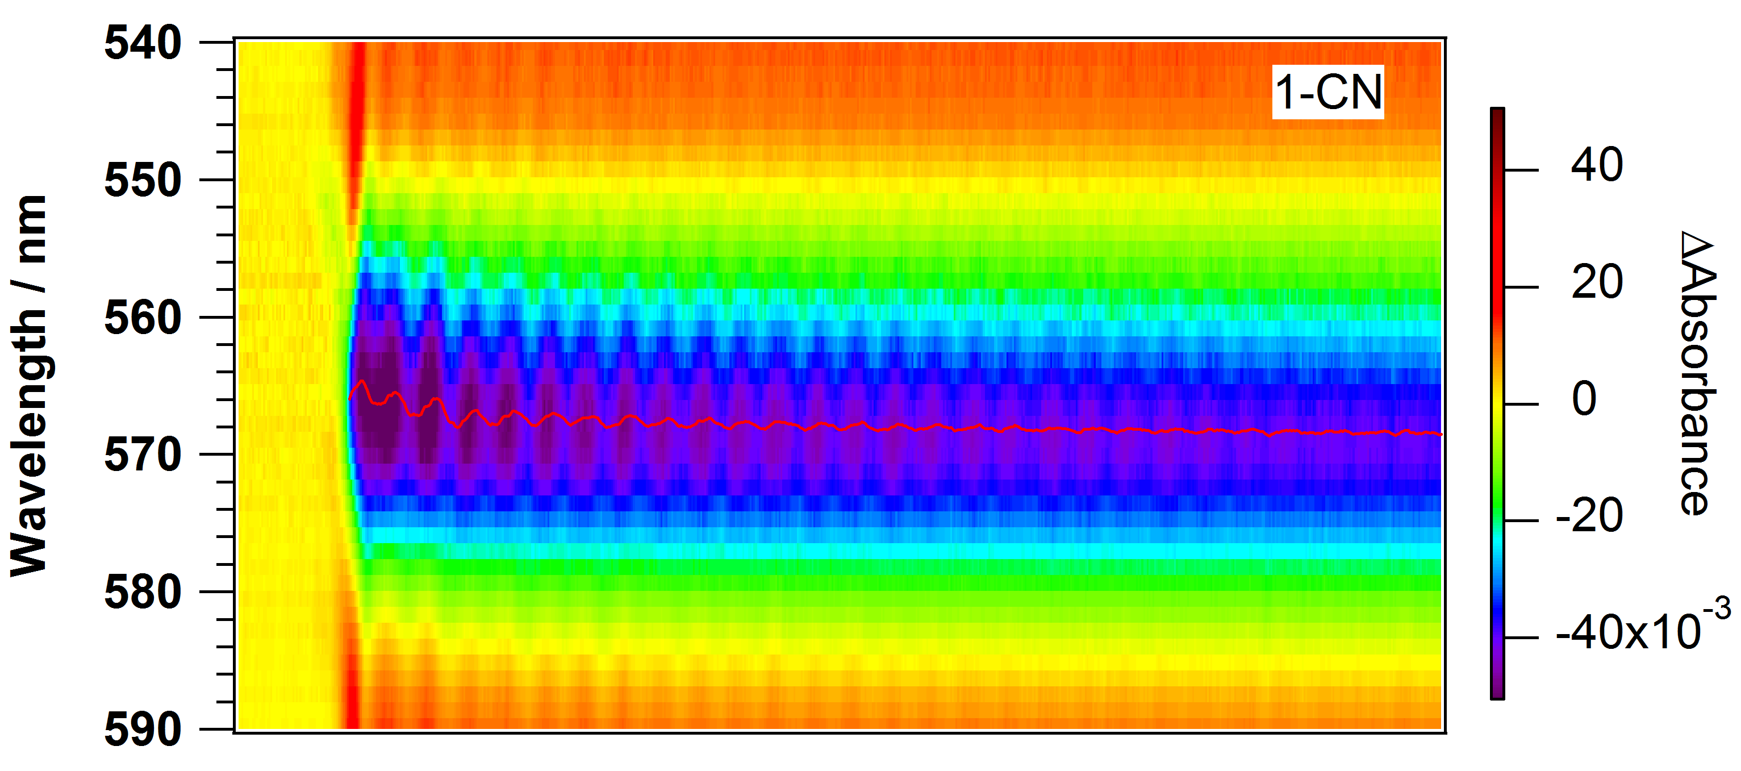
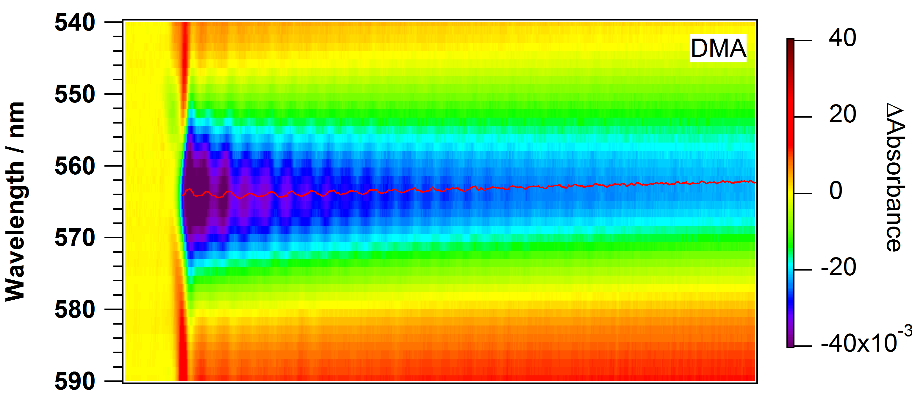
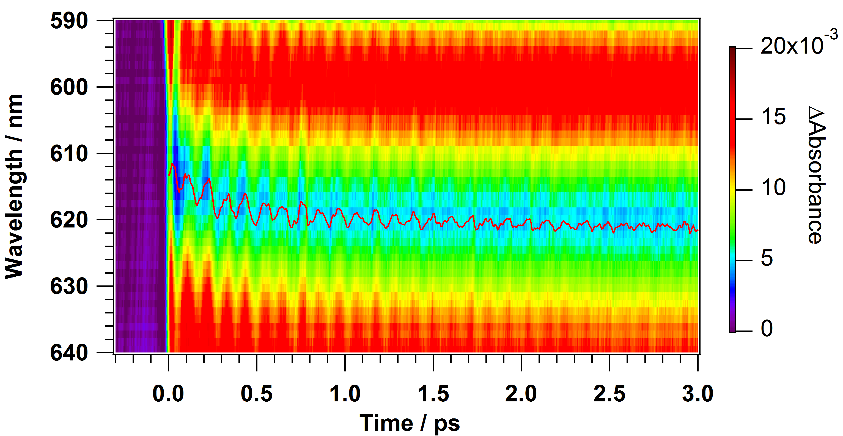
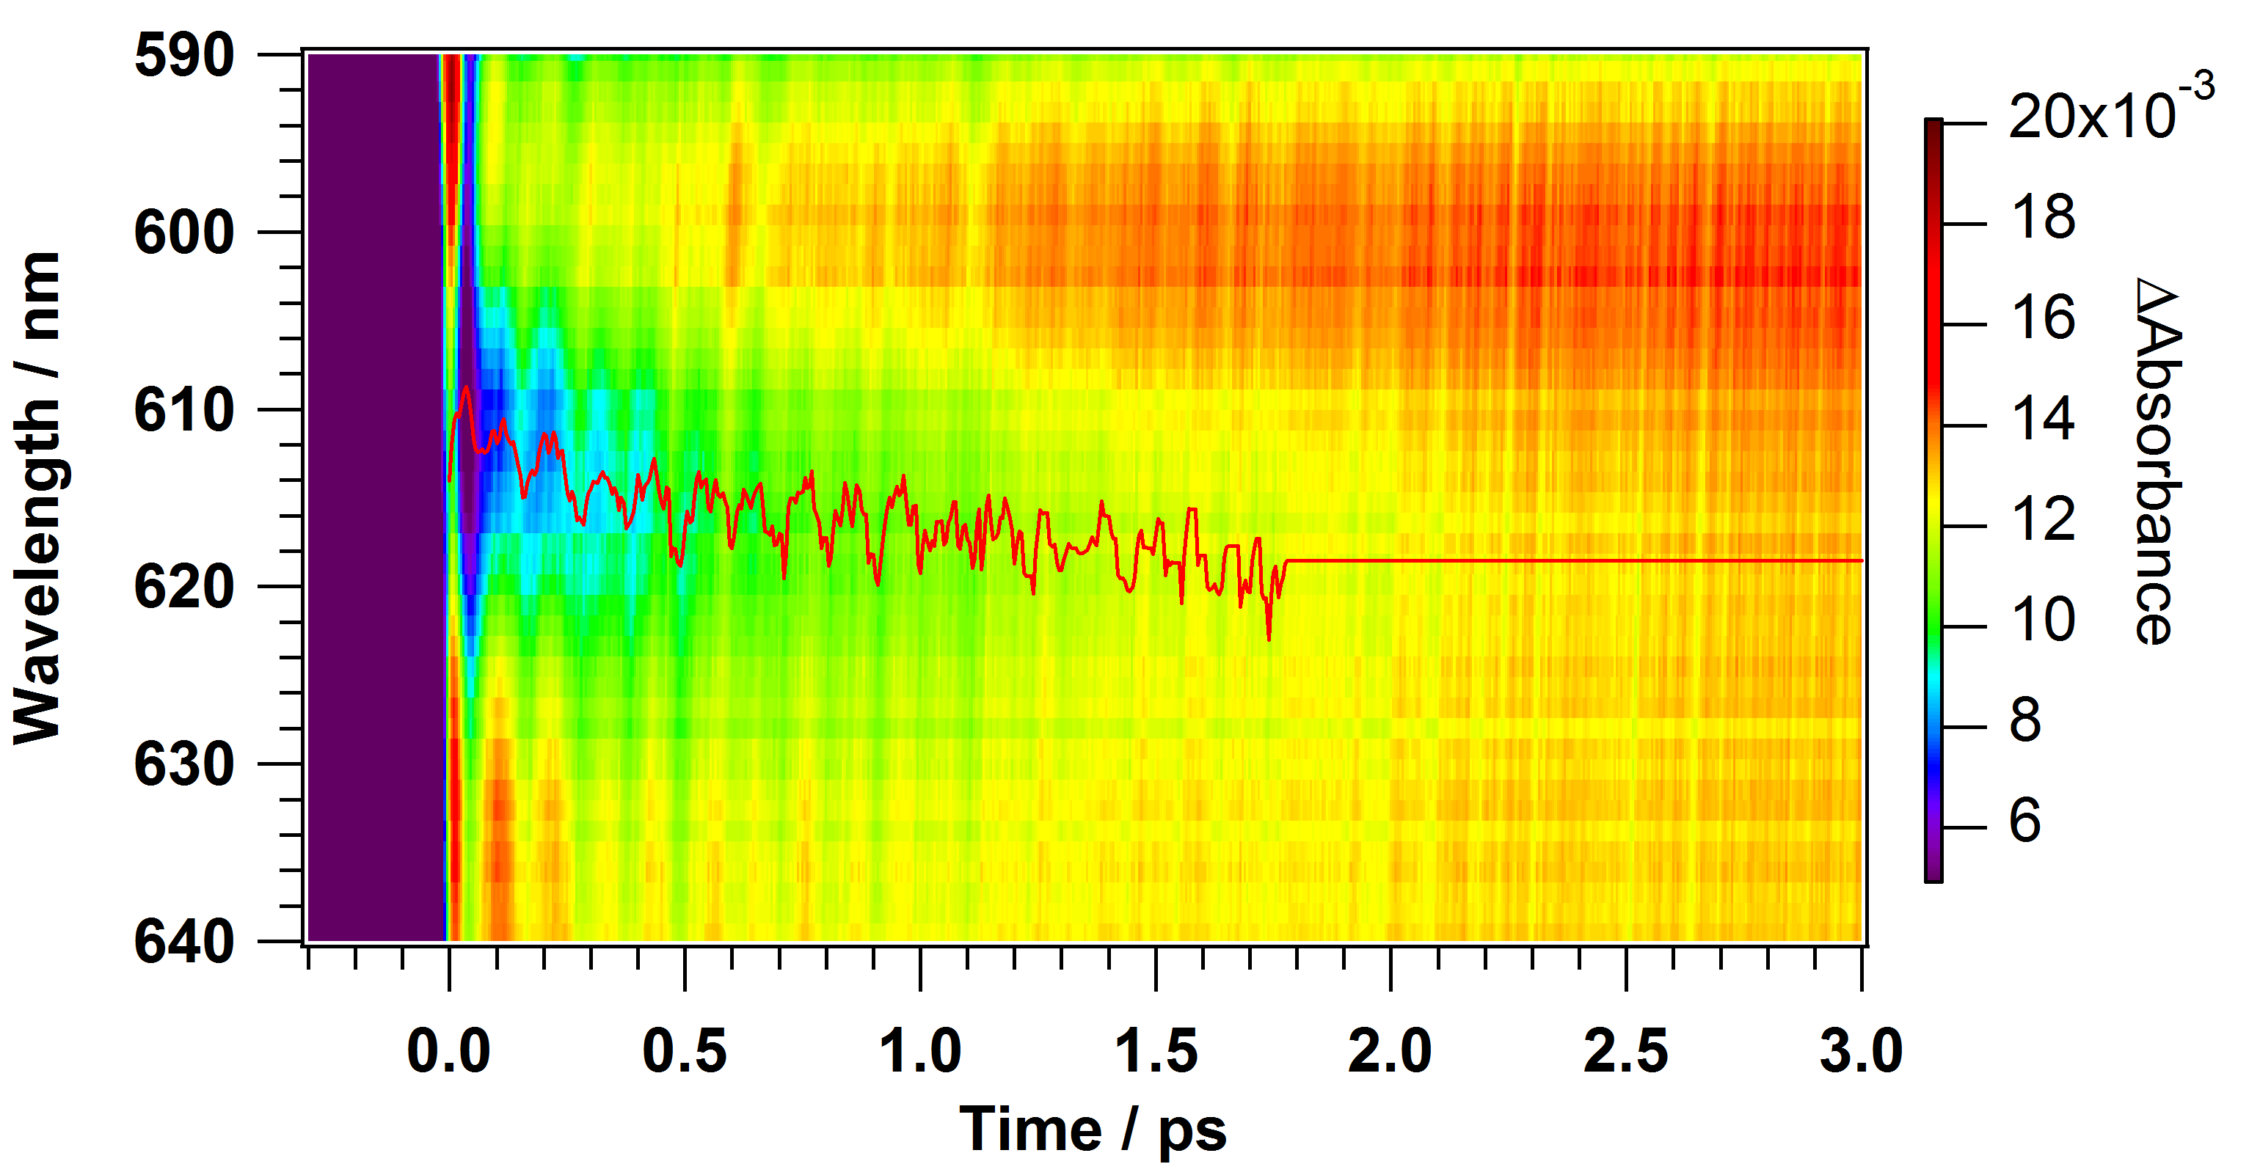
2D Plot of Transient Absorption
Bleach
Stimulated emission
1-CN: The peak of the ground bleach and the stimulated emissioin were modulated by coherent nuclear wavepacket motion.
DMA: Stimulated emission signal disappeared in a few ps due to the ET.
modulate 変調

Slide 21
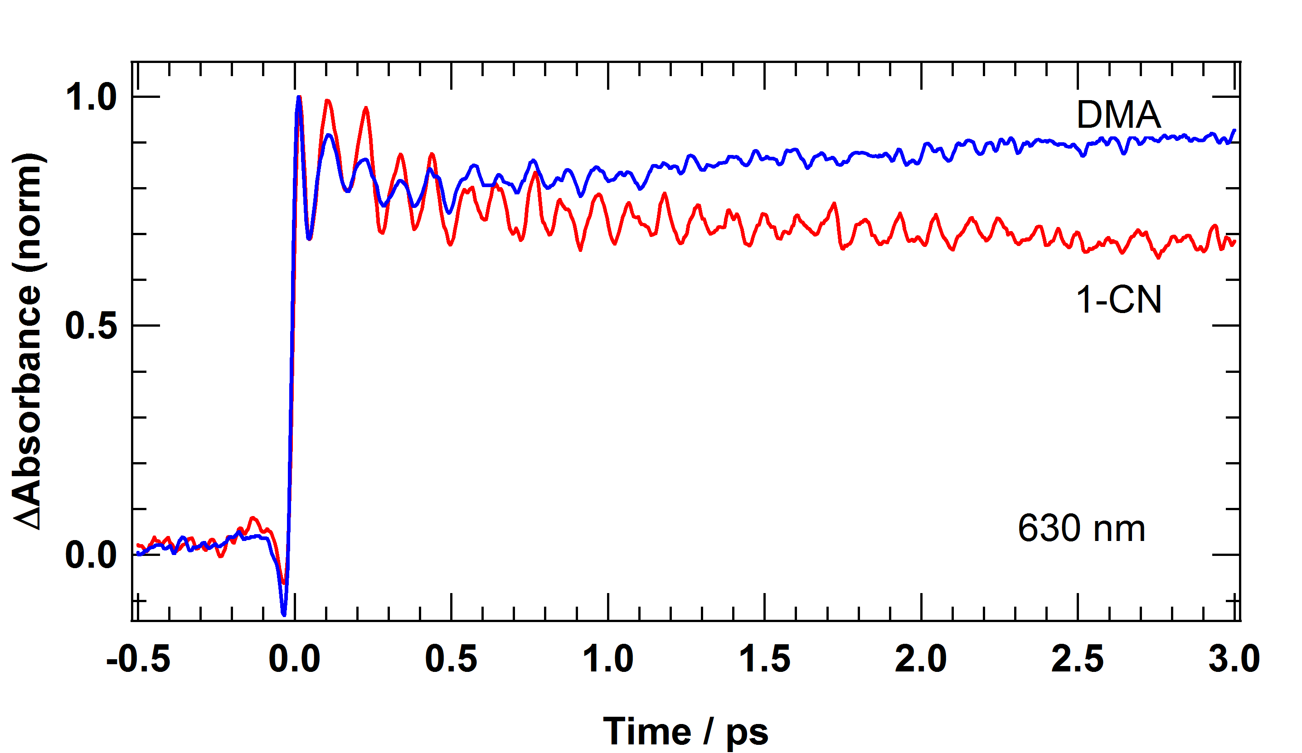
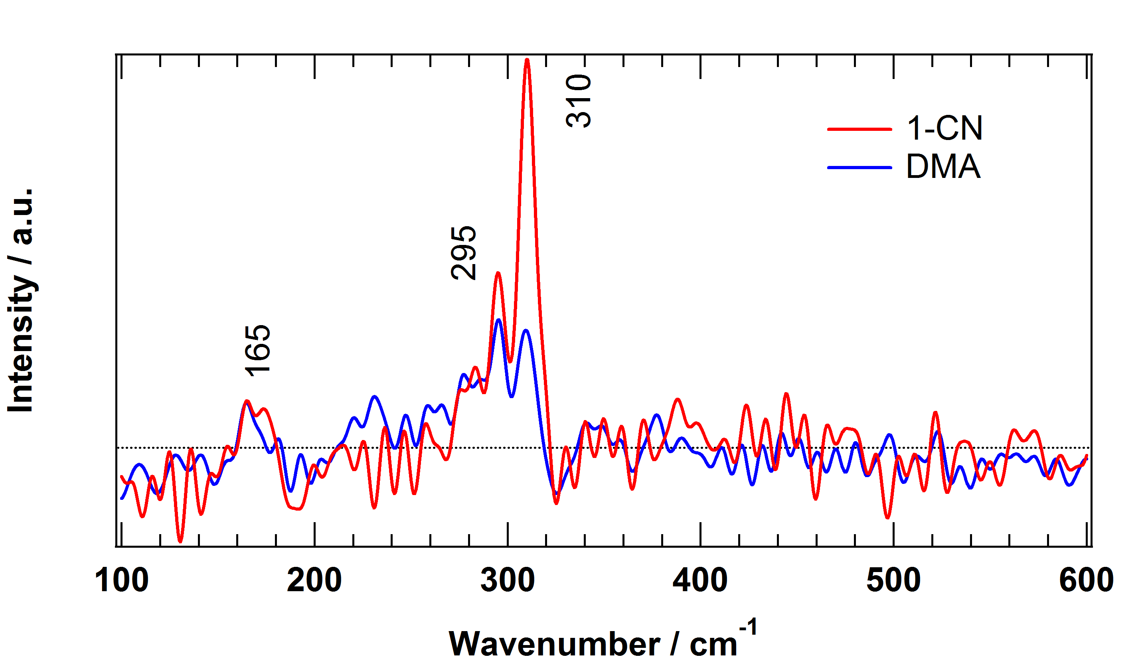
Wavepacket Motion in The Excited State
Time Evolution of Transient Absorbance
Fourier Transformed Spectra
1-CN: Coherent wavepacket motion was observed.
DMA: The oscillation was reduced by the electron transfer.
The band at 310 cm⁻¹ is dominant in 1-CN and it is significantly reduced in DNA.
→ 310 cm⁻¹ oscillation is strongly perturbed by the electron transfer!

Slide 22
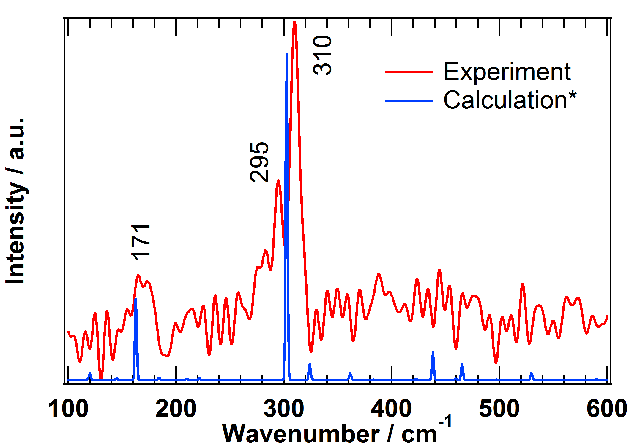
Quantum Mechanical Calculation
Calculation: Franck Condon factor
Calc. with Gaussian 09
Ground State B3LYP/6-31G
Excited State TD B3LYP / 6-31G
162 cm⁻¹ *
303 cm⁻¹ *
*scaled value
J. P. Merrick, et al., J. Phys. Chem. A 2007, 111, 11683-11700
Gaussian 09, Revision D.01, M. J. Frisch, G. W. Trucks, H. B. Schlegel, G. E. Scuseria, M. A. Robb, J. R. Cheeseman, G. Scalmani, V. Barone, B. Mennucci, G. A. Petersson, H. Nakatsuji, M. Caricato, X. Li, H. P. Hratchian, A. F. Izmaylov, J. Bloino, G. Zheng, J. L. Sonnenberg, M. Hada, M. Ehara, K. Toyota, R. Fukuda, J. Hasegawa, M. Ishida, T. Nakajima, Y. Honda, O. Kitao, H. Nakai, T. Vreven, J. A. Montgomery, Jr., J. E. Peralta, F. Ogliaro, M. Bearpark, J. J. Heyd, E. Brothers, K. N. Kudin, V. N. Staroverov, R. Kobayashi, J. Normand, K. Raghavachari, A. Rendell, J. C. Burant, S. S. Iyengar, J. Tomasi, M. Cossi, N. Rega, J. M. Millam, M. Klene, J. E. Knox, J. B. Cross, V. Bakken, C. Adamo, J. Jaramillo, R. Gomperts, R. E. Stratmann, O. Yazyev, A. J. Austin, R. Cammi, C. Pomelli, J. W. Ochterski, R. L. Martin, K. Morokuma, V. G. Zakrzewski, G. A. Voth, P. Salvador, J. J. Dannenberg, S. Dapprich, A. D. Daniels, Ö. Farkas, J. B. Foresman, J. V. Ortiz, J. Cioslowski, and D. J. Fox, Gaussian, Inc., Wallingford CT, 2009.

Slide 23
Conclusion
The rates of the electron transfer reaction were estimated to be 230 fs and 3.2 ps.
We have observed coherent wavepacket motion in the ground state bleach, the stimulated emission.
The wavepacket motion in the stimulated emission can be assigned to the excited state.
The 310 cm⁻¹ oscillation was strongly perturbed by the ultrafast ET.

