Slide 1
Nanoscale imaging and control of resistance
switching in VO₂ at room temperature
Jeehoon Kim, Changhyun Ko, Alex Frenzel, Shriram Ramanathan,
and Jennifer E. Hoffman
APPLIED PHYSICS LETTERS 96, 213106 (2010)
Tanaka lab.
Kotaro Sakai

Slide 2
Contents
・Introduction
Strongly correlated electron system
The characteristics of VO₂
Domain structure in VO₂
・Experiment
Methods
Result & Discussion
・Summary
・Future work

Slide 3
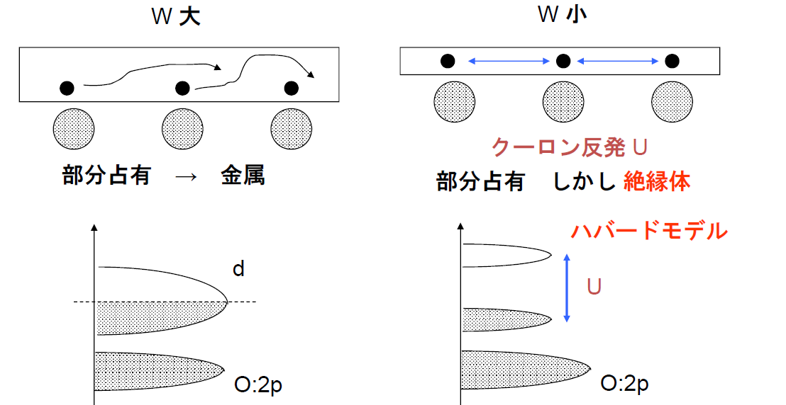
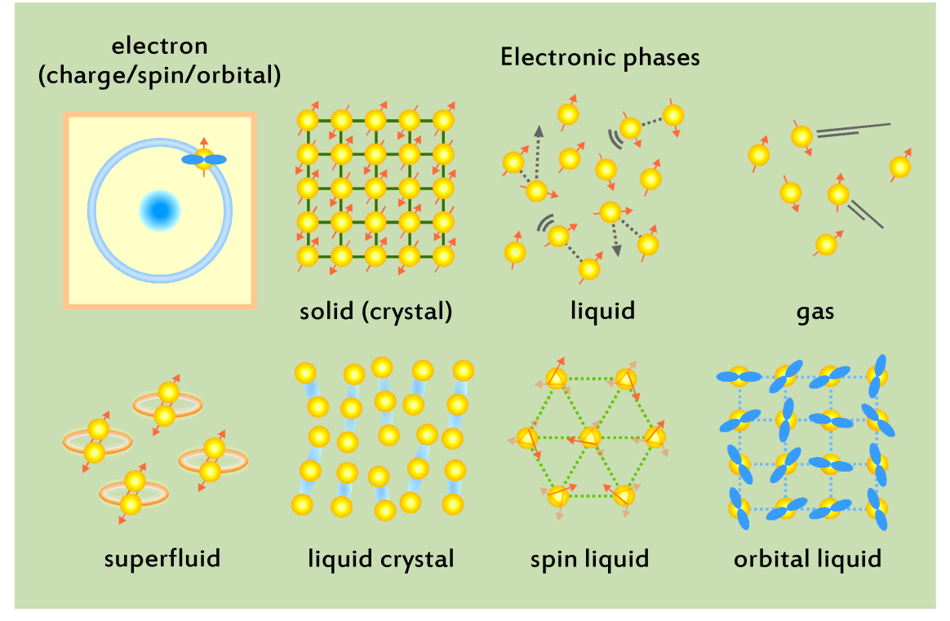
Strongly correlated electron system
Band Width : wide
Band Width : narrow
Coulomb's repulsion U
Partial occupation ⇒
Metal
Partial occupation ⇒ but Insulator
Stimulation
Temperature
Electric field
Magnetic field
Light

Slide 4
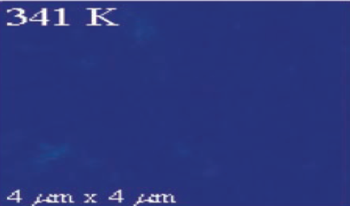
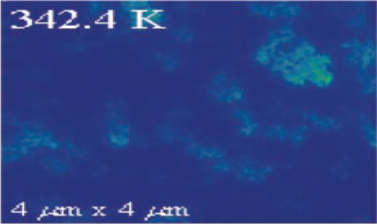
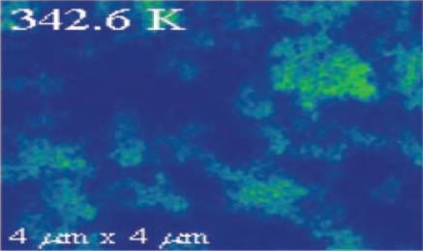
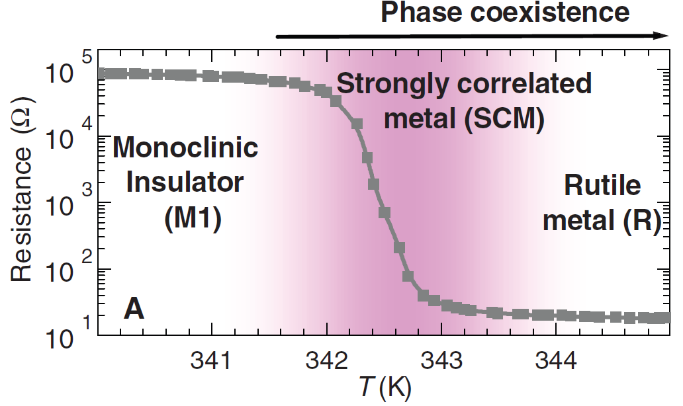
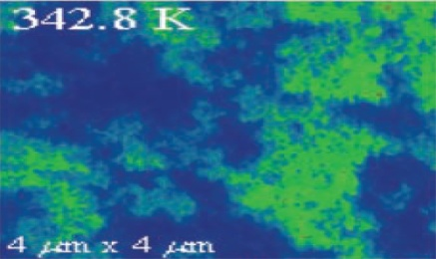
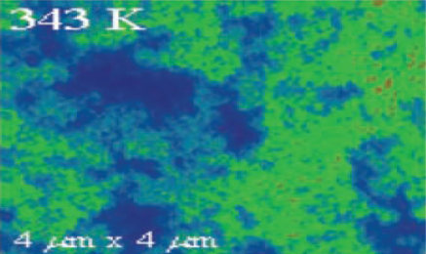
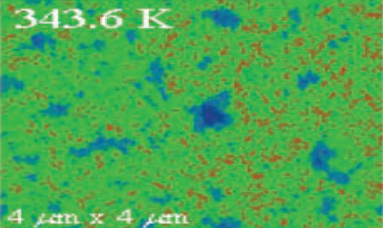

The characteristics of VO₂
Science 318, 1750 (2007)
High-T: metal
Low-T: insulator

Slide 5
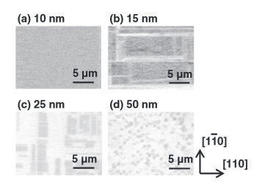
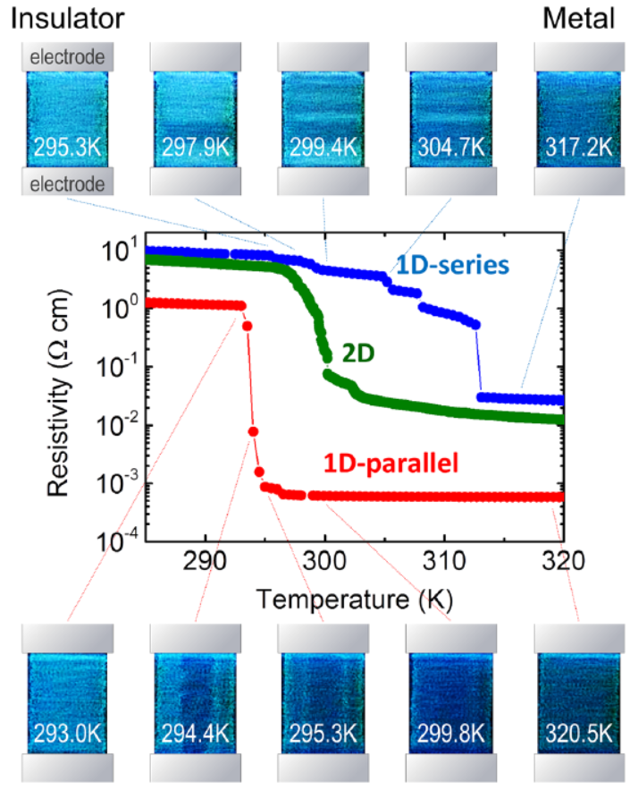
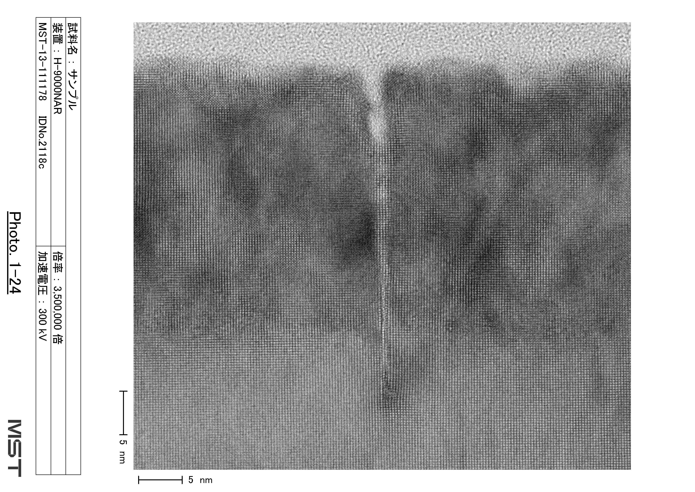
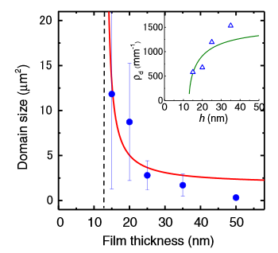
Domain configuration
crack
VO₂
TiO₂
VO₂
TiO₂
[001]
10nm
[110]

Slide 6
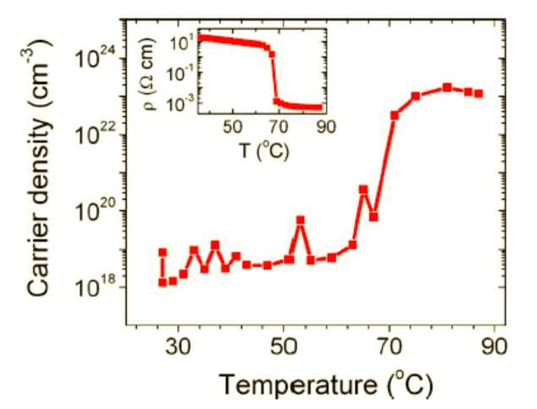
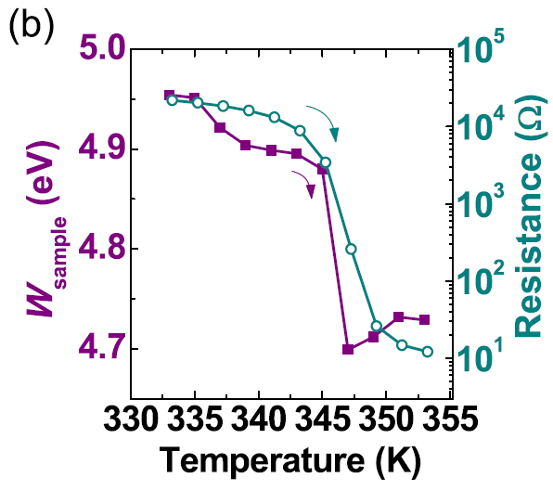

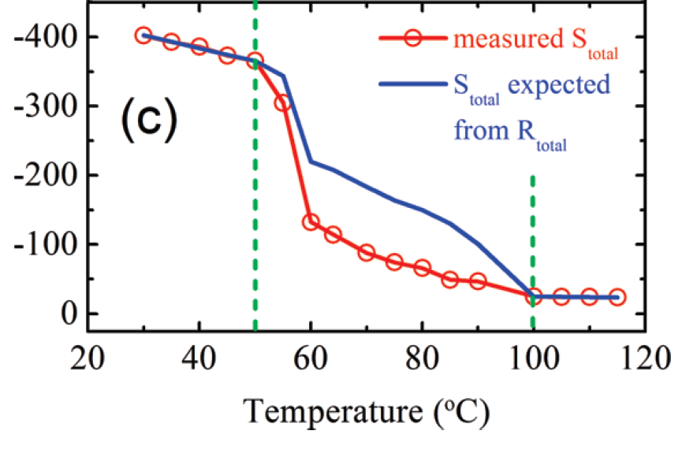
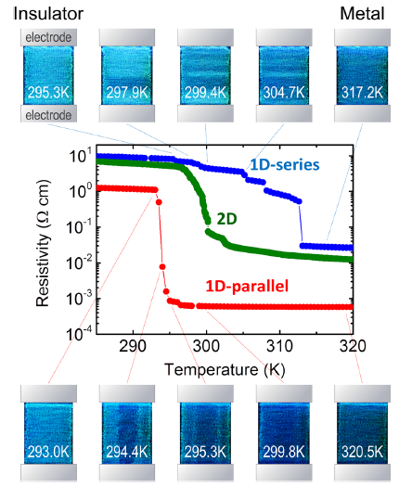
The characteristics of VO₂
・Carrier density
・Work function
Phys. Rev. B 79, 153107 (2009)
・Seebeck coefficient
Appl. Phys. Lett. 101, 191605 (2012)
Insulator
Metal + Insulator
Metal
・Transmittance
Nano Lett. 9, 4001(2009)
Appl. Phys. Lett. 102, 153106(2013)

Slide 7
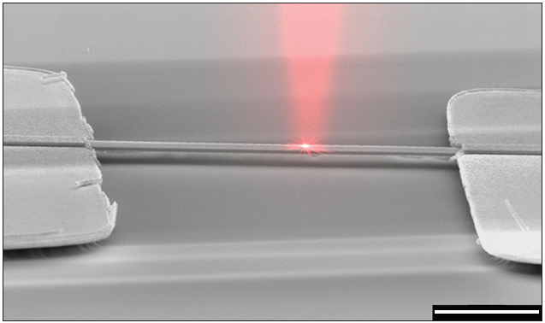
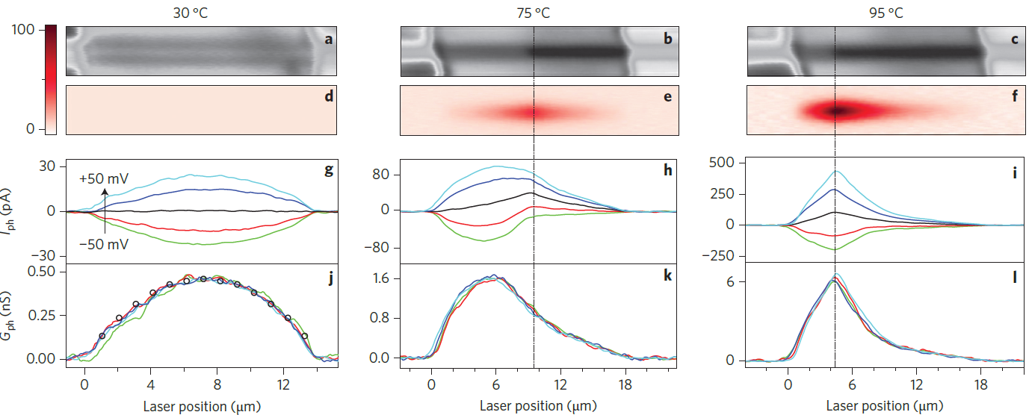

Domain boundary
Nature Nanotech. 7, 723 (2012)

Slide 8

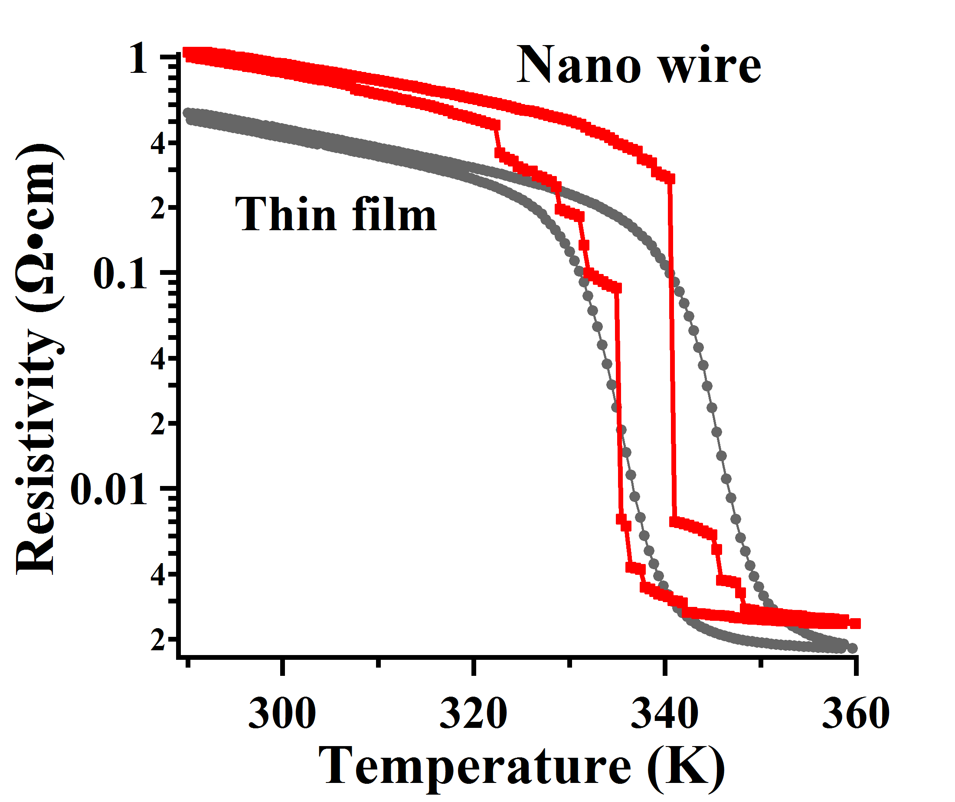
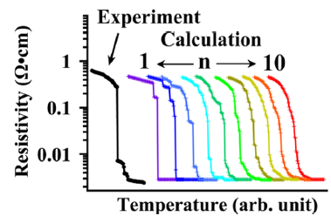
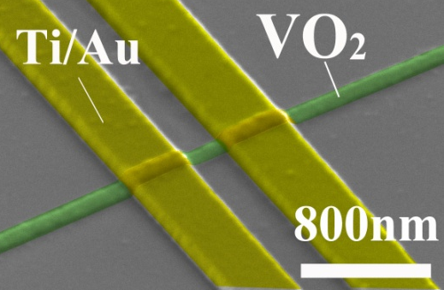
Nano domain in VO₂
・Step resistivity changes in 200nm VO₂ wire on Al₂O₃(0001)
n=4
50nm
Appl. Phys. Lett. 104, 023104 (2014)
Domain size ＝ 50nm～

Slide 9
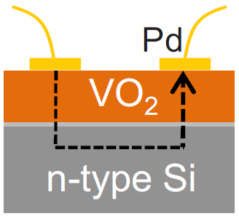
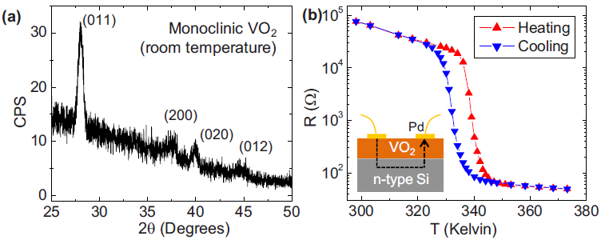
Sample details
・VO₂
Thickness : 200 nm
Rms roughtness : ～ 6 nm
・Si substrate (As-doped)
Resistivity : 0.002-0.005 Ωcm

Slide 10
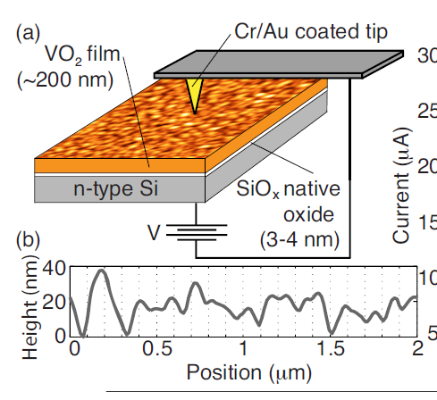
Measurement system
VO₂
I
n-type Si
grain
on Al₂O₃ or Si
（Volmer-Weber growth mode)

Slide 11
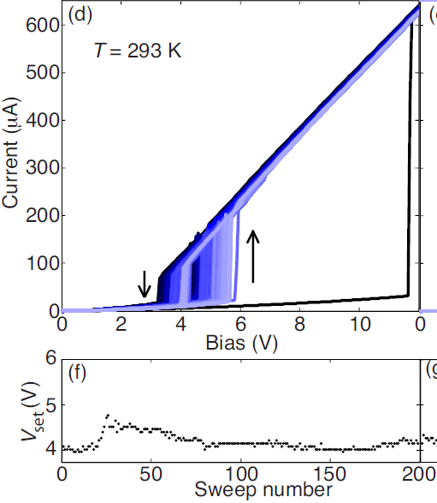

Transition by applied voltage
VO₂
I
n-type Si
P=100μW
VO₂
I
n-type Si
・They succeeded to demonstrate a threshold switching
by Joule heating.

Slide 12
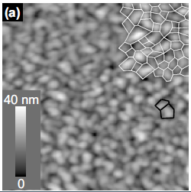
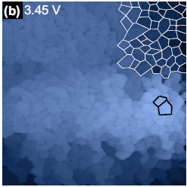
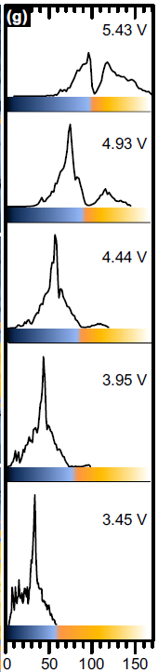
Domain mapping
I
500nm
・The insulating state displays variations
in conductivity up to 100%.
・Conductivity appears lower in the grain boundary.
Current (μA)

Slide 13
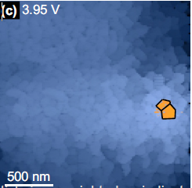
Domain mapping
500nm
・The metallic state nucleates at the grain
with largest insulating-state conductivity

Slide 14
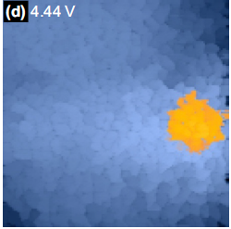
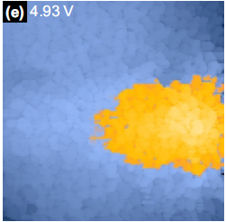
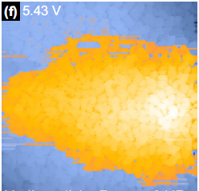
Domain mapping
・Lower conductivity grain boundaries remain
apparent as well as the insulating phase.
Current (μA)

Slide 15
Summary
・They demonstrated a threshold switching by using
metal-insulator transition in a single domain of VO₂.
・This transition results most directly from
Joule heating.
・Conductivity appears lower in the grain boundaries
due to a different stoichiometric phase.

Slide 16
Future work
grain
・・・・・・・・・・・・・・・・・
・・・・・・・・・・・・・・・・・・・・・・・
・・・・・・・・・・・・・・・・・・・・・・・
on TiO₂
（Frank van der Merwe growth mode)
on Al₂O₃ or Si
（Volmer-Weber growth mode)
No crack & grain boundary
crack
VO₂
TiO₂
VO₂
TiO₂
[001]
10nm
[110]

Slide 17


Future work
A cantilever coated with Pt or Rh
Sample stage (Cu)
I
Nb-dope TiO₂
Science 318, 1750 (2007)

Slide 18
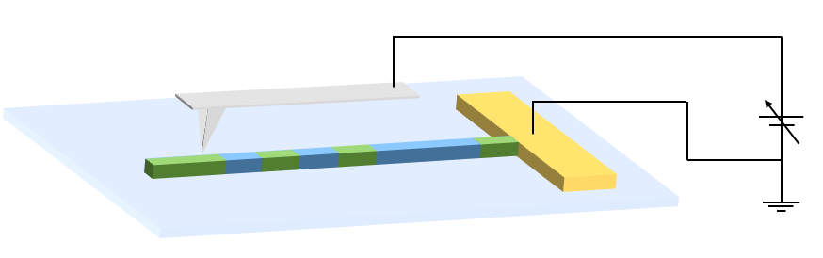
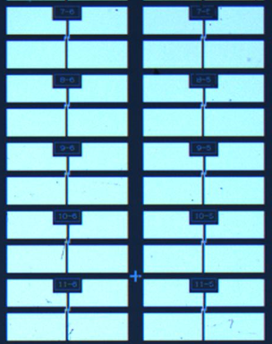
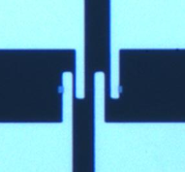
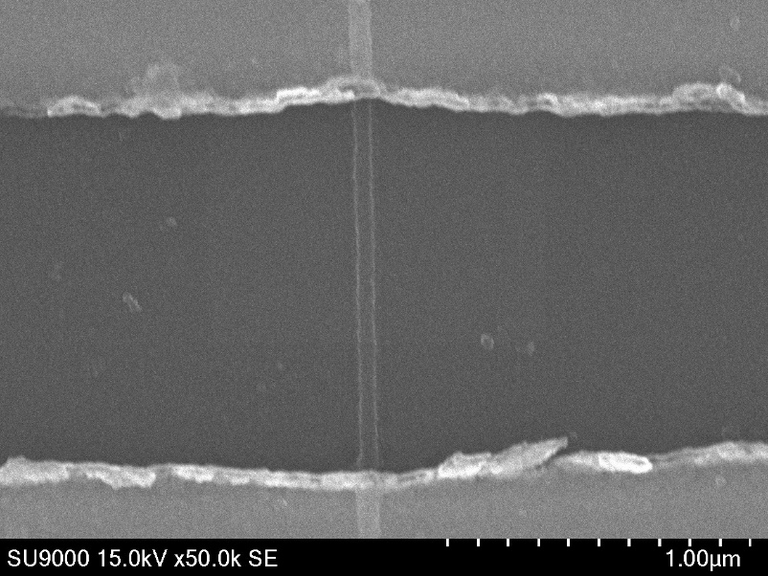
Future work
Pt
Pt coated tip
TiO₂ substrate
I
L
Metal
Insulator
Pt
AFM image
Pt
Pt
VO₂ nano-wire
VO₂ nanowire
50nm
300μm
20μm
500nm
Pt

Slide 20
Lattice mismatch
crystal | VO₂ | TiO₂ | Al₂O₃
Lattice constant (nm) | 0.455 | 0.459 | 0.476
Lattice mismatch(%) | - | 0.863 | 4.41

Slide 21
R-T curve on Nb doped TiO2
Nb-dope TiO₂substrate
z
VO₂
VO₂-VO₂
・
・
・
・
Resistance[Ω]
VO₂-TiO₂(Nb dope)
Temperature[K]

