Slide 1
Ferroelectricity induced by collinear magnetic order in Ising spin chain
Yoshida lab
Ryota Omichi

Slide 2
Contents
Introduction
Multiferroic
Ferroelectricity
First principles calculation
Density of functional theory
Motivation
Calculation methods
Results
Summery
Future work

Slide 3
Multiferroic
E
H
Magnetoelectric effect
P
M
+
−
N
S
N. A. Spaldin and M. Fiebig, Science 309, 391 (2005)
Ferroic :: P,M or ε are spontaneously formed to produce ferroelectricity, ferro/antiferro-magnetism or ferroelasticity
Multiferroic :: co-existence of at least two kinds of ferroic orderings
Magnetoelectricity :: Control of P(M) via a magnetic(electric) field

Slide 4
Ferroic quantities
Ferroic (M and P) quantities are classified by their symmetry transformations under space and time reversal.
1’
1
M
-M
M
M
P
P
P
-P
M
P
M_{s}
P_{s}
H_{c}
H
E_{c}
E
Notes:
----- 会議メモ (2014/10/31 16:30) -----
磁化と自発分極。
時間反転対称性と空間反転対称性。

Slide 5
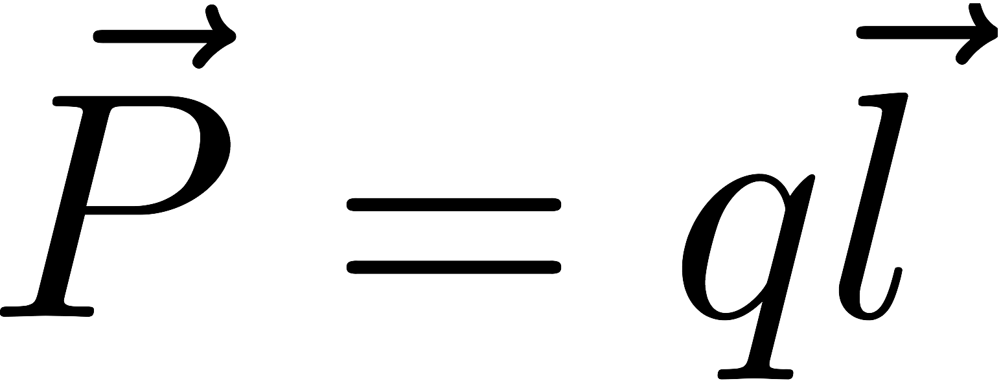
Ferroelectrics
Crystals having a spontaneous electric
polarization are pyroelectrics. For example,
GaN and ZnO are pyroelectrics
Ferroelectrics are pyroelectrics, where the spontaneous polarization can be reversed by an electric field
+
-
P
P_{s}
Ferroelectrics
E_{c}
E
Pyroelectrics
Notes:
----- 会議メモ (2014/10/31 16:30) -----
ガリウム内とライド
ジンクオー
が詳伝帯
自発分極は結晶中の磁気モーメントの和ののこったやつ
空間反転対称性があると０になる。
PsとEc

Slide 6
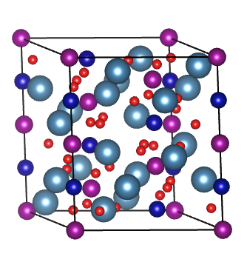
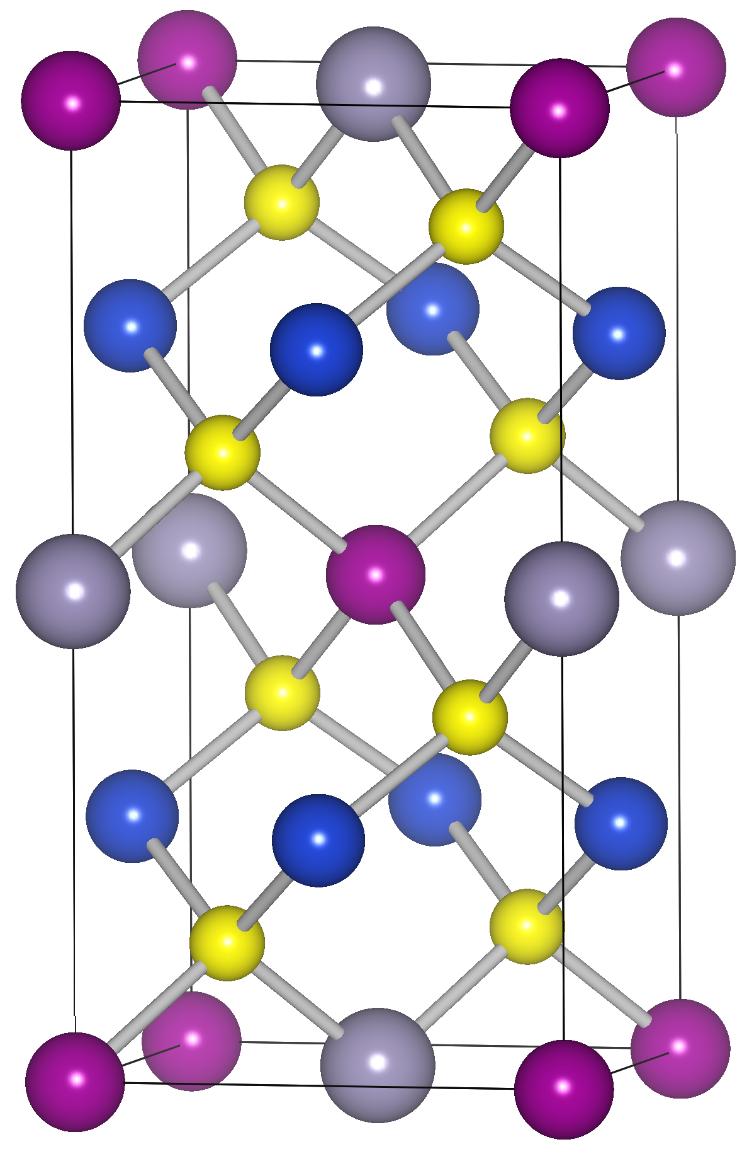
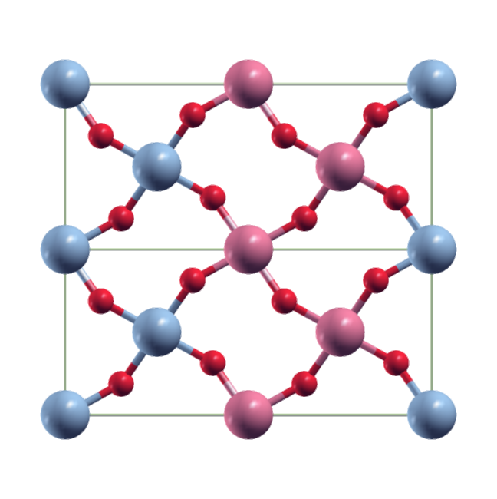
Ferroelectricity
FERROELECTRICITY
proper
improper
Ionic displacement breaks inversion
symmetry
Electron degrees of freedom breaks inversion symmetry
In order to obtain a large magnetoelectronic coupling, we
investigate improper ferroelectrics by first-principles and model
approaches.
Spin-order (AFM)
S. Picozzi et al., Phys. Rev. Lett. 99,
227201 (2007)
Spin-order (AFM)
T. Fukushima et al.,
Phys. Rev. B. 82,
014102 (2010)
Ca
Mn
Co
Cu₂MnSnS₄
O
HoMnO₃
Notes:
Ca3CoMnO6について発表する。

Slide 7
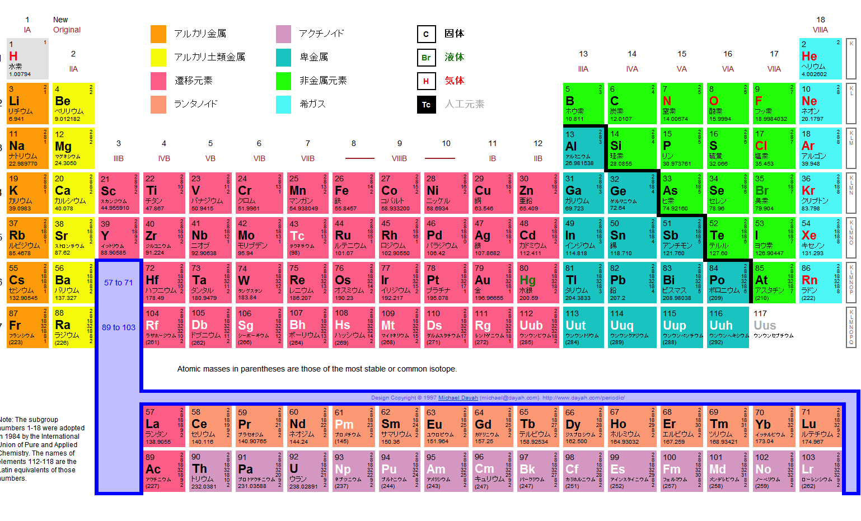
First principles calculations
Parameter based on experiment
○ Predict physical properties
of materials
Input parameter
Only atomic number and
atomic position
Physics in condensed system
result from interaction between electrons
Notes:
実験にもとずいたパラメータは用いない

Slide 8
Density functional theory
Hohenberg-Kohn theorem
A wave function resulting from density of electron in
ground state is decided uniquely except degeneracy .
Ground state Ψ
Energy functional of the electron density delivers the ground state energy in external potential
P. Hohenberg and W. Kohn, Phys. Rev. 136 B864 (1964)
W. Kohn and L. J. Sham, Phys. Rev. 140 A1133 (1965)

Slide 9
Density functional theory
Schrodinger equation
v
Kohn Sham equation
v
V_{eff}
Notes:
補助場 effective potential

Slide 10
Contents
Introduction
Multiferroic
Ferroelectricity
First principles calculation
Density of functional theory
Motivation
Calculation methods
Results
Summery&Future work

Slide 11
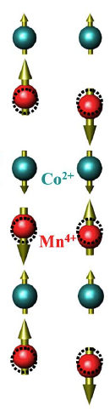

Motivation~Ca₃CoMnO₆~
Ca₃Co₂O₆
Ca₃CoMnO₆
Ca
Mn dope
Mn
Co
O
Exchange striction
bonds between parallel spins
P
shorter
bonds between antiparallel spins
longer
Electric polarization
P
Y. J. Choi et al., Phys. Rev. Lett. 100 047601 (2008).

Slide 12
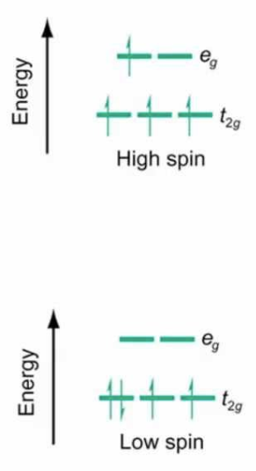


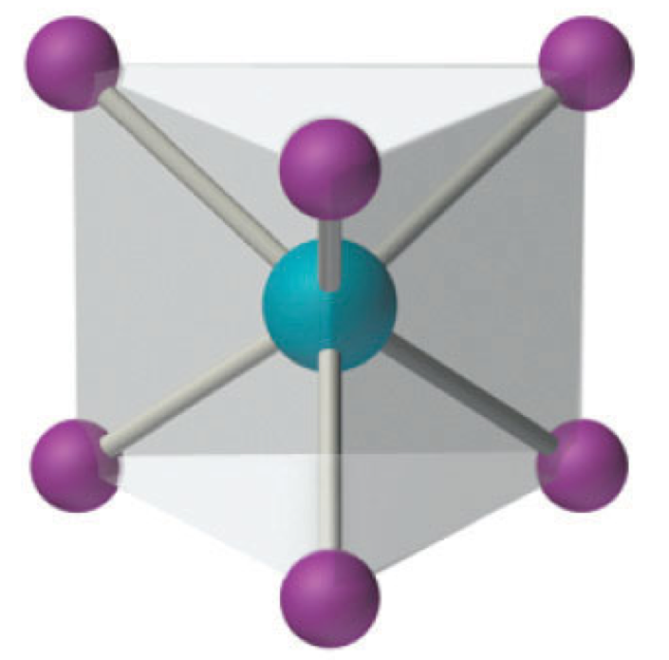
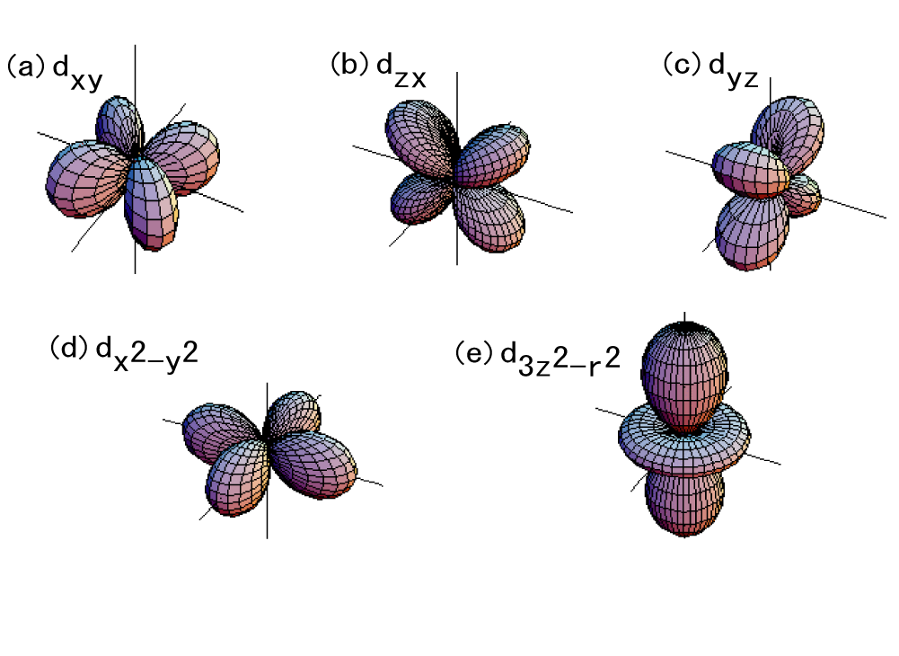

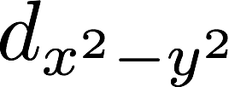

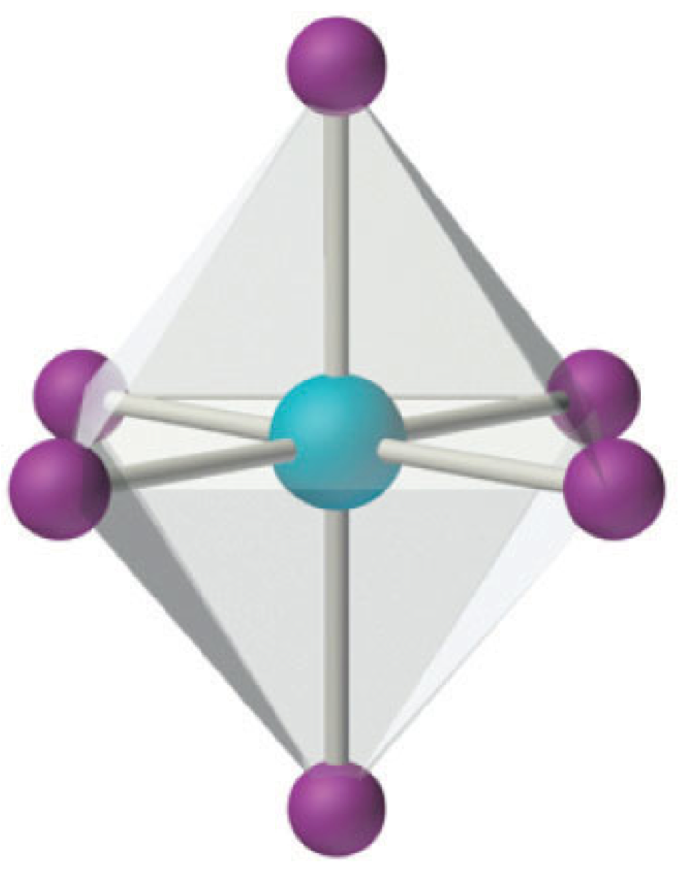
Ca₃CoMnO₆
Crystal structure
Formal charge
CoO₆
trigonal prism
Mn⁴⁺ Co²⁺
MnO₆
octahedral
Energy
Energy

Slide 13
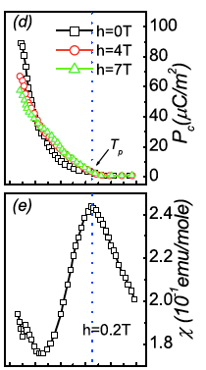

Previous work
Polarization and susceptibility correlate with each other .
Journal of applied physics 104, 083919 (2008)

Slide 14
Purpose
I calculate electron state, using LDA+U and Hybrid functional theory .
I investigate consistency with experiment

Slide 15
Contents
Introduction
Multiferroic
Ferroelectricity
First principles calculation
Density of functional theory
Motivation
Calculation methods
Results
Summery
Future work

Slide 16
Local Density Approximation(LDA)
For a realistic approximation , we refer homogeneous electron gas
Coulomb potential
External potential
Effective potential
Exchange correlation energy
A. I. Liechtenstein et al, Phys Rev. B 52 R5467 (1995)
S. L. Dudarev et al, Phys Rev. B 57 1505 (1998)
Notes:
E_{xc}は実際に与えられておらず計算するのが非常に難しい。
+Uについて書く。

Slide 17
LDA+U
Error of LDA
Underestimation of lattice constant
Underestimation of band gap
Predicting metallic behavior for materials that are known to be insulator
improvement
Introduction of U_{eff}(U-J)
U :: Hubberd parameter
J :: exchange interaction

Slide 18
Hybrid function method
Hybridization of Hartree-Fock and density function
Exchange correlation energy of LDA
Exchange correlation energy of LDA or GGA
Hartree-Fock exchange energy
demerit
Length of computational time

Slide 19
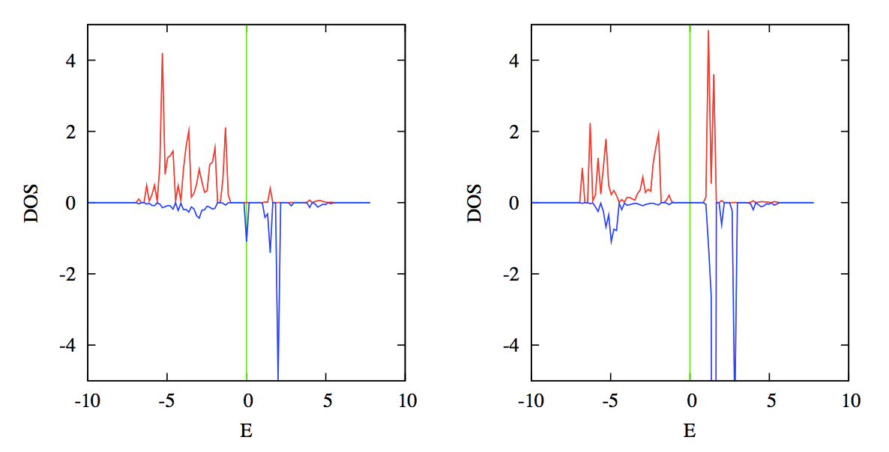
Results~LDA+U(2eV)
Co_d_up
Co_d_down
Mn_d_up
Mn_d_down
Notes:
μ_{B}つける
CoとMnのd軌道
縦軸横軸の説明
スピン分極
結晶場についてDOSの形が変わる。
D電子の数が異なる。

Slide 20
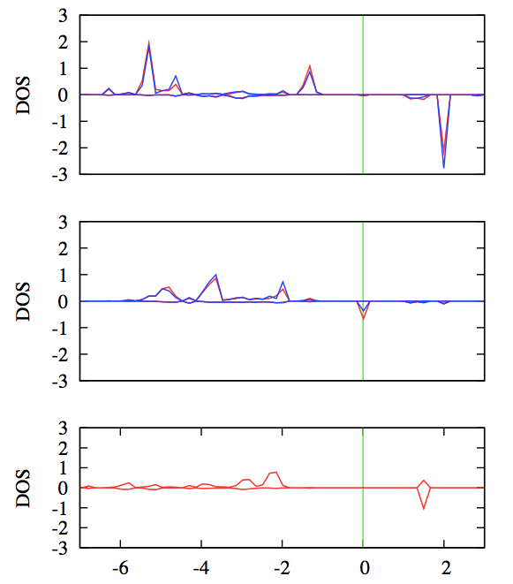
DOS~LDA+U(U=2eV)~
Co-d-xz
Co-d-yz
Co-d-xy
Co-d-x²-y²
Co-d-3z²-r²
E

Slide 21
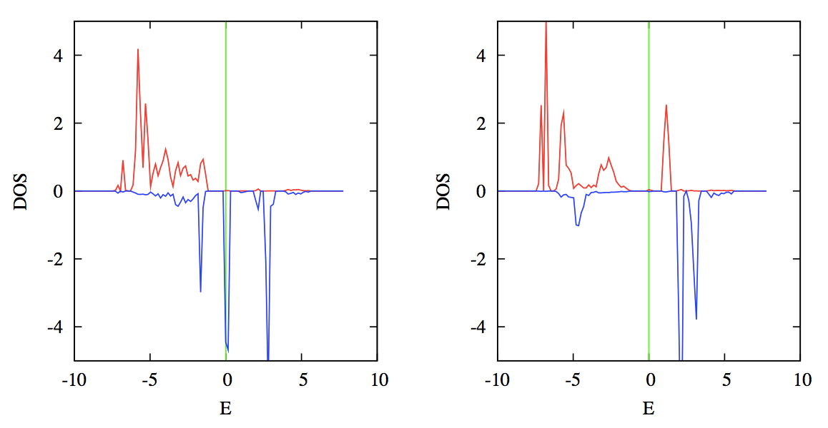
DOS~LDA+U(U=4eV)~
Co_d_up
Co_d_down
Mn_d_up
Mn_d_down

Slide 22
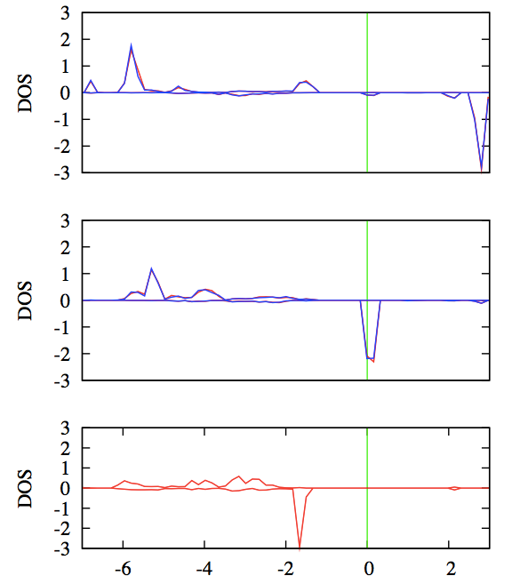
DOS~LDA+U(U=4eV)~
Co-d-xz
Co-d-yz
Co-d-xy
Co-d-x²-y²
Co-d-3z²-r²
E
Notes:
クーロンrepusion
Uで占有された軌道はエネルギー的に深くなる。逆に占有されていない軌道はエネルギー的に上に押し上げられる。

Slide 23
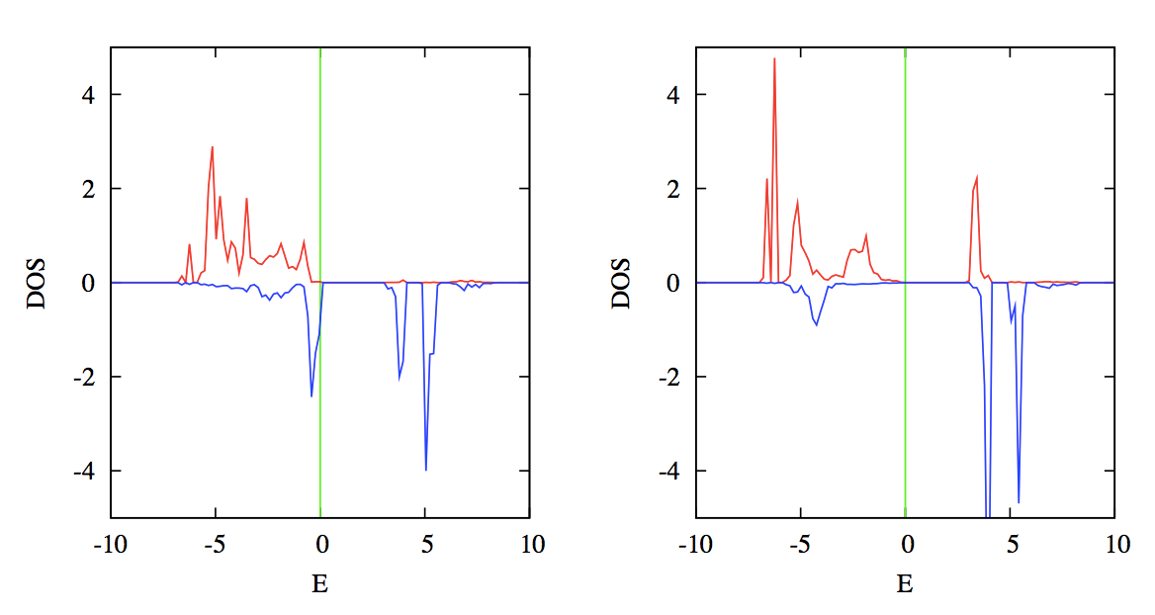
Results~Hybrid function~
Co_d_up
Co_d_down
Mn_d_up
Mn_d_down

Slide 24
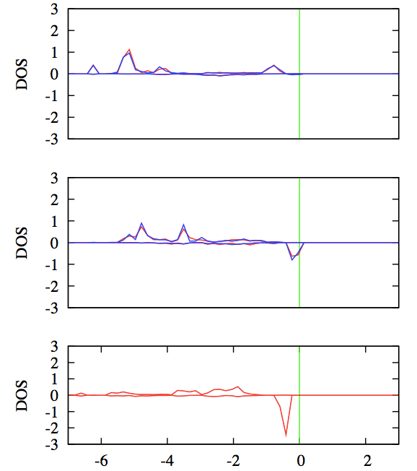
Hybrid function theory
Co-d-xz
Co-d-yz
Co-d-xy
Co-d-x²-y²
Co-d-3z²-r²

Slide 25
Magnetic moment
I compare results of simulations with experiment
 | LDA+U (U=2eV) | LDA+U (U=4eV) | Hybrid functional theory | experiment
Co | 2.568 | 2.652 | 2.676 | 0.66
Mn | 2.818 | 3.025 | 2.938 | 1.63
Y. J. Choi et al., Phys. Rev. Lett. 100 047601 (2008).

Slide 26
Summary
I investigated the crystal field splitting from calculating density of state of Co and Mn in Ca₃CoMnO₆ .
Magnetic moments resulting from simulation were not consistent with experiment .
Notes:
磁気モーメントの値が合わなかった。
SOCや格子緩和

Slide 27
Future work
The origin of both the Ising chain magnetism and ferroelectricity in Ca₃CoMnO₆ is studied .
Exchange coupling constant is calculated by first principles calculation.
By Monte-Calro simulation , I calculate various physical quantities
I will investigate correlation between ferroelectricity and spin orderings .

Slide 28
Decision of J_{ij}
Calculating total energy in various spin state
(↑↑↓↓ , ↑↓↑↓ , ↑↓↓↓ , ↑↑↑↑) , I calculate exchange coupling constant by calculating difference between spin states.
Hamiltonian
Energy difference

Slide 29
Crystal field splitting
Degenerated 3d orbitals are split by
Coulomb interaction with the ligand anions.
Energy
Energy

Slide 30
Ferroelectrics(2)
Symmetry restriction
space inversion
rotation : C_{2z}
mirror : σ_{z}
z
x
y

