Slide 1


Search for pressure induced superconductivity on iron-based-layered material
Shimizu lab.
Masayoshi Kikuchi
Notes:
Thank you for introducing me. I’m Masayoshi Kikuchi from Shimizu lab. Today, I’ll speak to you about my work, “Search for pressure induced superconductivity on iron-based-layered material.”

Slide 2

Contents
Introduction
Superconductivity
Pressure effect
SrFeO₂
My Work
Summary
Notes:
This is the contents. At first, I’ll talk you about phenomena and history of superconductivity, after then, I’ll speak to you about what will happen under the high pressure condition. And, talk you about my sample, SrFeO2, and my measurements of this sample. Lastly, I’ll summarize my work. After that, I’ll talk you another sample I’ll measure.

Slide 3
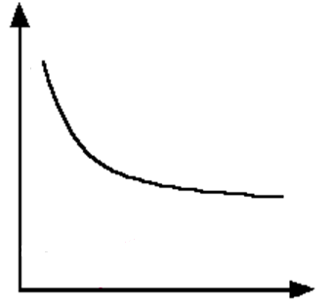
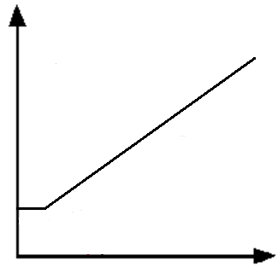
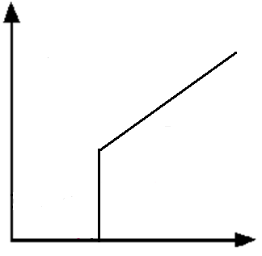
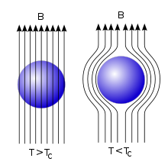
Superconductivity
insulator
Semiconductor
Metal
Superconductor
Resistance
Resistance
Resistance
Temperature
Temperature
T_{c}
Temperature
Meissner Effect
Insulator or Semiconductor | T dep. R has negative slope.
Metal | T dep. R has positive slope.
Superconductor | Electrical resistance = 0 Perfect diamagnetism
Notes:
Then, what is semiconductor, metal and superconductor? Please look at this graph. This shows temperature dependence on electrical resistance. Semiconductor has negative slop. This is because the semiconductor, insulator also, has band gap. On room temperature or higher, electrons gain the energy from around heat. With the temperature become lower, the energy gains from around heat is lower. So, the electrons of semiconductor overlaps the band gap more difficult with becoming the temperature lower. Next, please look at the graph of metal. Metal has positive slop. The electrons of metal can move freely among the atoms. At room temperature or higher, the atoms vibrate and the electrons are disturbed moving. With the temperature lower, the vibration of the atoms settles, and the electrons can move easily. Consequently, the electrical resistance tunes lower with temperature lower. Then, please look at pink line. At high temperature region, the behavior looks like metal, but at some temperature, the electrical resistance suddenly downs and turns to 0. We say this temperature critical temperature “Tc.” Under Tc, the superconductor shows perfect diamagnetism, magnetic fields can’t enter into superconducting material, derived by meissner effect. So the superconductor shows 0 electrical resistivity and perfect diamagnetism at the same time under Tc.

Slide 4
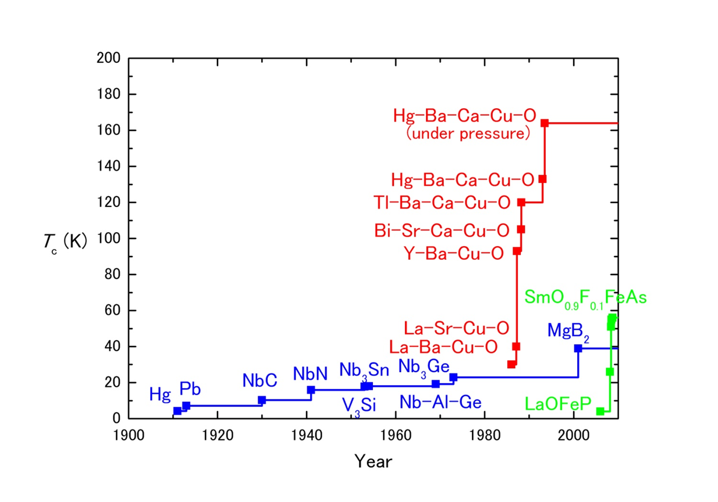
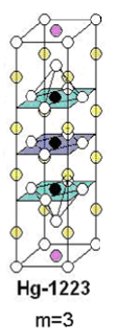
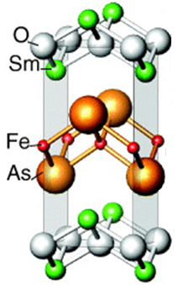
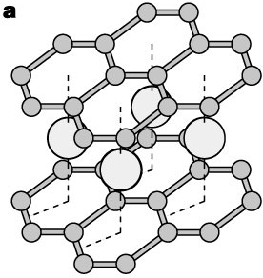
High T_{c} superconductor
The crystal structure of high temperature superconductor has layered structure, but shapes of these layers between the materials of Cu plate and Fe-based have some differences.
Hg
B
Ba
O
Cu
2-D Cu-O layer
3-D Fe-As layer
Ca
Mg
MgB₂
HgBa₂Ca₂Cu₃O_{8+δ}
SmFeAsO_{1-x}F_{x}
Notes:
The history of superconductor started from about 100 years ago. At first, the superconductivity observed on simple substance, mercury, whose Tc is about 4 K. As the years roll on, many superconductor was found and Tc becomes higher. You can see three types of colored line. On the blue line, the system of superconductivity is explained by BCS theory. As you can see on the red line, there took sudden growth of Tc, they are so called Cu plate. Their superconducting system is unknown exactly, and growth of Tc stops at about there. We can’t observe more high Tc as long time, and another types of materials are gathered attention. On the green line, it’s the Fe-based superconductor. They took sudden growth of Tc like as Cu-plate. Then I’ll focus on their crystal structure.

Slide 5
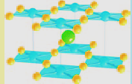
SrFeO₂
Fe
O
At ambient conditions,
P4/mmm
a=3.991 Å, c=3.474 Å
Antiferromagnetic (AFM)
T_{N}=473K
Insulator
Sr
T. Kawakami et al., Nature Chemistry 1, 371 (2009)
2-D Fe-O layer same as Cu plate high temperature Superconductivity!
For observing superconductivity,
・ hole or electron doping
・ lattice vacancy
・ pressure
Insulator and AFM is unfavorable to observe superconductivity.
・ pressure

Slide 6
Pressure effect
Pressurized
Applying pressure means…
・Structural transition
・Magnetic transition
・Insulator-Metal transition
・Superconducting transition
The atomic distance becomes closer.
Electronic states change.

Slide 7
The example of pressure induced superconductor
SrFe₂As₂
Superconductivity shows with applying pressure!

Slide 8
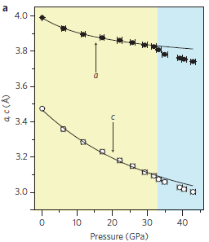
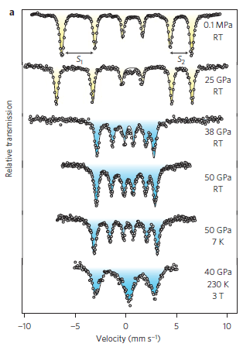
Prior research
AFM
Ferromagnetism (FM)
⁵⁷Fe Mӧssbauer spectra
The length of a-axis and c-axis measured by X-lay diffraction.
At 32 GPa, the transition from AFM to FM is observed.
T. Kawakami et al., Nature Chemistry 1, 371 (2009)

Slide 9
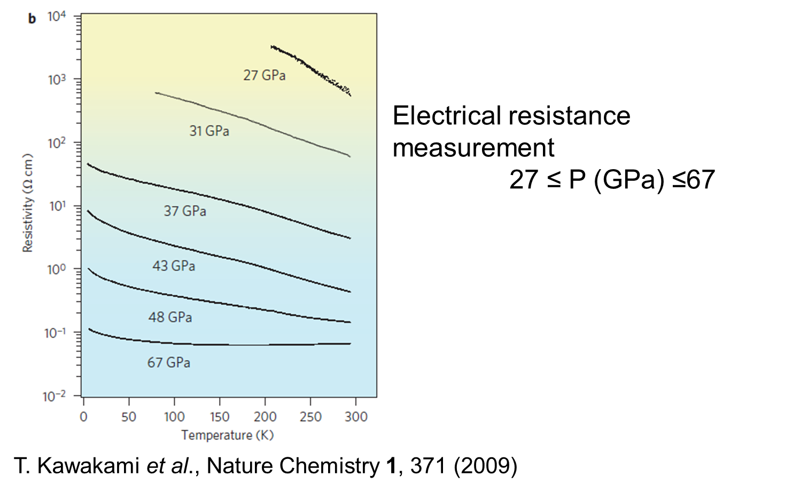
Prior research
Metallization is observed at about 67 GPa.

Slide 10
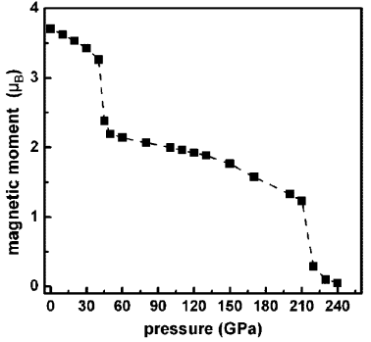
Calculation result of magnetic moment
At 45 GPa,
a spin transition from S = 2 to S = 1, accompanied by an AFM-FM transition, is observed.
At 220 GPa,
another spin transition from S = 1 to S = 0 occurs.
M. Rahman et.al., Inorg. Chem., 52, 12529 (2013).

Slide 11
My motivation
Antiferromagnetic
Insulator
S=2
Ferromagnetic
(Metal)
S=1
Nonmagnetic
(Superconductor)
S=0
32
130
Pressure (GPa)
・According to collaborator, spin transition from S = 1 to S = 0 is observed by ⁵⁷Fe Mӧssbauer spectra and X-ray diffraction.
・SrFeO₂ is expected to be a superconductor because of its crystal structure.

Slide 12
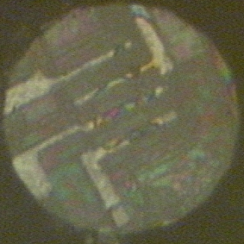
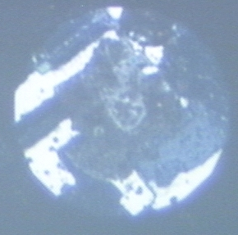
Setting
Experimental setup
Sample;SrFeO₂ powder
Anvil culet ; 100 μm^{ϕ}
Pressure medium; Not-used
Measurement method; four-probe scheme
Gasket; Rhenium
Insulation material; c-BN + epoxy
Electrodes ; Platinum
diamond
ruby
Insulating layer
sample
100 µm
Electrodes
gasket
ruby
sample
Electrodes

Slide 13
My results
･With applying pressure, electrical resistivity decreases.
･The decreasing rate changes at high pressure.

Slide 14
My results
Between 34 GPa and 70 GPa, the slope changes from negative to positive.
Between 70 GPa and 90 GPa, the slope changes from positive to negative.
The M-I transition may occur in these regions.

Slide 15

Metal-insulator transition
Insulator
Metal
From previous work, R rises at about 150 K.
There are large differences.
About 40 K
One of the hypothesis
Grain boundary
Room among grains (red area) shows insulating behavior on T dep. R graph.

Slide 16
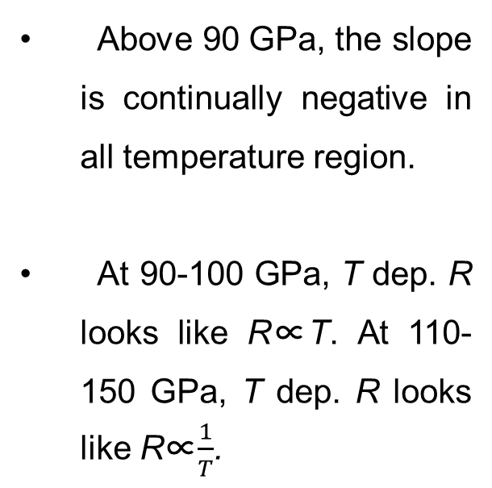
More high pressure
Above 90 GPa, the slope is continually negative in all temperature region.
At 90-100 GPa, T dep. R looks like R∝T. At 110-150 GPa, T dep. R looks like R∝$\frac{1}{T}$.
Some transitions would be observed?

Slide 17
The response to the magnetic field
80 GPa
Temperature dependence on electrical resistance is not affected by magnetic field at 110 GPa, which is affected at 80 GPa.
There is possibility to be the nonmagnetic (S=0) state which is expected by first-principle study.

Slide 18
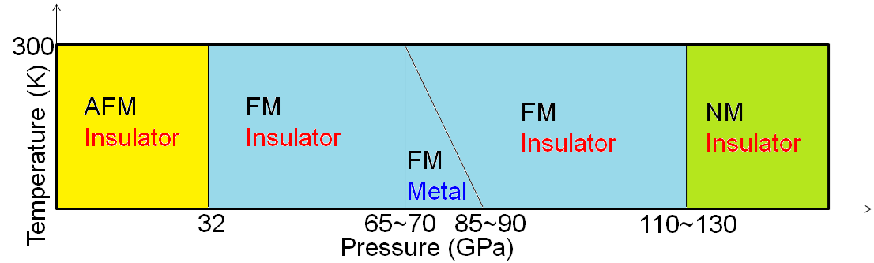
Summary
Temperature dependence of electrical resistance has been measured at high pressure up to 150 GPa.
Ferromagnetic and metallic state is found around 80 GPa at low temperature.
Superconductivity hasn’t been found until 150 GPa, although we measure down to 60 mK.

Slide 19
headline

Slide 20
The crystal structure of high temperature superconductor
Hg
B
Ba
Cu
O
Mg
Ca
2-D Cu-O layer
3-D Fe-As layer
MgB₂
HgBa₂Ca₂Cu₃O_{8+δ}
SmFeAsO_{1-x}F_{x}
T_{c} = 39K
T_{c} = 135K
T_{c} = 55K
The crystal structure of high temperature superconductor has layered structure, but shapes of these layers between the materials of Cu-based and Fe-based have some differences.

Slide 21
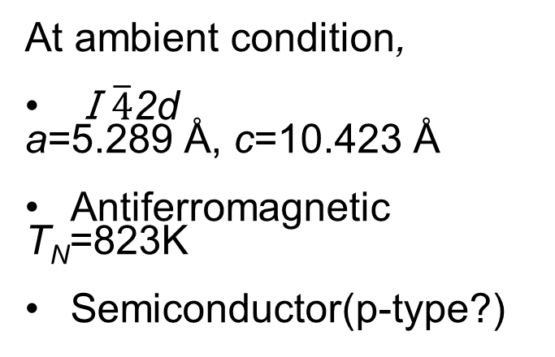
Future work
At ambient condition,
Ⅰ$\overline{4}$2d
a=5.289 Å, c=10.423 Å
Antiferromagnetic
T_{N}=823K
Semiconductor(p-type?)
Cu
Fe
S

Slide 22
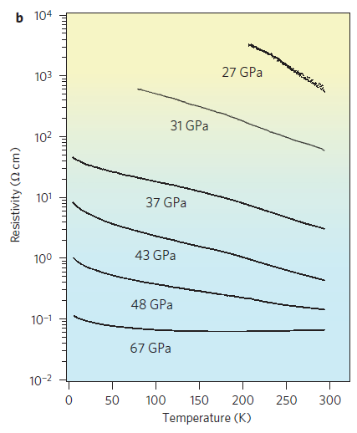
Metal-insulator transition
T. Kawakami et al.,
Nat. Chem. 1, 371 (2009)

Slide 24
32~70GPa
Insulate-metal transition occurred.

Slide 25
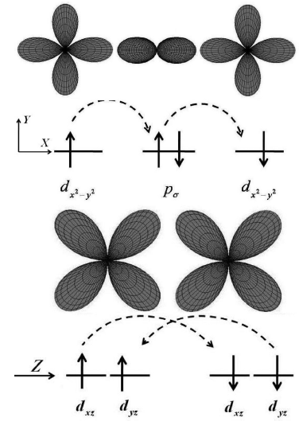
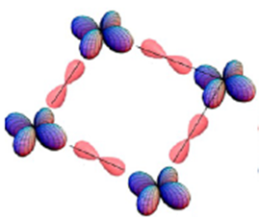

AFM:SrFeO₂ at ambient pressure
O
Fe
Fe²⁺ :(d _{z}2 ) ²(d _{xz} d _{yz} ) ²( d _{xy} ) ¹(d _{x}2 _{− y}2 ) ¹ was obtained by first principle caluculation.
In the x−y plane, the single unpaired electrons of two d_{xy} orbitals should be coupled antiferromagnetically through p_{π}.

Slide 26
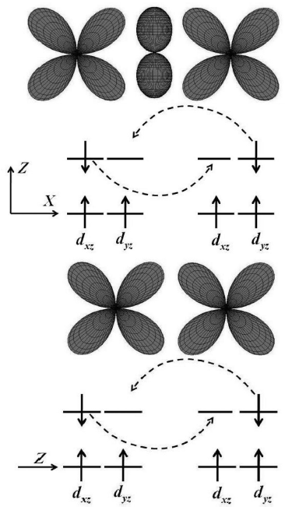
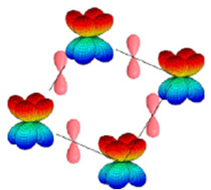
FM:SrFeO₂ under high pressure
Fe
O
Fe²⁺ :(d _{z}2 ) ²(d _{xz} d _{yz} ) ³( d _{xy} ) ¹(d _{x}2 _{− y}2 ) ⁰
In the x−y plane, there are two complete mechanisms, AFM order and FM order, favored by d_{xy} and degenerate d_{xz}d_{yz} orbitals.

Slide 27
Inflection point

Slide 28
100~125 GPa

Slide 29
Resistance on 4K

