Slide 1
Observation of ultrafast nonlinear response due to coherent coupling between light and confined excitons in a ZnO crystalline film
Ashida Lab.
Subaru Saeki

Slide 2
Contents
Introduction
Background
Coherent coupling between light and confined excitons
Degenerate four-wave mixing (DFWM)
Previous work
Comparison between ZnO and GaN
Motivation
Sample
Experimental setup
Results
Summary
Future work

Slide 3
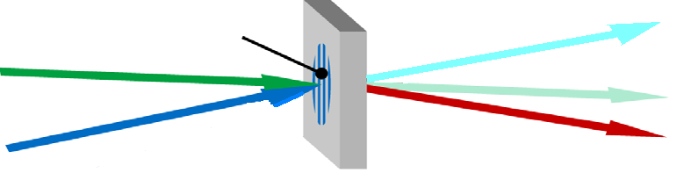
Background (Realization of optical router)
Electronic router light → electrical signal → light
Optical router light → light
Transient grating
Control light
Signal light
Merit
Noise is reduced.
Energy efficiency can be improved.
Transmission speed increases.

Slide 4
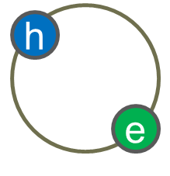
Background (Realization of optical router)
Requirement for optical router
→ High efficiency and high-speed response
10 ps order
(exciton lifetime : 100ps～)
Trade-off problem!
 | efficiency | speed
resonance | ○ | ×
non-resonance | × | ○
Processes associated with the exciton resonance cause high efficient optical response.
High-speed response in resonance process is required!

Slide 5
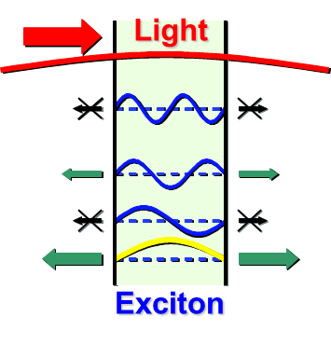
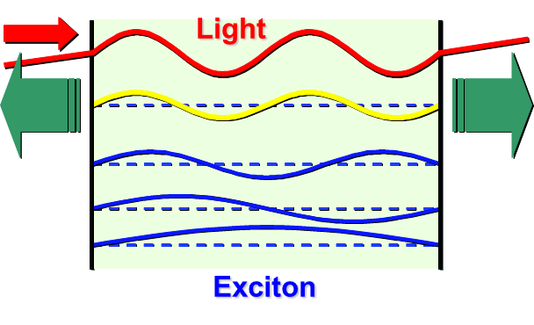
Coherent coupling between light and confined excitons
Nanostructure
Long wavelength approximation region
The n=1 exciton dominantly interacts with light.
n = 4
n = 3
Both efficiency and speed of response is enhanced with increase of system size,
but saturated in larger region
n = 2
n = 1
System where exciton wave functions are
coherently extended to the whole volume
Multinode-type excitons complicatedly interact with light.
Both efficiency and speed of optical response are size-resonantly enhanced.

Slide 6
Degenerate four-wave mixing (DFWM)
Two-pulse configuration
Three-pulse (TG) configuration
Transient grating (TG)
Transient grating (TG)
Probe pulse
Probe pulse
Pump pulse
Pump pulses
DFWM signal
TG signal
Non-linear medium
Non-linear medium
The decay profile is determined by population and phase relaxations
The decay profile is determined by only population relaxation

Slide 7
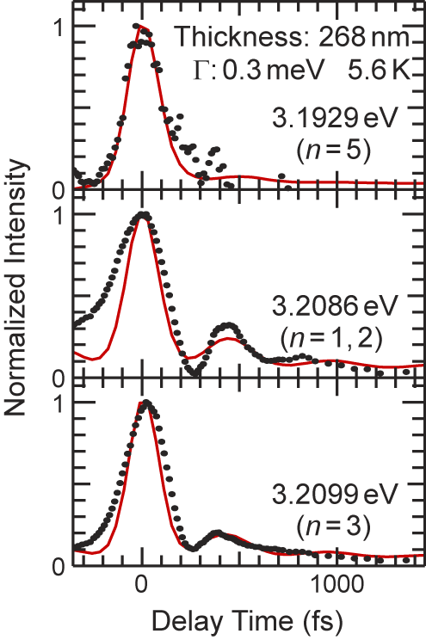
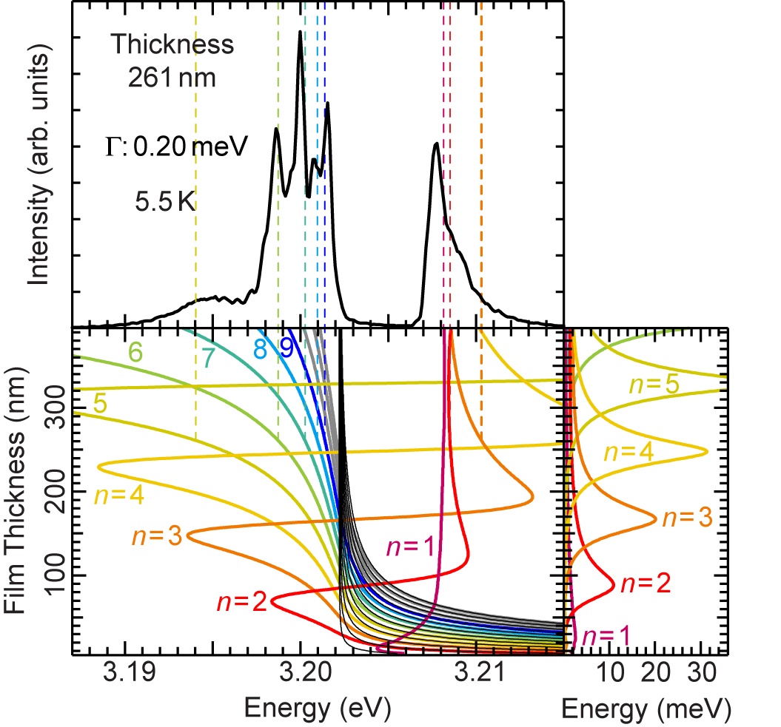
Previous work 1 (CuCl high-quality films)
DFWM spectrum
Appearance of peculiar spectrum structures
Ultrafast radiative decay of 100 fs order
Ref: M. Ichimiya, M. Ashida, H. Yasuda, H.Ishihara and T. Itoh, Phys. Rev. Lett. 103, 257401 (2009)

Slide 8
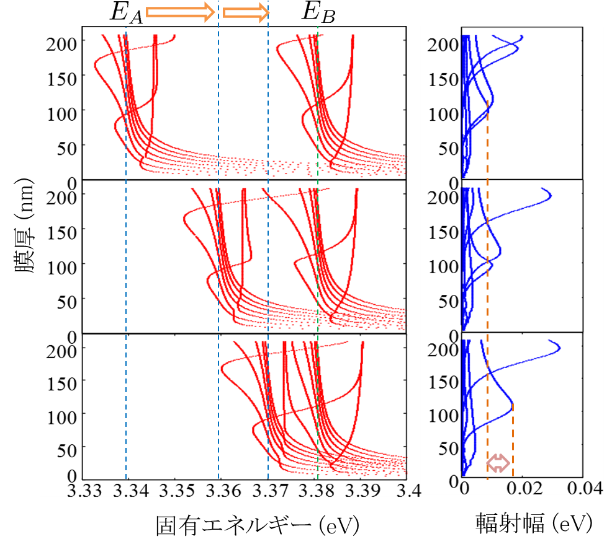
Previous work 2 (ZnO)
A,B exciton resonance energy
E_{A}:3.376eV
E_{B}:3.381eV
Thickness (nm)
Enhancement of radiative width by coupling between A and B excitons
T. kinoshita, H. Ishihara, JPS 2014 spring meeting, 27aCD-13.
Eigenenergy (eV)
Radiative width (meV)

Slide 9
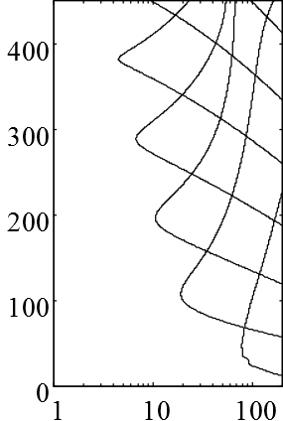
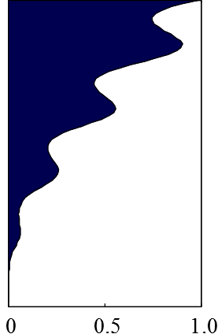
Previous work 3 (ZnO)
ZnO thin film with the thickness where an excitonic state shows ultrafast decay time
Optical nonlinearity is also enhanced at the same thickness.
n=5
Thickness (nm)
n=4
n=3
Larger nonlinearity and faster radiative decay than CuCl is expected.
n=2
n=1
T.kinoshita, H.Ishihara, JPS 2014 spring meeting, 27aCD-13.
Radiative decay time(fs)
Integral intensity of non-linear response (Optical kerr)

Slide 10
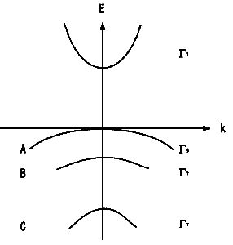
Comparison between ZnO and GaN
electron
 | ZnO | GaN
Room temperature band gap (eV) | ～3.37 | ～3.4
Exciton binding energy (meV) | ～60 | ～28
Exciton Bohr radius (nm) | ～1.4 | ～3.2
polarization
hole
Binding energy =
Stability of exciton
ZnO and GaN have attracted attention as wide band gap semiconductor.
In terms of stock quantity, stability of exciton and safety,
ZnO is superior to GaN.
ZnO is expected as blue light-emitting devices, optoelectronic devices etc.
Band structure of ZnO
Notes:
Gaはレアメタルと呼ばれ、日本はリサイクルを除くと、そのすべてを中国、台湾、カザフスタンなどからの輸入に頼っている。2050年までの需要量が埋蔵量の6倍と予測されている。供給不足の可能性が考えられる。
それに比べてZnはベースメタルと呼ばれ、社会で大量に使用され、生産量が多い。

Slide 11
Motivation
Observation of ultrafast radiative decay in CuCl crystalline films
ZnO
Possibility of enhancement of non-linearity
Application possibility for optical devices
Observation of ultrafast and highly efficient nonlinear response due to coherent coupling between light and confined excitons in a ZnO crystalline film

Slide 12
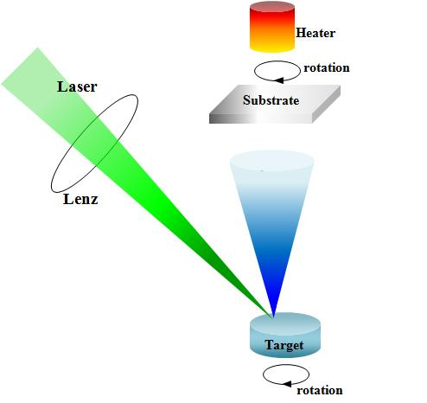
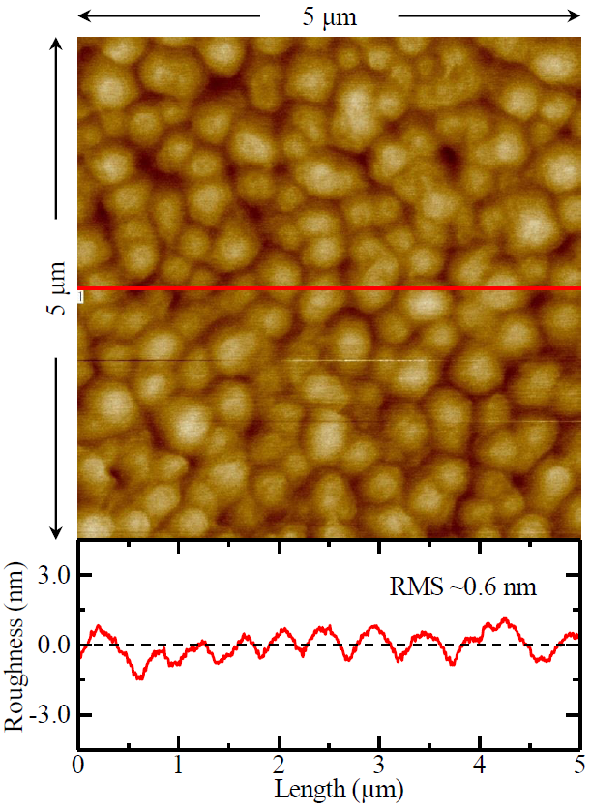
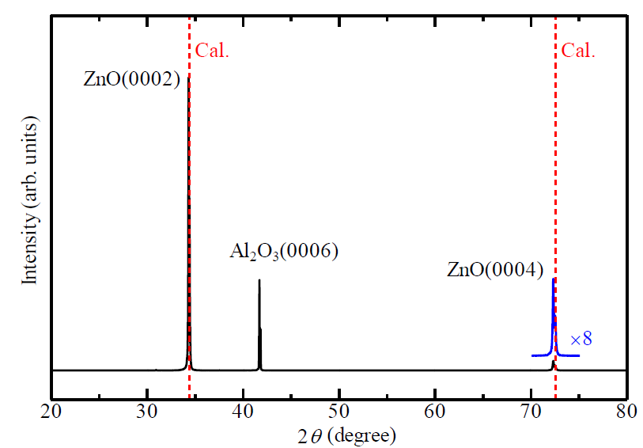
Sample (ZnO)
Pulse laser deposition (PLD) method
Thickness : 330nm
Substrate : Al₂O₃ (0001)
Providing source：
Osaka city university Nakayama lab.

Slide 13

Experimental setup (TG configuration)
Mode-locked
Ti:Sapphire
laser
Parabolic mirror
SHG crystal
Polarized beam splitter
Pulse width : 110 fs
Repetition frequency : 80 MHz
λ/2 wave plate
BS
Optical delay stage
Cryostat
Spectroscope
5 K～

Slide 14
DFWM spectrum (two pulse configuration)
DFWM signal
E_{A} E_{B}
DFWM
Reflection
3.378 eV Exc.
Reflection spectrum shows sharp peak structures in the exciton resonance region.
:
Reflection of high crystalline quality
Two peaks appear at the energy region lower than the exciton resonance energy.
Effect of coherent coupling
between light and confined excitons

Slide 15
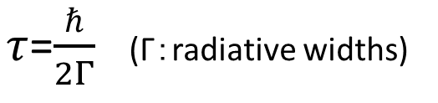
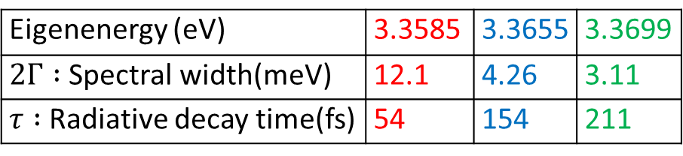
DFWM spectrum by TG method
TG signal
Probe
Pump
Three peaks are observed.
Spectral widths reflect the radiative widths for the corresponding excitonic states.
The radiative decay times are estimated by the value of Γ.
Eigenenergy (eV) | 3.3585 | 3.3655 | 3.3699
$2Γ :$Spectral width(meV) | 12.1 | 4.26 | 3.11
$τ :$Radiative decay time(fs) | 54 | 154 | 211
$τ$=$\frac{ℏ}{2Γ}$ (Γ：radiative widths)

Slide 16
Radiative decay profile of excitons (by TG method)
Delay time
TG signal
Probe
Pump
Ultrafast radiative decay times in the order of 100 fs are observed.
The decay times agree well with the calculated values estimated by spectral widths.

Slide 17
Summary
In a ZnO crystalline film, peculiar spectrum structures due to coherent coupling between light and confined excitons are observed.
In TG spectrum, peculiar spectral feature with three peaks is observed, and the radiative decay time of each excitonic state is estimated from the spectral width.
Ultrafast radiative decay in the order of 100 fs is observed, and the decay times agree well with the values estimated by spectral widths.

Slide 18
Future plan
Comparison of radiative decay time with other excitonic states
Observation of DFWM signal and the decay profile at room temperature
Estimation of optical nonlinearity by measuring nonlinear refractive index using optical kerr effect
Comparison with other materials (CuCl, GaN, ZnSe, anthracene)

Slide 19

Back ground (Optical communication)
Optical communication use higher five figures frequency than electric communication.
Ultrafast pulsed light of 6fs (electronic circuit : ~0.1ns)
Optical signal
optical fiber
Optical signal

