Slide 1
Investigation of fluid- fluid phase transition of hydrogen under high pressure and high temperature
2014/11/26
Shimizu laboratory
SHO Kawaguchi

Slide 2
Contents
Introduction
Hydrogen under high pressure
Previous work
My study
Experimental method
Results
Summary & Future work

Slide 3
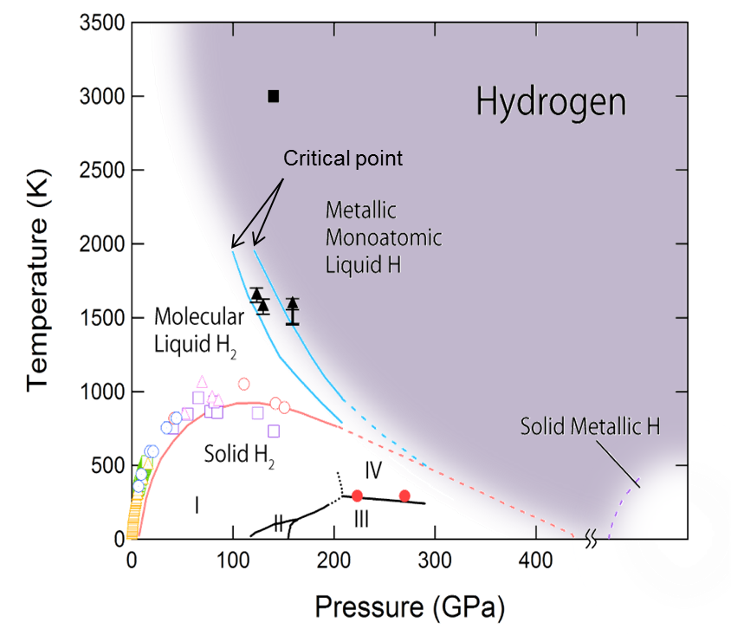
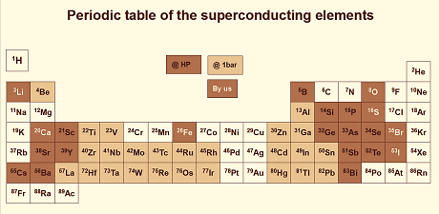
Introduction
Solid metal and superconductor under ultra high pressure (P > 400 GPa) → very difficult
Fluid metal under high pressure and high temperature

Slide 4
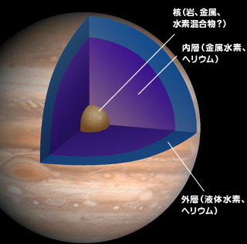
Introduction
Cross section of Jupiter
JAXA
Aurora of Jupiter
JAXA
Metallic - liquid hydrogen circulate in Jupiter
→ Strong magnetic field

Slide 5
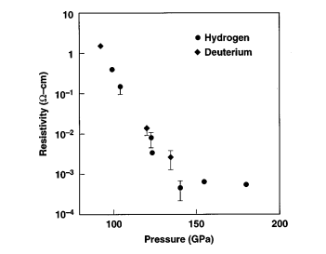
Previous work
Shock wave experiment
Metallization
P = 140 GPa,
T < 3000K
W. J. Nellis, S. T. Weir, and A. C. Mitchell, Phys. Rev. B 59, 3434 (1999)

Slide 6
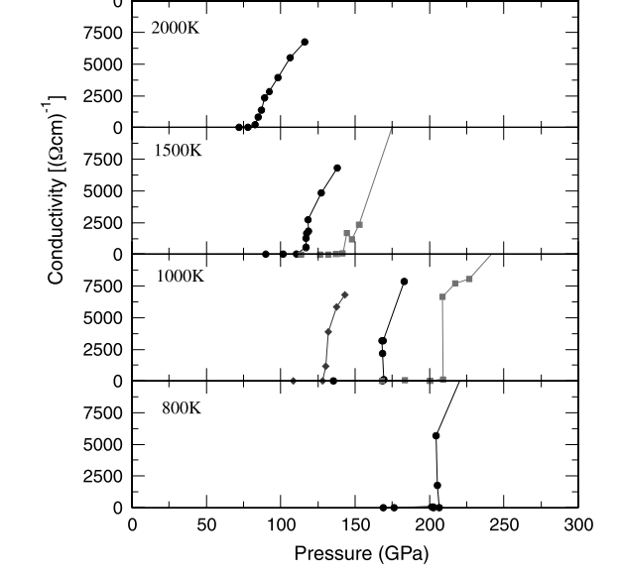
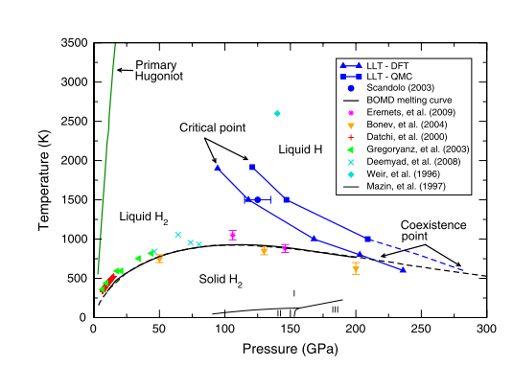
Previous work
Theoretical calculation
M. A. Morales et al., PNAS, 107, 29, 12799-12803(2010)
from insulator to metal

Slide 7
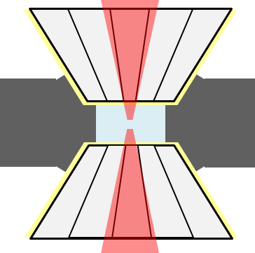
Previous work
LASER heating
Heating LASER
Temperature vs LASER Power
sample
transition temperature
Plateau
Phase transition
Change of thermal conductivity
Change of Reflectance
Heat of transition etc.
Temperature
Phase
transition
LASER power
Heating efficiency changes

Slide 8
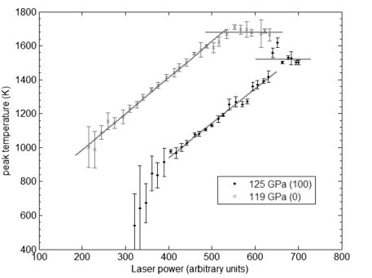
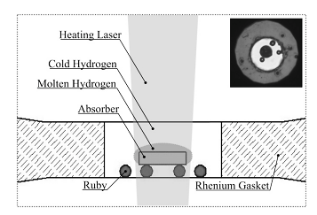
Previous work
LASER heating
Plateau
Heating LASER (Palse)
Heating efficiency changes
→ phase transition
V. Dzyabura et al. PNAS, 110, 20, 8040-8044 (2013)

Slide 9
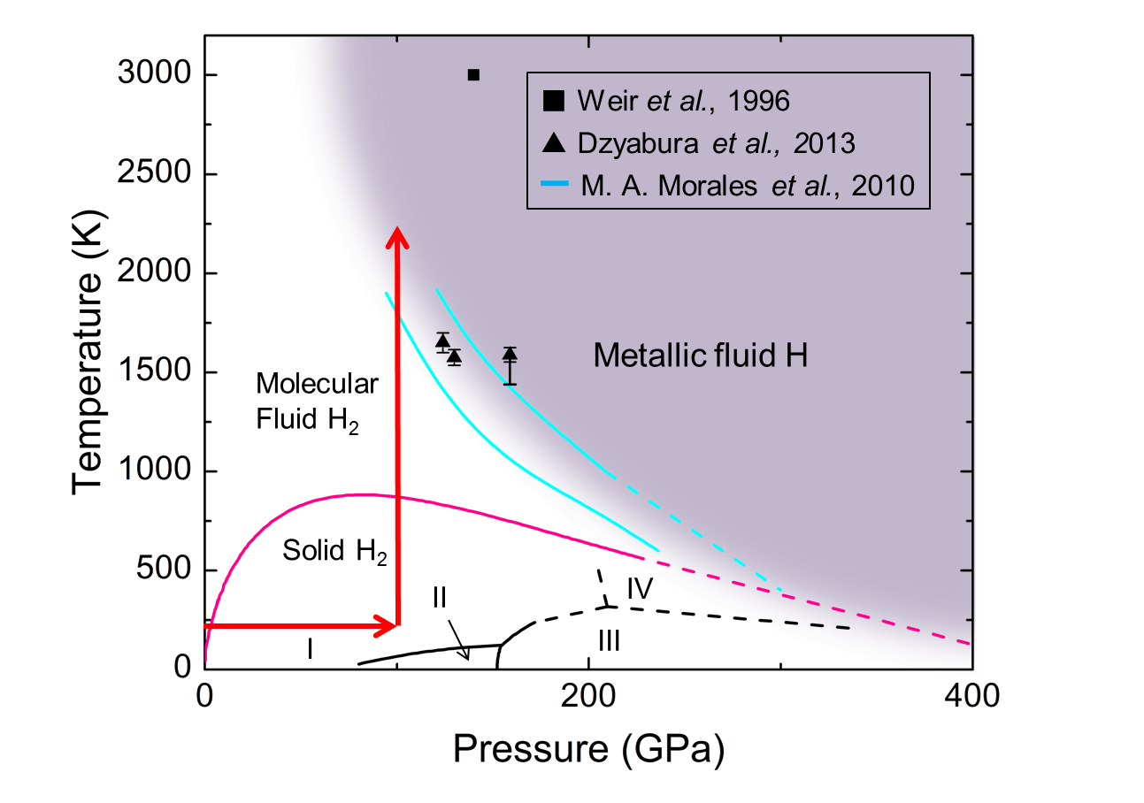
Motivation
Generating metallic liquid hydrogen under hydrostatic pressure
Investigation of boundary between Insulator Liquid and Metallic Liquid

Slide 10
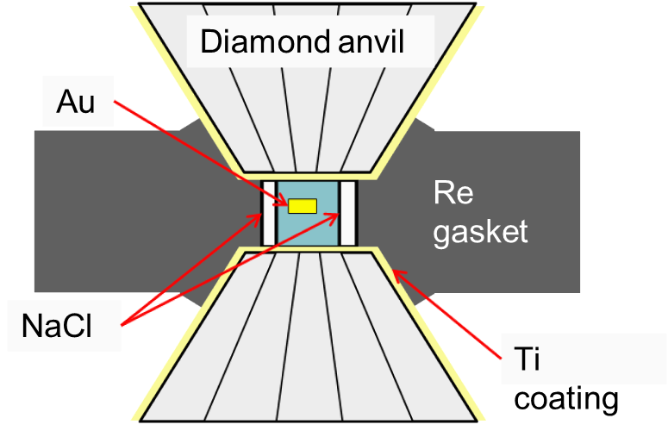
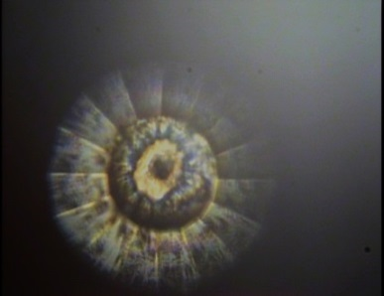
Experiment
Diamond Anvil Cell (DAC)
・Sample : H₂
・Anvil Culet : φ100 or 150 μm
・Gasket : Re
・LASER absorber : Au
・Pressure determination method
: Diamond Raman
Re Gasket

Slide 11
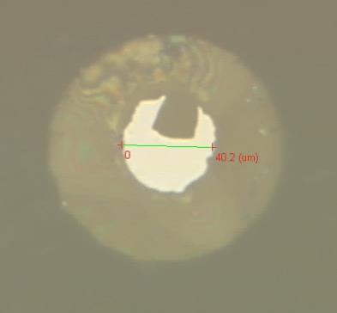
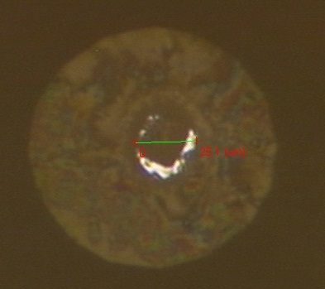
Experiment
Technical difficulties of experiments
High diffusibility
→ Hydrogen embrittlement of diamond anvil
Hydrogenation of Rhenium gasket
High compressibility
→ Contraction of the sample room
Apply pressure
@ 1 atm
@ 50 GPa

Slide 12
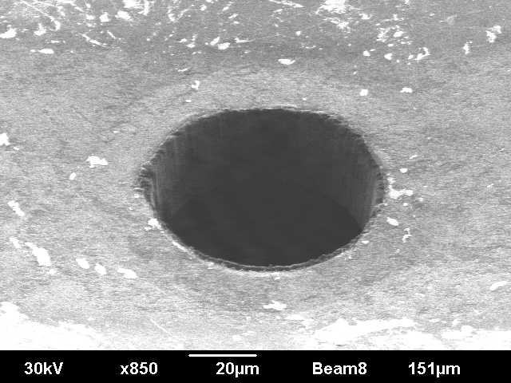
Experiment
Formation of the sample room using FIB
→ to prevent the diffusion of hydrogen
NaCl wall on the inner wall of gasket
to prevent hydrogenation of the gasket
Ti-coating on diamond surface
to prevent Hydrogen embrittlement of diamond anvil
→
→
NaCl
Sample room formed by FIB (FIB = Focused Ion Beam)

Slide 13
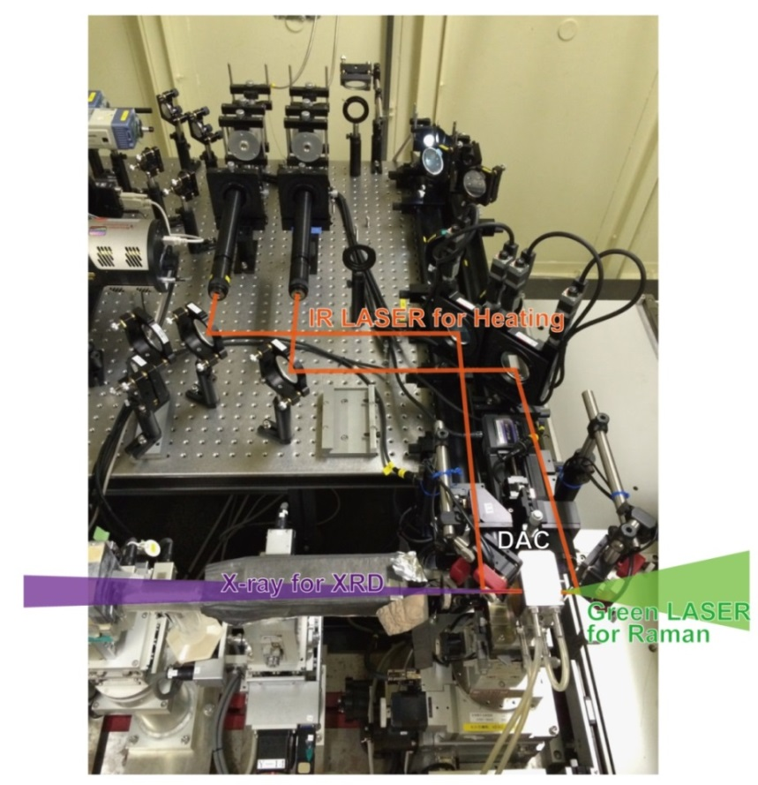
Experimental
Laser Heating @SPring-8/BL10XU
IR LASER
・Heating LASER : 1053 nm fiber LASER
・Temperature Determination method
: radiation measurement
・ XRD before and after heating
To comfirm that Au and NaCl don’t react
・ Raman spectroscopy before and after heating
To comfirm that Hydrogen remains

Slide 14
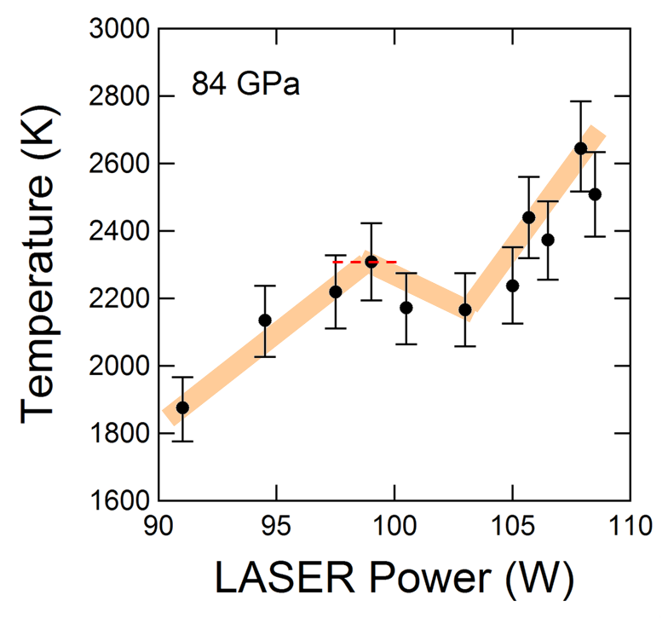
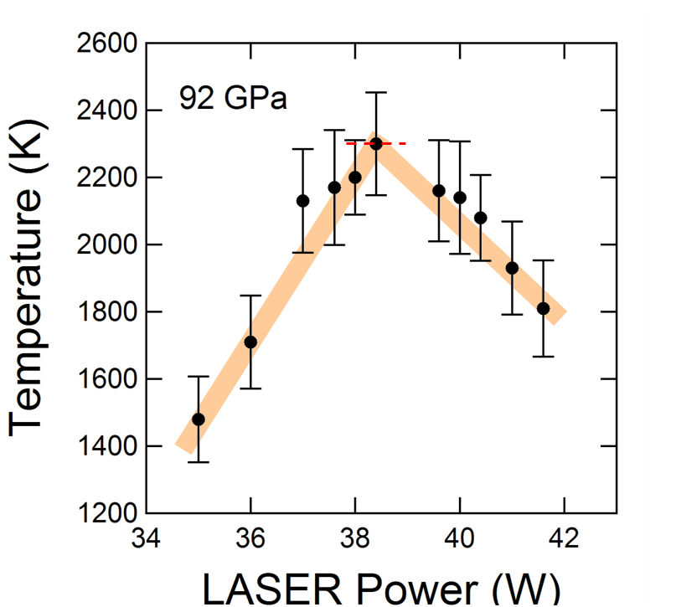
Results
Temperature vs LASER Power
Heating efficiency changes

Slide 15
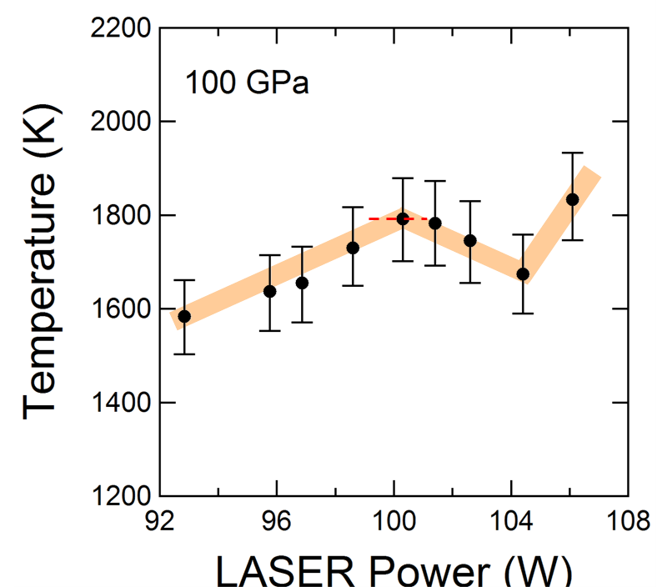
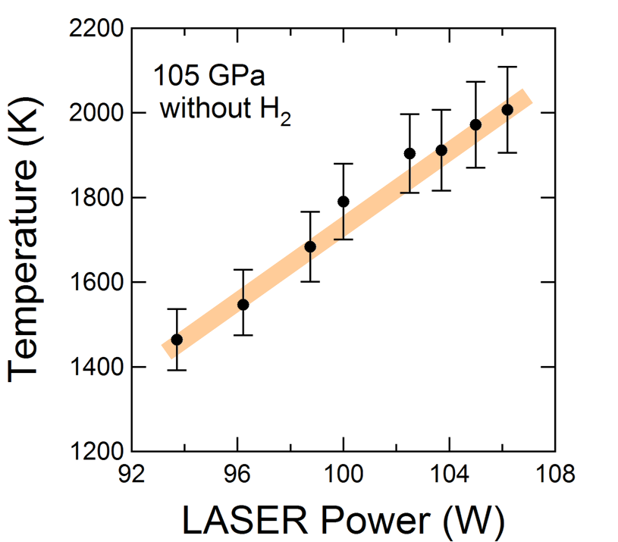
Results
Control experiment
Hydrogen
No Hydrogen
No changing point
Without hydrogen

Slide 16
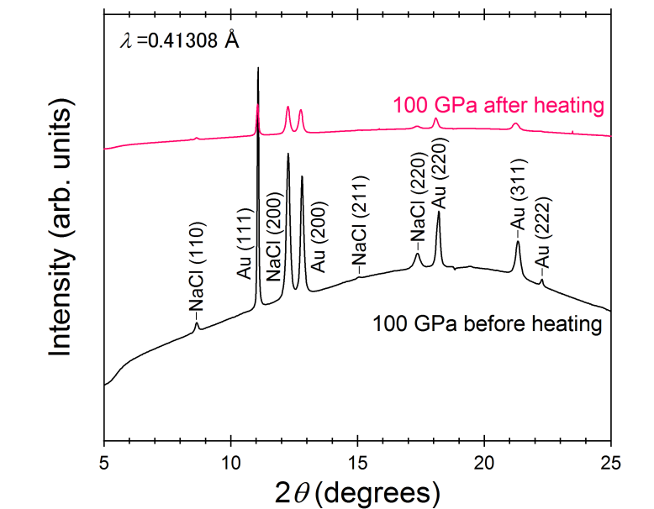
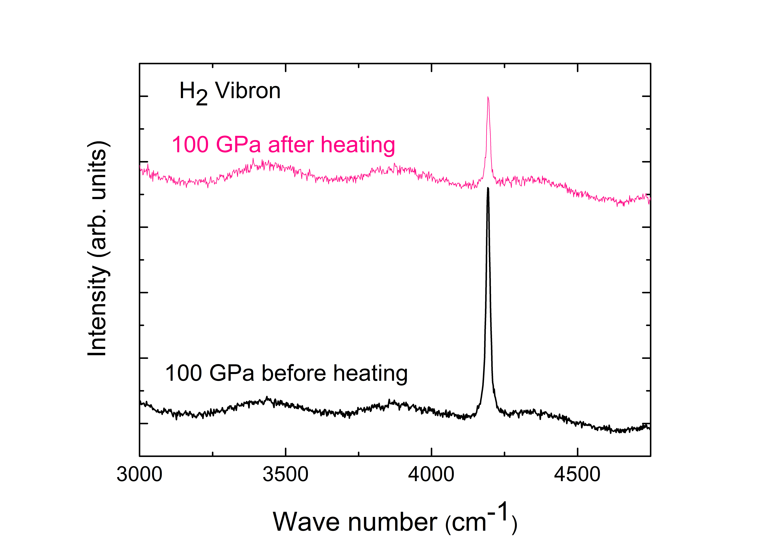
Results
XRD patterns before and after heating
H₂ vibron before and after heating
No changes of X-ray pattern of Au and NaCl
Hydrogen remained after heating

Slide 17
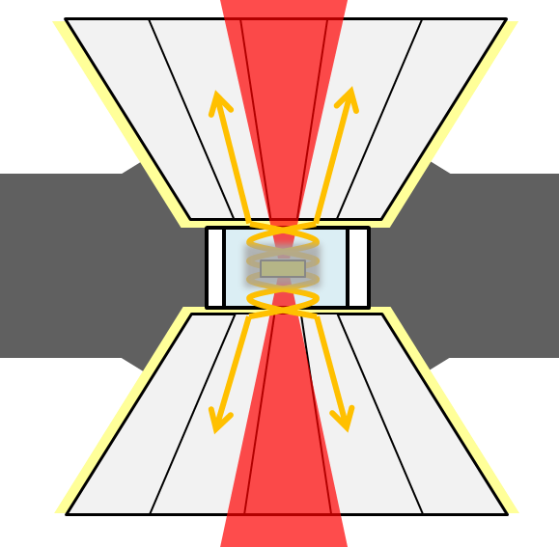
Results
Temperature vs LASER Power
transition temperature
Heating efficiency changes
Temperature
Phase
transition
→ Thermal conductivity and
reflectance change
→ Phase transition
LASER power

Slide 18
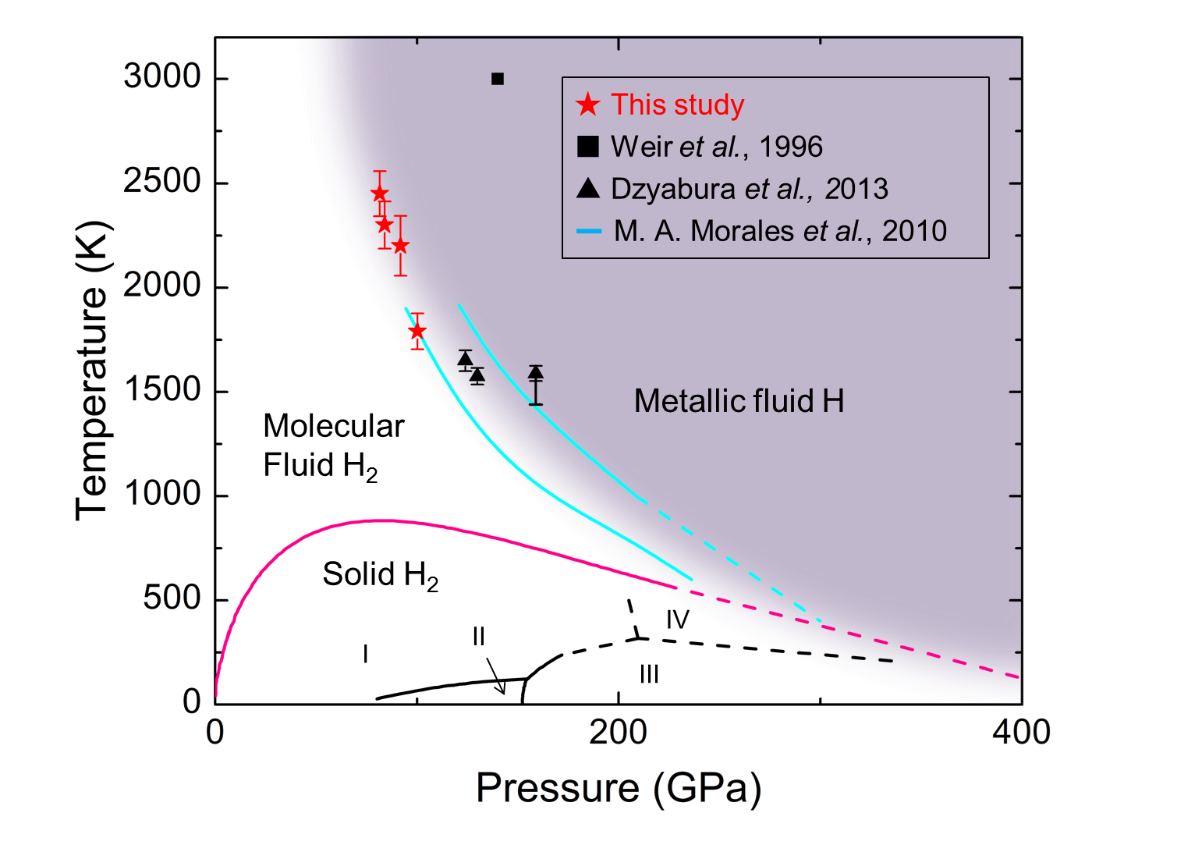
Results
Phase diagram of Hydrogen
Critical point

Slide 19
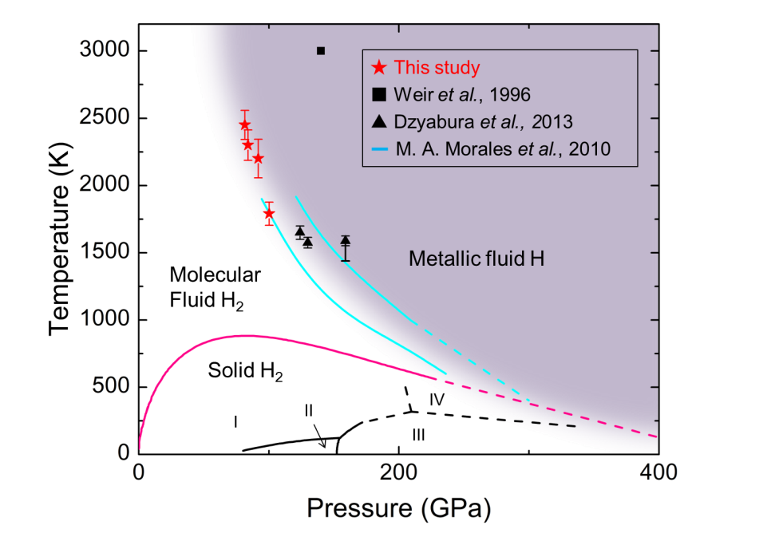
Summary
In the LASER heating experiment, heating efficiency changes
On the other hand, heating efficiency doesn’t change without hydrogen
These results shows good agreement with theoretical calculations
The transition was observed
above critical point by
theoretical calculation
Critical point

Slide 20
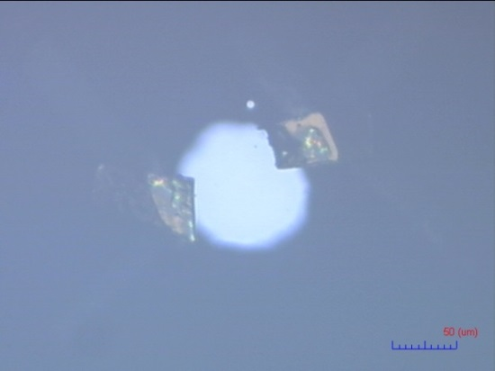
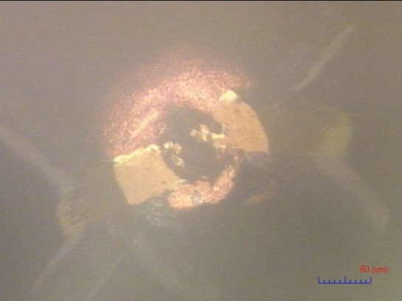
Future work
In order to confirm the metallization directly….
Electric resistance measurement
Drop of electric resistance with the metallization
However, insulating gasket is difficult to confine the hydrogen
→ Optimization of the insulation layer
shrinking
Before filling
After filling

