Slide 1
Pressure dependence of crystal structure and superconductivity in beryllium
2014.11.26
Shimizu Lab.
M1 Takuya Yamauchi

Slide 2
Contents
Introduction
Superconductivity of light elements
Enhancement of Tc
Structure
Previous work
Motivation
Experiment
Measurement of X-ray diffraction.
Measurement of electrical resistance.
Result＆Discussion
Summary

Slide 3
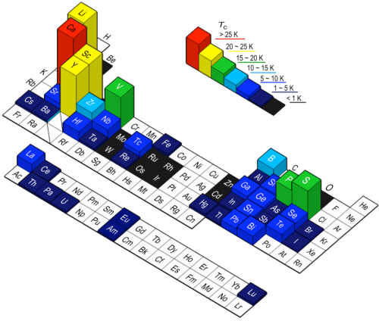
Superconductivity of light elements Introduction
The superconducting critical temperature(Tc) of beryllium is very lower than other light elements.
Beryllium
Tc=24mK
My target
Ref. HP@SPring8(2011)

Slide 4
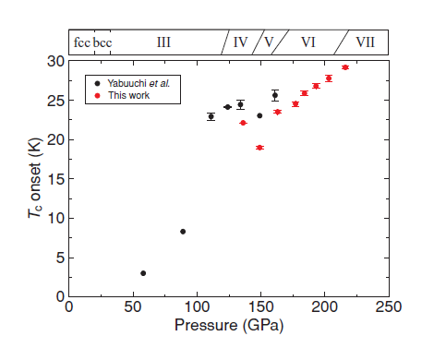
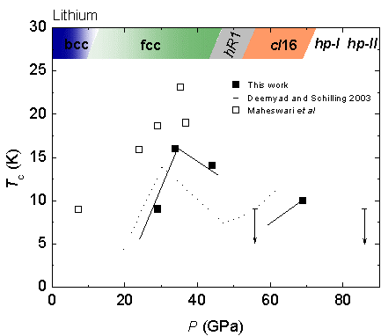
In case of Calcium and Lithium
Calcium
Lithium
16 K
29 K
0.4 mK
Ref. M. Sakata., et al., PRB 83, 220512 (2011).
Ref. T. Matsuoka, et al., j, phys, 121, 052003 (2008).
Calcium’s T_{c} achieves 29 K, which is the highest T_{c} in elements.
T_{c} of Li < 0.4 mK at 1 atm, but under high pressure, T_{c} ~16 K.

Slide 5
Enhancement of Tc Introduction
In BCS theory
T_{c} = 1.14 θ_{D} exp [ -1 / N V ]
θD: Debye temperature
N: Density of state at the Fermi surface
V: Interaction between electron and lattice vibration
In light elements
Intensity of attraction between the electron does not change that causes increase of ωd.
ωd : Debye frequency
Tc ∝ θD, N,V
θD
cf. Li 344 K
Ca 230 K
However
Tc(24 mK) is too low.
very high
Approaching to N,V
Applying pressure
θD of Be is 1440 K.

Slide 6
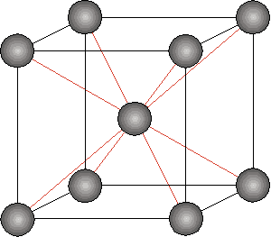
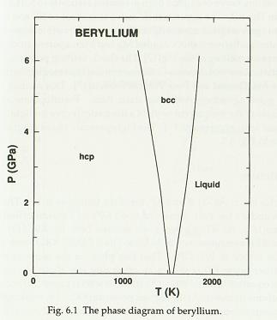
Structure of beryllium Introduction
Beryllium has small c/a ratio.→ 1.568
(Its ideal value of hcp is 1.633 )
heat
pressure
hcp(～1530 K)
bcc(1530～1560 K)
Melting point: 1551 K
hcp structure is
stable at ambient temperature and pressure.
bcc structure would be appeared at high temperature and prssure.
Ref. D. A. Young, Phase Diagrams of the Elements (University of California, 1991), P. 79.c

Slide 7
Previous work Introduction
No pressure medium
The Tc of beryllium has enhanced in a pressure range, where a decrease its c/a ratio was observed.
Ref. K.Kubota修士論文(2013)

Slide 8
Motivation
Experiment @Spring-8 BL10XU
1. I’ll confirm whether the structure changes.
→ measure the c/a ratio and volume by using powder X-ray diffraction.
X-ray
Diamond anvil cell
Imaging plate
(検出器)
2. I’ll measure the electrical resistance of beryllium to see the its drop caused by superconductivity.
The decrease of electrical resistance rate is only 0.13%.
Ref. K.Kubota 修士論文(2013)

Slide 9
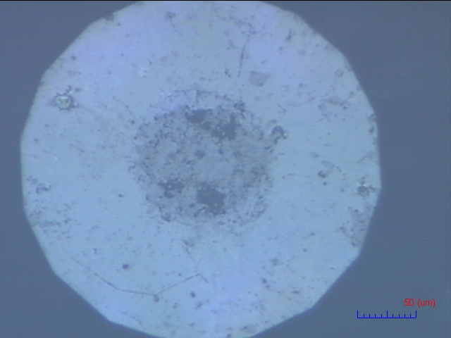
Settings Experiment
For the accurate measurement of c/a ratio.
非静水圧
NM
: No pressure Medium
: with pressure medium He
Sample: Be (99.9 %)
Diamond anvil: 300 μm
Gasket: Re
Pressure marker: Ruby
Pressure medium: none, He(gas)
He
静水圧
Diamond anvil
once twice
NM
He
Gasket
300μm
Beryllium
Pressure maker
Ruby
sample

Slide 10
X-ray diffraction pattern Experiment
λ=0.414Å
λ=0.413Å
He
NM
Beryllium has characteristic five peaks.
Affection of orientation is weak.
The peak 002 disappeared with applying pressure.
配向
Beryllium’s atomic number is 4, so it has very few electrons.

Slide 11
Orientation Experiment
配向
My sample beryllium is polycrystal.
NM
c
c
pressure
a
a
Peak corresponding to c-axis is weakened.
: Direction of the crystal

Slide 12
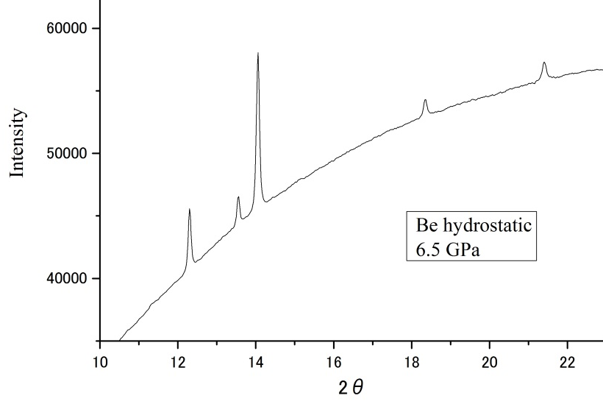
Calculation of c/a ratio Experiment
He
101
110
102
Bragg’s condition
2dsinθ=λ
d= $\frac{λ}{2sinθ}$
λ=0.414Å
const.
100
002
Miller index | (100) | (002) | (101) | (102) | (110)
Low pressure | 〇 | 〇 | 〇 | ○ | 〇
High pressure | 〇 | × | 〇 | × | 〇
The value of c/a ratio can have more error at high pressure.
Calculate with the cellcalc.

Slide 13
c/a ratio Result＆Discussion
c/a vs P
No pressure medium
The c/a ratio decrease at specific pressure.
He
with pressure medium He
The c/a ratio increase monotonically with
increasing pressure.
NM
[1] K.Kubota 修士論文(2013)

Slide 14
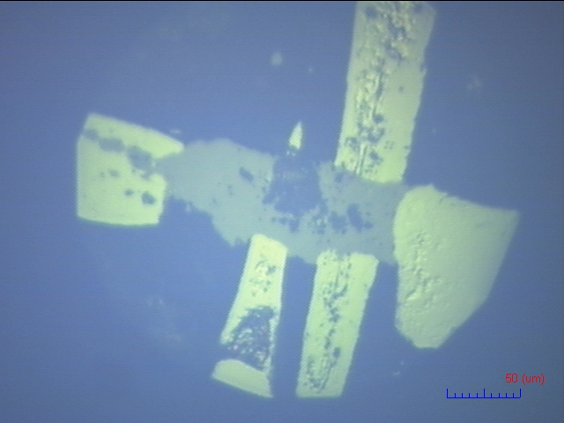
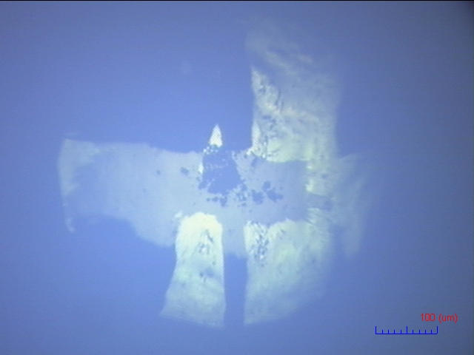
Setting Experiment
For the measurement of electrical resistance.
Sample: Be (99.9 %)
Diamond anvil: 300 μm
Gasket: SUS310S
Insulator layer: c-BN with epoxy
Electrodes: Pt
Pressure medium: none
Pressure marker: Ruby
NM
300μm
Electrodes
ruby
Insulator layer
Pressure maker
sample
Gasket
11.2 GPa
31.2 GPa

Slide 15
Electrical resistance Result＆Discussion
R vs T
NM
Low temp.

Slide 16
Problems Result＆Discussion
Possibility
Pressure effect.
Impurities(Fe)
Setting.
Oxidization of sample.
Error of data.
Its decrease is only 0.05 mΩ

Slide 17
Summary
I confirmed the changes of c/a ratio in beryllium.
The changes have caused by presence or absence of pressure medium.
The decrease of electrical resistance caused by superconductivity couldn’t be seen.
THE END.

Slide 18
ρvsT @room temp.

Slide 19
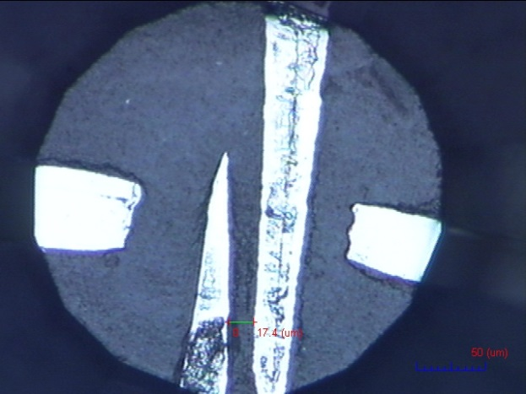
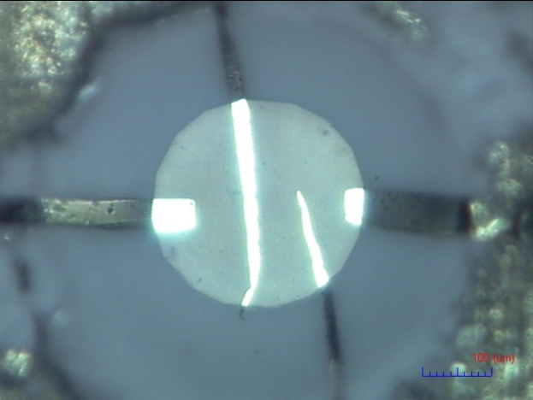
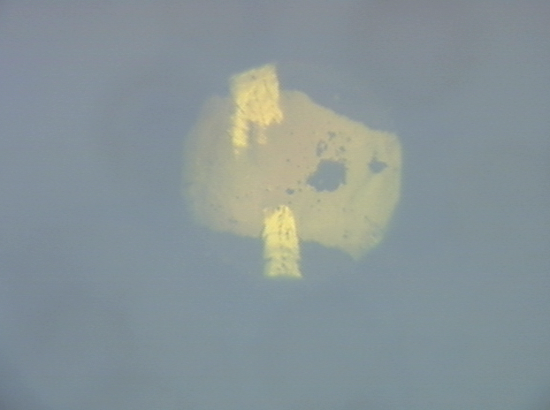
Difference of setting
My work
Previous work
Before sampling
Before sampling
ρ
31 GPa
38 GPa

