Slide 1
NMR study on bismuth oxide superconductor BaPb_{x}Bi_{1-x}O₃
Kitaoka Lab.
Takashi MATSUMURA
K.Kumagai.et,al Physica C 274 (1997) 209-220
H. Matsuura and K. Miyake, J. Phys. Soc. Jpn. 81 (2012) 113705

Slide 2
Contents
Introduction
NMR,NQR
Result
¹³⁷Ba spectrum
¹³⁷Ba・¹³⁵Ba T₁
Summary

Slide 3
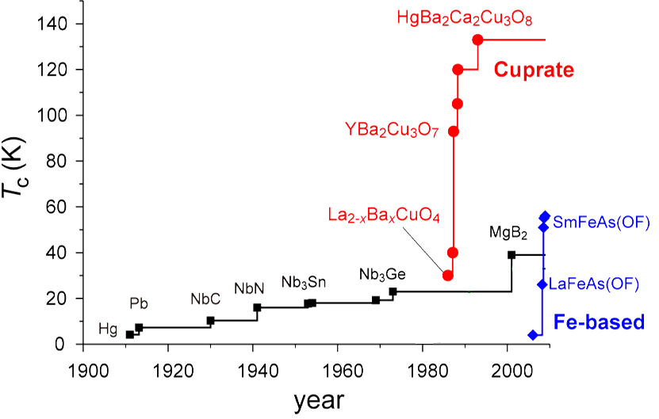

History of Superconductors
Valence skipper?
1975
T_{c}max~12K
spin
BaPb_{X}Bi_{1-X}O₃
1988
T_{C}max~30K
Ba_{1-X}K_{X}BiO₃
phonon
Spin
+
orbital
Introduction

Slide 4
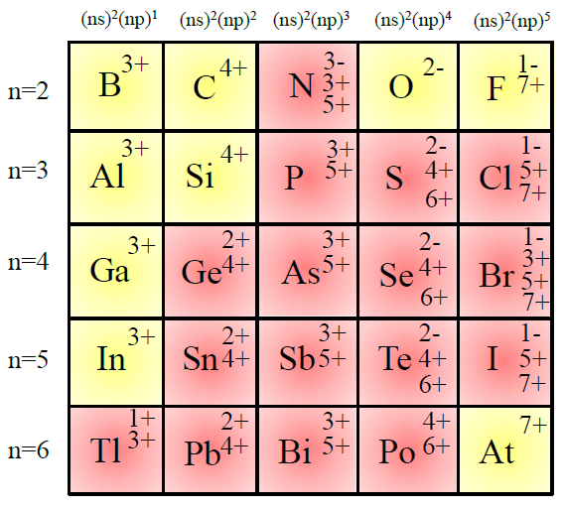
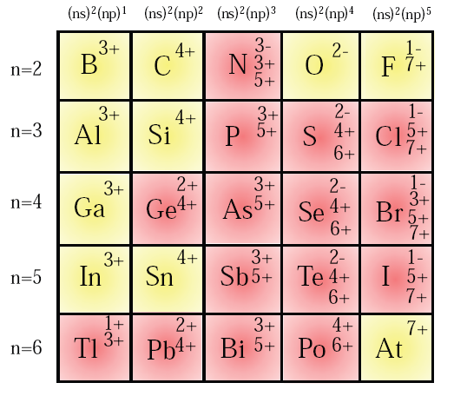
Valence skipper
Anion
O
(1s)²(2s)²(2p)⁴
O²⁻
(1s)²(2s)²(2p)⁶
closed-shell structure
Cation
Bi
[Xe](4f)¹⁴(5d)¹⁰(6s)²(6p)³
Bi³⁺
[Xe](4f)¹⁴(5d)¹⁰(6s)²(6p)⁰
Bi⁵⁺
[Xe](4f)¹⁴(5d)¹⁰(6s)⁰(6p)⁰
結晶化学入門 遠藤忠 他
講談社サイエンティフィック、wikipedia
stable structure
Bi⁴⁺
[Xe](4f)¹⁴(5d)¹⁰(6s)¹(6p)⁰
unstable structure
Skipping (ns)¹ state
Valence skipper
Introduction

Slide 5
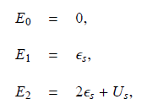
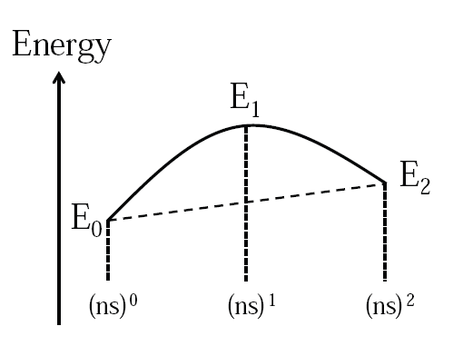
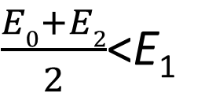
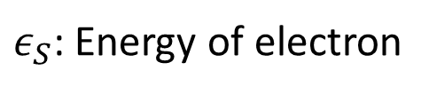
Negative U
6s⁰
6s¹
$ε_{S}$: Energy of electron
6s²
U_{S}: Coulomb interaction
$\frac{E0+E2}{2}$<E₁
U_{S}<0
Attraction
Introduction

Slide 6
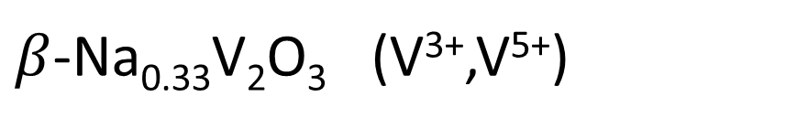
Candidates for Valence skipper SC
BKBO,BPBO (Bi³⁺,Bi⁵⁺)
Nb_{1-x}Ta_{x}Se₃ (Nb³⁺,Nb⁵⁺)
Pb_{1-x}Tl_{x}Te (Tl¹⁺,Tl³⁺)
Valence skipping effect?
AgSnSe₂ (Sn²⁺,Sn⁴⁺)
$β$-Na_{0.33}V₂O₃ (V³⁺,V⁵⁺)
・
・
・
・
・
・
Introduction

Slide 7


Mother compound BaBiO₃
Perovskite structure
Different valence Bi
BaPb_{x}Bi_{1-x}O₃

Slide 8

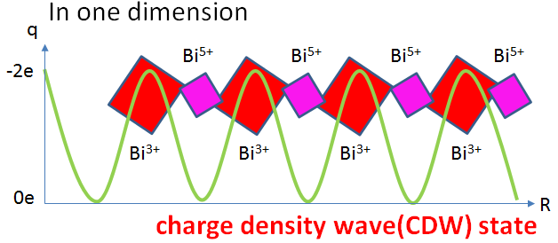





Mother compound BaBiO₃
$${Ba}^{2+}$$
$$O^{2−}×3$$
$${Bi}^{4+}$$
$${Bi}^{3+}$$
/
$${Bi}^{5+}$$
BaPb_{x}Bi_{1-x}O₃

Slide 9
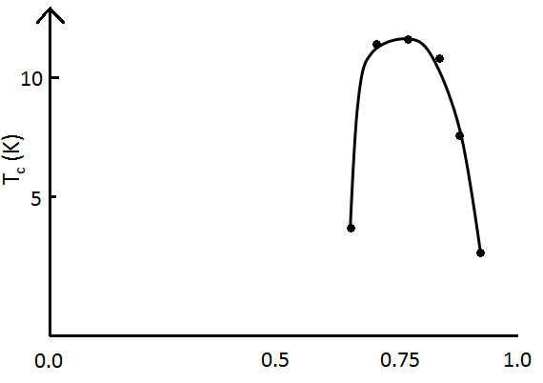
Superconductivity of BaPb_{x}Bi_{1-x}O₃
Bi
[Xe](4f)¹⁴(5d)¹⁰(6s)²(6p)³
Pb
[Xe](4f)¹⁴(5d)¹⁰(6s)²(6p)²
Hole doping
sc
CDW state
BaBiO₃
BaPb_{0.5}Bi_{0.5}O₃
BaPbO₃
CDW state
Hole doping
BaPb_{x}Bi_{1-x}O₃

Slide 10
Samples
BaPb_{x}Bi_{1-x}O₃
sc
CDW state
Hole doping
0.64
0.91
BaBiO₃
x=0.64 Semiconductor
x=0.75 Superconductor
x=0.91 Metallic
BaPb_{x}Bi_{1-x}O₃

Slide 11


Nuclear Magnetic Resonance
Ex. I=1/2
Zeeman interaction
$$ℋ0=−μ∙H0$$
$=−γℏI∙H0$
$Em=−γℏH0m$
$$H0$$
m=-1/2
I=1/2
γℏ H₀
m=+1/2
H₀＝0
H₀≠0
NMR (Nuclear Magnetic Resonance) 核磁気共鳴
γ (gyromagnetic ratio) 磁気回転比
Zeemann splitting
ω= γ H₀
NMR Intensity [a.u.]
ω,H₀
Frequency,H₀
NMR,NQR

Slide 12

Nuclear Quadrupole Resonance
Ex. Ba I=3/2
m=±3/2
+
+
hν_{Q}
quadrupole interaction
+
m=±1/2
+
NQR Intensity [a.u.]
$$νQ$$
Frequency
NMR,NQR

Slide 13
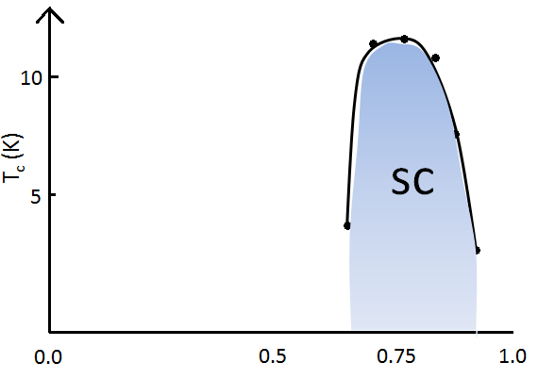
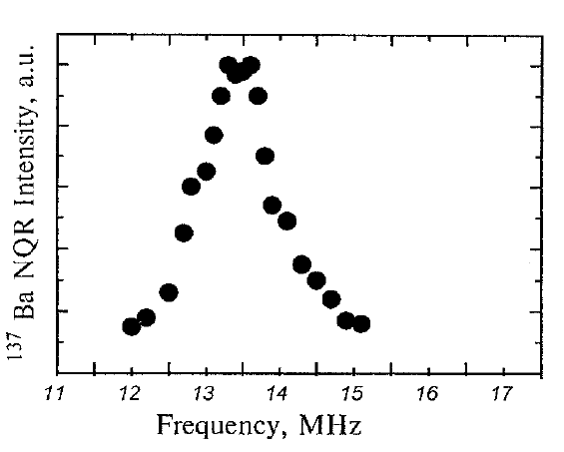

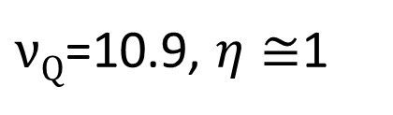
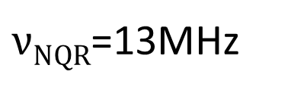
¹³⁷Ba NQR Spectrum of x=0.91: Metallic
(T=1.6K)
$νNQR$=13MHz
$νQ$=10.9, $η≅$1
Spectrum

Slide 14
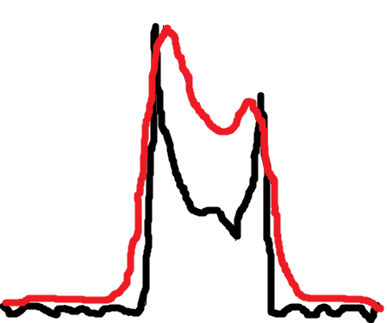

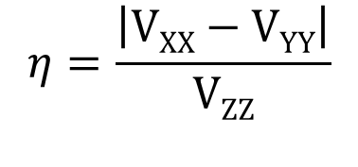

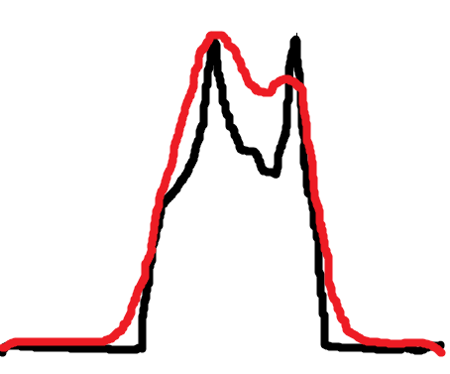
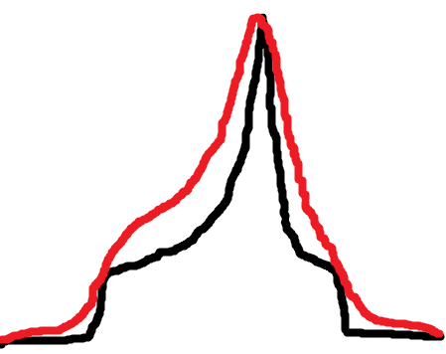
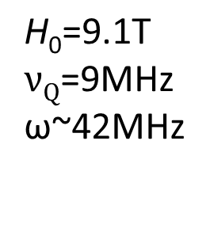
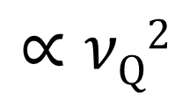
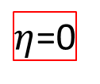
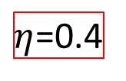
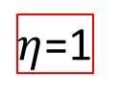
Nuclear Magnetic Resonance
$η$=0
Real, broadening
Ideal
$$∝νQ2$$
ω
Ex. Ba I=3/2
$η$=0.4
$η$=1
$$\text{H}\text{0}\text{=9.1}\text{T}$$
$νQ$=9MHz
ω~42MHz
Real, broadening
NMR Intensity
Ideal
ω
EFG:電荷分布
NMR,NQR

Slide 15
Mother compound BaBiO₃
Perovskite structure
Rotation
BaPb_{x}Bi_{1-x}O₃

Slide 16
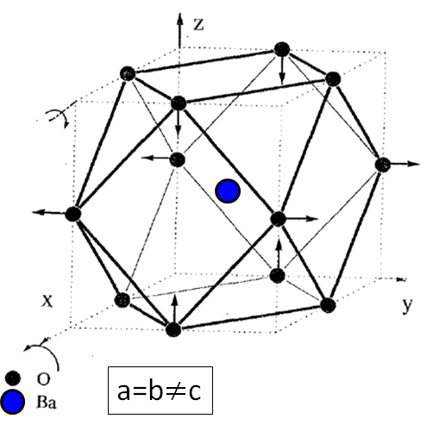


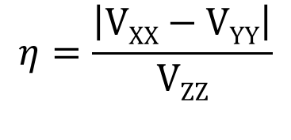
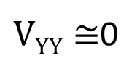

Ba site: tetragonal
(1,0,0)
V_{ZZ}
V_{ZZ}
V_{YY}
V_{YY}
V_{XX}
V_{XX}
$VYY≅$0
$η≅\frac{\left|VXX\right|}{VZZ}≅$1
Spectrum

Slide 17
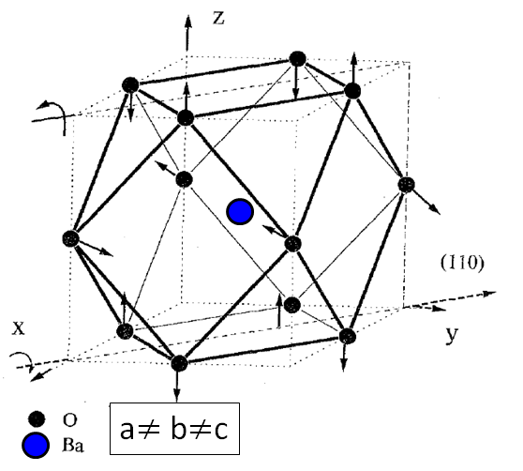


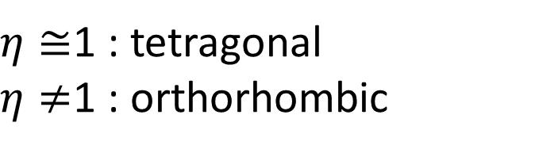
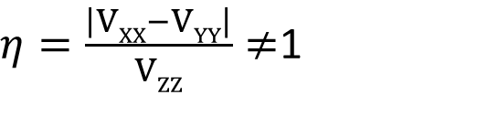
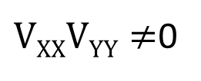
Ba site: orthorhombic
$VXXVYY≠$0
$η=\frac{\left|VXX−VYY\right|}{VZZ}≠$1
$η≅$1 : tetragonal
$η≠$1 : orthorhombic
Crystal structure → Spectrum shape
Spectrum

Slide 18
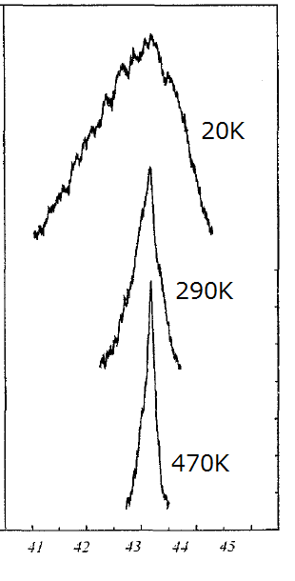

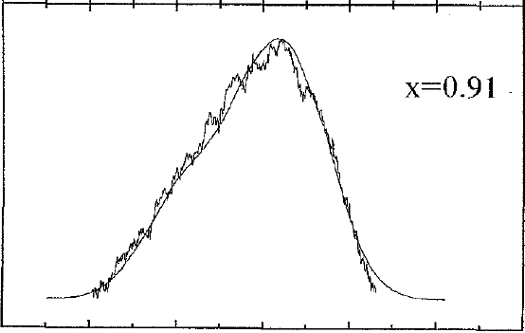


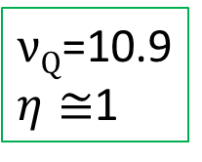
¹³⁷Ba NMR Spectrum of x=0.91: Metallic
20K
One component
tetragonal
x=0.91
Metallic
$νQ$=10.9
$η≅$1
Spectrum

Slide 19
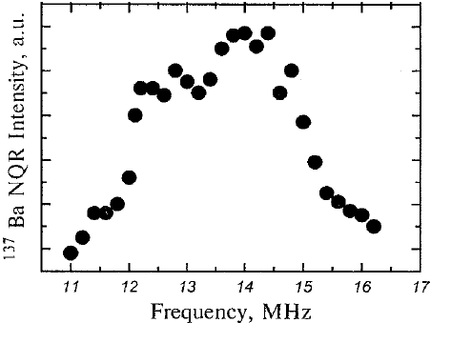
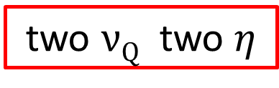
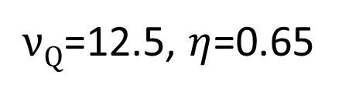
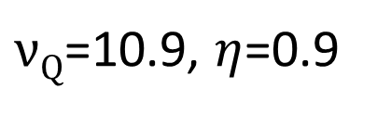
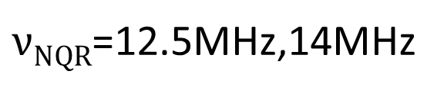
¹³⁷Ba NQR Spectrum of x=0.64: Semiconductor
(T=1.6K)
$νNQR$=12.5MHz,14MHz
$νQ$=10.9, $η$=0.9
$νQ$=12.5, $η$=0.65
two $νQ$ two $η$
Spectrum

Slide 20
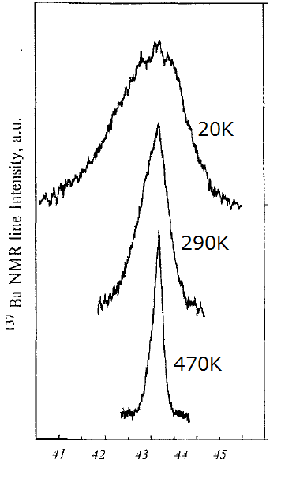
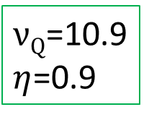
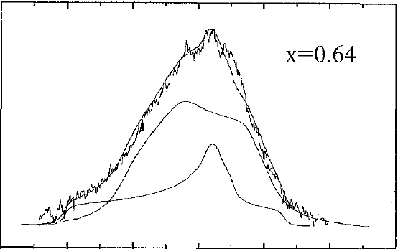
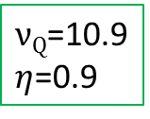
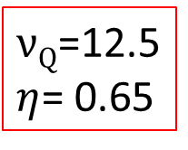
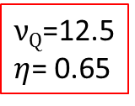
¹³⁷Ba NMR Spectrum of x=0.64: Semiconductor
orthorhombic
$νQ$=12.5
$η$= 0.65
20K
Two components
$νQ$=10.9
$η$=0.9
40%
$νQ$=10.9
$η$=0.9
+
tetragonal
$νQ$=12.5
$η$= 0.65
60%
Spectrum

Slide 21
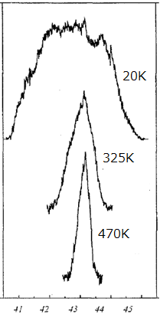
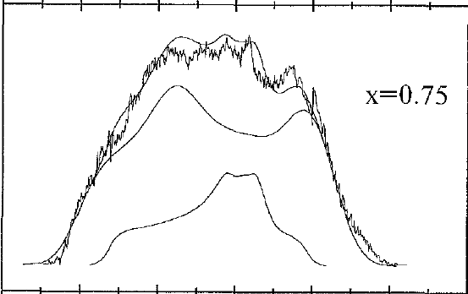
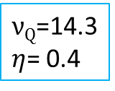
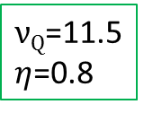


¹³⁷Ba NMR Spectrum of x=0.75: Superconductor
orthorhombic
$νQ$=14.3
$η$= 0.4
20K
Two components
$νQ$=11.5
$η$=0.8
30%
$νQ$=11.5
$η$=0.8
+
tetragonal
$νQ$=14.3
$η$= 0.4
70%
Spectrum

Slide 22





Temperature vs $νQ$
$νQ$ ($η≅$1)
Part of $η≅$1
$νQ$ ($η≠$1)
Tetra
x=0.91 Metallic
Tetragonal phase
Whole temperature
Ortho
Tetragonal phase
+
Orthorhombic distortion
x=0.75
Superconductor
Tetra
T<350K
Ortho
Tetragonal phase
+
Orthorhombic distortion
x=0.64
Semiconductor
Tetra
T<350K
Spectrum

Slide 23
Nuclear magnetic relaxation rate (T₁⁻¹)
Ex. I=1/2
t < 0
t = 0
t > 0
Electronic spin, etc.
m=-1/2
H₀
m=+1/2
Thermal equilibrium state
M = M（∞）
Exited state
M = M(0) = 0
Relaxation
M = M（t）
M
M(t) = M(∞)[1- exp(-t/T₁)]
0
t
time
Ba T₁

Slide 24







Nuclear magnetic relaxation rate (T₁⁻¹)
$$∝γ^{2}$$
$$∝{(eQ)}^{2}$$
T_{1M}⁻¹
T_{1Q}⁻¹
T₁⁻¹=T_{1M}⁻¹+T_{1Q}⁻¹
¹³⁷Ba/¹³⁵Ba-NMR
Valence skipping fluctuation?
Ba T₁

Slide 25



Nuclear magnetic relaxation rate (T₁⁻¹)
x=0.91 Metallic
x=0.75 Superconductor
x=0.64 Semiconductor
large
small
E_{a}
Ba T₁

Slide 26
Samples
BaPb_{x}Bi_{1-x}O₃
x=0.64 Semiconductor
x=0.75 Superconductor
sc
x=0.91 Metallic
Hole doping
0.64
0.91
BaBiO₃
C
D
W
CDW
fluctuation?
fluctuation
large
small
Ba T₁

Slide 27

Pair hopping
Bi
Pb
Bi
Pb
Pb
Pb
Pb
Pb
Pb
BaPb_{x}Bi_{1-x}O₃
x=0.75
Bi
Bi
Pb
Pb
Pb
Pb
Pb
Pair hopping

Slide 28
Pair hopping
BaPb_{x}Bi_{1-x}O₃
x=0.75
Bi (6S) state
Pair hopping

Slide 29
Pair hopping
BaPb_{x}Bi_{1-x}O₃
x=0.75
Negative U
Bi (6S) state
Pair hopping

Slide 30
Summary
Superconductivity and a change of the structure are in a close relation.
Nuclear relaxation mechanism was determined by charge fluctuations.
The superconductivity in BPBO may be mediated by the valence skipping effect.

