Slide 1
Effect of Length and Flexibility of Axle Components on Shuttling Dynamics in Rotaxane Type Molecular Machines
Tobe Lab. M1
Ryohei Kano
Notes:
I’m Ryohei Kano from Tobe lab.
The title of today’s presentation is…

Slide 2
Contents
Introduction
Backgrounds of Molecular Machines
Exemplified Molecular Machines
Typical Researches on [2]rotaxane
My Approach and Results
Design of Target Rotaxanes
Syntheses of Rotaxanes
Determination of Shuttling Dynamics
Discussion
Conclusion
Notes:
These are contents of my presentation
First I will introduce backgrounds of molecular machines, some exemplified machines
Then typical research on [2]rotaxane type molecular machines
Then I will explain my work
Finally I will summarize my work briefly.

Slide 3
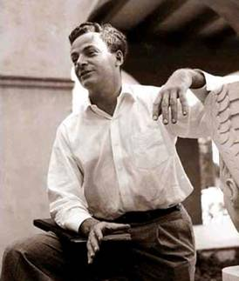
Backgrounds of Molecular Machines
The first time a concept of the molecular machines was seriously contemplated was in 1959 by Richard Feynman, Nobel Laureate in Physics, in his historic address “There is Plenty of Room at the Bottom” to the American Physical Society in December of that year.
http://www.its.caltech.edu/~feynman/
http://www.amazon.co.jp/
Notes:
分子機械の概念を最初に取り上げたのはノーベル物理学賞受賞者であるリチャードファインマン
彼は、1959年に
There is Plenty of Room at the Bottom 原子レベルの世界には発展の余地がある
という題で講演を行った。

Slide 4
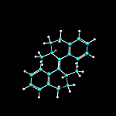
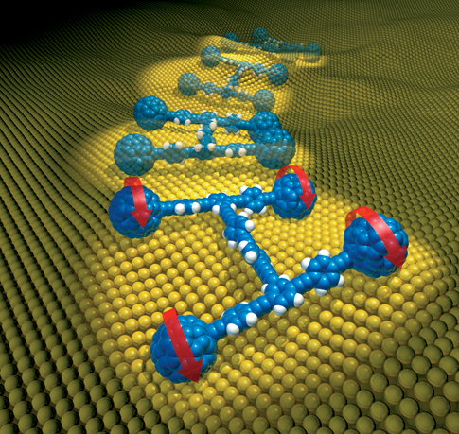
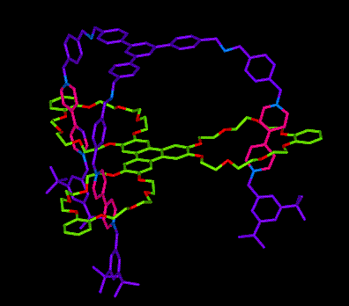
Exemplified Molecular Machines
Rotor
Harada, N.; Feringa, B. L. et al. Nature 1999, 401, 152–155.
Car
Switch
Stoddart, J. F. et al. Nature 1994, 369, 133–137.
http://www.benferinga.com/
http://fatpenguinblog.com/2006/03/page/3/
http://www.org-chem.org/yuuki/rotaxane/machine.html
Elevator
Stoddart, J. F. et al. Science 2004, 303, 1845–1849.
Notes:
多種多様な分子機械が創り出されている。
一方向のみに回転する分子ローター
One directional
実際の車のようにタイヤを回転させて動く分子カー
Can rotate their wheel and run as real cars
ONとOFFの2つの状態をとることが出来る分子スイッチ
Stay two state, on off
物理的な力を生み出すことが出来る分子エレベーター
Generate physical force

Slide 5
Exemplified Machines
Axle
Ring
Stopper
Stopper
Station
[2]Rotaxane
Switch
Stoddart, J. F. et al. Nature 1994, 369, 133–137.
http://www.benferinga.com/
http://fatpenguinblog.com/2006/03/page/3/
http://www.org-chem.org/yuuki/rotaxane/machine.html
Elevator
Stoddart, J. F. et al. Science 2004, 303, 1845–1849.
Notes:
特に下の分子スイッチやエレベーターなどはロタキサン構造を有する。
Especially having rotaxane structure
ロタキサンとはこのような構造・・・説明
ゆえに分子機械の主要な候補の一つであり、ロタキサン構造を含む分子機械が数多く存在する。
Adequate for

Slide 6
Molecular Machines
Fine tuning of the molecular machines is not achieved.
Deep understanding of dynamics of them is essential.
Switch
Stoddart, J. F. et al. Nature 1994, 369, 133–137.
http://www.benferinga.com/
http://fatpenguinblog.com/2006/03/page/3/
http://www.org-chem.org/yuuki/rotaxane/machine.html
Elevator
Stoddart, J. F. et al. Science 2004, 303, 1845–1849.
Notes:
正確な制御を実現し、さらに分子機械を発展させ、応用するには運動性への深い理解が必要である。
しかしながら、これら分子機械の運動性については、研究例が少なく詳細に分かっていないことが多い
運動の正確な制御ができていない。

Slide 7
Molecular Machines
There are three biggest effects on their dynamics.
(i) Ground-state effects
Strength of interaction between ring and station
(ii) Spacer effects
Length, Flexibility…
(iii) Physical environment effects
Temperature, Solvent…
Stoddart, J. F. et al. Acc. Chem. Res. 2014, 47, 482–493.
Notes:
分子機械の主要な候補であるロタキサンに関して、その運動性を決定づける主な要因は3つある。
3つ
そのなかの
スペーサーの効果について定量的に調べた研究はほとんどない
その中から2つのけんきゅう例を紹介する。

Slide 8
Typical Researches on [2]rotaxane
ΔG‡₃₀₀ = 64.8 kJmol⁻¹
ΔH‡ = 53.1 kJmol⁻¹
ΔS‡ = −38.9 JK⁻¹mol⁻¹
ΔG‡₃₀₀ = 64.7 kJmol⁻¹
ΔH‡ = 60.7 kJmol⁻¹
ΔS‡ = −13.4 JK⁻¹mol⁻¹
ΔG‡₃₀₀ = 62.9 kJmol⁻¹
ΔH‡ = 56.9 kJmol⁻¹
ΔS‡ = −20.1 JK⁻¹mol⁻¹
Stoddart, J. F. et al. Chem. Eur. J. 2004, 10, 2555–2564.
Structure of the spacers is not systematic.
To compare these parameters is very difficult.
Notes:
ストッダートらの研究ではこのような構造のロタキサンについて調べており、
スペーサーの構造をこのように変化させてそれぞれのパラメーターをもとめた
しかし
これらのスペーサーの構造は系統的ではなく
得られたこれらのパラメーターをひかくすることは 困難

Slide 9
Typical Researches on [2]rotaxane
Long Flexible Spacers
Folded Conformer
Brouwer, A. M. et al. J. Org. Chem. 2012, 77, 5724–5735.
Brouwer, A. M. et al. Chem. Eur. J. 2013, 19, 5566–5577.
Folded conformer is formed in transition state.
The shuttling mechanism is very complicated.
Notes:
ブラウワーは柔軟な長さの異なるスペーサーについてしらべた。
シャトリングの途中でおりたたまった構造をとり
シャトリング機構が複雑
正確にスペーサー効果を評価することが難しい。

Slide 10
Design of Target Rotaxanes
Purpose: Investigation of Effect of Length and Flexibility of Spacer
on Shuttling Dynamics
Rigid Spacers
Flexible Spacers
Notes:
そこで私はこの様なロタキサンを設計して・・・

Slide 11
Design of Target Rotaxanes
Station
Secondary ammonium
Hydrogen bonds etc..
Ring Component
Dibenzo-24-crown-8 ether
Stopper
Rigid Spacers
Flexible Spacers

Slide 12
Design of Target Rotaxanes
Purpose: Investigation of Effect of Length and Flexibility of Spacer
on Shuttling Dynamics
Rigid Spacers
Flexible Spacers

Slide 13
Syntheses of Rotaxanes
How to Synthesize Rotaxanes
Attractive Interaction

Slide 14
Syntheses of Rotaxanes

Slide 15
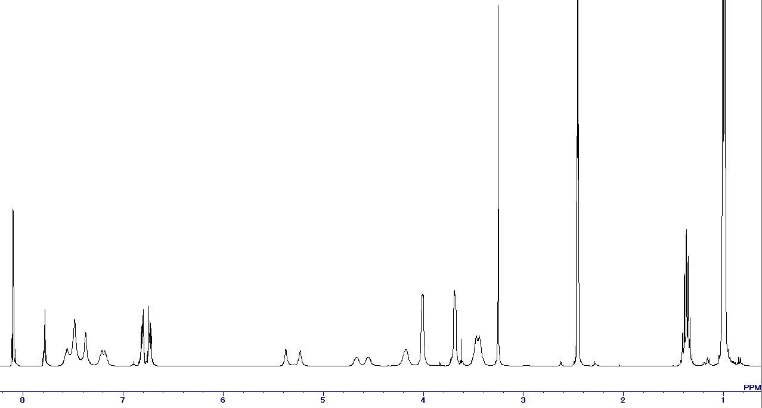
Determination of Shuttling Dynamics
¹H NMR spectrum (DMSO-d₆, 303 K)
m.p. = 19 ºC, b.p = 189 ºC
DMSO: dimethyl sulfoxide
α β

Slide 16
Determination of Shuttling Dynamics
Enlarged View of the NMR Spectrum
Shutter Speed of Cameras
Experimental
Simulated
SLOW FAST
http://digitalphotographylive.com/shutter-speed/
High Temperature
FAST SHUTTLING
Low Temperature
α β
5.5
5.4
5.3
5.2
5.1
ppm
SLOW SHUTTLING

Slide 17
Determination of Shuttling Dynamics
Line Shape Analyses
Experimental
Simulated
Line Shape Analyses of NMR signals provides temperature dependence of the rate constants
5.5
5.4
5.3
5.2
5.1
5.5
5.4
5.3
5.2
5.1

Slide 18
Determination of Shuttling Dynamics
Eyring Plots
Experimental
Simulated
Line Shape Analyses of NMR signals provides temperature dependence of the rate constants
Eyring plots allowed for the determination of kinetic properties
$$\text{Eyring} \text{equation}$$
$ln\frac{k}{T}=ln\frac{k_{B}}{h_{P}}+\frac{∆S^{‡}}{R}−\frac{∆H^{‡}}{RT}$
${ΔH}^{‡}=−R×slope$
${ΔS}^{‡}=\left[intercept−ln\left(\frac{kB}{hP}\right)\right]R$
5.5
5.4
5.3
5.2
5.1
5.5
5.4
5.3
5.2
5.1

Slide 19
Determination of Shuttling Dynamics
Kinetic Parameters
Rotaxane Spacers | ΔH‡ (kJmol⁻¹) | ΔS‡ (JK⁻¹mol⁻¹)
 | 26.9 ± 0.5 | −129 ± 1.5
 | 27.2 ± 1.3 | −140 ± 3.5
 | 26.5 ± 0.8 | −132 ± 2.0
 | 26.8 ± 1.0 | −144 ± 2.7
ΔH‡ (Activation Enthalpy): Relates to changes in the sum of strengths of bonds.
Positive: Decrease the sum of strengths of bonds
Negative: Increase the sum of strengths of bonds
ΔS‡ (Activation Entropy): Relates to changes in the order of a system.
Positive: Decrease the order of a system
Negative: Increase the order of a system

Slide 20
Determination of Shuttling Dynamics
Kinetic Parameters
Ring Shuttling
ΔH‡, ΔS‡
ΔH‡ (Activation Enthalpy): Relates to changes in the sum of strengths of bonds.
Positive: Decrease the sum of strengths of bonds
Negative: Increase the sum of strengths of bonds
ΔS‡ (Activation Entropy): Relates to changes in the order of a system.
Positive: Decrease the order of a system
Negative: Increase the order of a system

Slide 21
Determination of Shuttling Dynamics
Kinetic Parameters
Rotaxane Spacers | ΔH‡ (kJmol⁻¹) | ΔS‡ (JK⁻¹mol⁻¹)
 | 26.9 ± 0.5 | −129 ± 1.5
 | 27.2 ± 1.3 | −140 ± 3.5
 | 26.5 ± 0.8 | −132 ± 2.0
 | 26.8 ± 1.0 | −144 ± 2.7
ΔH‡: There are small variation between
all of the rotaxanes.

Slide 22
Determination of Shuttling Dynamics
Kinetic Parameters
Rotaxane Spacers | ΔH‡ (kJmol⁻¹) | ΔS‡ (JK⁻¹mol⁻¹)
 | 26.9 ± 0.5 | −129 ± 1.5
 | 27.2 ± 1.3 | −140 ± 3.5
 | 26.5 ± 0.8 | −132 ± 2.0
 | 26.8 ± 1.0 | −144 ± 2.7
ΔS‡: Larger entropy loss are observed
in case of the flexible rotaxanes.

Slide 23
Discussion
Rigid Spacer
Flexible Spacer
E
Entropy Loss
Position of interlocked ring along the vector of the axle
Strong interaction between the ring and ammonium stations gives rise to large initial energy barriers.
Rigid Spacer
Axle length has influence on neither the activation enthalpy nor activation entropy for ring shuttling along the axle of rotaxanes.
Flexible Spacer
At the transition state of shuttling, the ring component locates on the flexible axle, thereby reducing its conformational flexibility. The transition state energy increases due to this entropy reduction.

Slide 24
Conclusion
Length effect:
“LENGTH” DOSE NOT AFFECT
SUTTLING DYNAMICS
OF ROTAXANES
Flexibility effect:
“FLEXIBILITY” CONTRIBUTES
TO ONLY ENTROPY TERM

