Slide 1
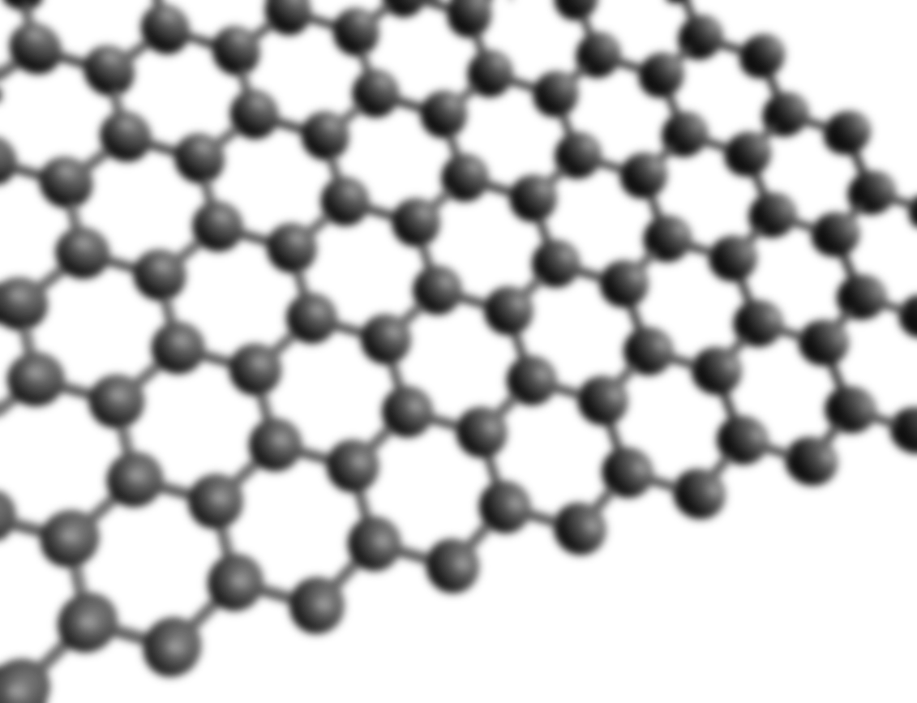

Electronic state calculation of the Kondo effect on a hydrogenated graphene vacancy $V_{111}$
M1 colloquium 2nd semester 2015/1/7
MORISHITA Naoki
Kusakabe laboratory M1
Division of Frontier Materials Science, Department of Material Engineering Science
Graduate School of Engineering Science, Osaka University

Slide 2
Contents
Introduction
Concept map of my research
Details of Backgrounds and My Research
Studies of graphene
Studies of the Kondo effect
My Research
Summary
Chronological Tables of Related Studies

Slide 3
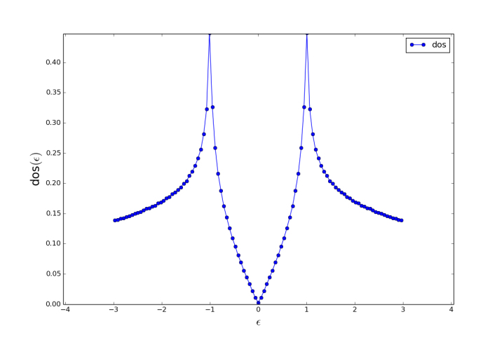
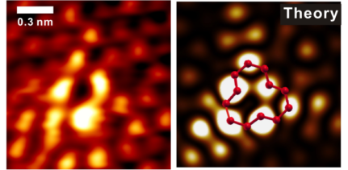
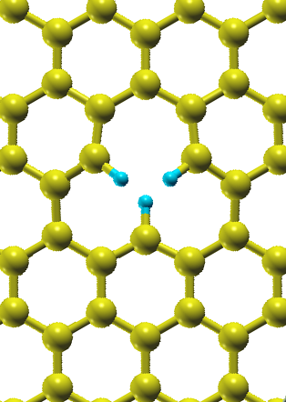
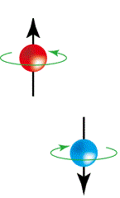

Concept Map of My Research
Pseudo Gap Kondo Effect of the Zero mode on V111
V111
Pseudo Gap
Kondo Effect
Zero Mode
My Research

Slide 4
Introduction
Backgrounds
Study of graphene vacancy
Study of the Kondo effect in graphene
Graphene vacancy
The Kondo effect
The zero mode
Theoretical models
Electronic structure
The Kondo effect
in graphene

Slide 5
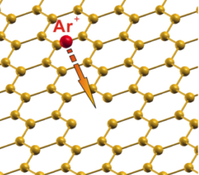
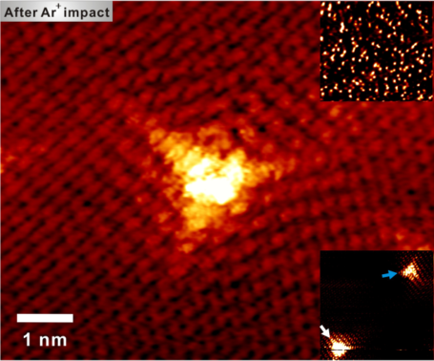
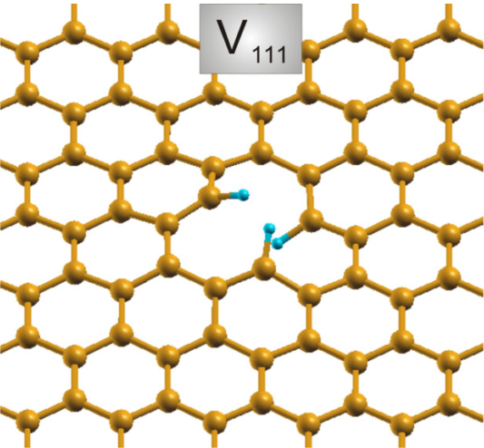
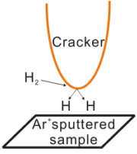
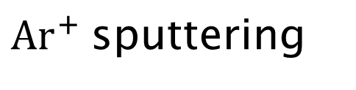
Study of Graphene Vacancy
Details of Backgrounds and My Research
Graphene vacancy
V
$Ar^{+}$sputtering
Hydrogenation

Slide 6
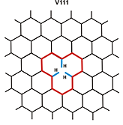
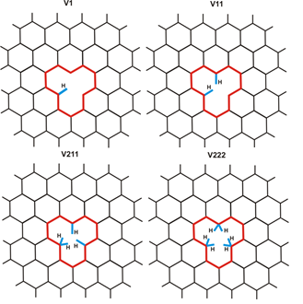
Study of Graphene Vacancy
Details of Backgrounds and My Research
V111 and other hydrogenated structures
V111

Slide 7
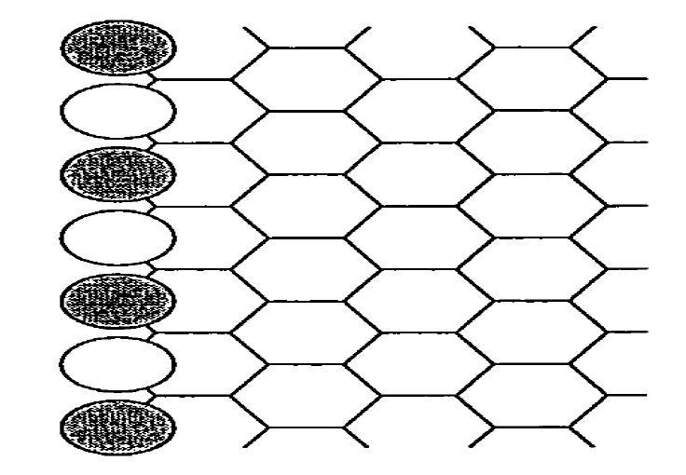
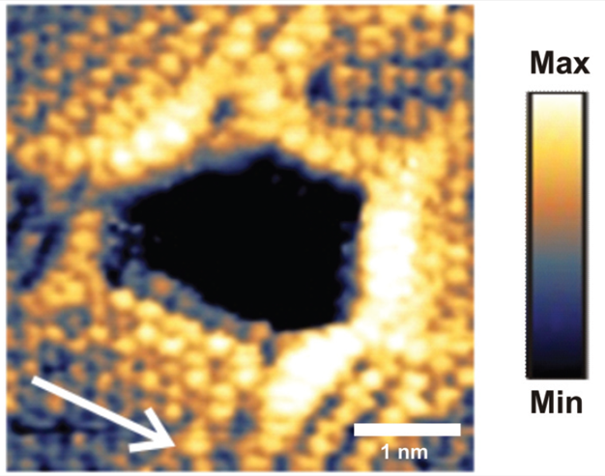
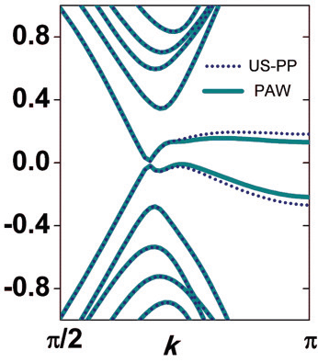
Study of Graphene Vacancy
Details of Backgrounds and My Research
Graphene edge and defects
Graphene edge
Graphene nano hole

Slide 8
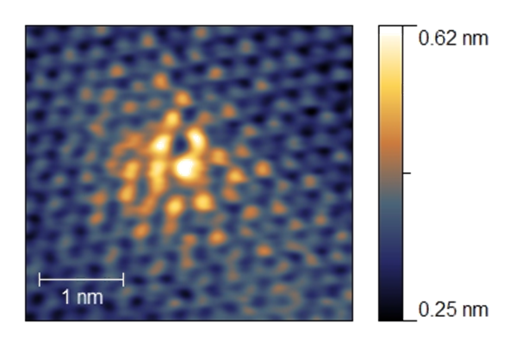
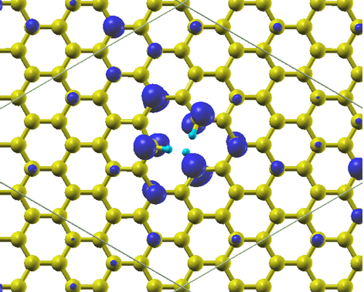
Study of Graphene Vacancy
Details of Backgrounds and My Research
The “Zero Mode” on V111
- a localized π mode
STM image
DFT calculation
Zero mode

Slide 9
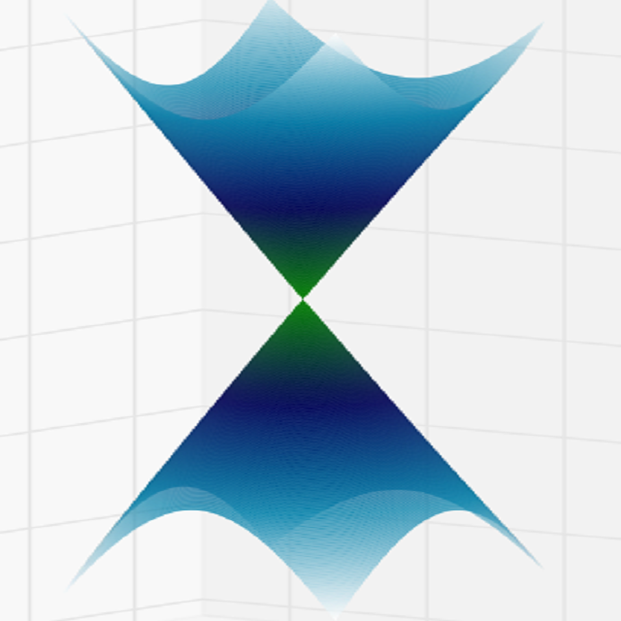
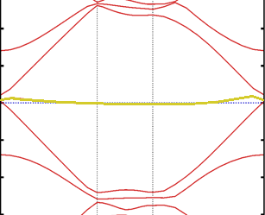
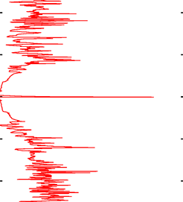
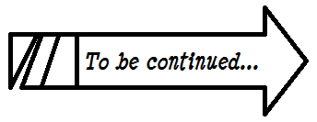



Study of Graphene Vacancy
Details of Backgrounds and My Research
The “Zero Mode” on V111
- always at the energy level of Dirac point!
$$E$$
Dirac point
Zero mode
Zero mode
$$0$$
Dirac cone ($k$-space)
Band structure
DOS

Slide 10
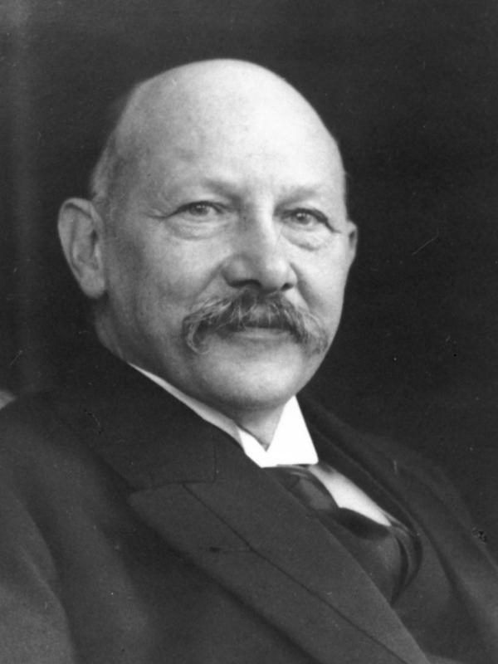
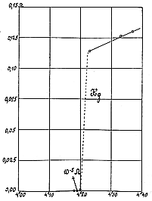
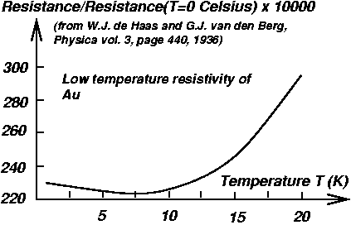
Study of the Kondo effect in graphene
Details of Previous Studies (and My Research)
The Kondo effect
Finding of resistance minimum (1930s)
Kamerlingh Onnes Laboratorium (Holland)

Slide 11


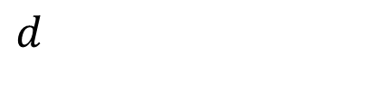
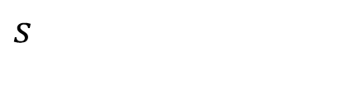
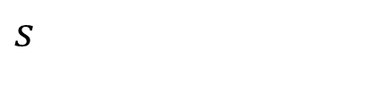


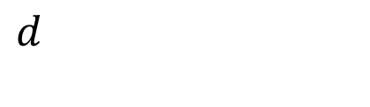


Study of the Kondo effect in graphene
Details of Backgrounds and My Research
$s−d$ model
𝑠−𝑑 model
Impurity Anderson model
A localized spin in $d$ level
A localized spin in 𝑑 level
$d$ orbit and hybridization
𝑑 orbit and hybridization
Theoretical models
$s$
$s$
$J$
$J$
$V$
$U$
$d$
$d$

Slide 12

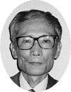
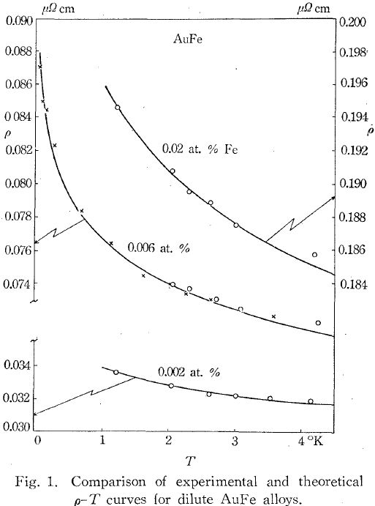
Study of the Kondo effect in graphene
Details of Backgrounds and My Research
First successful explanation
KONDO Jun
(Japan, 1930-)

Slide 13
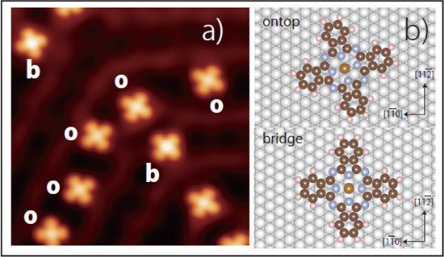
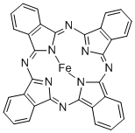
Study of the Kondo effect in graphene
Details of Backgrounds and My Research
Diversity of the Kondo effect and derivatives
spin – spin correlation
Conduction electron
(in metal)
FePc (Iron phthalocyanine) on Au substrate
Symmetry-Driven Novel Kondo Effect in a Molecule
Emi Minamitani et al., Phys. Rev. Lett. 109, 086602 (2012)
Wilson Renormalization Group
Localized electron
(impurity, defect, etc.)

Slide 14
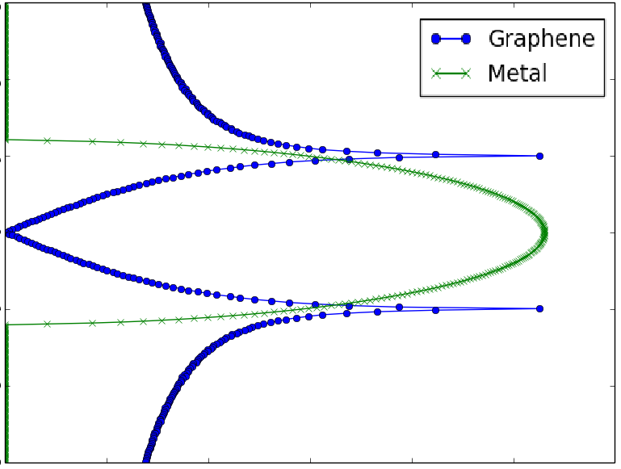




Study of the Kondo effect in graphene
Details of Backgrounds and My Research
The Kondo effect in graphene
DOS
$$ε$$
$$ε$$
$$k$$

Slide 15
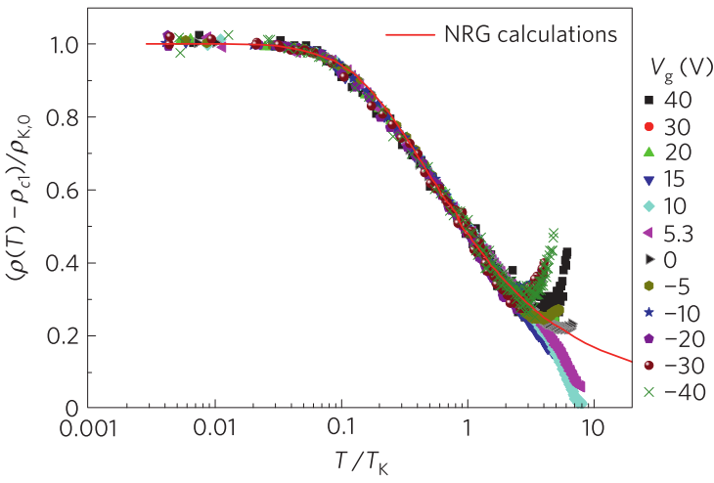
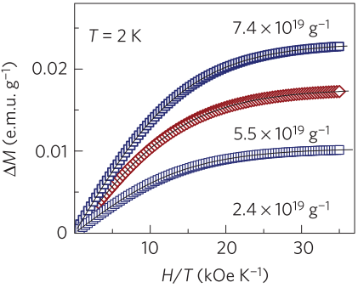
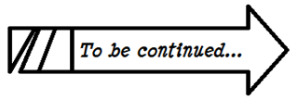
Study of the Kondo effect in graphene
Details of Backgrounds and My Research
The Kondo effect in graphene
Kondo effect in graphene vacancy
(2011)
Localized spin-1/2 at graphene vacancy
(2012)

Slide 16
My Research
Details of Backgrounds and My Research
Pseudo Gap Kondo Effect of the Zero mode on V111
DFT calculation
Representation of the system in a Kondo Hamiltonian
Unitary transformation
Multi site impurity Anderson model
Numerical calculation for the model
Interpretation of the calculation results
Explanation and consensus

Slide 17
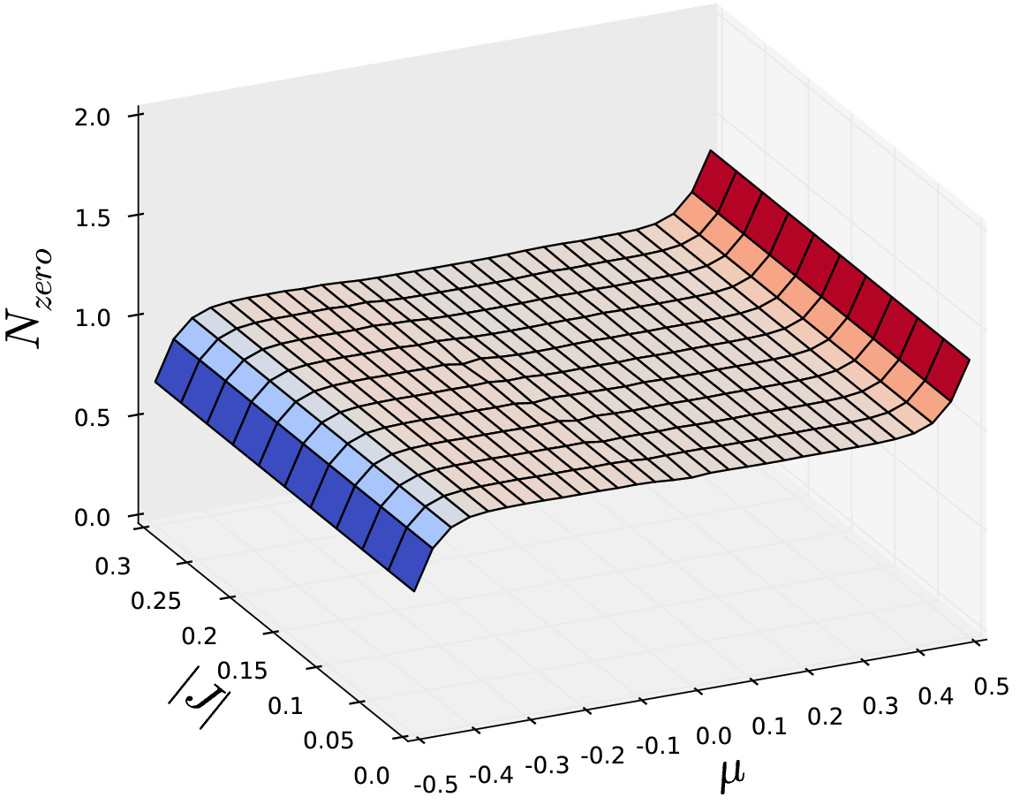
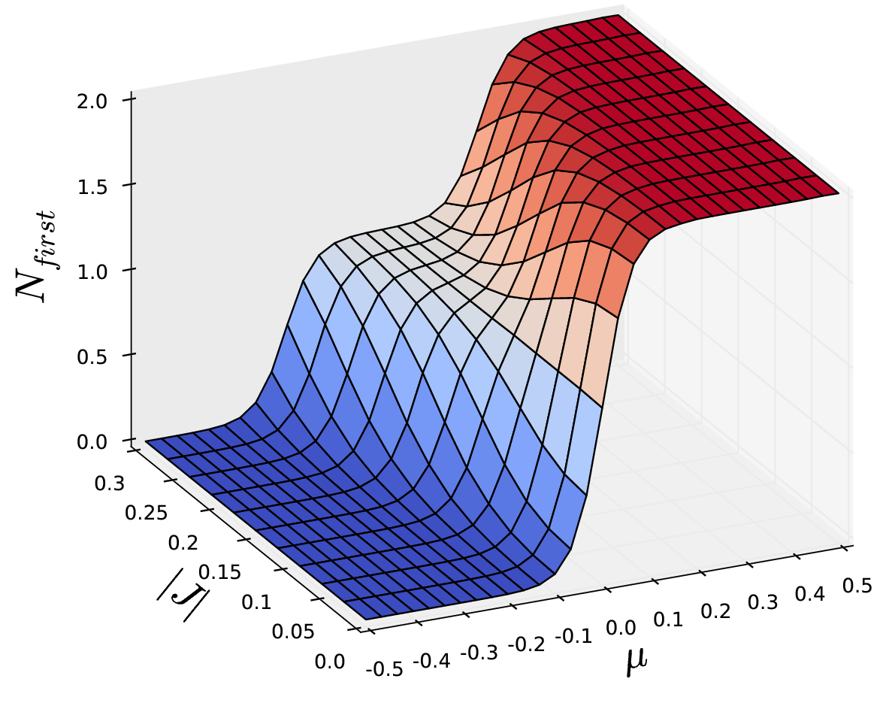
My Research
Details of Backgrounds and My Research
Kondo effect on V111 implied

Slide 18
Summary
Summary
Graphene vacancy
V111, V, etc.
zero mode
The Kondo effect in graphene
Kondo effect
Theoretical models
Study of the Kondo effect in graphene
My research
Pseudo Gap Kondo Effect of the Zero mode on V111

Slide 19
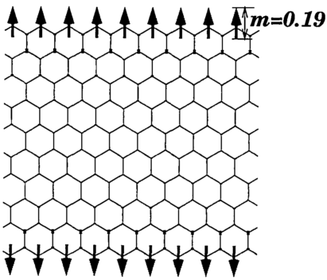
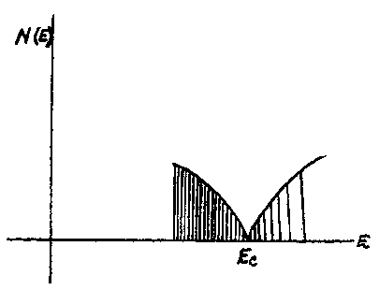
Chronological Tables of Relevant Studies
Discovery of the edge state on a graphite sheet with the zigzag edge
“Peculiar Localized State at Zigzag Graphite Edge”
Mitsutaka FUJITA,
Katsunori WAKABAYASHI and
Koichi KUSAKABE. J. Phys. Soc.
Jpn. 65, 1920
The first calculation of the peculiar property of an electron in graphene
“The Band Theory of Graphite”
P. R. Wallace. Phys. Rev. 71, 622
1947
1996
WWII (‘39-’45)
1930s
1964
1982
Nobel Prize in Physics awarded to Wilson for his work on phase transitions
Discovery of the Kondo effect
“Resistance Minimum in Dilute Magnetic Alloys” Jun KONDO. Prog. Theor. Phys. 32 (1):37-49.
Finding of resistance minimum
1961
The impurity Anderson model
“Localized Magnetic States in Metals” P. W. ANDERSON. PhysRev.124.41

Slide 20
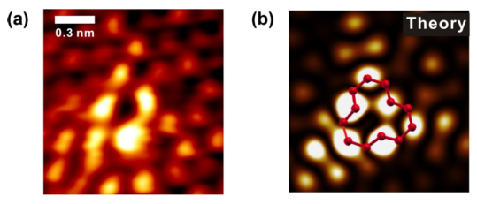
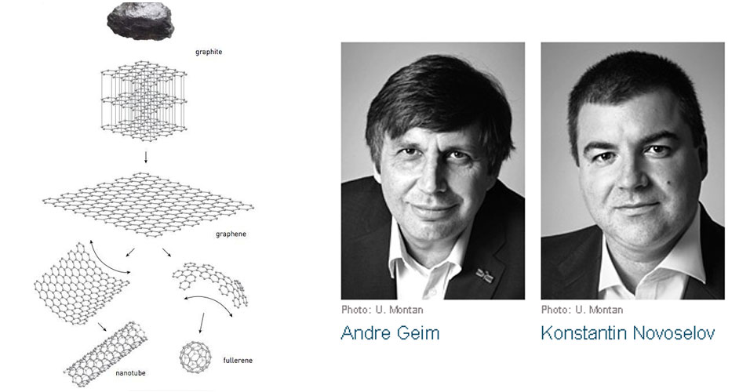
Summary
The number of papers which include “graphene” in their titles on Condensed Matter – arXiv.org
First graphene monolayer film
“Electric Field Effect in Atomically Thin Carbon Films”
K. S. Novoselov, A. K. Geim et al., Science, 306 (5696): 666-669
Observation of V111 and the zero mode
“Visualization of electronic states on atomically smooth graphitic edges with different types of hydrogen termination” M. Ziatdinov et al., Phys. Rev. 87, 115427
2004
2014
2010
Nobel prize awarded to
Andre Geim & Konstantin Novoselov
2015
2011
The possibility of the Kondo effect emerged (Exp.)
Nature Physics 7, 535
2012
Proof of spin-1/2 on graphene vacancy (Exp.)
Nature Physics 8, 199

